Slide 1
7. Graphing Problems
From "Calling Bullshit: The Art of Skepticism in a Data-Driven World", Carl Bergstrom and Jevin West, 2020

Slide 2
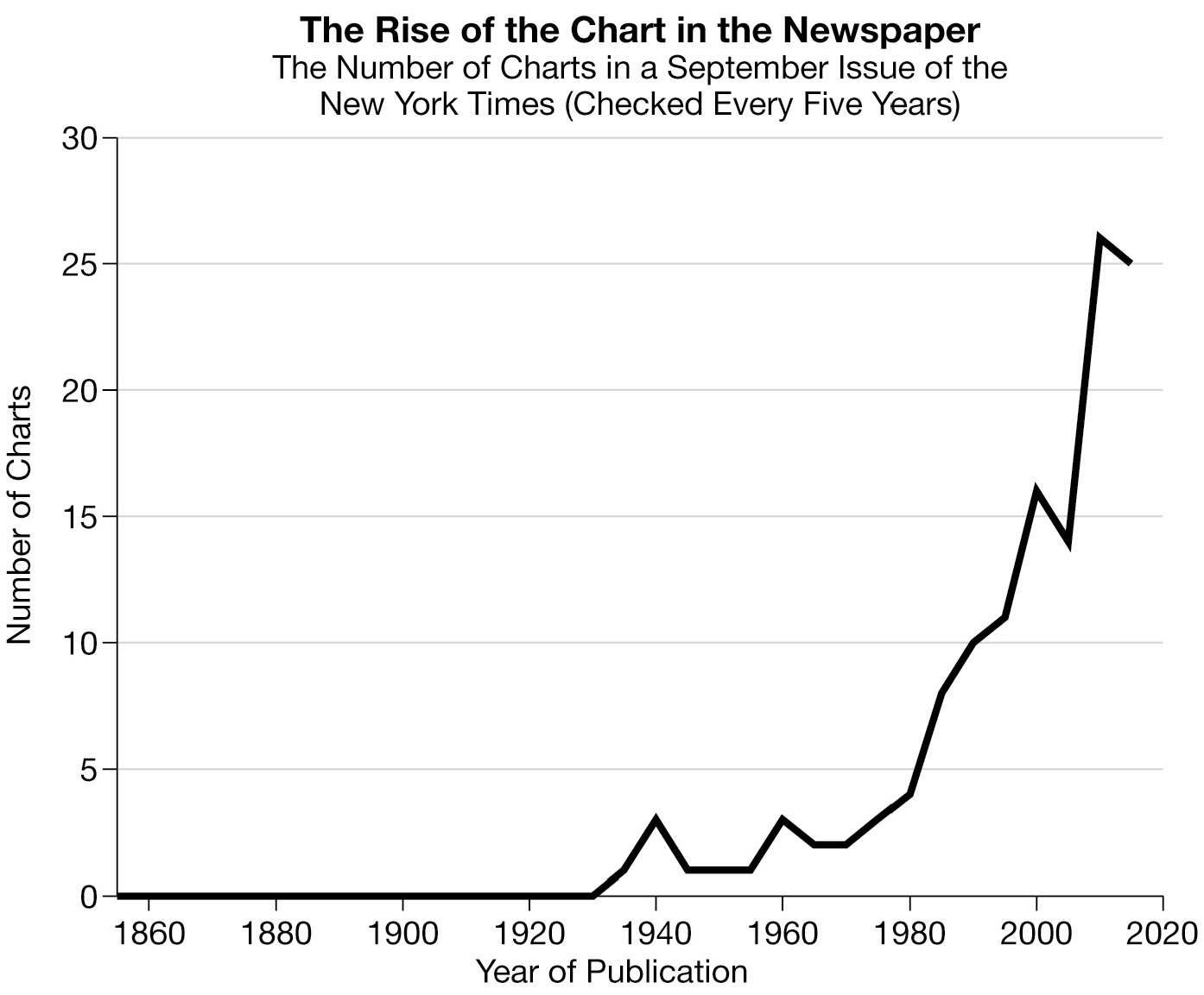
Graphing is becoming more and more important...

Slide 3
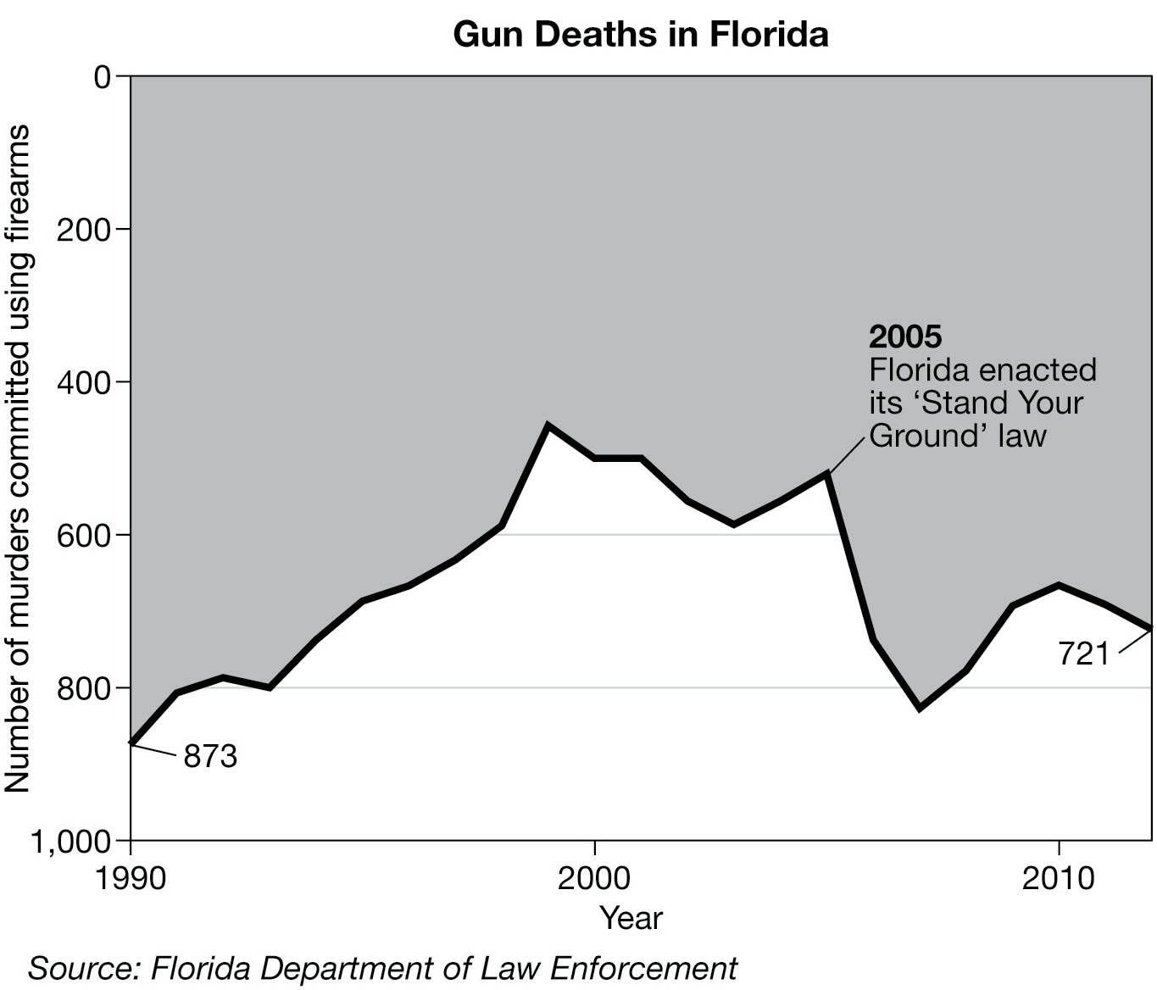
Are Stand Your Ground laws good?
But they can be used badly...
if some one attacks you, you
can fight back with deadly force.

Slide 4
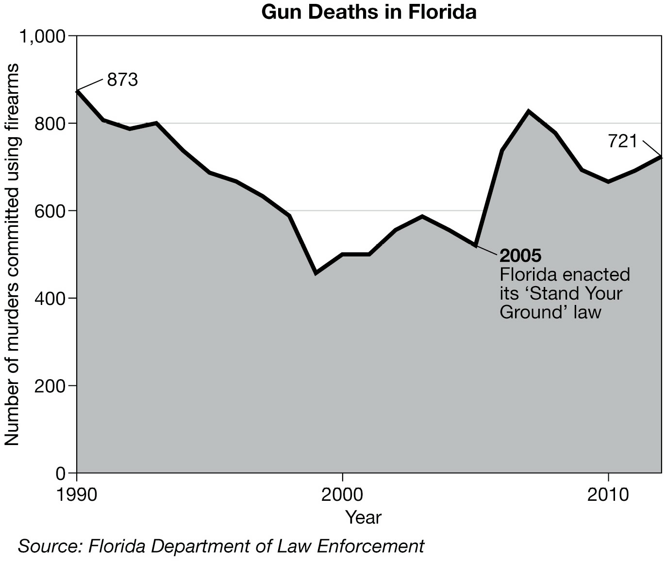
Probably not

Slide 5
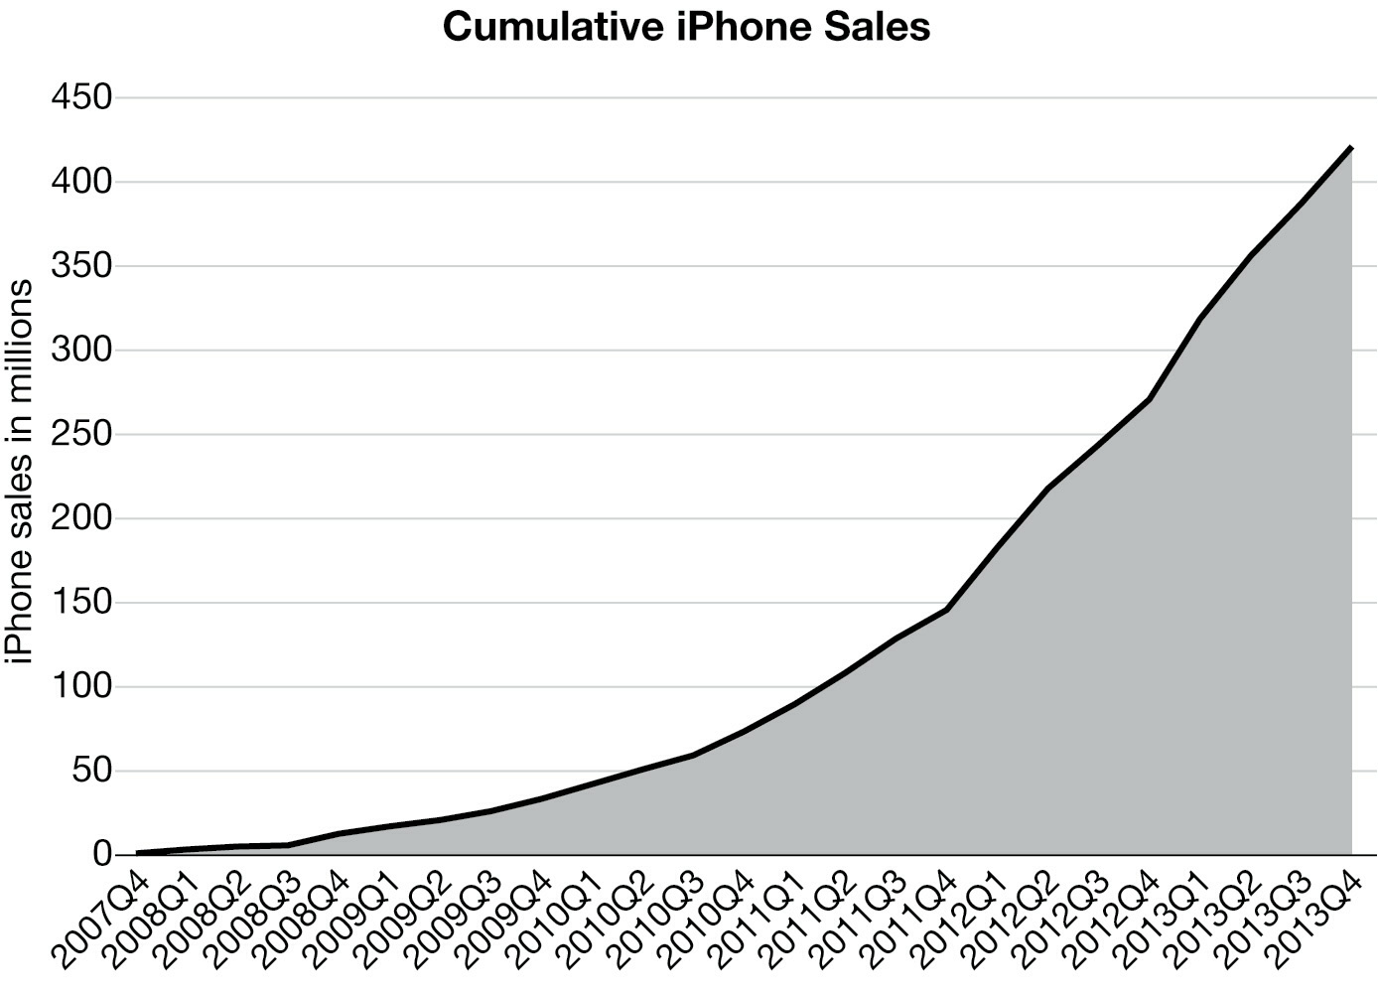
The choice of graph is important...
What
does
this
graph
mean for
iphones?

Slide 6
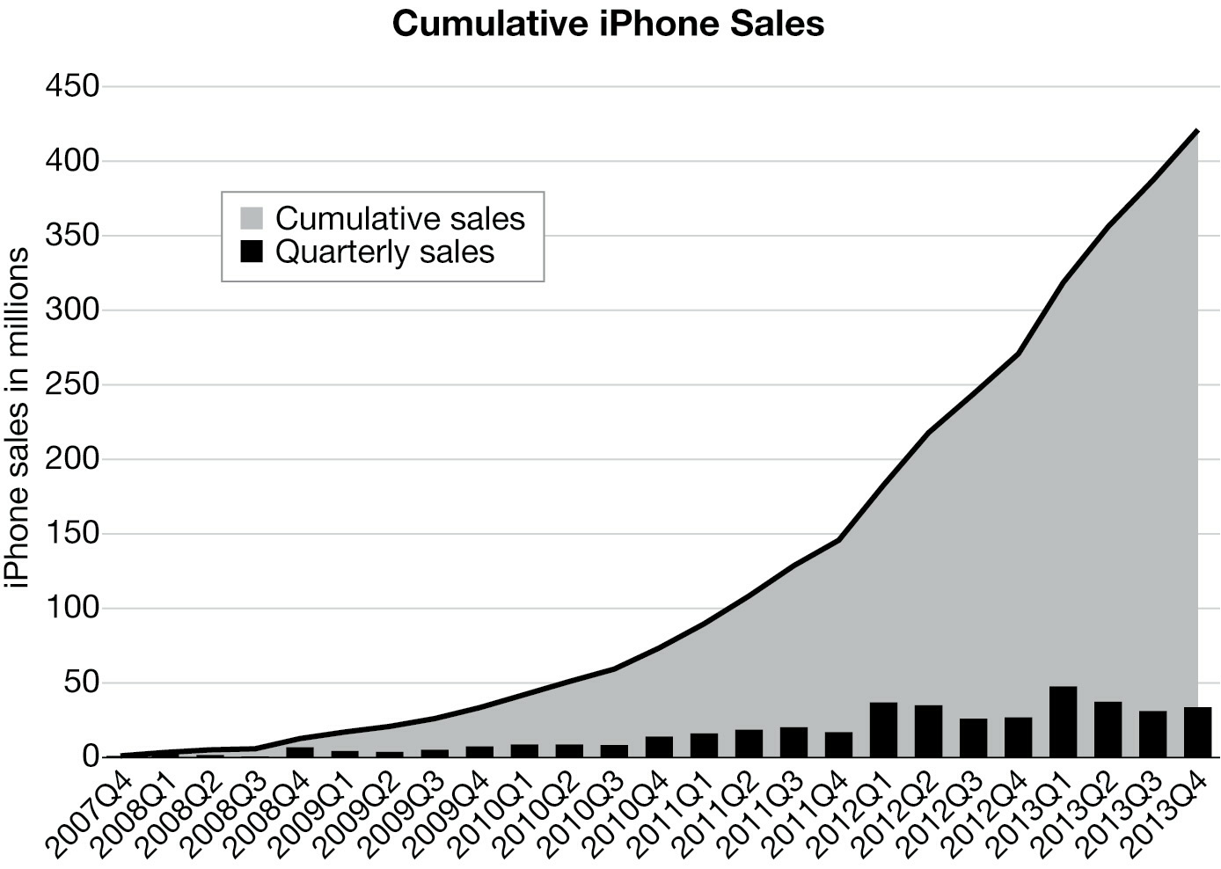
Same data. Better Choice
What
does
this
graph
mean for
iphones?

Slide 7
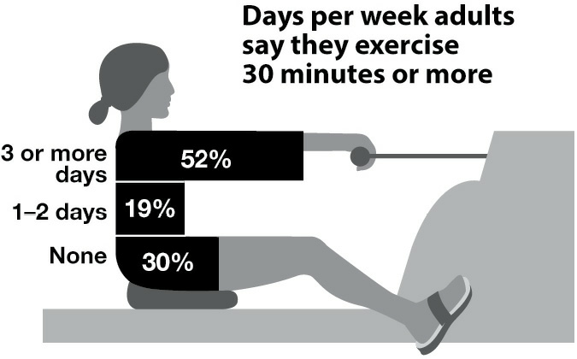
Duck Graphs
Data graphics should be about the data, not about pretty pictures. Graphs that break this rule are called “duck graphs.”
Why is
there a
lady in
this
graph?

Slide 8
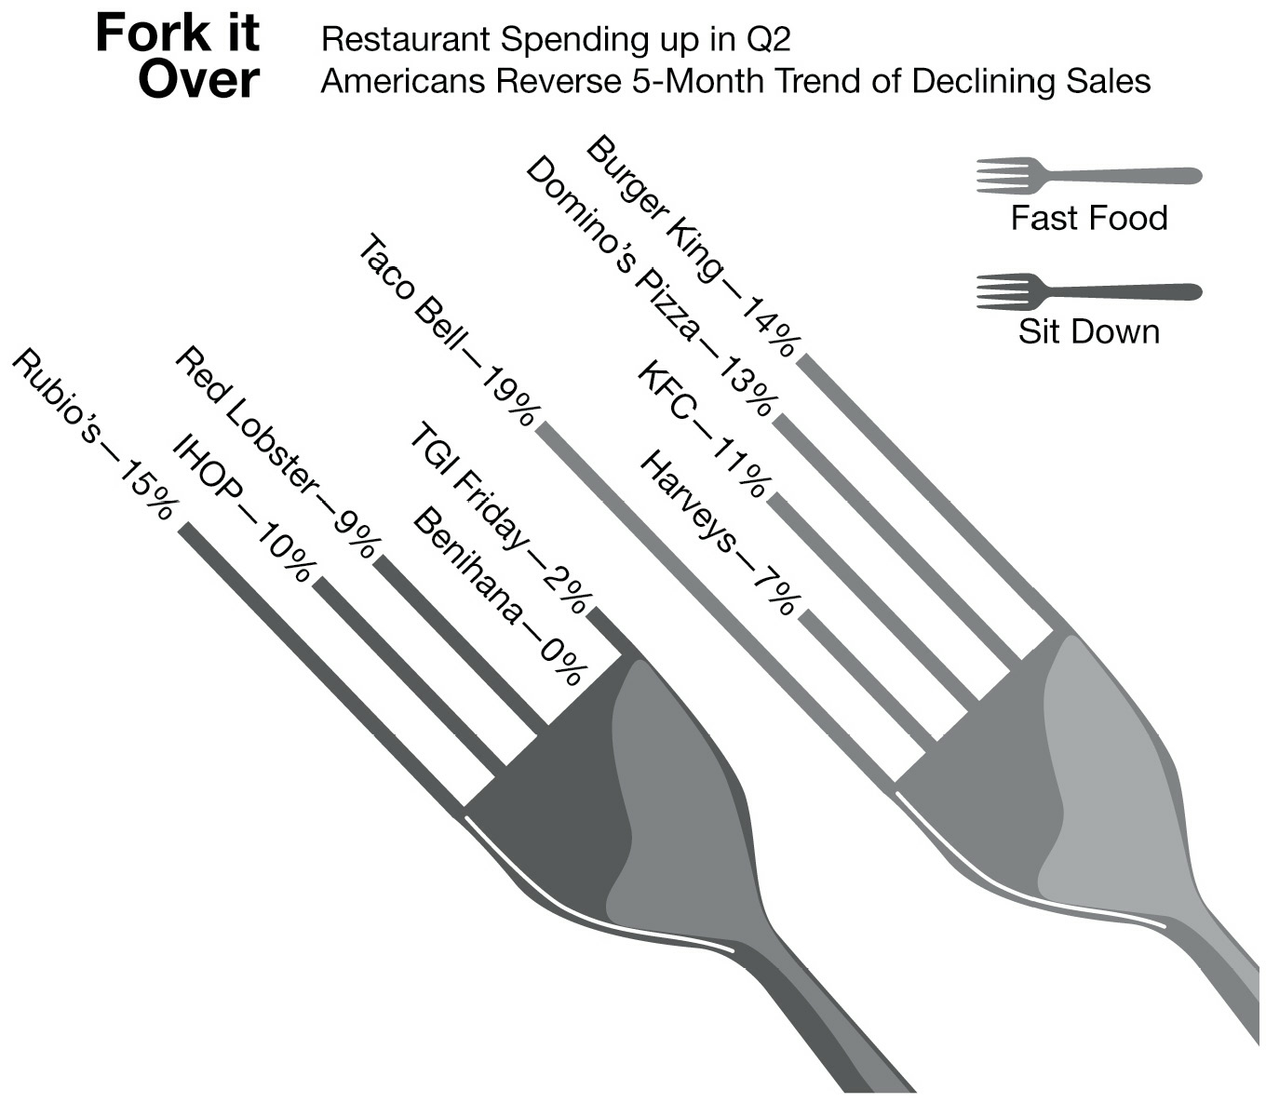
Why are
there forks in
this graph?
Which is bigger?

Slide 9
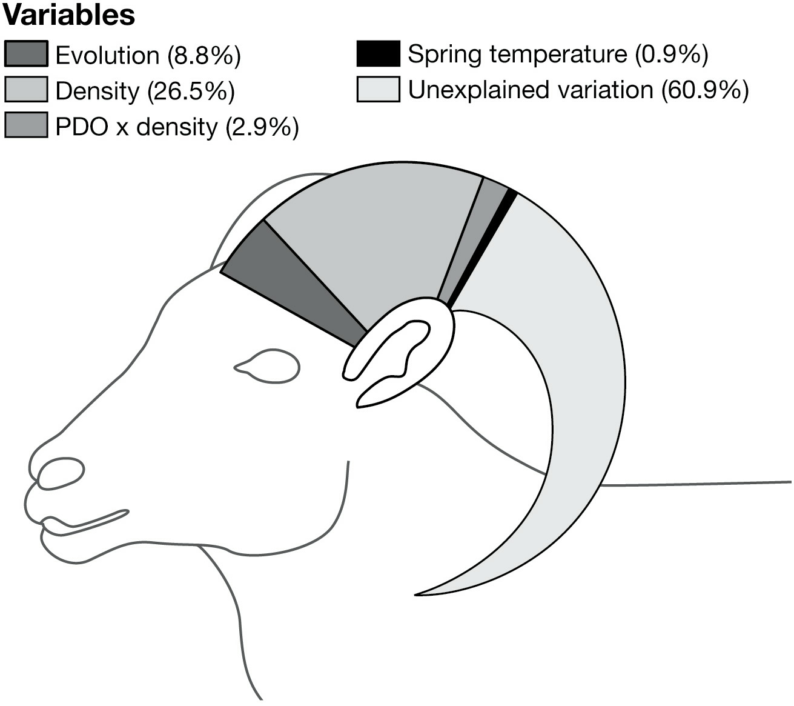
Why is there
a goat in
this graph?
Which is bigger?

Slide 10
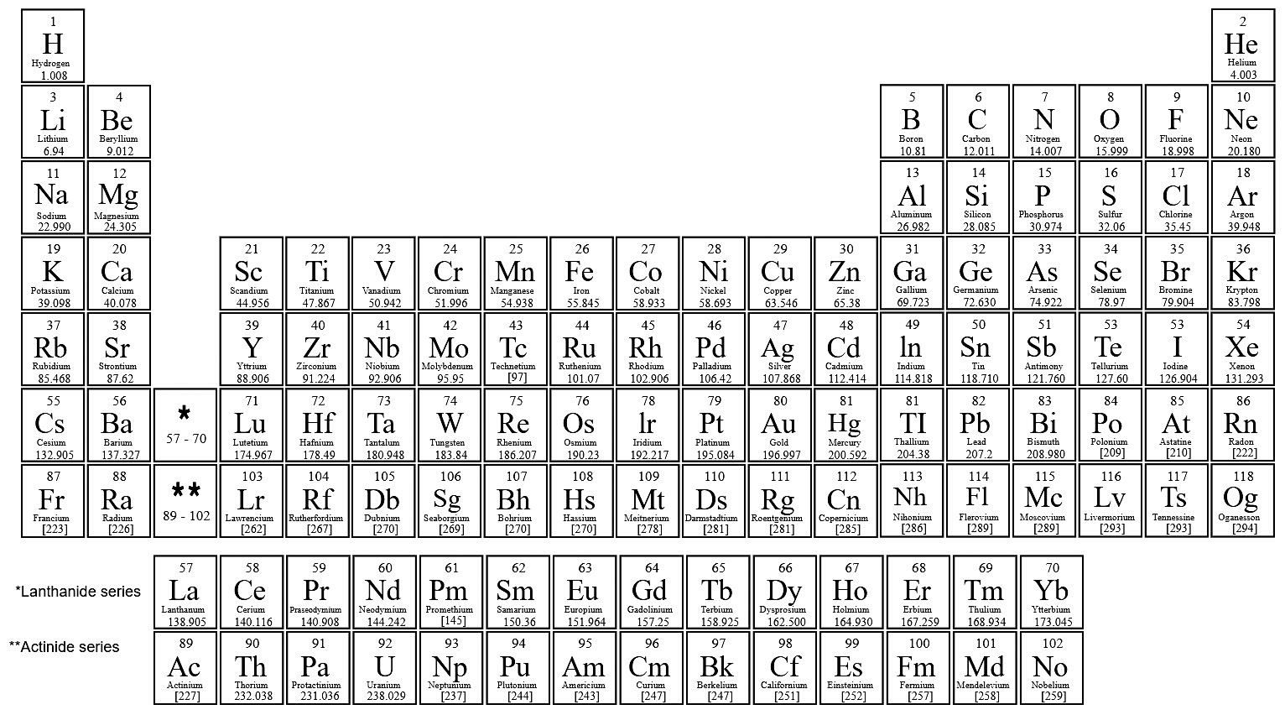
Glass Slippers
Glass slippers take one type of data and force it into a form designed to display different data.
This is NOT a glass slipper.
The Periodic Table of Elements
GOOD. The positions match the atomic structure of chemical elements

Slide 11
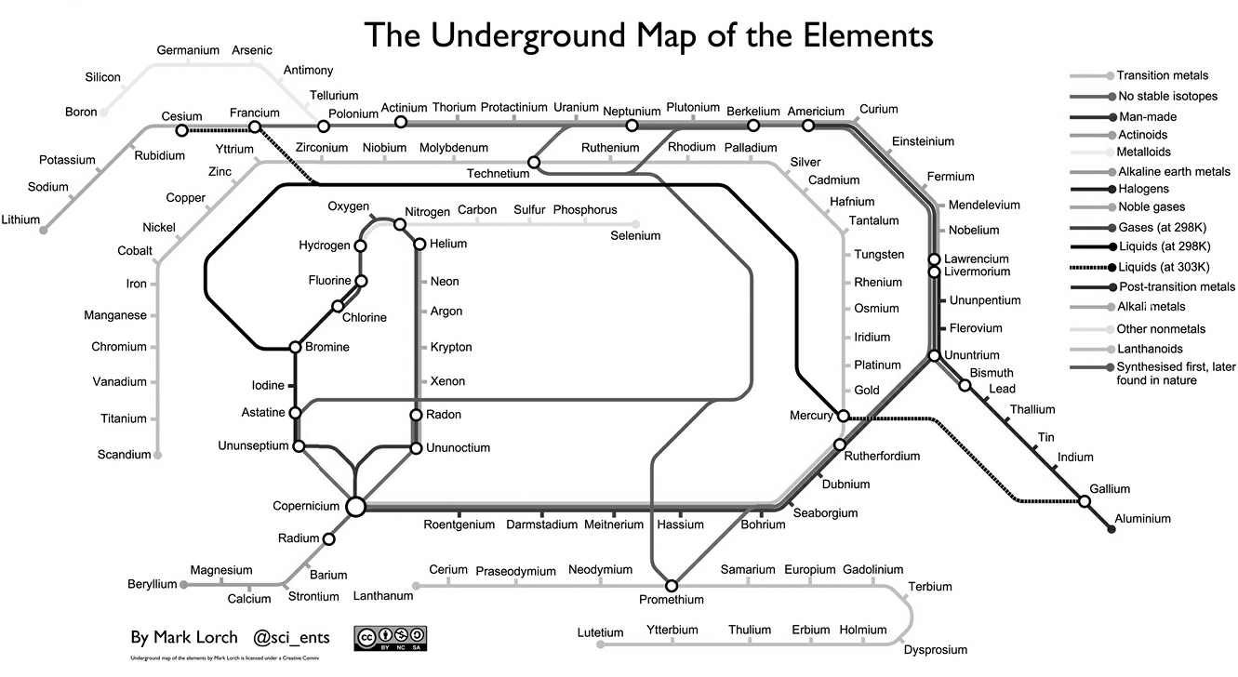
This is a Glass Slipper…
Why is Cadmium
near Fermium?

Slide 12
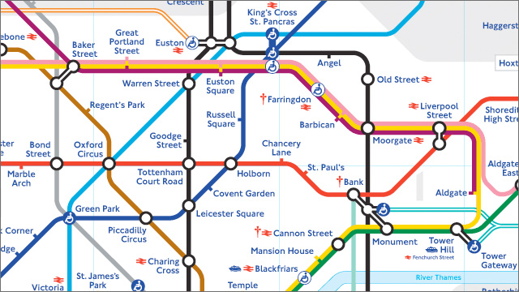
Based on the London Underground Map

Slide 13
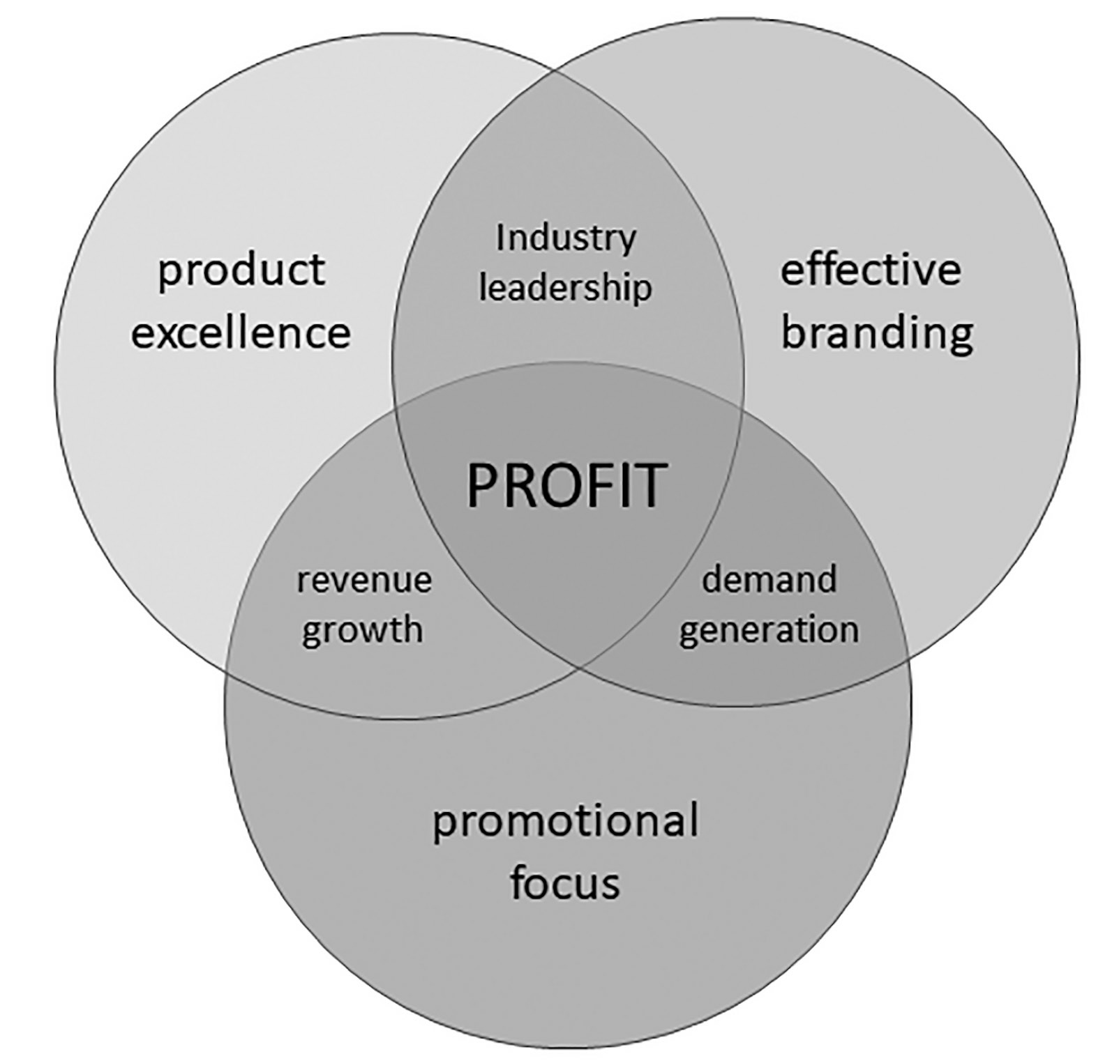
This is not a Venn Diagram
What does this mean
in terms of sets?

Slide 14
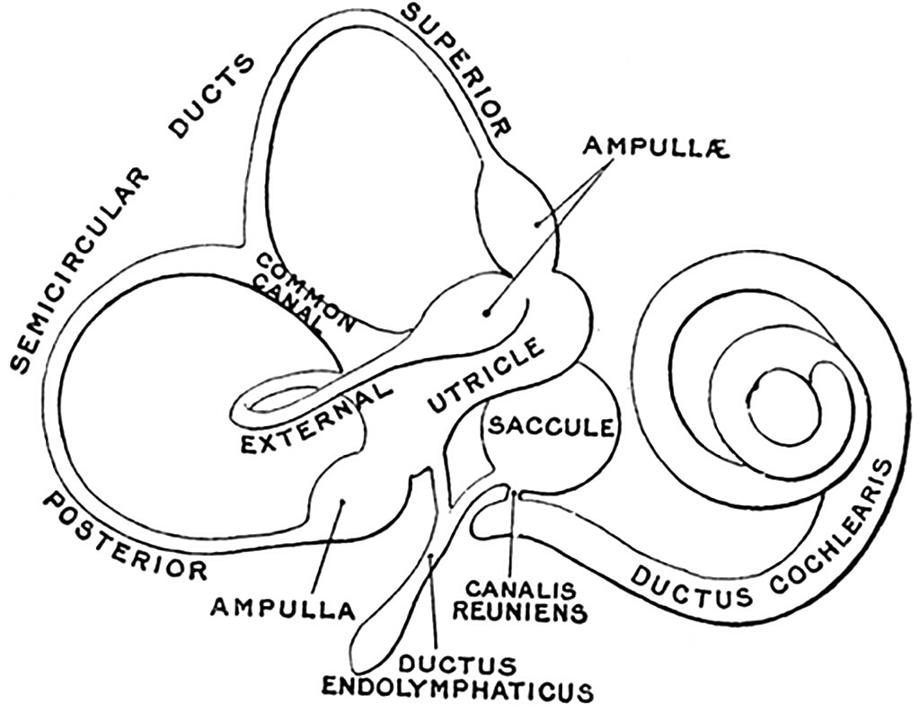
Labelled Schematics (good)

Slide 15
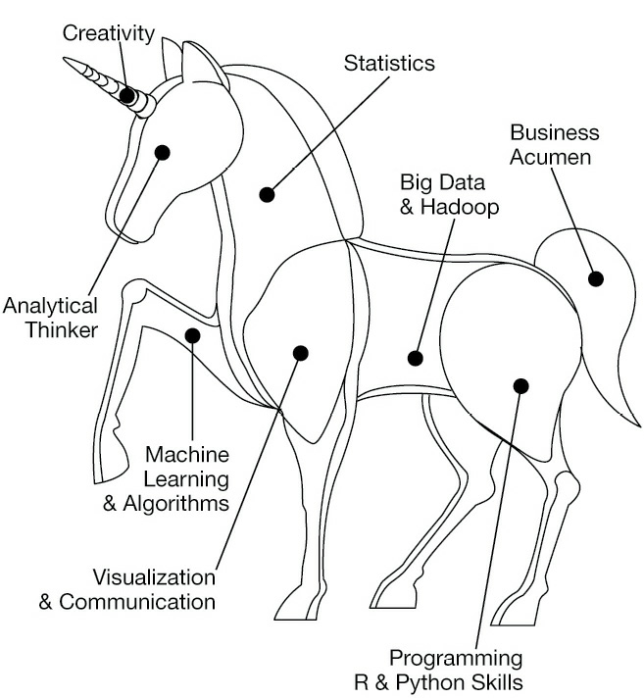
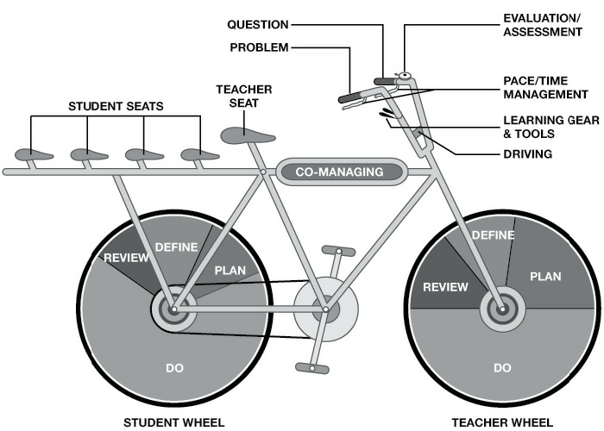
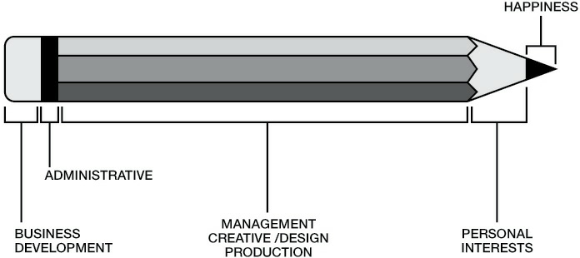
But these are bad:
Why is this the
eraser part of the
pencil?

Slide 16
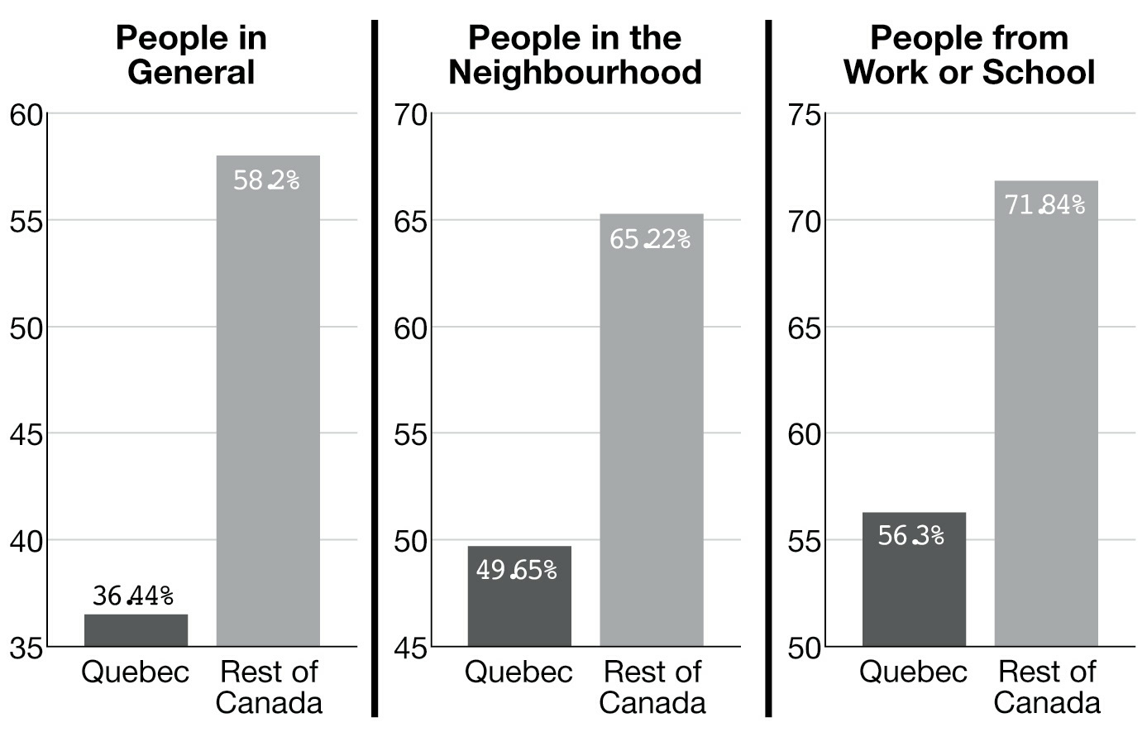
Misleading Axes
Based on these graphs,
is Quebec is a low-trust place?
Level
of trust
of people.

Slide 17
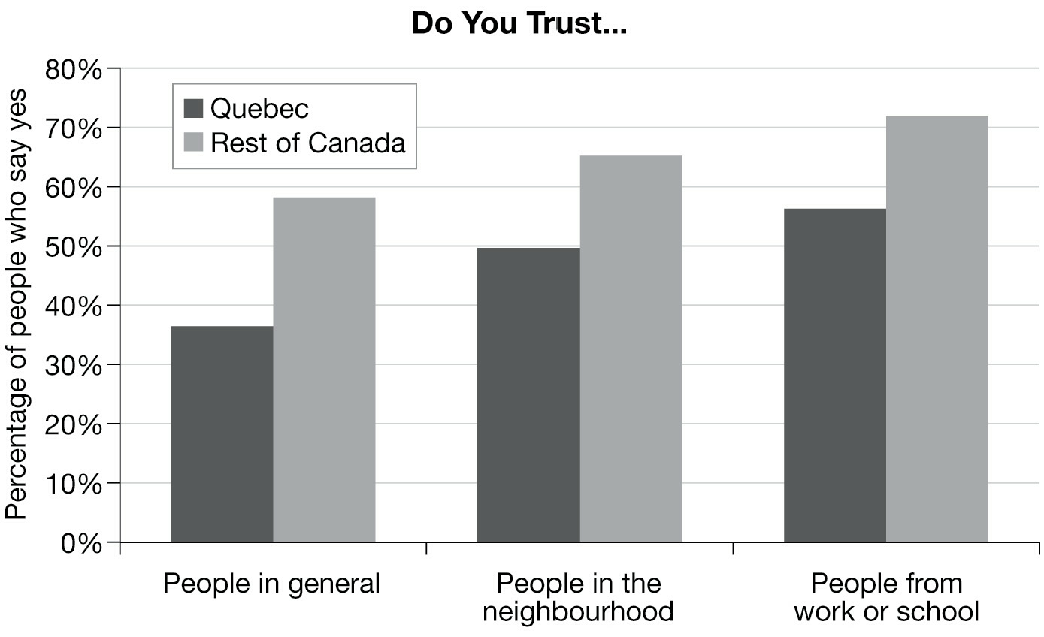
Same data, but better axes...

Slide 18
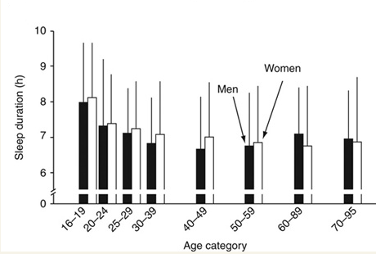
One Way to include 0

Slide 19
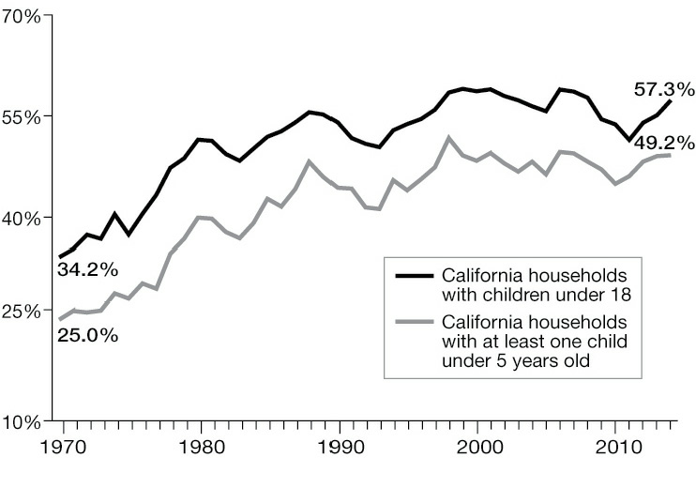
Line Graphs emphasize change: that's good

Slide 20
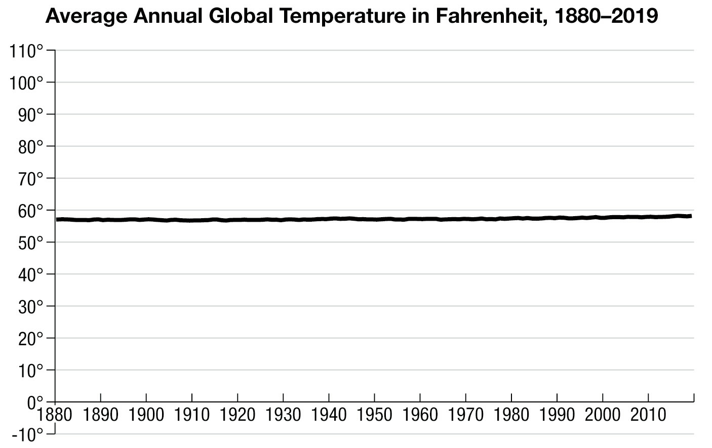
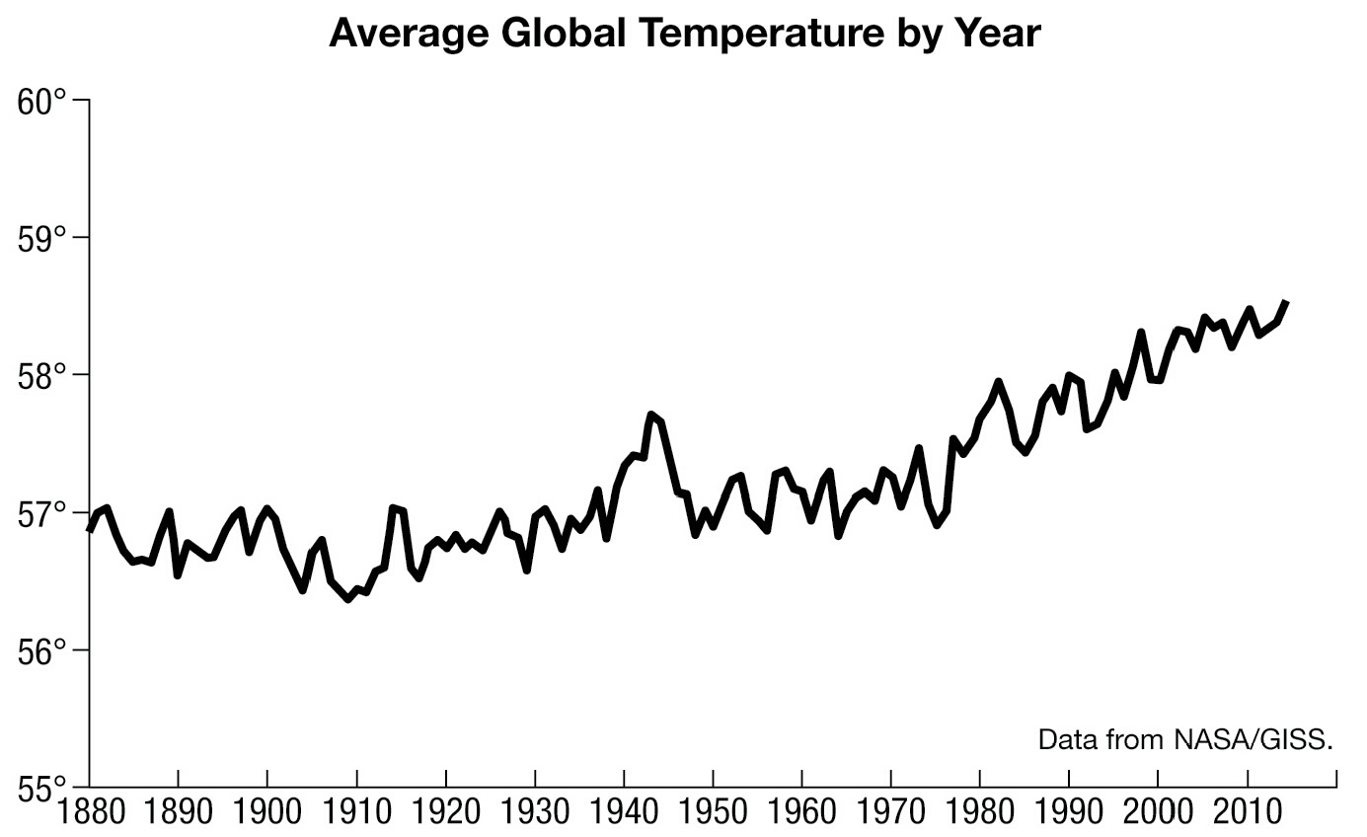
Same data, but with different ranges
Should you include 0?

Slide 21
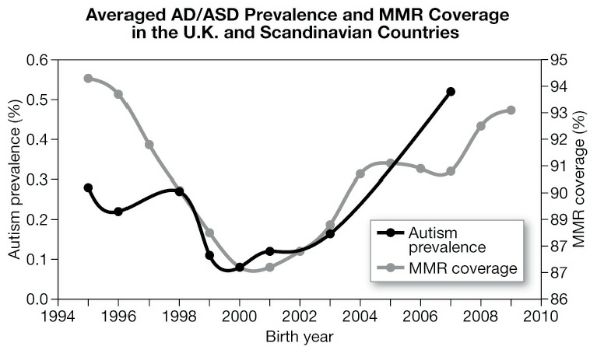
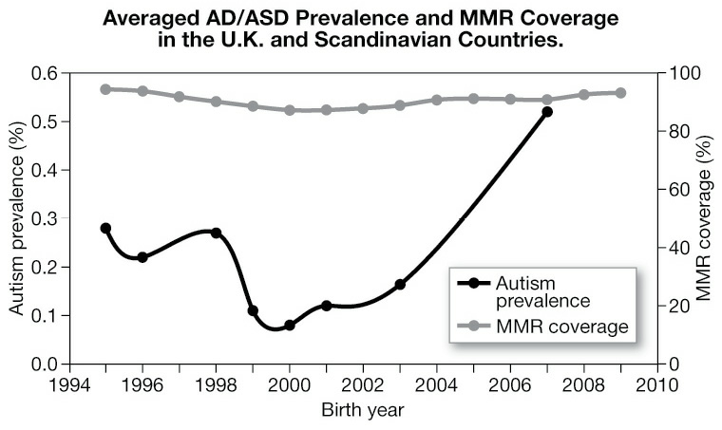
Two Vertical Scales
Almost always
VERY confusing. Avoid.

Slide 22
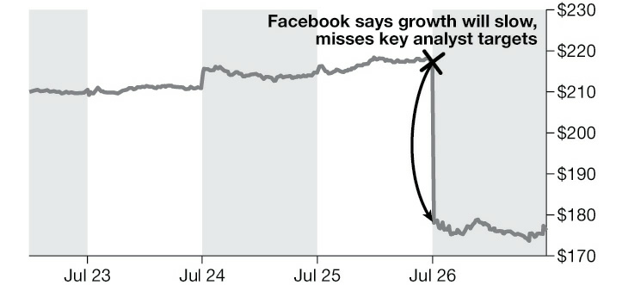
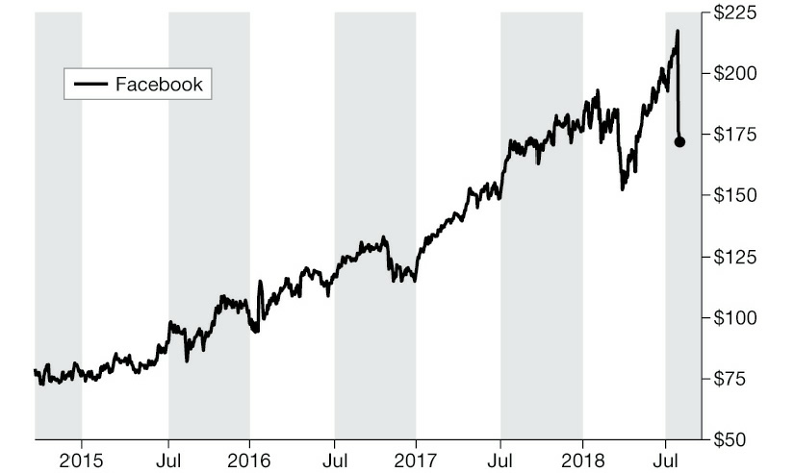
Misleading Horizontals
Same data,
different axes...

Slide 23
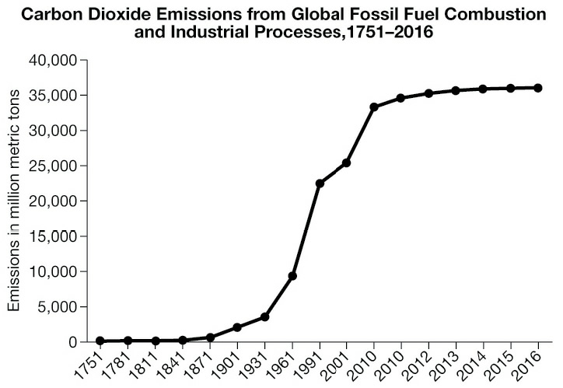
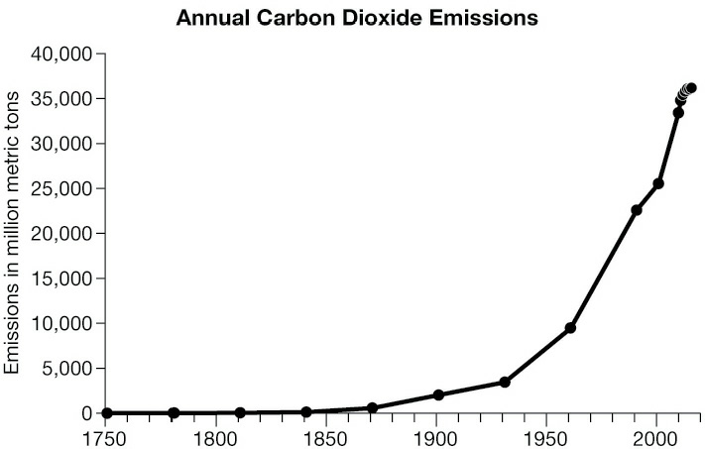
Watch the Ticks
Same data,
different axes...

Slide 24
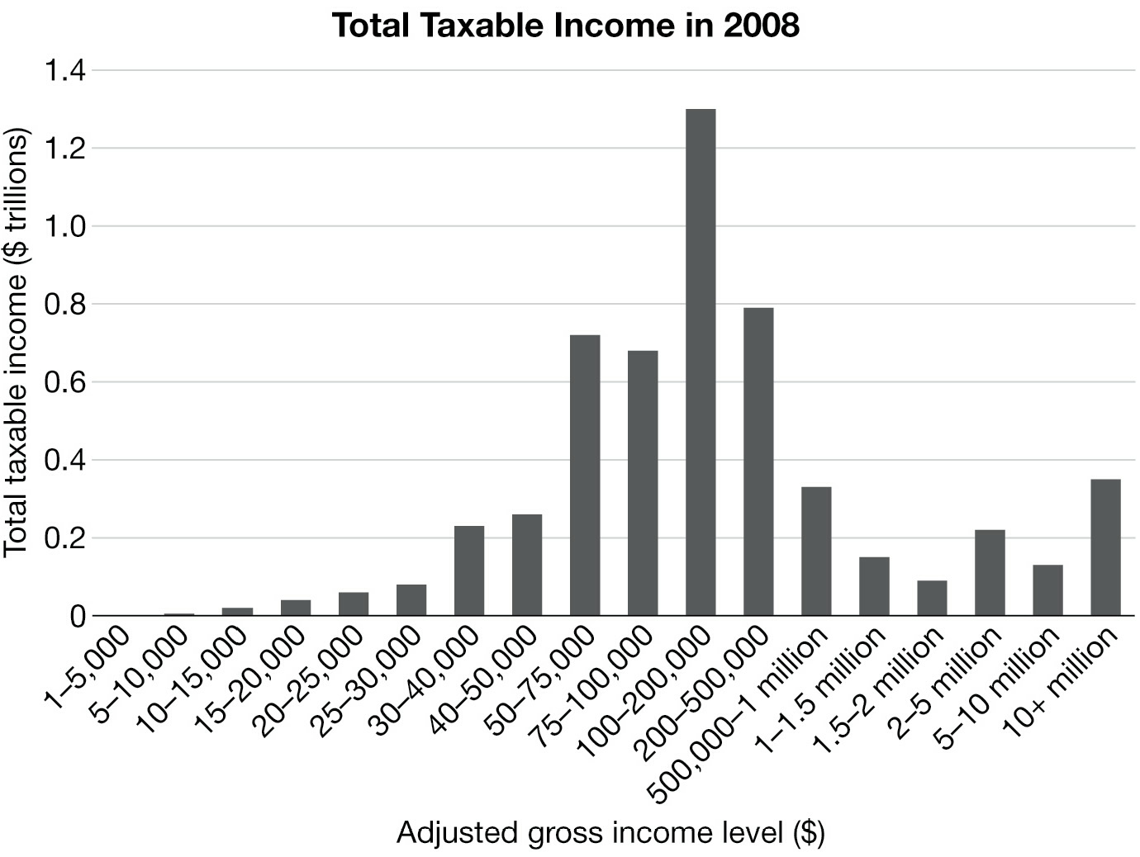
Uneven Bins
A "bin" is the range of values
represented by a single bar.
biggest bin
Most of the tax income comes from the middle bar.

Slide 25
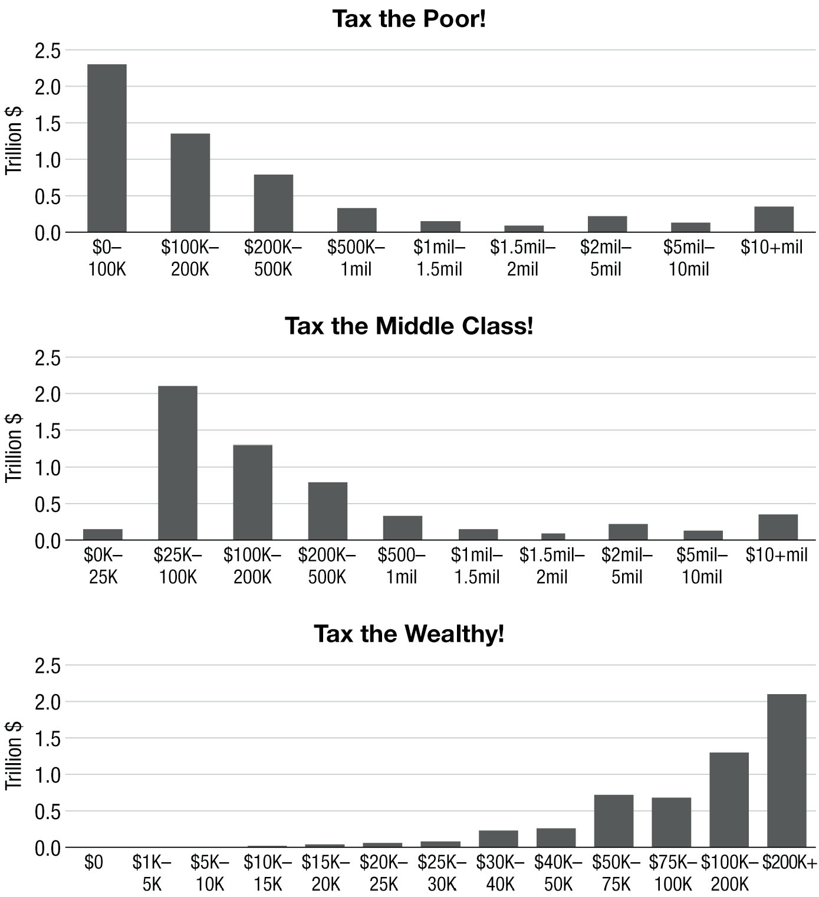
Same data, but different size bins...
biggest bin

Slide 26
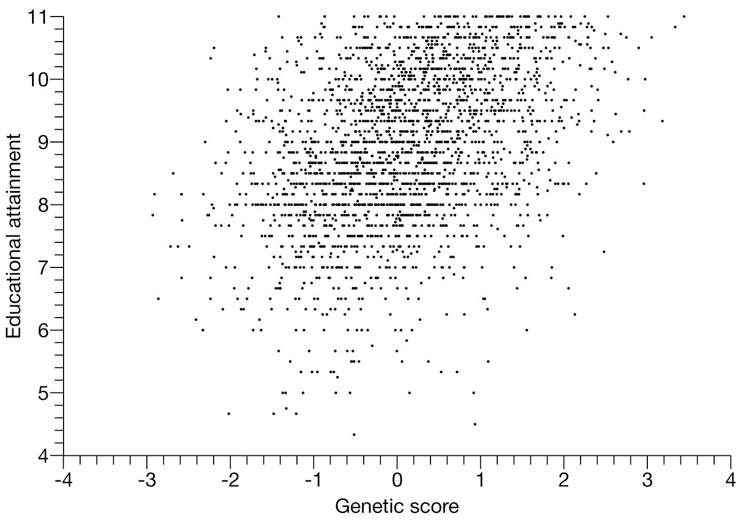
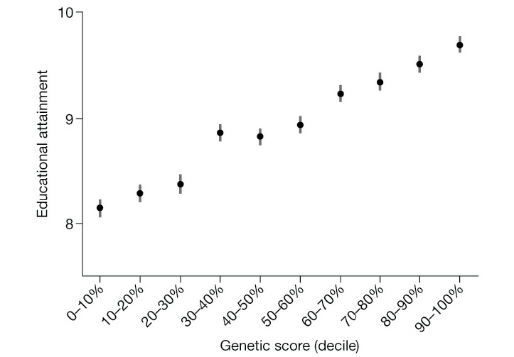
Genes and Education Bins
What is the pattern?
Same data, but bins vs. original data

Slide 27
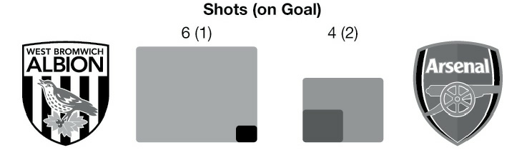
Proportional Ink
A shaded region should be proportional to the value.
Which football team scored the
most goals?

Slide 28
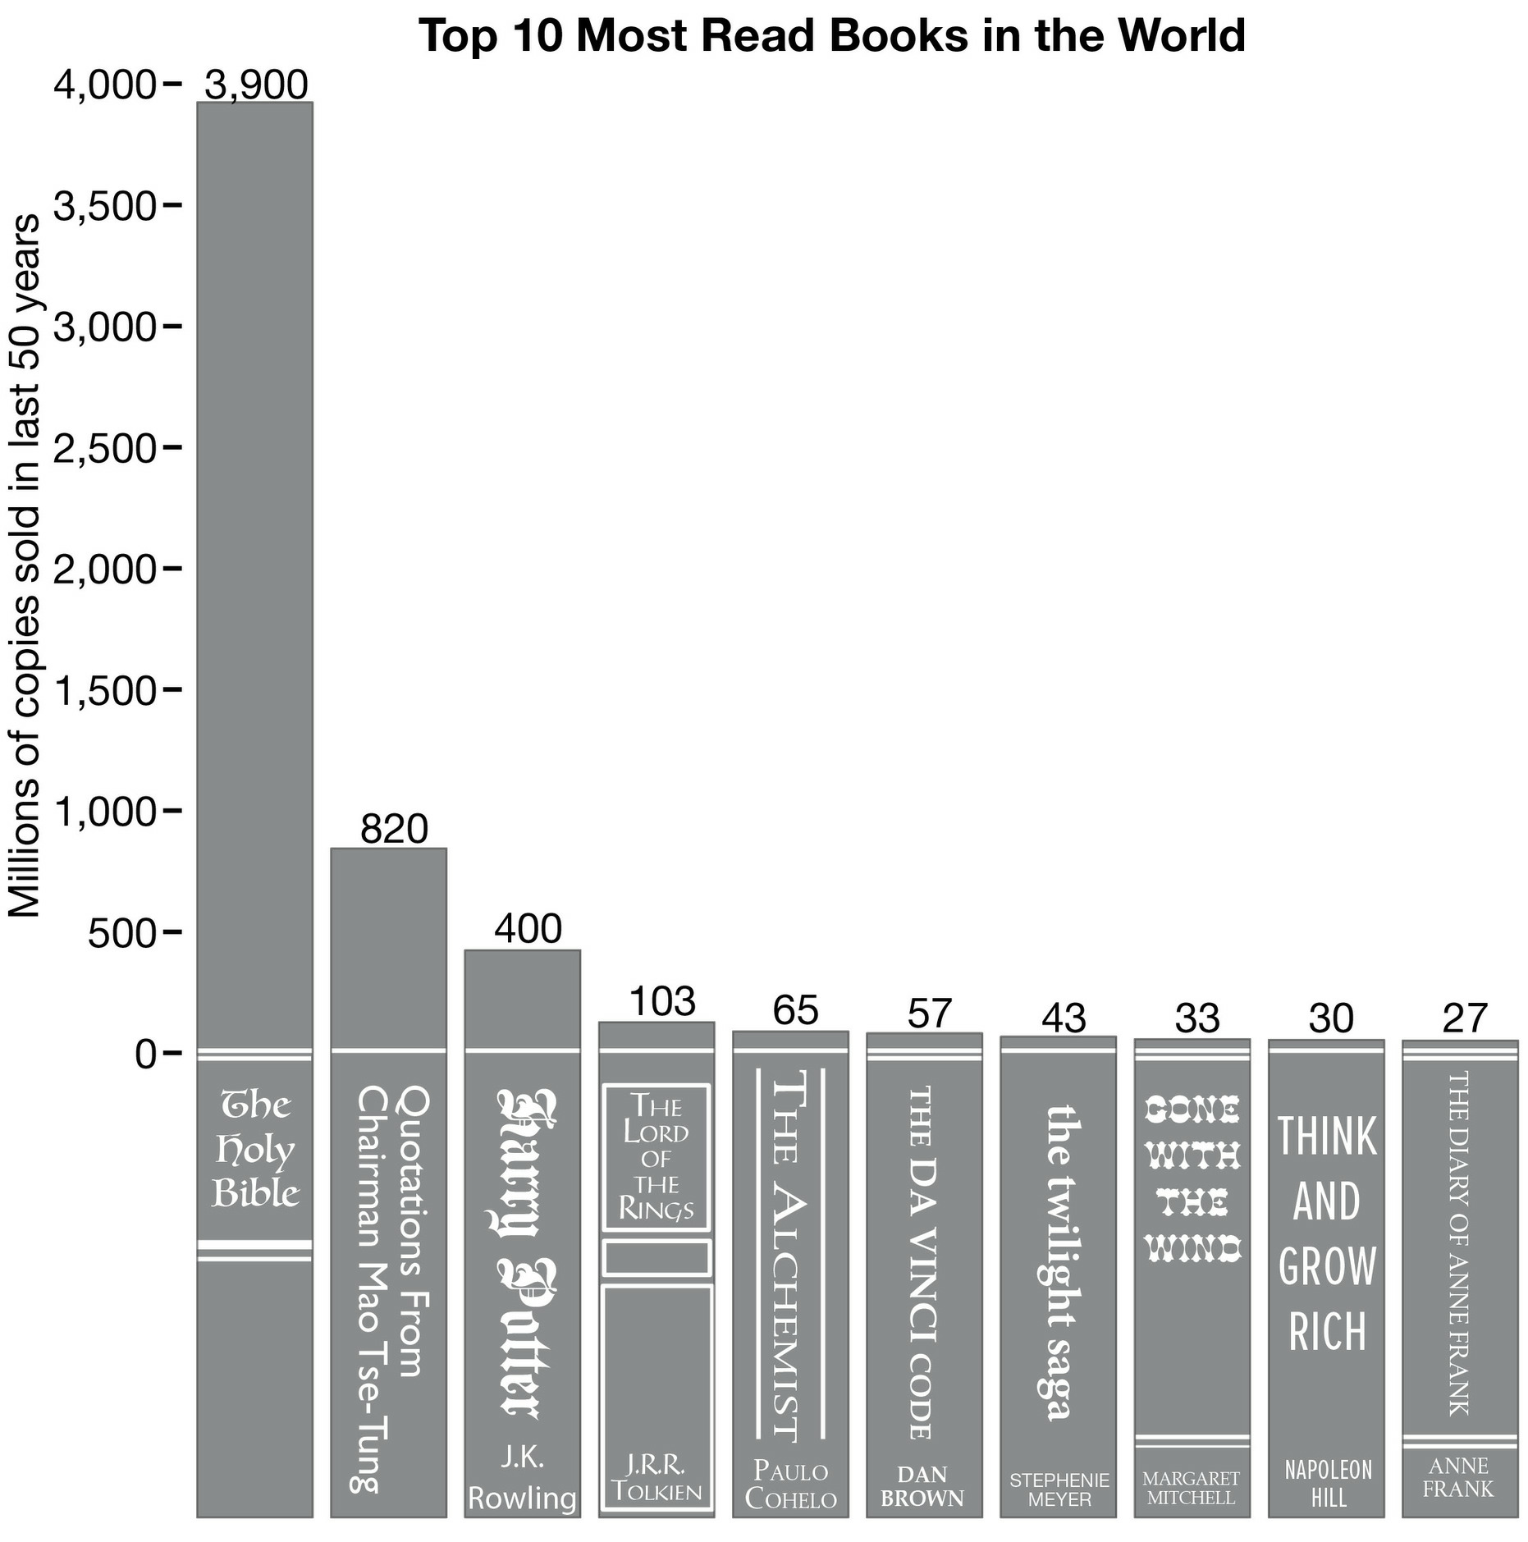
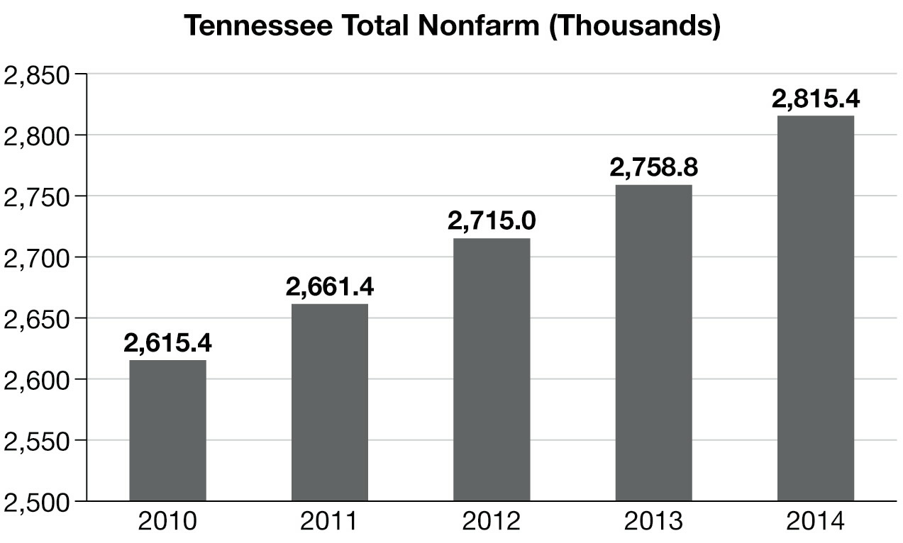
How much bigger is this number compared to this number?
How much bigger is this number compared to this number?

Slide 29
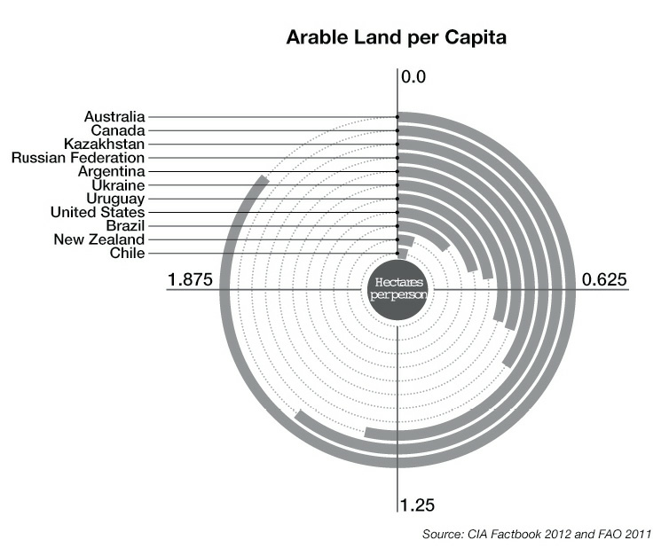
Donut Charts
How much bigger is this number compared to this number?
A donut bar chart is usually a bad choice.

Slide 30
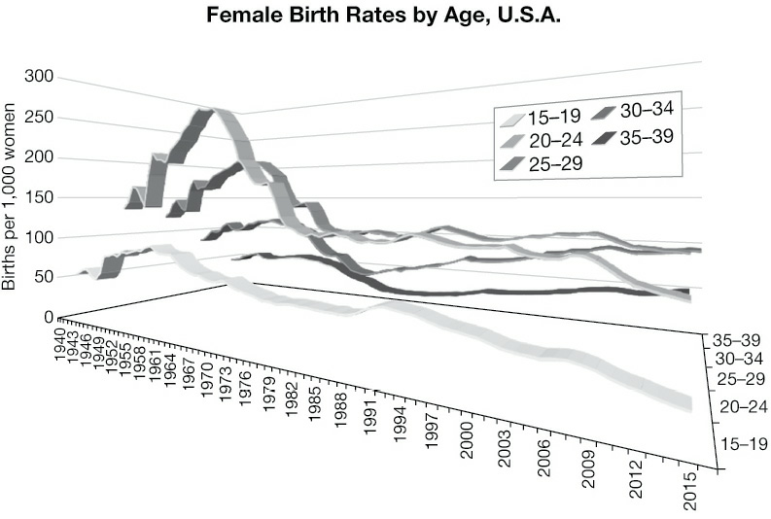
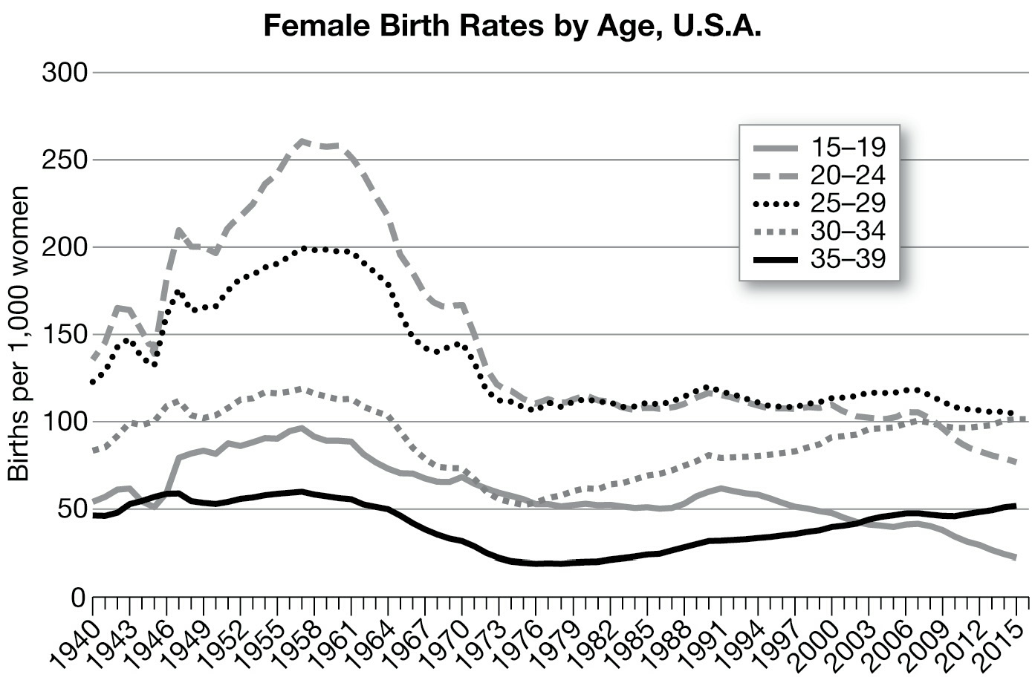
3D is almost always a bad choice
Same data: 2D vs. 3D
Look at two line in the two graphs, which pair
are easier to compare.

Slide 31
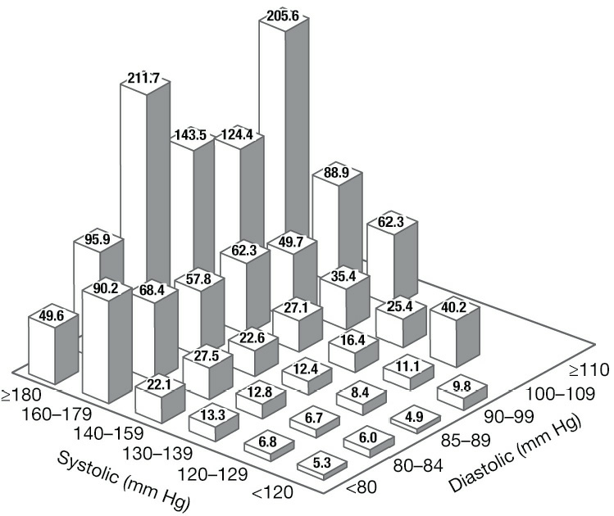
This 3D graph is okay
3D bar charts may be useful when you need to compare a pair of variables

Slide 32
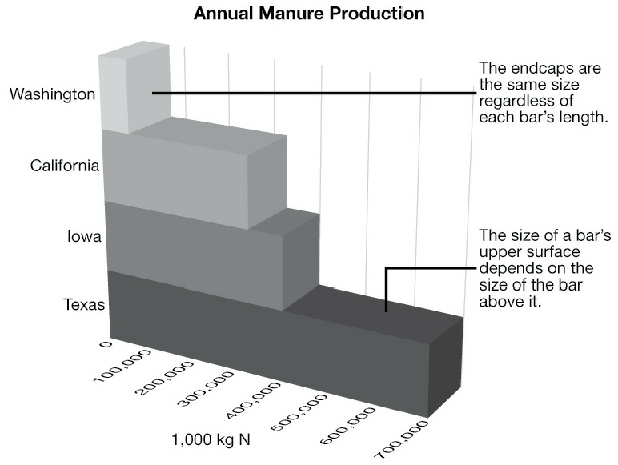
3D Messes up Sizes/Lengths
What does
this area mean?
Where does
Iowa data
end? Here
or here.

Slide 33
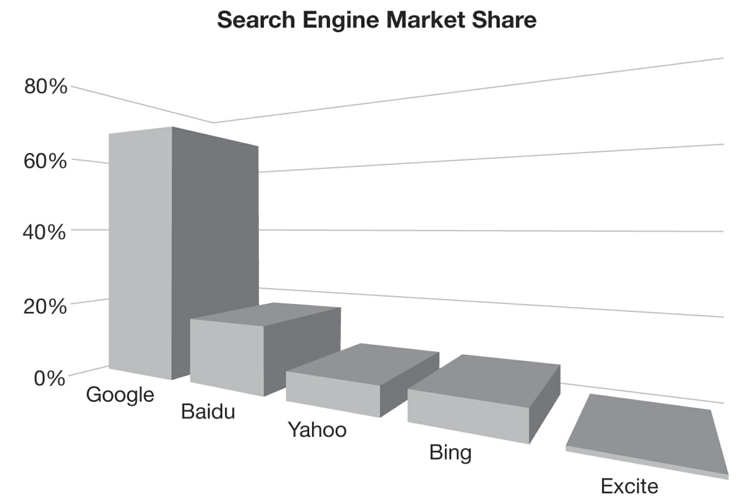
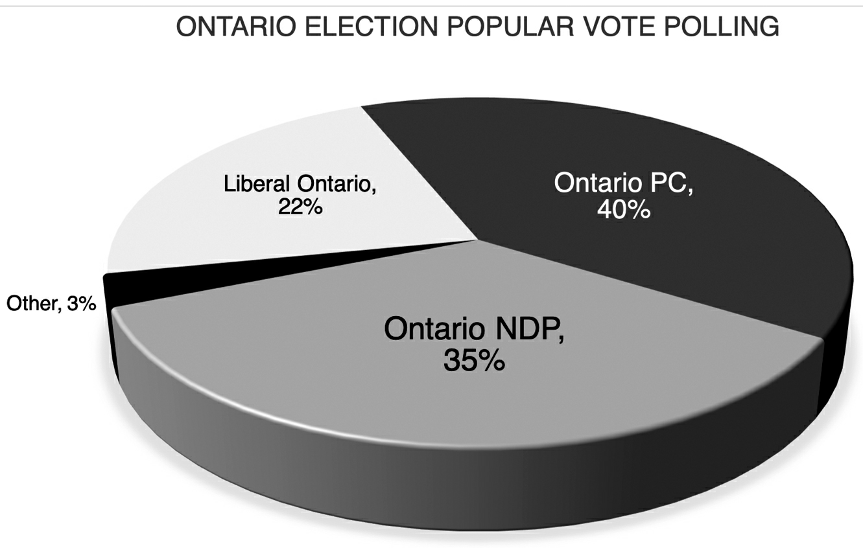
Which is bigger?
Why is this wider?
Whish is bigger
PC or NDP?

