Slide 1

4. Introduction to LaTeX

Slide 2
Overview
1. What is Latex?
2. Document Structure
3. Text Features
4. Packages
5. Maths
6. Beamer
7. Bibliography
8. More Information

Slide 3
1. What is LaTeX?
A typesetting system used to produce academic documents.
Good at handling maths.
LaTeX is also good for managing a bibliography.
Pronounced “lay-tech” or “lah-tech”

Slide 4
Where do I get LaTeX?
You will need a LaTeX compiler and editor
MiKTeX, a popular LaTeX compiler:
http://miktex.org/download
install first; let it install updates
TeXstudio, a popular LaTex editor:
https://www.texstudio.org/
http://fivedots.coe.psu.ac.th/Software.coe/ Seminar_II/basic-miktex-2.9.7269-x64.exe

Slide 5
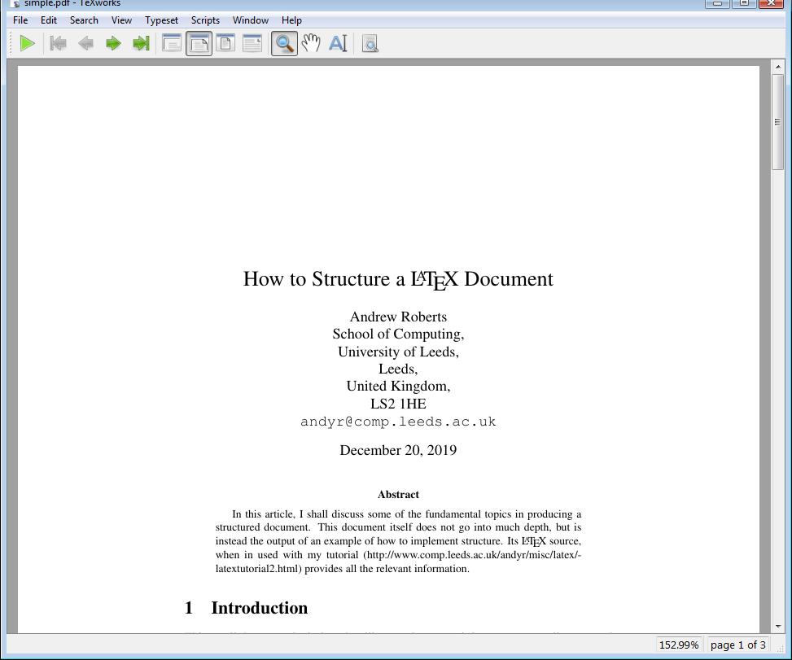
MiKTeX Setup and Testing
Optional: start MiKTeX Console
Switch to Admin mode
In Packages, install acmart, acmconf, ieeetran, ieeeconf
Start MiKTeX TeXWorks (a simple editor in MiKTeX)
open simple.tex (get from the website)
compile (let MiKTeX install any missing packages)
look at simple.pdf

Slide 6
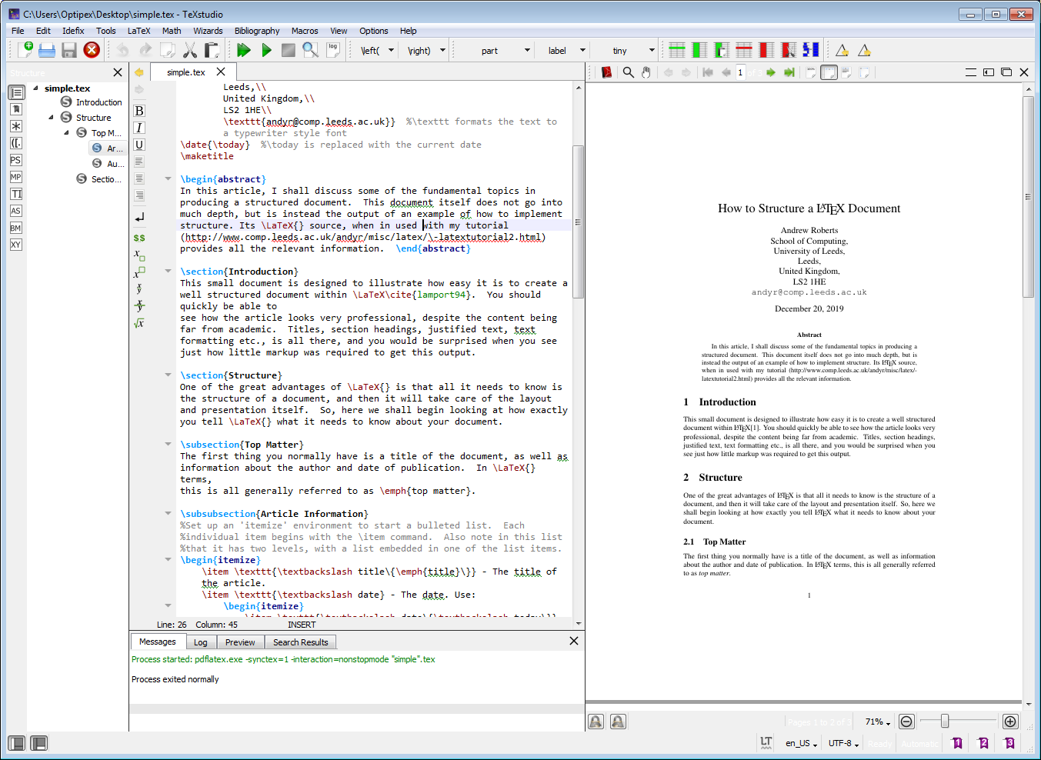
TeXstudio
Load simple.tex into TeXstudio and compile.

Slide 7
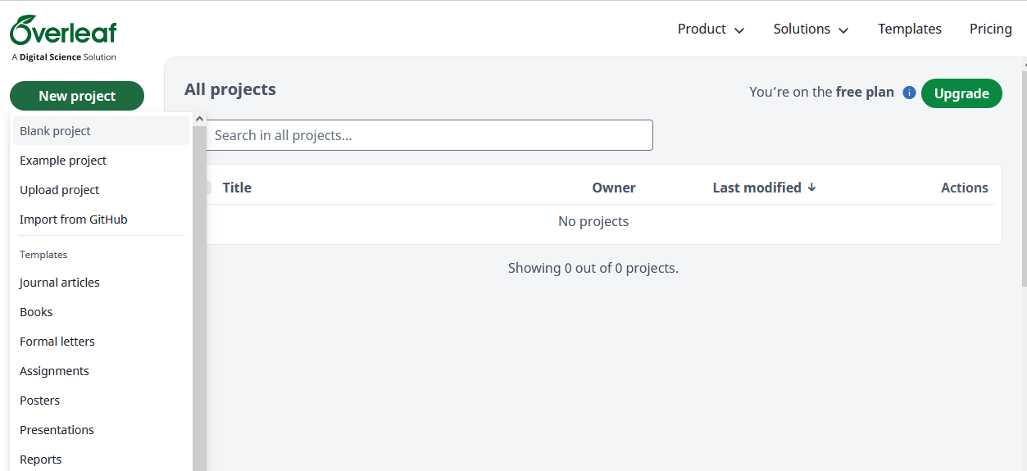
Online: Overleaf Editor
Must register,
but is free
https://www.overleaf.com/project

Slide 8
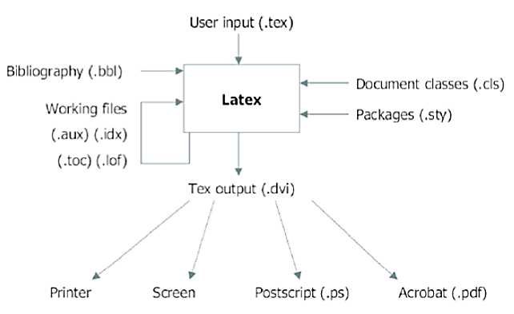
LaTeX Files Used
pdflatex

Slide 9
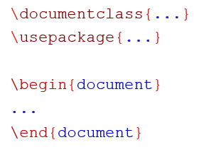
2. Document Structure
the preamble. It contains commands that affect the document.
the text of your document
Look at simple.tex
for a complete example

Slide 10
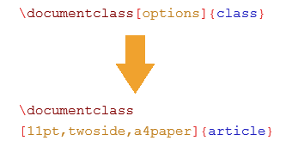
Document Classes
class specifies the type of document to be created.
The options customizes the behaviour of the document

Slide 11
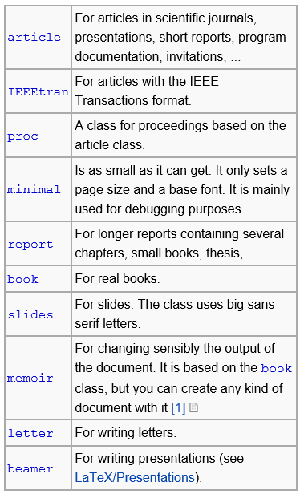
Common Classes

Slide 12
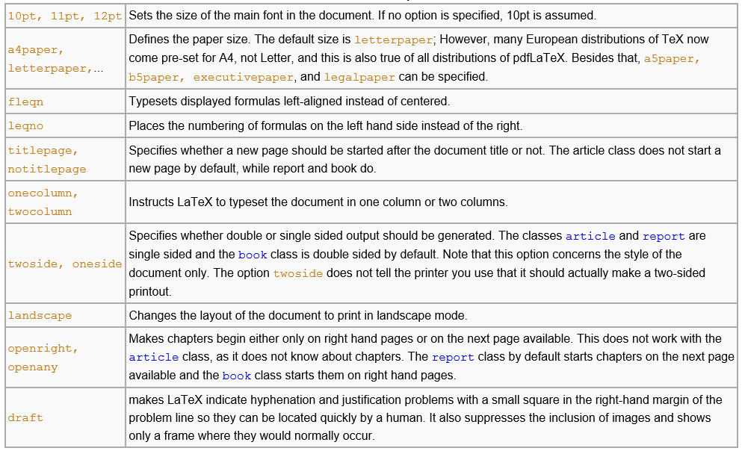
Common Options

Slide 13
2.1 Title Page
Look at simple.tex
for a complete example
\title{Title Here}
\author{Andrew Davison\\
Department of Computer Engineering,\\
Prince of Songkla Universityl\\
\texttt{ad@fivedots.coe.psu.ac.th}
}
\date{\today}
\maketitle
The double backslash (\\) is the command for a forced line break.
The \texttt command formats the e-mail address using a mono-spaced font.
The \today command is used to insert the current date.
To omit the date simply leave the braces empty.

Slide 14
2.2. Abstract
\documentclass{article}
\begin{document}
\begin{abstract}
Here is where you would write some nice abstract.
\end{abstract}
\end{document}
Appears at the top of the main body of the document, but before the other sections.
Available for the article and report classes, not the book class.

Slide 15
2.3. Sections
\documentclass{article}
\begin{document}
\section{Introduction}
Some text here…
\section{PhD aims}
\subsection{Variation to the model}
\subsubsection{Agent Variations}
\subsubsection{Environment Variations}
\end{document}
Sections can be used to help structure a document to make it more readable.
Think of these like chapters or section headings.
Text placed in the brackets will appear as headings on the document.
Sections are also useful when creating a contents page.

Slide 16
2.4. Multiple Files for One Doc
Sometimes you don’t want to keep everything in one text file
e.g. have one file per chapter, section
\include{filename}

Slide 17
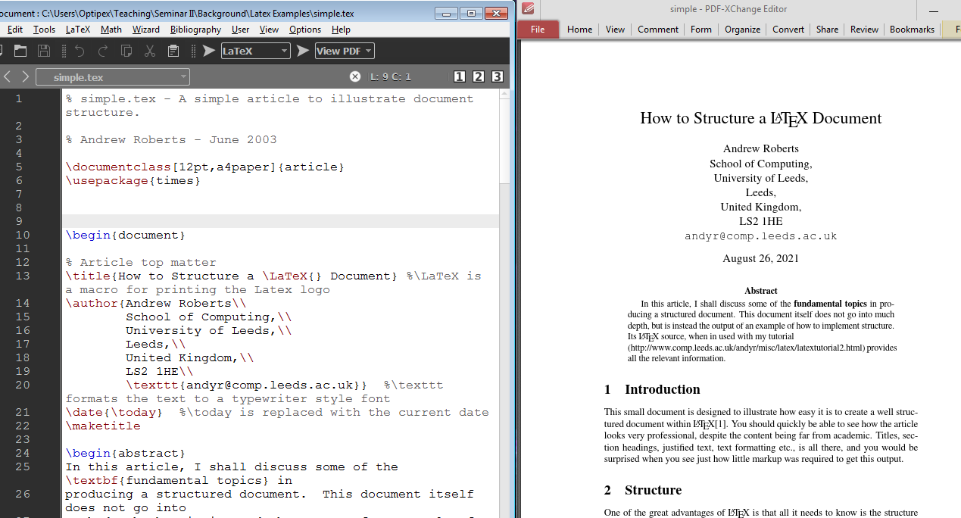
Simple.tex and simple.pdf

Slide 18
3. Text Features
Font styles
Special characters
Lists
Tables
Figures
Table of contents, tables, figures

Slide 19
3.1. Font Style
Styles
\emph{text} – italicizes the text
\textbf{text} – bold face
\underline{text} - underline
\textsl{text} – slant
- And on and on
When something is \emph{really}, \textbf{really} important, you can \underline{underline it}. If you \underline{\textbf{\emph{must do all three}}}, then you can nest them.

Slide 20
3.2. Special Characters
& symbol is reserved so use \&
% symbol is reserved so use \%
~ is a non-breaking space so use ~~

Slide 21
3.3. Lists
Bulleted List
\begin{itemize}
\item Item 1
\item Item 2
\end{itemize}
Numbered List
\begin{enumerate}
\item Item 1
\item Item 2
\end{enumerate}
Description List
\begin{description} \item[First] Item 1 \item[Second] Item 2
\item[Second] Item 3 \end{description}
Nested Lists
\begin{enumerate} \item Item 1 \begin{enumerate} \item Nested item 1 \item Nested item 2 \end{enumerate} \item Item 2 \end{enumerate}

Slide 22
3.4. Tables
\begin{tabular}[pos] {table spec}
…table here…
\end{tabular}
The table spec argument is the alignment to be used in each column and the vertical lines to insert.
The optional parameter pos specifies the vertical position of the table relative to the surrounding text.

Slide 23
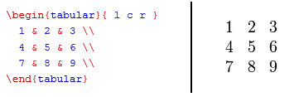
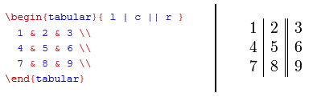
example 1:
example 2:

Slide 24
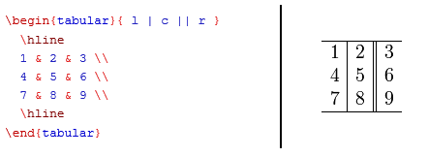
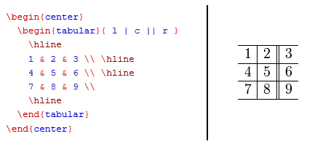
example 3:
example 4:

Slide 25
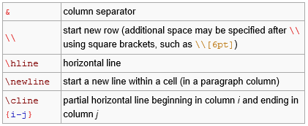

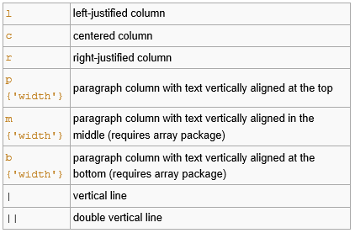
Basic commands in the tabular environment:
pos option:
To describe the table columns:

Slide 26
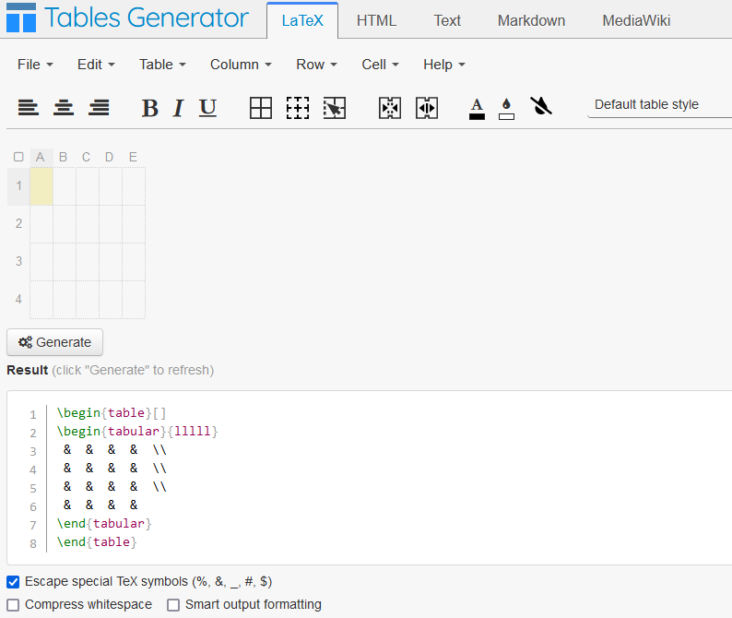
Tables Online
https://www.tablesgenerator.com/

Slide 27
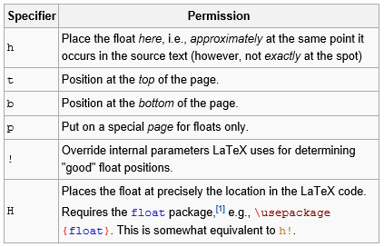
3.5. Figures
\begin{figure}[placement] ... figure contents ... \end{figure}
Creates a figure that floats in the text.
The placement parameter gives more control over where floating figures are placed.
Placement

Slide 28
3.6. TOC, LOF, LOT
Include a table of contents by inserting the following command where you would like your contents to appear in the document.
\tableofcontents
Include a list of figures or tables:
\listoffigures
\listoftables
See thesis.tex in the thesis/ example

Slide 29
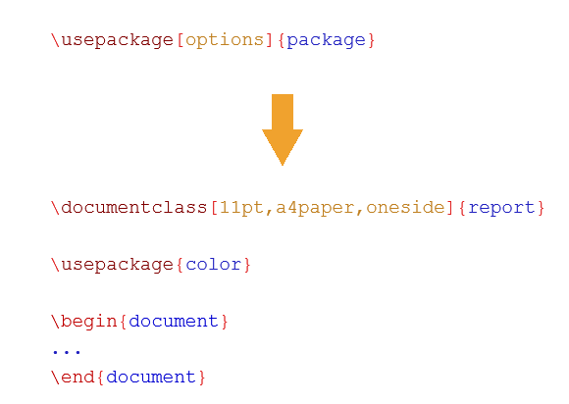
4. Packages

Slide 30
A comprehensive list of packages: http://www.ctan.org/
More commonly used packages:
\usepackage{amsmath}
for maths
\usepackage{graphicx}
for inserting figures
\usepackage[a4paper]{geometry}
adjust margins of a certain page
\usepackage{hyperref}
makes citations “clickable” in the .pdf document
MiKTeX will automatically download any packages that it needs to compile your document

Slide 31
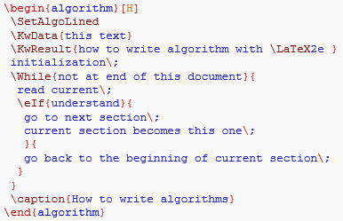
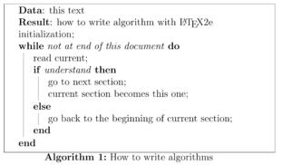
4.1. Algorithms
Pseudo code using the algorithm2e package
Declare it in the preamble with:
\usepackage{options}{algorithm2e}

Slide 32
4.2. Showing Code
1. The listings package
\usepackage{listings}
see the listings1.tex example
2. The verbatim environment:
\begin{verbatim}
your code example
\end{verbatim}
3. Add inline code with {\tt code } or \texttt{ code }

Slide 33
4.3. Graphics
\usepackage{graphicx}
\includegraphics{image.png}
\includegraphics[scale=0.5]{image.png}
\includegraphics[width=2.5cm]{image.png}

Slide 34
5. Maths
For more complicated formulas you should use:
\usepackage{amsmath}
Inline maths:
$a + b = c$
Maths on its own line:
$$a + b = c$$

Slide 35
Simply Math Formulas
$x^2$
$\sqrt{x}$
$x_2$
$\sqrt[6]{n+3}$
$x^{n+2}$
$\frac{x^2}{y}$
$x_{n+2}$
$\int^t_0 xdx$
$x_{n+2}^{n+2}$
$\int xdx$
$ \sum_{n=0}^\infty n$

Slide 36
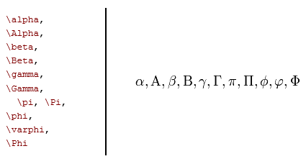

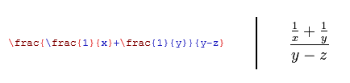
Basic symbols:
+ - = ! / ( ) [ ] < > | ' :

Slide 37
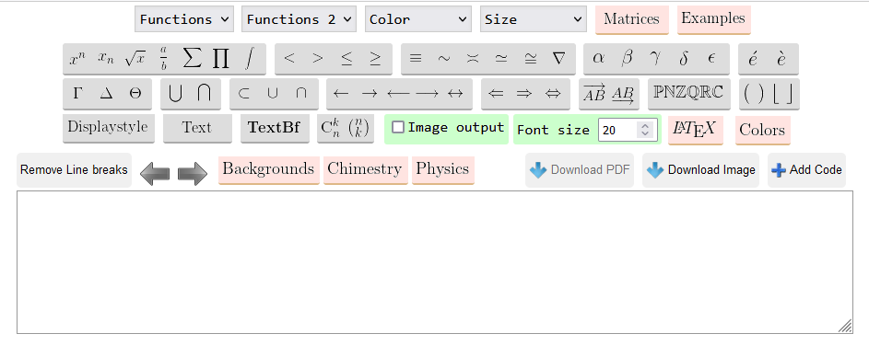
Online Equation Editor
https://latexeditor.lagrida.com/

Slide 38
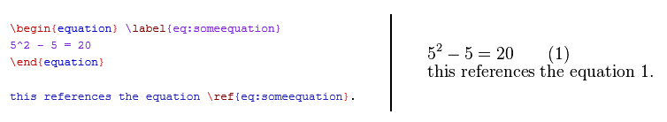
Advanced Maths
Look at maths.tex
for a complete example
For maths separate from the text, it is best to use the \equation environment.
another choice is \[ ... \]
This will automatically number your equations.
You can also name an equation (e.g. someequation ) and refer to it in the text.

Slide 39
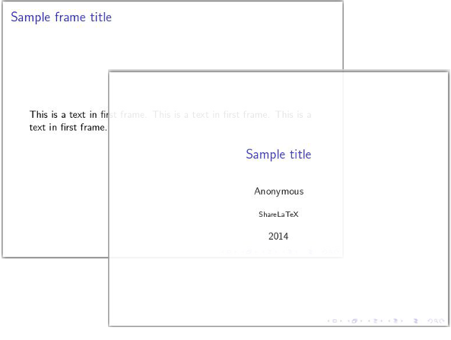
6. Beamer
A LaTex class for creating slide presentations.
see the beamer/ example folder
the bext tutorial: https://www.overleaf.com/learn/latex/beamer
A minimal beamer presentation:
\documentclass{beamer}
\usepackage[utf8]{inputenc}
\title{Sample title}
\author{Anonymous}
\institute{Overleaf}
\date{2014}
\begin{document}
\frame{\titlepage}
\begin{frame}
\frametitle{Sample frame title}
This is a text in the first frame. This is a text in the first frame. This is a text in the first frame.
\end{frame}
\end{document}

Slide 40
7. Bibliography
Two main ways to include a bibliography.
1. For short documents , embed the references in the file.
2. You can store refs in an external BibTeX file and then link to them via a command.
For more information, visit http://www.bibtex.org

Slide 41
Place all of your references in separate \bibitems.
Then place all of these inside of thebibliography environment.
Usually placed at the end of the document.
Refer to the item in your text with \cite{Davison20}
\begin{thebibliography}{99}
\bibitem{Davison20}
Andrew Davison.
Introduction to LaTeX.
\emph{Seminar II}, 2020.
\end{thebibliography}

Slide 42
8.1. Bibtex in a Separate File
Look at simpleB.tex and simpleB.bib
you can open the bib file in any text editor
Open simpleB.tex in the Latex editor, and compile as normal.
The LaTeX file links to the bib file at the end of the document:
\bibliographystyle{abbrv}
\bibliography{simpleB}

Slide 43
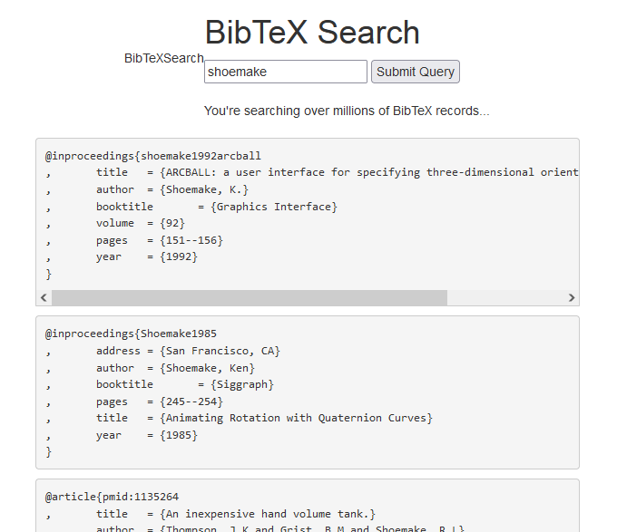
Finding Bibtex Data Online
http://www.bibtexsearch.com/

Slide 44
Conferences/Journals
Each publisher has its own set of rules and templates:
https://www.acm.org/publications/proceedings-template
https://www.ieee.org/conferences/publishing/templates.html
https://journals.ieeeauthorcenter.ieee.org/create-your-ieee-journal-article/authoring-tools-and-templates/ieee-article-templates/

Slide 45
8.2. BibTex Tools
JabRef (https://www.jabref.org/)
an open source bibliography reference manager
requires Java and JavaFX version 8 (currently Java is at v.19)
BibTeX entries can be fetched from online databases, including the ACM Digital Library, IEEEXplore, Google Scholar, and many more
First install a 64-bit JVM and JavaFX version 8
e.g. the Zulu OpenJDK FX build at https://www.azul.com/downloads/zulu-community/
get the JDK FX 8 zip file, and unzip to C:\Program Files\Zulu
When JabRef is installing, you must supply the path to the Zulu OpenJDK's java.exe
e.g. C:\Program Files\Zulu\zulu8....-win_x64\bin\java.exe

Slide 46
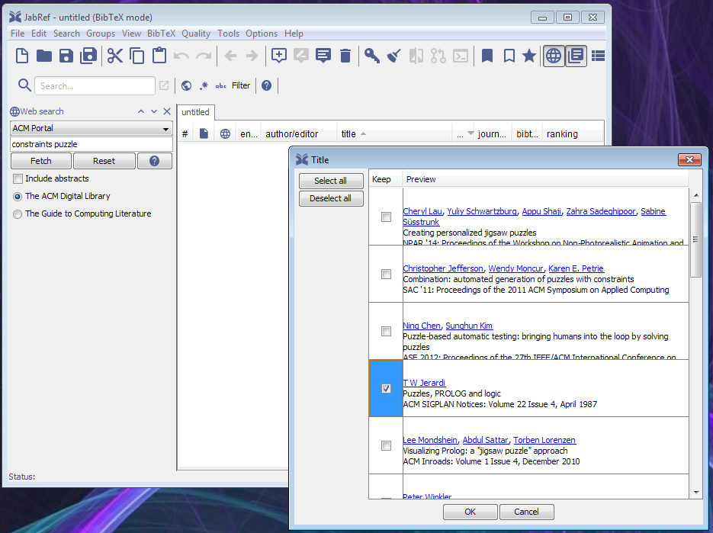
JabaRef Running

Slide 47
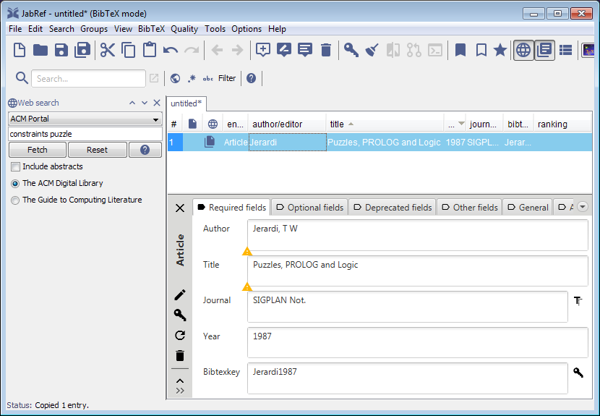

Slide 48
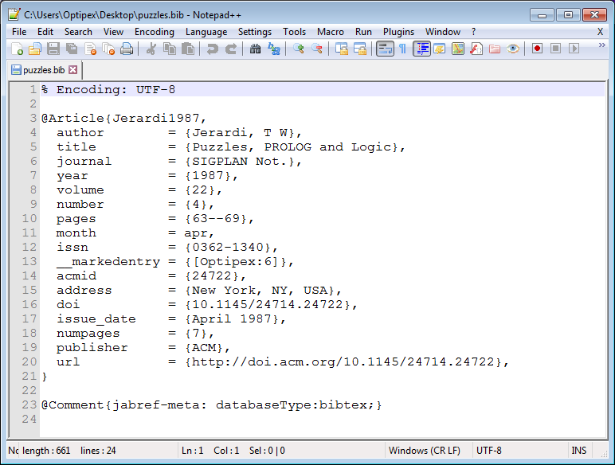

Slide 49
8. More Information
"Learn LaTeX in 30 minutes" https://www.overleaf.com/learn/latex/Learn_LaTeX_in_30_minutes
https://www.overleaf.com/learn/latex/Main_Page
"Getting to Grips with LaTeX" (tutorials) https://www.andy-roberts.net/writing/latex
Getting Started with LaTeX, David R. Wilkins (46 pp) https://www.maths.tcd.ie/~dwilkins/LaTeXPrimer/

Slide 50
Free Books
"LaTeX for Complete Novices", Nicola L. C. Talbot, 2012
https://www.dickimaw-books.com/latex/novices/
"The not so Short Introduction to LaTeX2e" , Tobias Oetiker, 2018
https://tobi.oetiker.ch/lshort/
"A Simplified Introduction to LaTeX", Harvey J. Greenberg, 2010
https://www.ctan.org/tex-archive/info/ simplified-latex?lang=en

