Slide 1
Seminar I
240-701, Semester 1, 2025-2026
1. Finding Papers
Objectives:
find papers related to your thesis statement
find survey/overview papers
find books

Slide 2
1. Collect Keywords (key phrases)
From your thesis statement
From the keywords in papers given to you by your supervisor
From other people in your research group
From your supervisor
My example:
"spatial logic", "constraint logic programming" (CLP)

Slide 3
2. Search Online
PSU Library's E-databases:
https://clib.psu.ac.th/e-resources/e-databases.html
Two most useful computing ones:
ACM Digital Library (software/maths)
IEEE Xplore (hardware/engineering)
Go to them via the library URL, so the databases see that you are a student at PSU

Slide 4
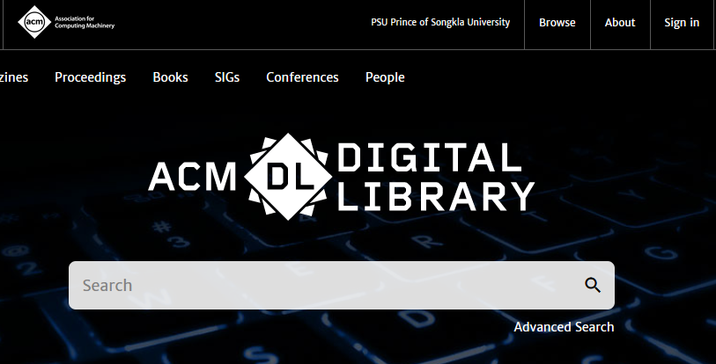

Slide 5
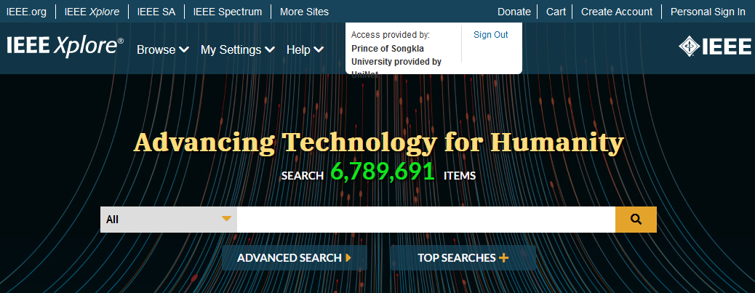

Slide 6
Database Search Tips
Use quotes,
e.g. "spatial logic" is more specific than spatial logic
Multiple terms are ANDed
"spatial logic" "constraint logic programming"
Or use OR:
"spatial logic" OR "geomertic logic"
Use "Advanced Search"
restrict time range to last 20 years (2000 – 2020)
restrict search to titles
restrict search to journals and conferences

Slide 7
Keyword Strategy
Add more keywords; put key phrases in quotes; add time periods
the aim is to get less than 10 paper matches
If you get no hits then remove keywords, remove quotes, widen time period
At the start of your research, concentrate on finding a good survey paper, and/or book
these will help you learn the important ideas, and collect better keywords

Slide 8
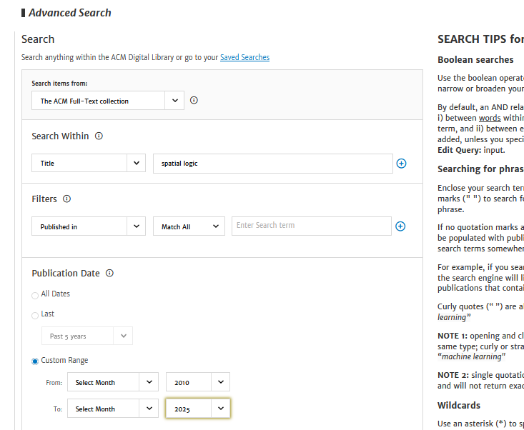
ACM Spatial logic in title; 2010-

Slide 9
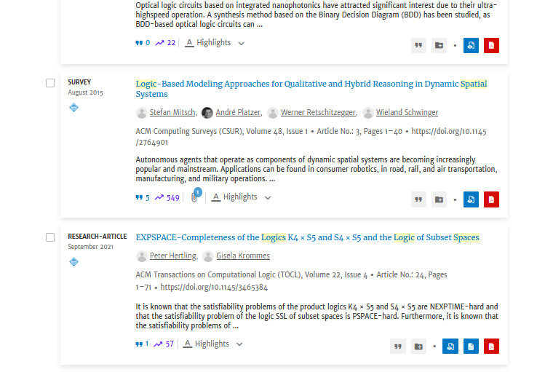
Click on the "survey" paper

Slide 10
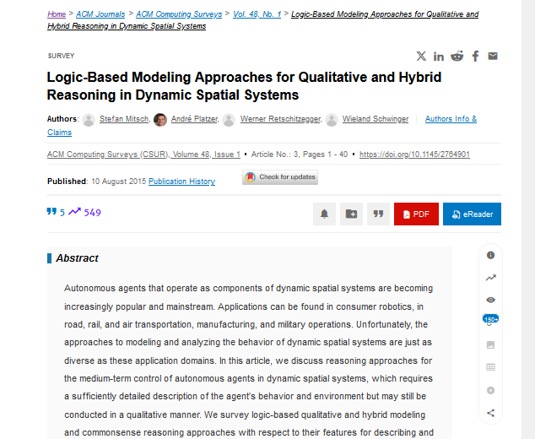
Look at Abstract, References, Citations, DOI

Slide 11
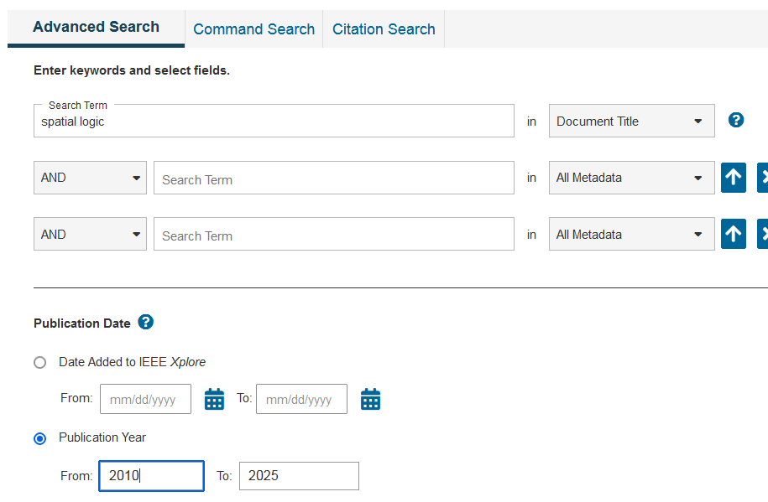
IEEE spatial logic 2010-

Slide 12
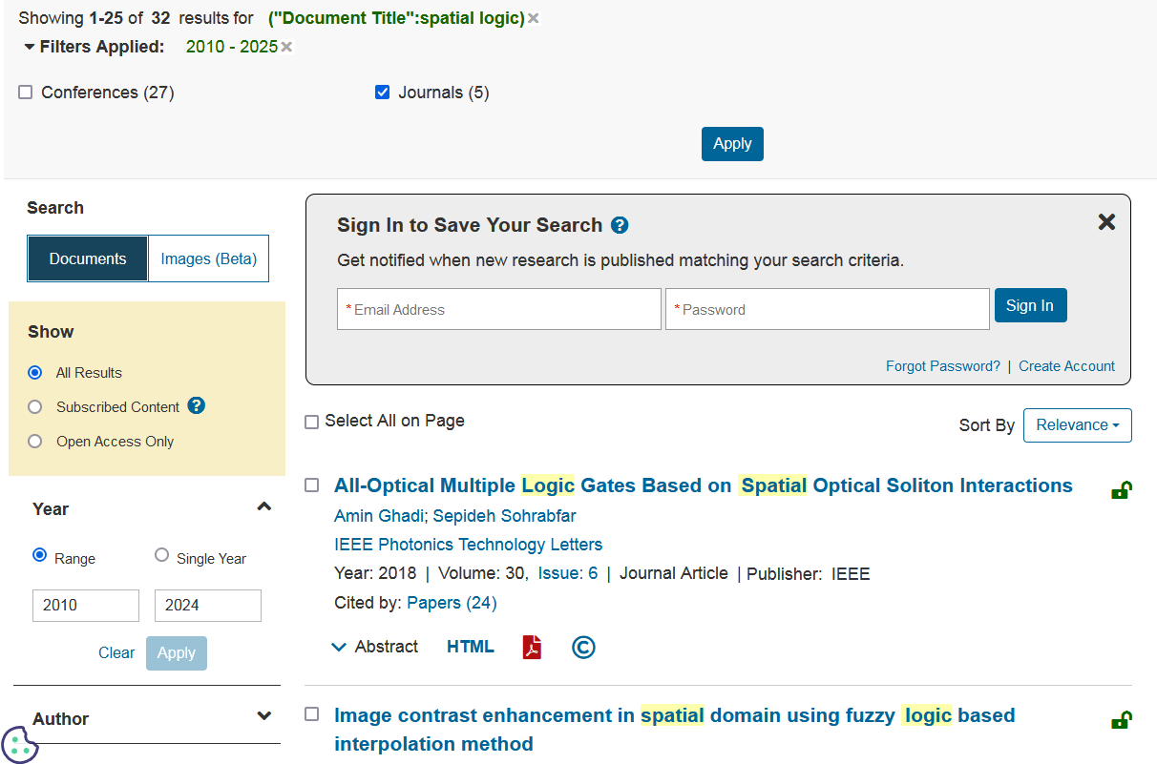

Slide 13
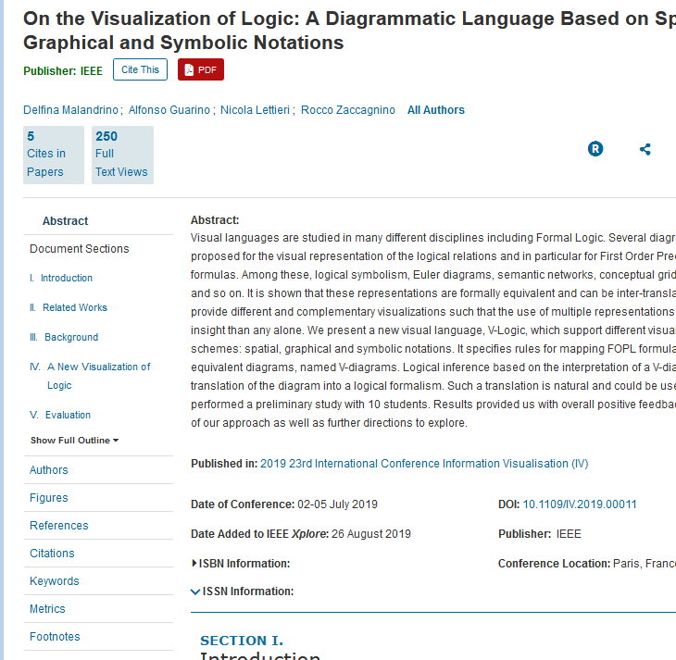
Look at Abstract, References, Citations, DOI

Slide 14
3. Using Papers to find More Papers
Use "Citations" / "Cited By" to search for papers that use this paper
i.e. this will find more recent papers
Use "References" to find useful older work, including survey papers and books
Combine this with reading the "Related Work" section of the paper
Use "Keywords" / "Index Terms" to add to your keyword collection to make future searches more powerful.
Use "Authors" to find newer papers by the same people, on the same topic.

Slide 15
Using the ACM paper
Paper: "Constraint logic programming over sets of spatial objects", Jesús M. Almendros-Jiménez
References include:
Krzysztof Apt, Principles of Constraint Programming, Cambridge University Press, New York, NY, 2003
Cited by includes:
Mehul Bhatt , Jae Hee Lee , Carl Schultz, CLP(QS): a declarative spatial reasoning framework, Proceedings of the 10th international conference on Spatial information theory, September 12-16, 2011, Belfast, ME

Slide 16
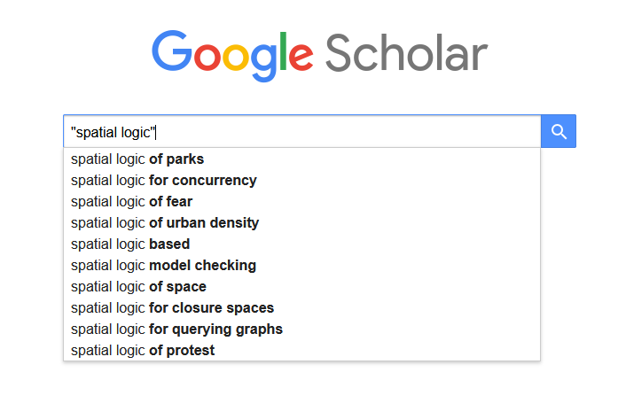
4. Google Scholar
https://scholar.google.co.th/

Slide 17
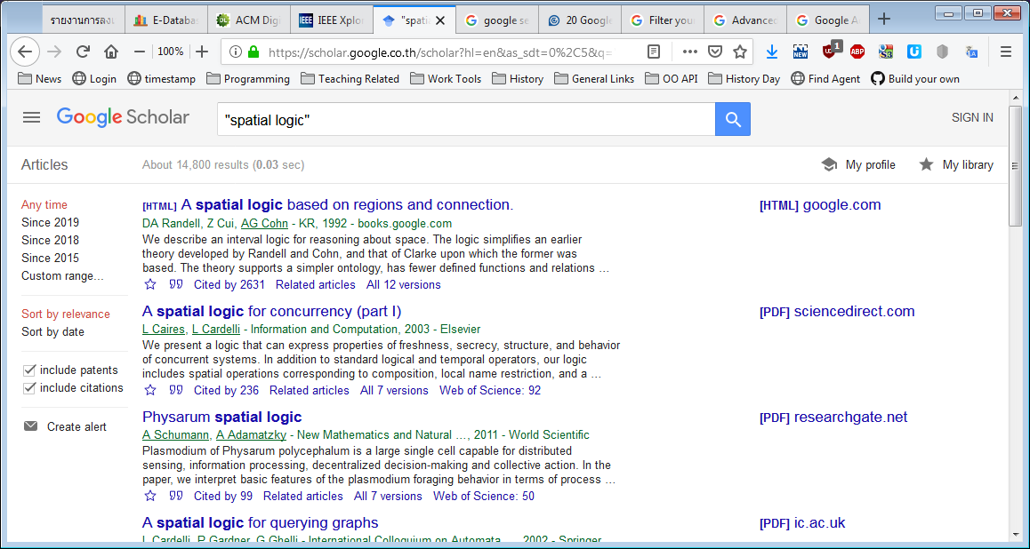

Slide 18
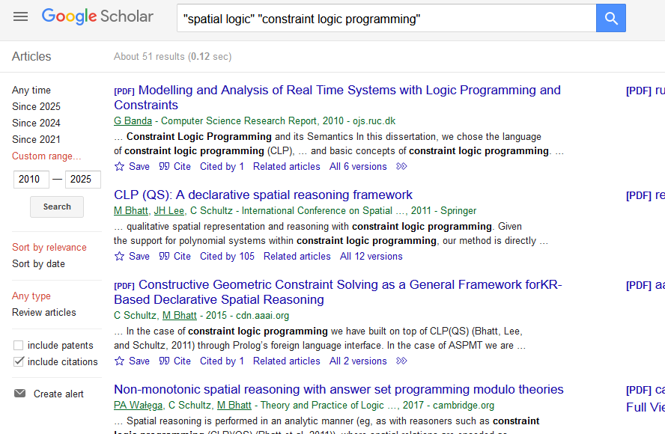
14,000 hits reduced to 51

Slide 19
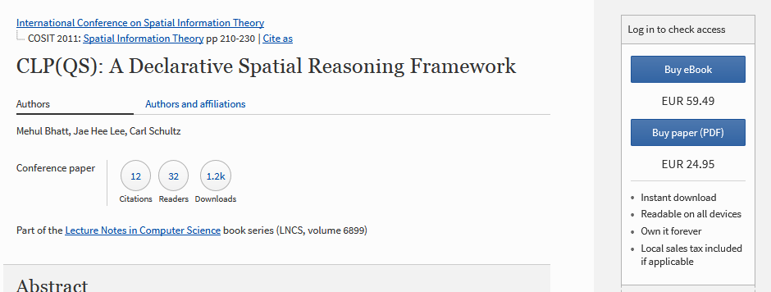
Click on Top Paper
Not free

Slide 20
Google Search Tips
https://support.google.com/websearch/answer/2466433
Use the most specialized Google search tool (e.g. images, news)
Use quotes, e.g. "spatial logic"
Use a hyphen to exclude words, e.g. -temporal
Search specific sites, e.g. site:psu.ac.th
Multiple terms are ANDed
"spatial logic" "constraint logic programming"
Or use OR:
"spatial logic" OR "geometric logic"
Google Advanced Search:
https://www.google.com/advanced_search

Slide 21
Other Uses of Google
Find a paper by searching for the paper's title in quotes:
"CLP(QS): A Declarative Spatial Reasoning Framework"
Search for the author's web site (which may have a copy of the paper) by searching for the name in quotes (and maybe the name of the university/afilliation):
"Mehul Bhatt" Bremen

Slide 22
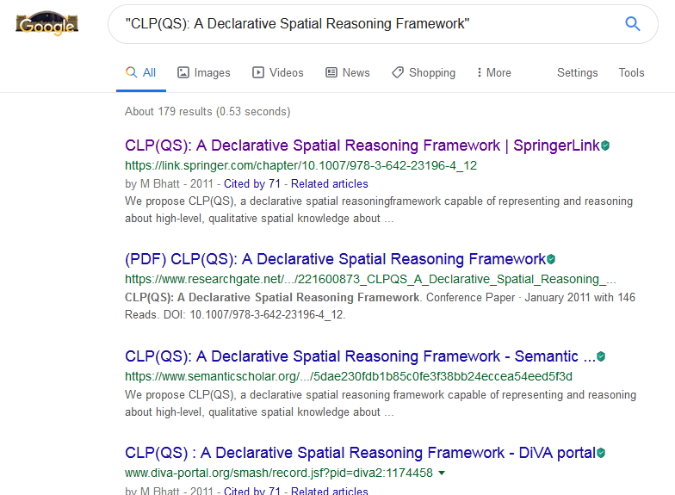
Search for the Paper Title
Not free
Free

Slide 23
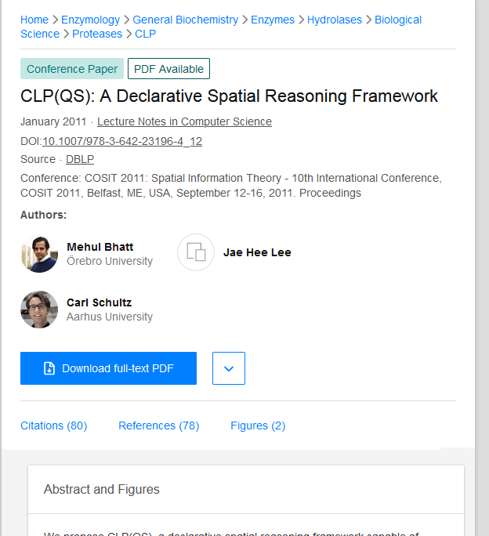
Look at Abstract, References, Citations, DOI

Slide 24
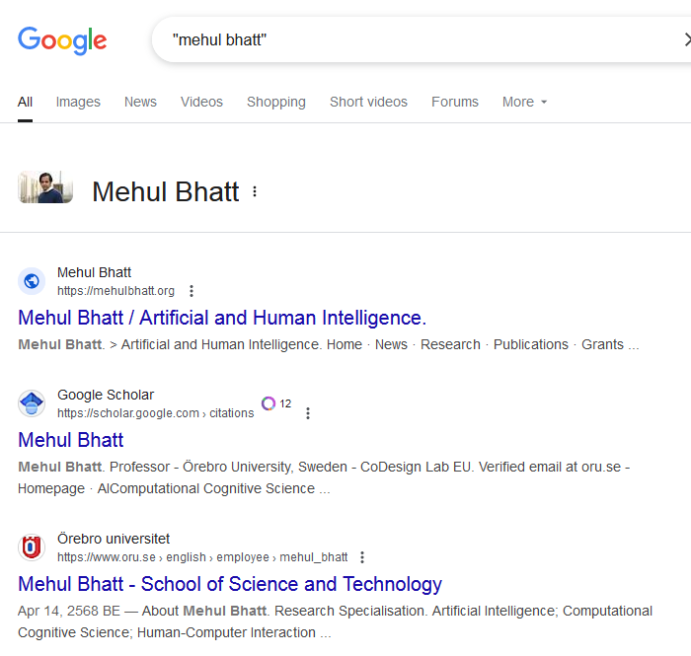
Search for Author's Name
Look for
publications

Slide 25
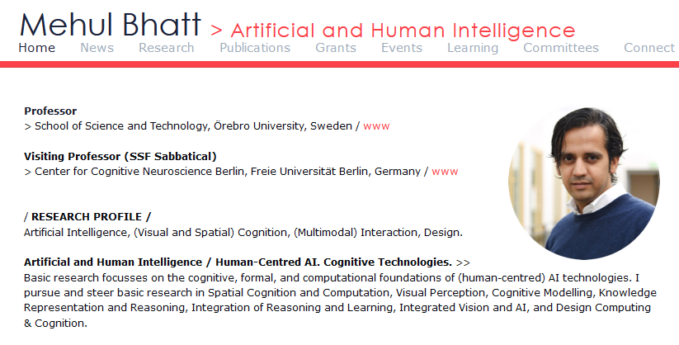
Click here

Slide 26
5. Finding Surveys/Overviews
You can restrict the ACM search to the journal "ACM Computing Surveys", plus a general keyword
OR add "survey", "overview", "review", or "tutorial" to your keywords
these are very general words, so make sure the other keywords are precise
e.g. "constraint logic programming" "survey"

Slide 27
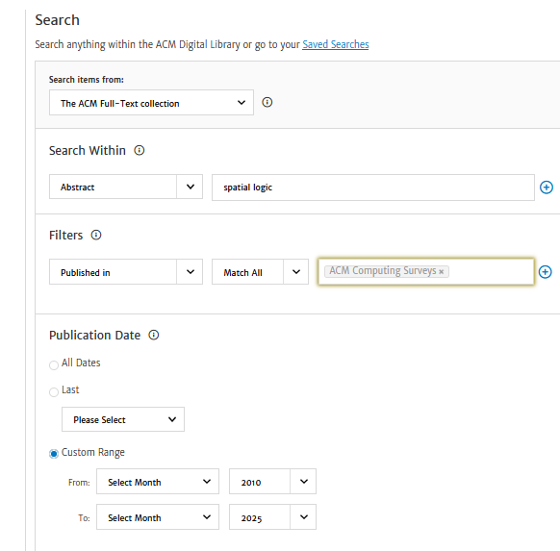
Looking in the abstract
without using quotes.

Slide 28
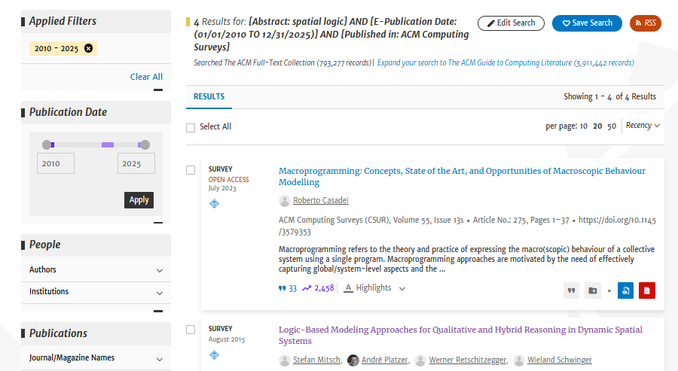

Slide 29
6. Finding Books
Look in "References" section of papers
Search for your keywords in Wikipedia
look at "References", "See Also" sections on the matching Wikipedia page
Search for your keywords on Amazon / Goodreads
look at star ratings, reviews
look for "related" books
look for other books by same author

Slide 30
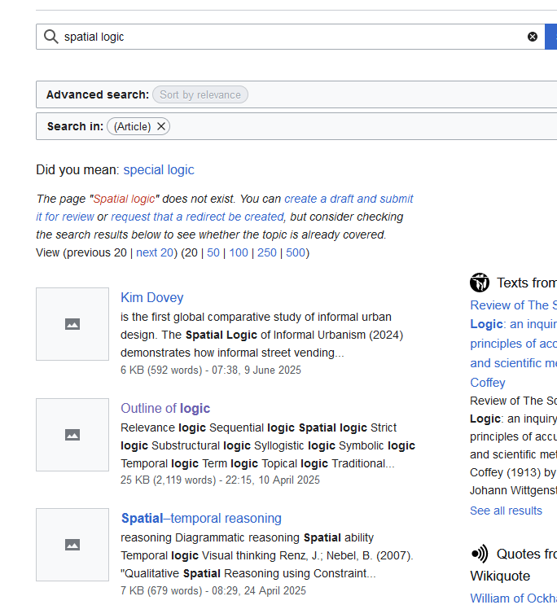
Wikipedia: spatial logic
No
exact
match

Slide 31
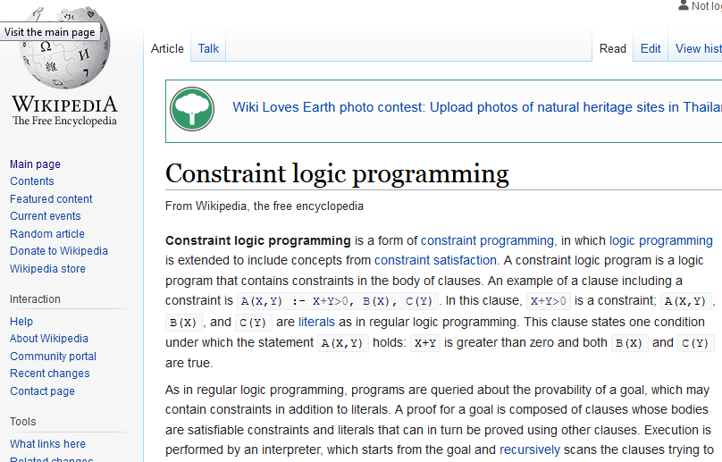
Wikipedia: CLP
Found
an exact
match

Slide 32
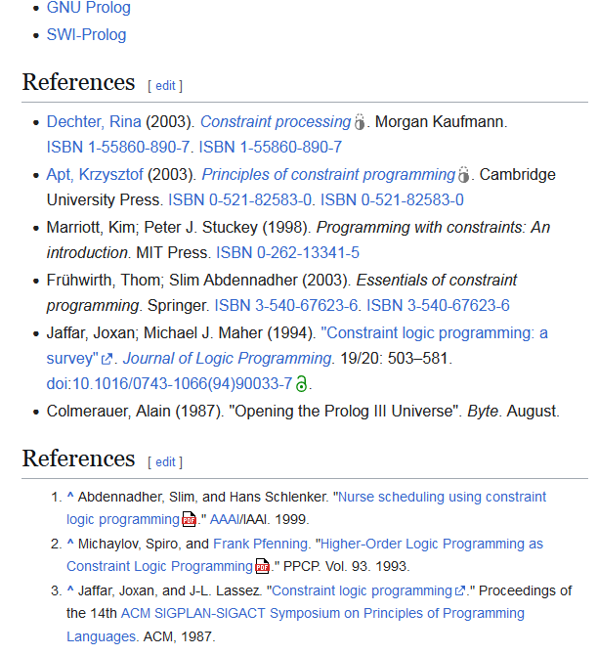
Scroll to End
systems that may be useful
and have tutorials.
Note: ECLiPSe for later

Slide 33
Look for the Most Recent Textbook
Apt, Krzysztof (2003). Principles of constraint programming. Cambridge University Press. ISBN 0-521-82583-0. ISBN 0-521-82583-0
Search for "Krzysztof Apt" (author)
Search for "Principles of constraint programming" (title)
Amazon allows you to search using the ISBN:
0521825830 // no dashes

Slide 34
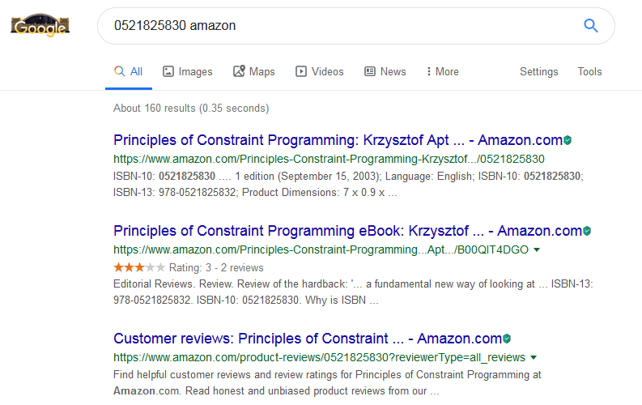

Slide 35
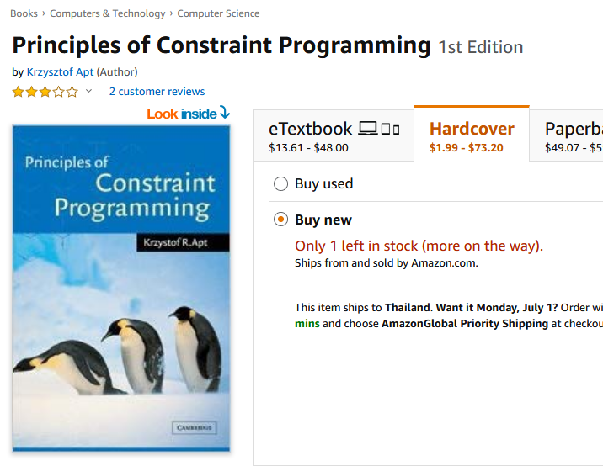
At Amazon
Look for other, newer books
by the author
Star rating
is only average
Look at contents and (maybe)
index and first chapter

Slide 36
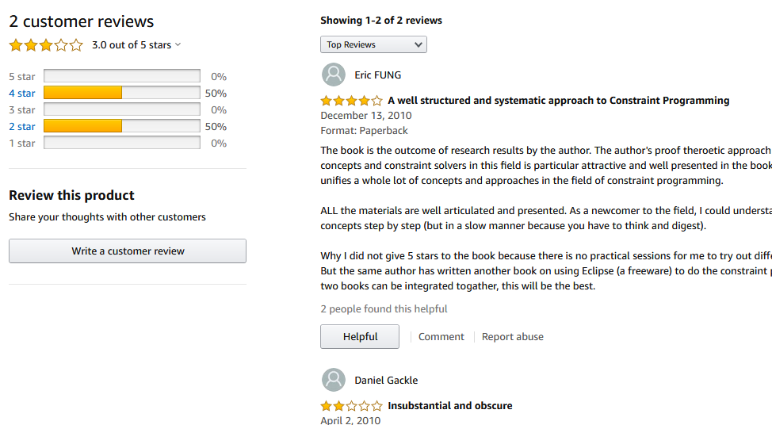
Look at Reviews

Slide 37
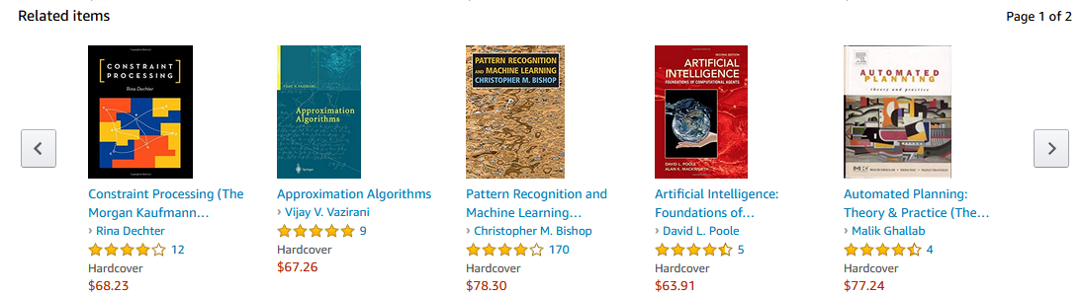
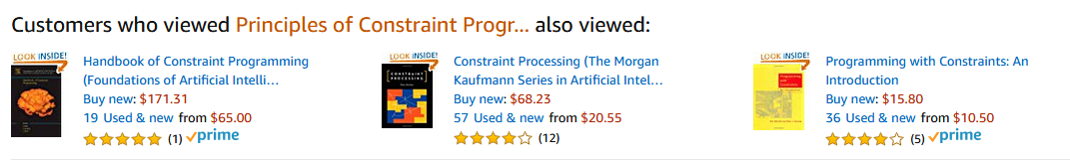
Look at Related Items

Slide 38
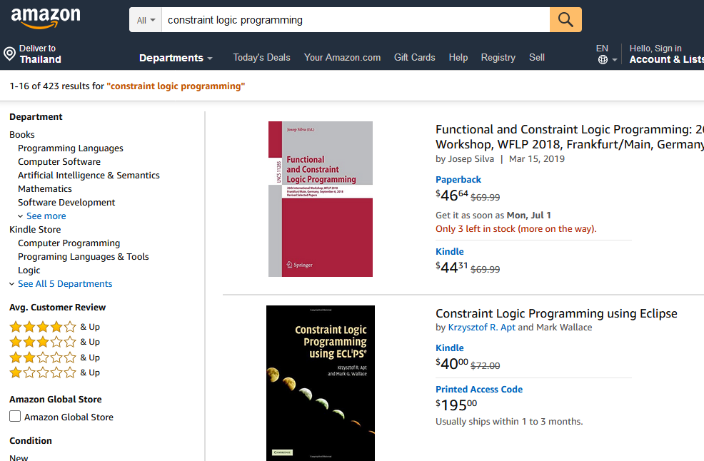
Search for keyword at Amazon
Eclipse Again

Slide 39
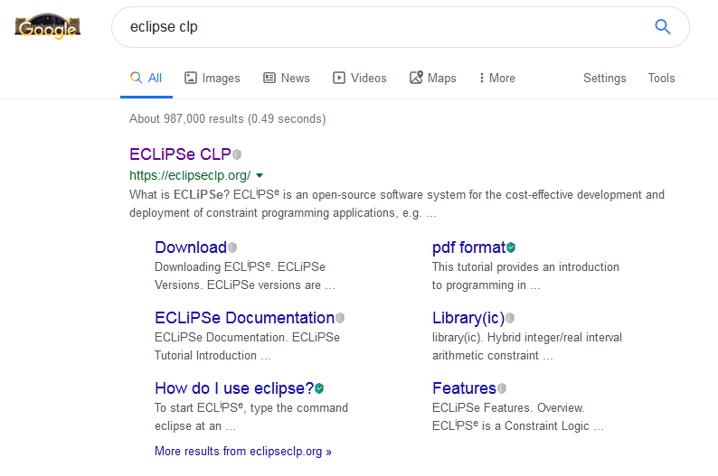
Find Eclipse Website

Slide 40
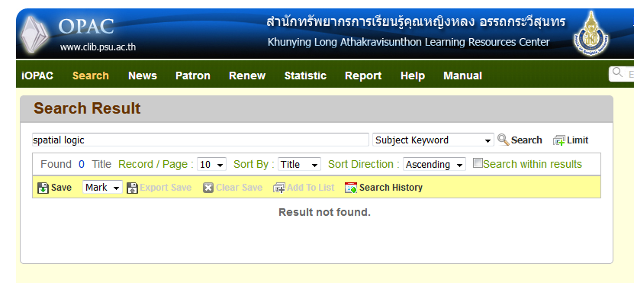
7. Other Book Sources
Usually not that useful
PSU Library:
http://opac.psu.ac.th/Search_Basic.aspx

Slide 41
CoE library
requires a manual search
actually contains a few books on "logic programming"
Ask your supervisor
Ask research group members
If the book is of general use, your supervisor may have research money to buy a copy for the group.

Slide 42
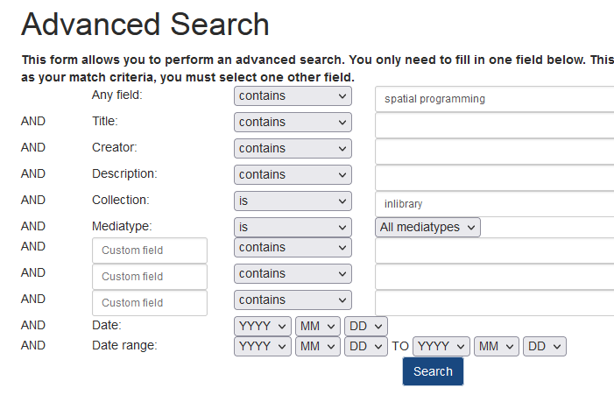
The Internet Archive
https://archive.org/advancedsearch.php

Slide 43
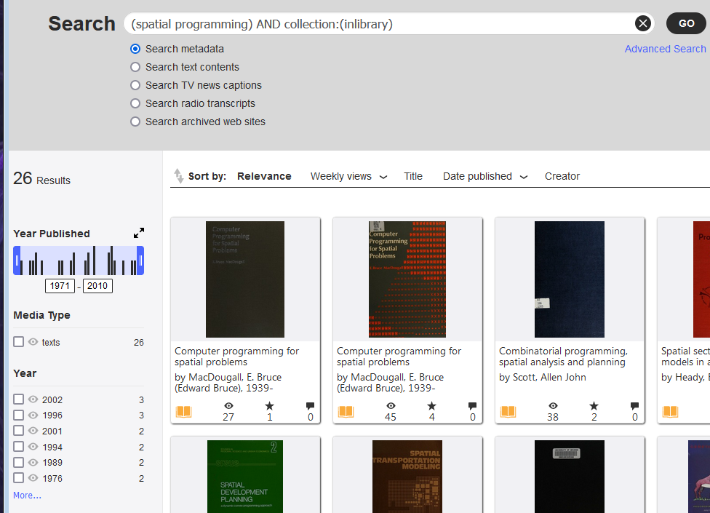

Slide 44
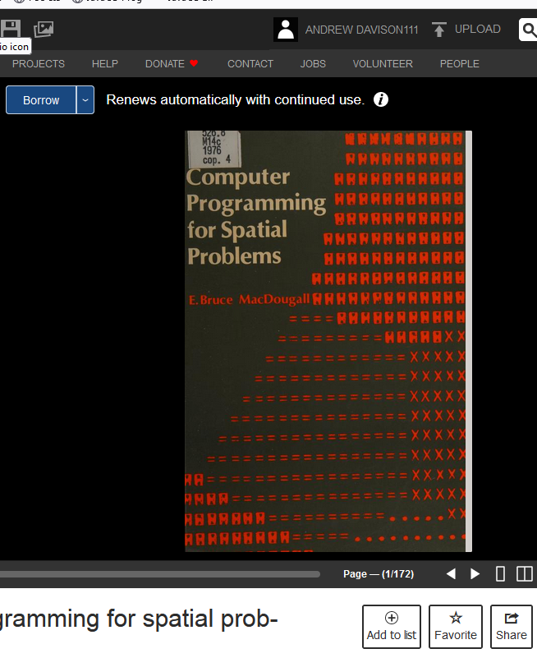
To borrow you must
create a FREE account.
It's an old book
that uses FORTRAN

Slide 45
8. Not all Papers are the Same
Best types of papers:
First: books and journal articles
Second: conference articles
Third: technical reports
Fourth: web sites
Do not include:
newsgroup postings, forum postings
popular magazines
e.g. no "PC Magazine"

Slide 46
The Paper-finding Report
This report should explain what searches you made online.
The aim is to find four things:
two papers about your thesis statement
a survey paper about your thesis statement
a book on the background to your thesis statement
Give details about the search queries that worked, did not work, and how and WHY you modified the searches.
Only briefly explain the papers/book. I am more interested in how you searched for them.

Slide 47
Do not hand in a report full of screenshots
but 1-2 small screenshots are okay
I want you to explain things in words. Make sure to explain WHY you searched in a certain way.
The report should be around 3-4 pages long.
It should have three subsections:
1 for the search for the two papers; 1 for the survey paper search; 1 for the book search
there should also be an introduction section, conclusion, and references
Due in week 4

