Slide 1

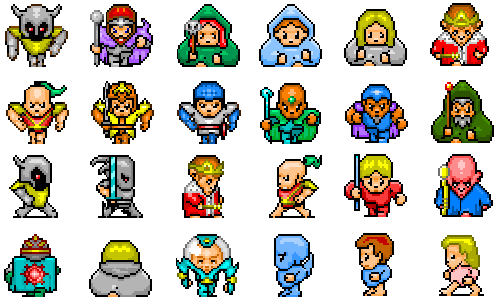
240-216 Explo. CoE Tech.
Semester 1, 2025-2026
4. Sprites

Slide 2
1. The Pygame sprite Module
http://www.pygame.org/docs/ref/sprite.html
a Sprite class for creating Sprite objects
we will create game sprites by inheriting Sprite
a Group class for grouping sprites together
lots of collision detection functions

Slide 3


2. The Sprite Class
Every sprite object contains an image and a rectangle (which contains its (x,y) position, width and height).
Sprite includes many functions for adding the sprite to groups.
Sprite object
image
(x,y)
rect
h
w
other
optional
data
a sprite is moved
by changing the
(x,y) value in rect

Slide 4

3. My BallSprite Class
BallSprite object
image
class BallSprite(pygame.sprite.Sprite):
def __init__(self, fnm):
super().__init__()
self.image = pygame.image.load(fnm).convert_alpha()
self.rect = self.image.get_rect()
self.rect.center = [scrWidth/2, scrHeight/2]
# start position of the ball
# in center of window
self.xStep, self.yStep = self.randomSteps()
# step size and direction along each axis
def randomSteps(self):
# create a random +/- STEP pair
x = STEP
if random.random() > 0.5:
x = -x
y = STEP
if random.random() > 0.5:
y = -y
return [x,y]
(x,y)
rect
h
w
xStep
yStep
xStep and yStep
will be used to move the sprite
scrWidth, scrHeight, STEP
are globals – see later

Slide 5
horizWalls, vertWalls
are globals – see later
def update(self):
if pygame.sprite.spritecollideany(self, horizWalls):
# change y-step direction at top and bottom sides
self.yStep = -self.yStep
if pygame.sprite.spritecollideany(self, vertWalls):
# change x-step direction at left and right sides
self.xStep = -self.xStep
self.rect.x += self.xStep # move the ball horizontally
self.rect.y += self.yStep # and vertically

Slide 6
4. My BlockSprite Class
The image is a black rectangle.
BlockSprite object
image
(x,y)
rect
height
class BlockSprite(pygame.sprite.Sprite):
def __init__(self, x, y, width, height):
super().__init__()
self.image = pygame.Surface((width, height))
self.image.fill(BLACK)
self.rect = self.image.get_rect()
self.rect.topleft = (x, y)
width

Slide 7
5. Groups of Sprites
Sprite objects can be grouped together inside a Group object:
# create wall sprites
top = BlockSprite(0, 0, scrWidth, WALL_SIZE)
bottom = BlockSprite(0, scrHeight-WALL_SIZE, scrWidth, WALL_SIZE)
left = BlockSprite(0, 0, WALL_SIZE, scrHeight)
right = BlockSprite(scrWidth-WALL_SIZE, 0, WALL_SIZE, scrHeight)
horizWalls = pygame.sprite.Group(top, bottom)
vertWalls = pygame.sprite.Group(left, right)
The sprites in a group can be tested, updated and drawn using functions:
vertWalls.draw(screen) # draws both sprites (left, right)

Slide 8
Different ways of Grouping
The sprite module contains a few different ways to group sprites
beachBounce.py will use Group and OrderedUpdates
Group groups sprites in no order
OrderedUpdates groups sprites in order

Slide 9


6. Types of Collision Detection
Using rectangles
often too big, but fast to test
Using circles
how big should the circles be?
Using the images' non-transparent pixels
slow but most accurate

Slide 10

All three approaches are in the sprite module:
pygame.sprite.collide_rect(sprite1, sprite2)
uses self.rect data in the Sprite objects
pygame.sprite.collide_circle(sprite1, sprite2)
requires self.radius data in the Sprite objects
pygame.sprite.collide_mask(sprite1, sprite2)
requires self.mask data in the Sprite objects
a mask is a black and white version of the sprite that shows its outline
image
mask

Slide 11
Collision Detection with Groups
spritecollideany(sprite, group)
Returns True if sprite has collided with any sprite in the group
spritecollide(sprite, group, kill)
Returns a list of all sprites in group that collide with sprite
If kill is True, a collision causes sprite to be deleted
groupcollide(group1, group2, kill1, kill2)
Returns list of all sprites in group1 that collide with group2

Slide 12
See BallSprite.update()
def update(self):
if pygame.sprite.spritecollideany(self, horizWalls):
# change y-step direction at top and bottom sides
self.yStep = -self.yStep
if pygame.sprite.spritecollideany(self, vertWalls):
# change x-step direction at left and right sides
self.xStep = -self.xStep
self.rect.x += self.xStep # move ball horizontally
self.rect.y += self.yStep # and vertically

Slide 13
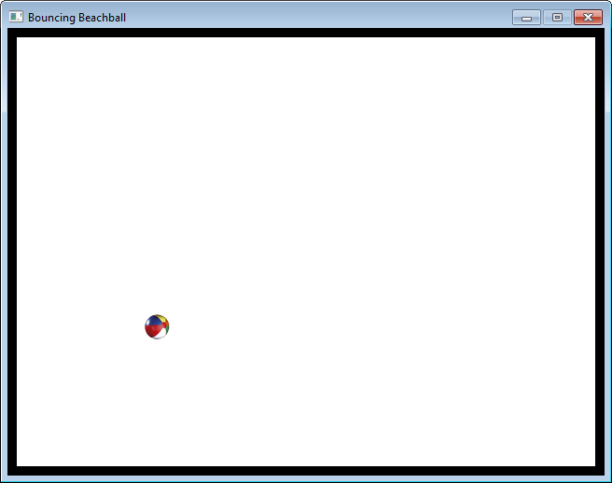
7. beachSprites.py
The same bouncing ball example as before, but coded using sprites.
note the black "walls" around the sides of the window

Slide 14
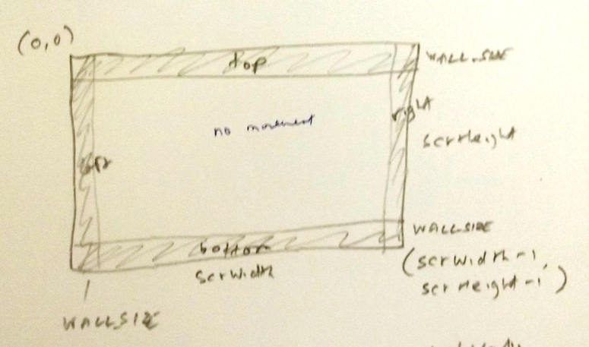
Design

Slide 15
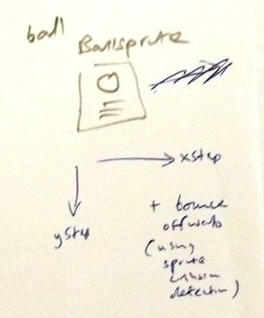

Slide 16
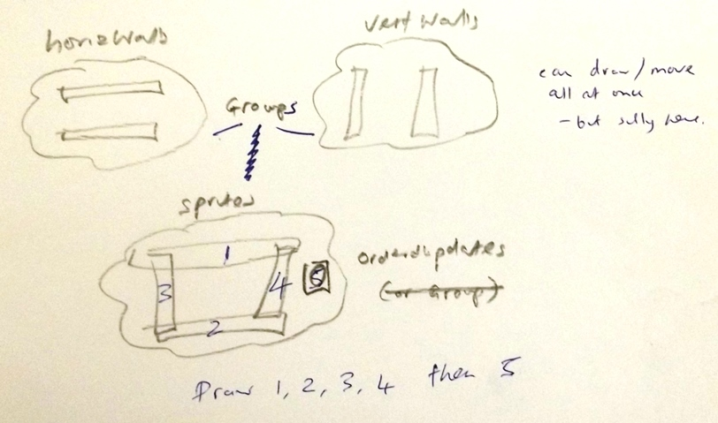

Slide 17
Code
BLACK = ( 0, 0, 0)
WHITE = ( 255, 255, 255)
WALL_SIZE = 10
STEP = 10
class BlockSprite(pygame.sprite.Sprite):
# see slide 9
class BallSprite(pygame.sprite.Sprite):
# see slides 7 - 8

Slide 18
# ---------- main -------------
pygame.init()
screen = pygame.display.set_mode([640,480])
screen.fill(WHITE)
pygame.display.set_caption("Bouncing Beachball")
scrWidth, scrHeight = screen.get_size()
# create wall sprites
top = BlockSprite(0, 0, scrWidth, WALL_SIZE)
bottom = BlockSprite(0, scrHeight-WALL_SIZE, scrWidth, WALL_SIZE)
left = BlockSprite(0, 0, WALL_SIZE, scrHeight)
right = BlockSprite(scrWidth-WALL_SIZE, 0, WALL_SIZE, scrHeight)
horizWalls = pygame.sprite.Group(top, bottom)
vertWalls = pygame.sprite.Group(left, right)
ball = BallSprite('smallBall.png')
# sprites = pygame.sprite.Group(top, bottom, left, right, ball)
sprites = pygame.sprite.OrderedUpdates(top, bottom,
left, right, ball)
clock = pygame.time.Clock()

Slide 19
running = True
while running:
clock.tick(30)
# handle events
for event in pygame.event.get():
if event.type == QUIT:
running = False
# update game state
ball.update()
# redraw
screen.fill(WHITE)
sprites.draw(screen) # draws all 5 sprites
pygame.display.update()
pygame.quit()
Here is the benefit of using Sprite and Group – the game loop becomes very simple.

