Slide 1


240-216 Explo. CoE Tech.
Semester 1, 2025-2026
2. Animation

Slide 2

1. Animation Loop for a Ball
# setup Pygame window as on last slide
# load ball as image
# initialize ball's (x,y) position
# initialize ball's step (xStep, yStep) done in each loop
clock = pygame.time.Clock()
running = True
while running: # game loop
clock.tick(30)
# handle events
for event in pygame.event.get():
if event.type == QUIT:
running = False
# update game
x += xStep; y += yStep
# redraw game
# draw image at (x,y)
pygame.display.update()
pygame.quit()
(x, y)
xStep
yStep

Slide 3
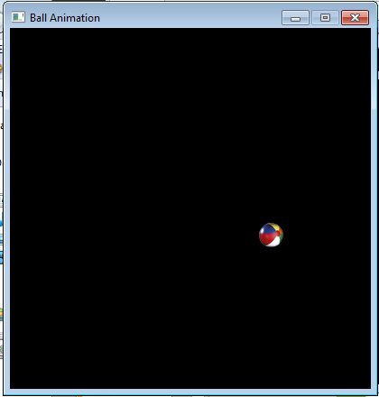
2. Ball Animation
The ball starts at a random position along the top, and then drops downwards forever.
the ball's position is printed in the command prompt window

Slide 4
animBall-1.py
pygame.init()
screen = pygame.display.set_mode((400, 400))
pygame.display.set_caption("Ball Animation")
# load ball as image
ballIm = pygame.image.load('smallBall.png').convert_alpha()
# store dimensions for later
scrWidth, scrHeight = screen.get_size()
imWidth, imHeight = ballIm.get_size()
# initialize ball's position
x = random.randrange(0, scrWidth-1 - imWidth)
y = 0
screen.blit(ballIm, [x,y])
# initialize ball's step done in each loop
xStep = 0; yStep = 8
clock = pygame.time.Clock()
:

Slide 5
running = True
while running:
clock.tick(30)
# handle events
for event in pygame.event.get():
if event.type == QUIT:
running = False
# update game state
# Move ball down
y += yStep
print("Pos: ", x, y)
# redraw
screen.fill(BLACK)
screen.blit(ballIm, [x,y])
pygame.display.update()
pygame.quit()

Slide 6
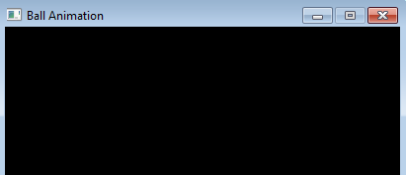
Setting the Ball's Start Position
x = random.randrange(0, scrWidth-1 - imWidth)
y = 0
screen.blit(ballIm, [x,y])
imWidth
scrWidth
(0, 0)
( scrWidth-1,
0)
imWidth
(x, y)
range of x for the ball

Slide 7
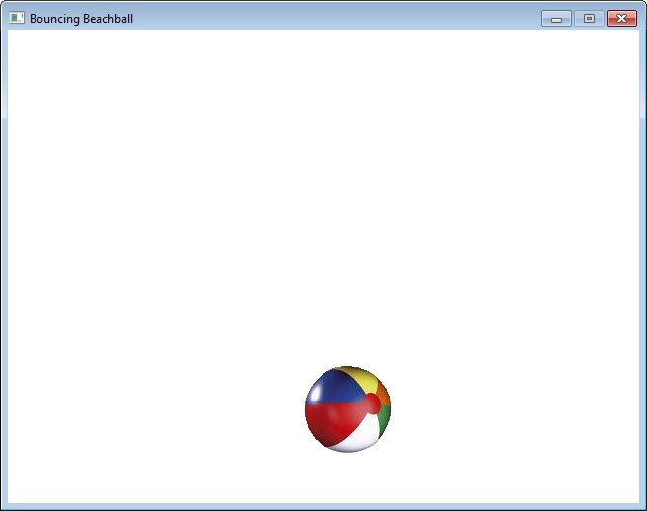
2. Bouncing Ball
Have a single ball bounce off the 'walls' of the screen.

Slide 8
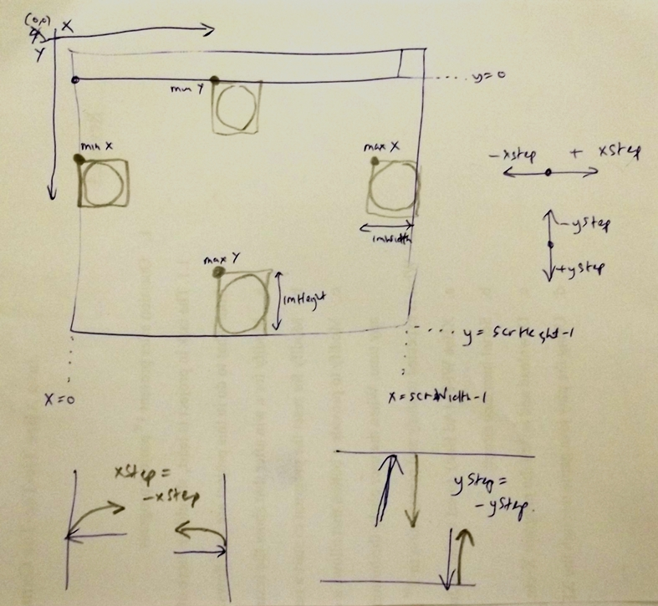
Bouncing Ball Coords

Slide 9
3. beachBounce.py
pygame.init()
screen = pygame.display.set_mode([640,480])
screen.fill(WHITE)
pygame.display.set_caption("Bouncing Beachball")
ballIm = pygame.image.load('ball.png').convert_alpha()
# store dimensions for later
scrWidth, scrHeight = screen.get_size()
imWidth, imHeight = ballIm.get_size()
# start position of the ball
x = 50; y = 50
# step size and direction along each axis
xStep = 10; yStep = 10
clock = pygame.time.Clock()
:

Slide 10
running = True
while running:
clock.tick(30)
# handle events
for event in pygame.event.get():
if event.type == QUIT:
running = False
# update game state
# change x-step direction at left and right sides
if (x <= 0) or (x >= scrWidth - 1 - imWidth):
xStep = -xStep
# change y-step direction at top and bottom sides
if (y <= 0) or (y >= scrHeight -1 - imHeight):
yStep = -yStep
x += xStep # move the ball horizontally
y += yStep # and vertically
# redraw
screen.fill(WHITE)
screen.blit(ballIm, [x, y])
pygame.display.update()
pygame.quit()

Slide 11
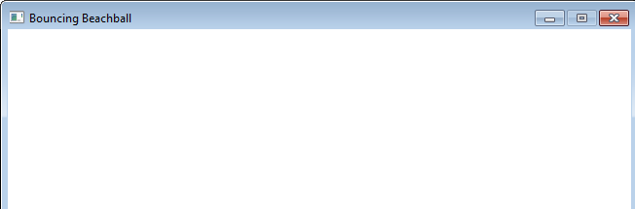
x- Direction Change
The x- direction depends on if xStep is positive or negative.
the direction is changed by swapping +/-
xStep = -xStep
It should change when the ball tries to leaves the screen on the left side or on the right side.
(0, y)
(scrWidth-1, y)
(x, y)
(x, y)
x >= scrWidth-1 -
imWidth
x <= 0
☒
☒

Slide 12
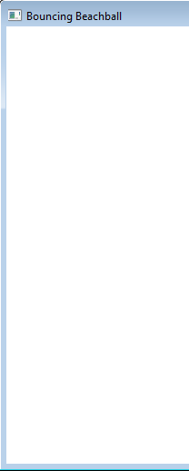
y- Direction Change
The y- direction depends on if yStep is positive or negative.
the direction is changed by swapping +/-
yStep = -yStep
It should change when the ball tries to leaves the screen on the top or bottom.
(x,0)
y <= 0
(x, y)
☒
(x, y)
y >= scrHeight-1 -
imHeight
(scrHeight-1,0)
☒

