Slide 1

240-216 Explo. CoE Tech.
Semester 1, 2025-2026
1. Pygame Intro
Who I am: Andrew Davison R212 ad@coe.psu.ac.th

Slide 2
1. What is Pygame?
A set of modules for writing games
home page: http://pygame.org/
documentation: http://pygame.org/docs/
pyGame helps you with:
2D graphics (and 3D)
images, sounds, music, (video)
user input (events) from keyboard, mouse, gamepad
support for game things
sprites, collision detection, etc.

Slide 3
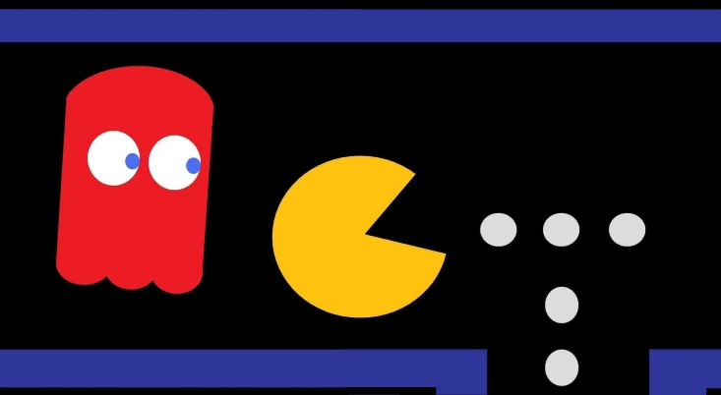
Game Things in Pygame
sprites: moving game characters / objects
collision detection: which sprites are touching?
event: a user action (e.g. mouse or key press), or computer change (e.g. clock tick)
game loop:
read new events
update sprites and game state
redraw game

Slide 4
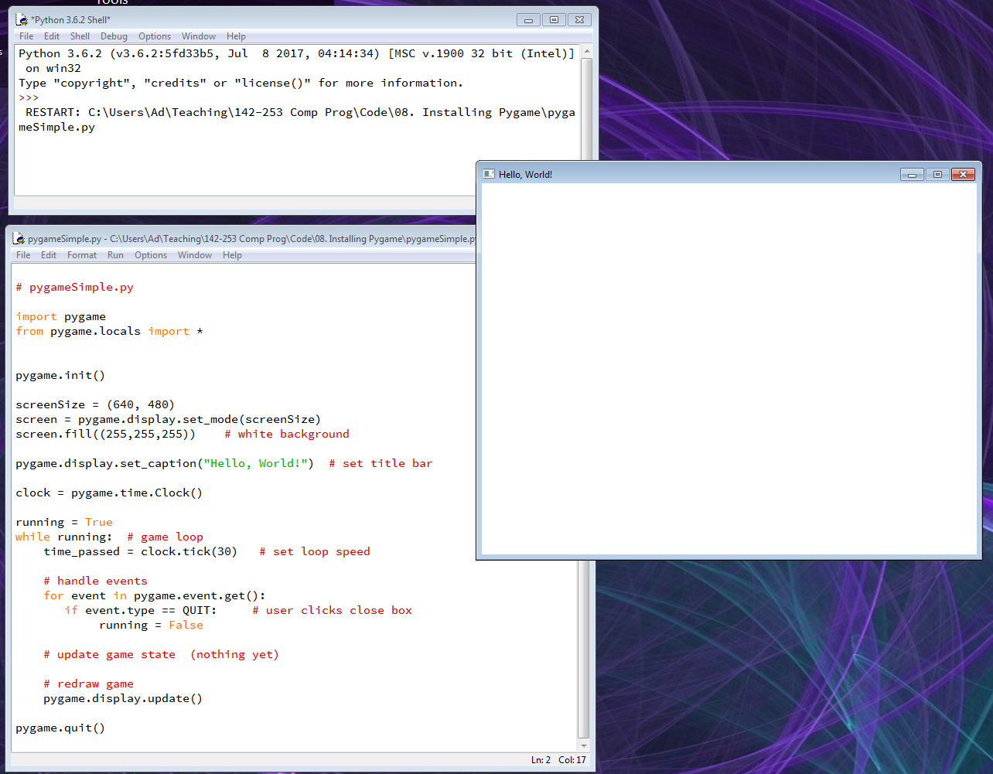
2. Run pygameSimple.py
A pygame
game window

Slide 5
3. pygameSimple.py Explained
EVERY game program adds to this one. Make sure you understand it.
import pygame
from pygame.locals import *
pygame.init()
screenSize = (640, 480)
screen = pygame.display.set_mode(screenSize)
screen.fill((255,255,255)) # white background
pygame.display.set_caption("Hello, World!") # set title bar
clock = pygame.time.Clock()
:
:

Slide 6
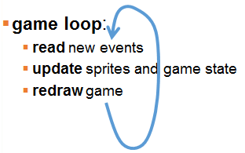
running = True
while running: # game loop
clock.tick(30) # set loop speed
# handle events
for event in pygame.event.get():
if event.type == QUIT: #user clicks close box
running = False
# update game state (nothing yet)
# redraw game
pygame.display.update()
pygame.quit()

Slide 7
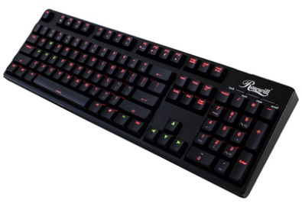

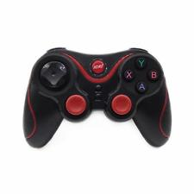



4. Events
An event is a user action (e.g. mouse or key press), or a computer change (e.g. clock tick).
a bit like "messages" sent to Pygame from the user and computer
handle events
update game state
redraw game

Slide 8
The "quit" event
for event in pygame.event.get():
if event.type == QUIT: # user clicks close box
running = False
When running is false, the game loop ends, and Pygame quits.

Slide 9
Quit by Also Typing <Esc>
for event in pygame.event.get():
if event.type == QUIT: # user clicks close box
running = False
if (event.type == KEYUP and event.key == K_ESCAPE):
running = False
# user clicks <ESC> key

Slide 10
Keyboard Events
KEYDOWN is sent when a key is pressed
KEYUP is sent when a key is released
Each key has a constant that begins with K_:
alphabet keys are K_a through K_z
Others: K_SPACE, K_RETURN, K_ESCAPE, etc.
For a complete list see
http://www.pygame.org/docs/ref/key.html

