Slide 1
240-216 Explo. CoE Tech.
Semester 1, 2025-2026
Prolog
Please ask
questions
Who I am:
Andrew Davison
Room 212
ad@coe.psu.ac.th

Slide 2

Programming Language Paradigms (kinds)
Imperative
(state/memory-based)
Declarative
(math-based)
Procedural
Object-based
Parallelism
Logic
Functional
Database
(relational)
e.g. C,
Basic,
Python
e.g. C++,
Java, C#
e.g. Erlang,
Linda, Oz,
Java, PVM
e.g. Prolog,
Mercury
e.g. Lisp
Scheme,
Racket
e.g. SQL

Slide 3
1. Why Learn Prolog?
Very popular in Artificial Intelligence (AI)
Unique features include:
  unification (more powerful than assignment)
  backtracking (builtin search)
  close links to predicate logic
  An engineer must know many tools
  Prolog is very different from C, Java
  Prolog is a logic programming language

Slide 4
C Program Compared to Prolog
void foo(...)
{ ... }
int bar(...)
{ ... }
void main()
{ ... }
Prolog predicate
-- made up of facts and rules
Prolog predicate
-- more facts and rules
?- Prolog query.
Lots of data types: int, char, struct, pointer, ...
Data types: term, list

Slide 5
2. Example (parents.pro)
download this file from the lab website
% parentOf/2 predicate (made of 6 facts, 0 rules)
parentOf(kim,holly). % e.g. kim is the parent of holly
parentOf(margaret,kim).
parentOf(margaret,kent).
parentOf(esther,margaret).
parentOf(herbert,margaret).
parentOf(herbert,jean).
% livesAt/3 predicate (made of 8 facts, 0 rules)
livesAt(margaret, 9, "Bar Lane").
livesAt(kim, 37, "Foo Street").
livesAt(holly, 37, "Foo Street").
livesAt(esther, 9, "Bar Lane").
livesAt(herbert, 23, "PSU Village").
livesAt(kent, 9, "Bar Lane").
livesAt(bill, 23, "PSU Village").
livesAt(john, 9, "Bar Lane").
?- parentOf(margaret, kent).
terms are
the data
inside facts
(and rules)
a query

Slide 6
Kinds of Terms
A term can be simple:
  a number, e.g. 321, 4.5
  a word, e.g. kim, holly
  a string, e.g., "Foo Lane", 'hello andrew'
  a variable, e.g. X, Kim, Foo, _
A term can be compound:
  a bit like a struct or record

Slide 7

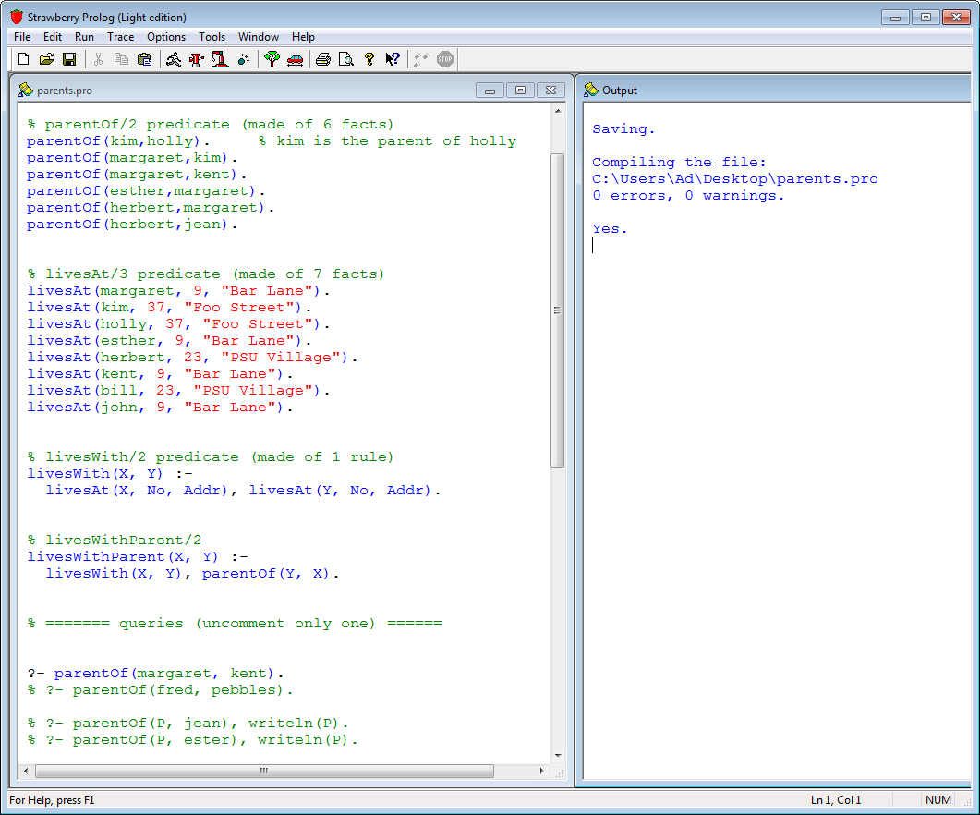
3. Executing Prolog
more details in section 11
result
My parents.pro file;
download from website
a query
only 1 query
must be
uncommented

Slide 8
Use a query to execute Prolog code.
  a query starts with "?-"
In SB Prolog:
  use F5 (or Run|Run) to execute the query
  the output appears in the Output window

Slide 9
3.1. Simple Queries
  ?- parentOf(margaret, kent).
  Yes // printed in the Output window
  ?- parentOf(fred, pebbles).
  No

Slide 10
Executing a Query
Match the query against a fact.
Prolog tries each fact in top-down order, until one matches, or it runs out of facts.
?- parentOf(margaret, kent)
parentOf(margaret, kent).

Slide 11
3.2. Queries With Variables
  ?- parentOf(P, jean), writeln(P).
  herbert
  Yes
  ?- parentOf(P, esther), writeln(P).
  No
  ?- livesAt(margaret, No, Addr),
  writeln(No), writeln(Addr).
the ',' means "and"

Slide 12
Executing a Query
Match query (e.g. ?- parentOf(P, jean))
against a fact
  also match (unify, bind) the variables
?- parentOf(P, jean)
P = herbert
parentOf(herbert, jean).

Slide 13
3.3. Conjunctions
the ',' means "and"
?- parentOf(margaret,X), parentOf(X,holly),
writeln(X).
kim
Yes
A conjunction is a series of queries.
Prolog works left to right, trying to match each query.

Slide 14
As Prolog executes the queries in a conjunction, it remembers variable matches (bindings).
  e.g. the first query sets X = kim
  this value for X is passed to the second query in the conjunction

Slide 15
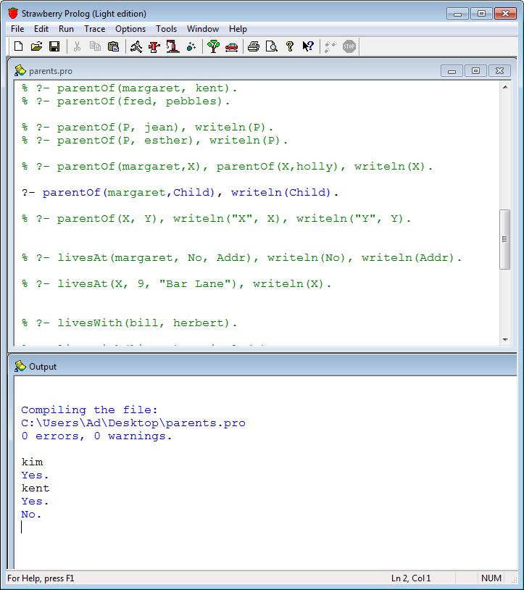
3.4. Multiple Solutions
?- parentOf(margaret,
Child), writeln(Child).
the user types
'F8' to make
SB Prolog look
for another
answer

Slide 16
How Multiple Solns Work?
When a query matches a fact, Prolog remembers which fact was chosen
  called a choice point
If the user types 'F8', Prolog goes back to the choice point (backtracks) and tries to find a different match.

Slide 17
4. Rules
head
read this as "if"
livesWith(X, Y) :-
livesAt(X, No, Addr),
livesAt(Y, No, Addr).
body goals
1. Match query
(e.g. ?- livesWith(bill,herbert) )
against the head of a rule.
  match (unify) the variables
2. Create new query conjunction from the body goals.

Slide 18
Example
Download queries.pdf
from web site
?- livesWith(bill, herbert).
Yes.
?- livesWith(kim, X), writeln(X).
kim
Yes.
holly
Yes.
No.
why?
I pressed F8

Slide 19
5. Lists
List notation
Meaning
[]
an empty list
[andrew]
list with one element
[1,2,"hello"]
3-element list
[1,name(X,Y)]
2-element list

Slide 20
Examples
?- X = [1, 2, 3].
X = [1, 2, 3]
?- [X, Y, Z] = [1, 2, 3].
X = 1
Y = 2
Z = 3
From now on,
I'm going to
leave out
calls to writeln().

Slide 21
List Notation With Tail
?- [1,2|X] = [1,2,3,4,5].
X = [3, 4, 5]
[1,2|X] matches with a list that starts with 1,2 and binds X to the rest (tail) of the list.
Say "|" as "bar"

Slide 22
?- [X|Y] = [a, b, dc, st, fg].
X = a
Y = [b, dc, st, fg]

Slide 23
6. member/2
a builtin predicate
(but defined in 2 lines)
?- member(1, [2, 1,3]).
Yes.
?- member(j, [a,n,d,y]).
No.
?- member(X,[j,i,m]),writeln(X).
j
i // F8
m // F8
No // F8
member(X,L) succeeds if X is an element in the list L

Slide 24
7. length/2
a builtin predicate
(but defined in 2 lines)
?- length([a,b,c,d], L), writeln(L).
4
?- length([1,2,3], 4).
no
length(X,Y) succeeds if Y is the length of the list X.

Slide 25
8. Arithmetic with is
?- X is 1+2*3, writeln(X).
7
yes
The general format is:
  Variable is expression

Slide 26
9. The append/3 Predicate
a builtin predicate
append([], B, B).
append([Head|TailA], B, [Head|TailC]) :-
append(TailA, B, TailC).
1 fact, 1 rule
?- append([1,2],[3,4],Z), writeln(Z).
[1, 2, 3, 4]
Yes
append(X,Y,Z) means that
the X list 'stuck onto' the Y list == the Z list
Download queries.pdf
from web site

Slide 27
Other Uses of append/3
?- append(X,[3,4],[1,2,3,4]), writeln(X).
[1, 2]
Yes
append/3 can be called with variables in any of its argument positions.

Slide 28
Multiple Answers
?- append(X,Y,[1,2,3]).
X = []
Y = [1, 2, 3]
X = [1]
Y = [2, 3]
X = [1, 2]
Y = [3]
X = [1, 2, 3]
Y = []
No
By using F8

Slide 29
10. ; (OR)
?- (parentOf(kim, andrew) ;
parentOf(kim, holly)).
Yes
; succeeds when one of its goals succeeds (or both).

Slide 30
11. The not/1 Predicate
?- not( member(4,[1,2,3]) ).
Yes
?- not( member(1,[2,1,3]) ).
No
not(X) succeeds when the X goal fails.
Only use not/1 when its goal contains no variables.
  use not/1 as a yes/no test

Slide 31
12. The findall/3 Predicate
?- findall(Child,
parentOf(margaret, Child),
List).
List = [kent, kim]
findall(X, p(X), List) fills List with all the possible X values for the predicate p.

Slide 32
13. Using Strawberry Prolog
Download SB Prolog system from:
  https://coe.psu.ac.th/ad/teaching/
  LAB/Prolog/
The filename:
  StrawberryProlog_6_1.exe
Read the README.txt file

Slide 33
14. More Information
The Help menu in SB Prolog leads to:
  a tutorial
  a Prolog language guide
  examples

Slide 34
SB Prolog’s Web Site:
  http://www.dobrev.com/download.html
  v.6.1, and other versions
"Learn Prolog Now" (chs 1-6):
  http://www.learnprolognow.org/

