Slide 1

DIN61-222 Adv. Prog. (Java)
Semester 1, 2019-2020
16. Coding Style
Objectives
  to give guidelines for good Java coding
    I use these guidelines when marking projects, exams, etc.

Slide 2
Overview
1. Class-related Guidelines
2. Method-related Guidelines
3. Comment-related Guidelines
4. Layout-related Guidelines
5. More Information

Slide 3
1. Class-related Guidelines
1.1. Class Names
1.2. Object Names
1.3. Class Data
1.4. Static for Constants
1.5. Initializing Variables
1.6. Few Global Variables
1.7. Get and Set
1.8. Change Date Locally
1.9. Classes in Files

Slide 4
1.1. Class Names
A class name should be a noun
  the noun is often a "type-of-thing" word
    e.g. Plane, Car, Database
  long names may use several words
    e.g. JumboJet, Toyota, StudentDb
starts with
an uppercase
letter
each word
starts with
an uppercase
letter

Slide 5
1.2. Object Names
An object name should be a noun
  the noun is often the class word and a number
    e.g. plane1 car2, database5
  but try to use names with more meaning
    e.g. andrewDb, coeCar
starts with
a lowercase
letter

Slide 6
1.3. Class Data
Always define data as private
  e.g. private int x;
Avoid the keywords public, protected
Always include a visibility keyword
  e.g. int x; // bad: unclear

Slide 7
1.4. Static for Constants
Only use static to declare constants:
  private static final int MAXLEN = 120;
  always write static final
  always write the constant name in all uppercase
(Almost) never use static with methods
(except for main())

Slide 8
1.5. Initializing Variables
Global objects and variables should be initialised inside a method (often the constructor):
  private int counter; // global
  public Matrix()
  { counter = 0; }
It may be okay to initialise simple global variables (e.g. ints, doubles) globally:
  private int counter = 0; // global

Slide 9
1.6. Few Global Variables
Keep the number of global variables in a class to a minimum.
Bad Code:
  private int x; // global in class
  public void calc()
  { x = 0; bar(5);
  System.out.println(x); }
  private void bar(int y)
  { x = x + y; }
continued

Slide 10
The code is bad because a person who looks at a class will need to check every line of code to find out where x is used.
The use of globals often means that a student is not sure how to change variables or objects inside Java methods
continued

Slide 11
the global x
has gone
Good Code:
  public void calcX()
  { int x = 0;
  x = addX(x,5); // x gets new value
  System.out.println(“x= “ + x);
  }
  private int addX(int x, int y)
  { return x+y; }
x in addX() is a
copy of the x in
calcX()
continued

Slide 12
The code is better since x is local to the method that uses it, and is passed as a parameter to the other method
Note how x is updated by using return
  the following code will not change x in calcX():
  private void addX(int x, int y)
  { x = x+y; }
continued

Slide 13
Good code with objects:
  public void calcMatrix()
  { Matrix m1 = new Matrix();
  processMatrix(m1);
  m1.print();
  }
  private void processMatrix(Matrix m)
  { // change m (really m1) }
objects are
passed using
call-by-reference,
so do not need
to be returned

Slide 14
1.7. Get and Set
Private data which will be accessible outside an object should be given set and get methods
  public class BankAccount
  {
  private double balance;
  public double getBalance()
  { return balance; }
  public void setBalance(double b)
  { balance = b; }
  :
  }
continued

Slide 15
The method names must be set<Variable> and get<Variable>.
Only include a set method if the variable needs to be changed.

Slide 16
1.8. Change Data Locally
Methods that change data should be in the class where the data is declared.
Bad code:
  public static void main(String args[])
  {
  BankAccount myacc = new BankAccount();
  double bal = myacc.getBalance();
  bal = bal * 1.15; // calculate interest
  myacc.setBalance(bal);
  }
bal change is done in main()
continued

Slide 17
Good code (in BankAccount):
  public void applyInterest(double interest)
  { bal = bal * interest; }
  in main():
  BankAccount myacc = new BankAccount();
  myacc.applyInterest(1.15);
bal change done in
the BankAccount object

Slide 18
1.9. Classes in Files
If a class is longer than 2 pages of code then it should be saved in its own Java text file.
There should not be more than 3 classes in a single Java text file.
Having multiple files makes it easier to find code, and (re-)compilation is quicker.
continued

Slide 19
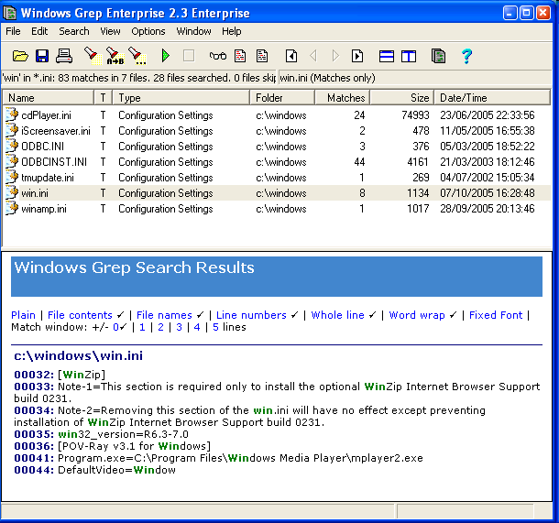
I use Windows Grep to search for text inside multiple files (and directories)
  free from http://www.wingrep.com

Slide 20
2. Method-related Guidelines
2.1. Method Names
2.2. Method Visibility
2.3. Method Length
2.4. Keep Anonymous Classes Small

Slide 21
2.1. Method Names
A method name should have the form verbNoun(…)
  e.g. makeGraph(), printFile()
Comments should not ‘echo’ the method name:
  private void makeGraph()
  // make the graph
  { ... }
useless since
it adds no new
information

Slide 22
2.2. Method Visibility
Methods should be private unless they will be called from outside the object.
In basic Java programming, you will not need to use the protected keyword.

Slide 23
2.3. Method Length
No method should be longer than 1 page of print-out
  e.g. large constructor methods are bad
No method should be smaller than 5 lines
  except for main() which should be as small as possible

Slide 24
2.4. Keep Anonymous Classes Small
An anonymous class inside a method should be less than 10 lines long.
A separate handler class is better style for large size listener code.

Slide 25
3. Comment-related Guidelines
3.1. Project Details
3.2. Project Overview
3.3. Class/Method Comments
3.4. Other People’s Code
3.5. Line Comments
3.6. Comment Style

Slide 26
3.1. Project Details
The top-level class is your program must start with project details:
  subject number, subject name
  project title
  student name, student number, student e-mail
  date when project finished (submitted)
continued

Slide 27
3.2. Project Overview
The top-level class is your program must include an overview of the project.
About 1/2 - 1 page of text, made up of:
  3-5 lines explaining the project;
  lines explaining how to compile and run the program;
  lines explaining program input and output

Slide 28
3.3. Class/Method Comments
Each class must start with 5-15 lines explaining what it does.
Each complex method should have 1-5 lines of comments at the beginning, saying what it does.

Slide 29
3.4. Other People’s Code
If you use (or modify) someone’s code, then you must include comments giving:
  the name of the original class/method;
  the author’s name;
  where the class/method is from (e.g. a URL);
  when you obtained (downloaded) the class/method;
  how you modified the class/method

Slide 30
3.5. Line Comments
Complex pieces of code inside a method should be commented with //
  // calculate the Von Krotsberg value
  double vk = x * (y-1) * (y-1);
Put the comment on a line above the code, or following the code on the same line.

Slide 31
3.6. Comment Style
Do not surround a comment with lots of rubbish. e.g.
  /******************************
  ******++++++++++++++++++*******
  ****** method getBalance() **
  *******************************/
  public int getBalance()
  { return balance; )
most (all) of this
can be deleted

Slide 32
4. Layout-related Guidelines
4.1. Avoid the “Tab” Key
4.2. Use Good Code Layout
4.3. Wrap-around Lines
4.4. Use a Java code Formatter (perhaps)
4.5. Don’t Waste Trees
4.6. Print-out Style

Slide 33
4.1. Avoid the “Tab” Key
Do not tab to indent code:
  private int foo()
  { if (x < 2) {
  if (y > 4) {
  if ( z != 5) {
  x = 1;
  :
  }
the code
disappears
off the screen
and print-out
Tab key
pressed
BAD
continued

Slide 34
Instead, use two spaces for a "tab":
  int foo()
  { if (x < 2) {
  if (y > 4) {
  if ( z != 5) {
  x = 1;
  :
  }
space key
pressed
GOOD
continued

Slide 35
4.2. Use Good Code Layout
Bad layout example:
  if (x<2) x++; else {y++; x--}
Look in text books for examples of good layout (or in my code examples).

Slide 36
4.3. Wrap-around Lines
A wrap-around line is a very long line of code that goes off the right edge of the screen and starts again on the next line. They are BAD.
These lines are hard to read, and when the code is printed, the wrap-around part may not appear.
Reformat the line to be several shorter lines.

Slide 37
4.4. Use a Java code Formatter
(perhaps)
I sometimes use a source code formatter called jacobe to help me format Java code.
A free version for Windows is available at:
  http://www.tiobe.com/jacobe.htm
But, changing its default output requires the editing of a large configuration file.
continued

Slide 38
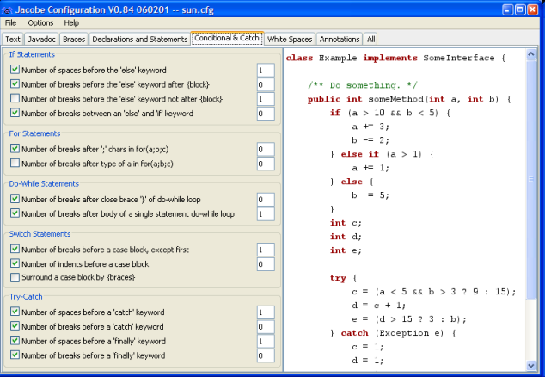

Slide 39
4.5. Don't Waste Trees
Print two pages of code onto a single sheet of A4
  this will half the amount of paper you use
FinePrint is a printer driver that will do this for most printers
  get it from http://www.fineprint.com
continued

Slide 40
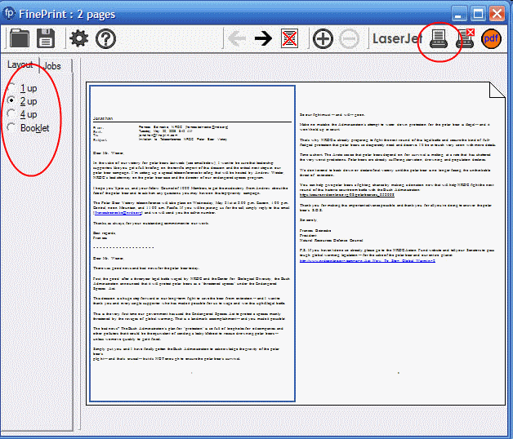

Slide 41
4.6. Print-out Style
In Windows, programs should be types using 10 point Courier New. e.g.:
  hello from Andrew
Print in pure black and white (i.e. no grey scales)
  colour is acceptable, but not required
continued

Slide 42
If your text editor allows it, include the date, time, and page numbers in the print-out.
I use the Notepad++ text editor, free from http://notepad-plus-plus.org/
  has a Thai language pack
continued

Slide 43
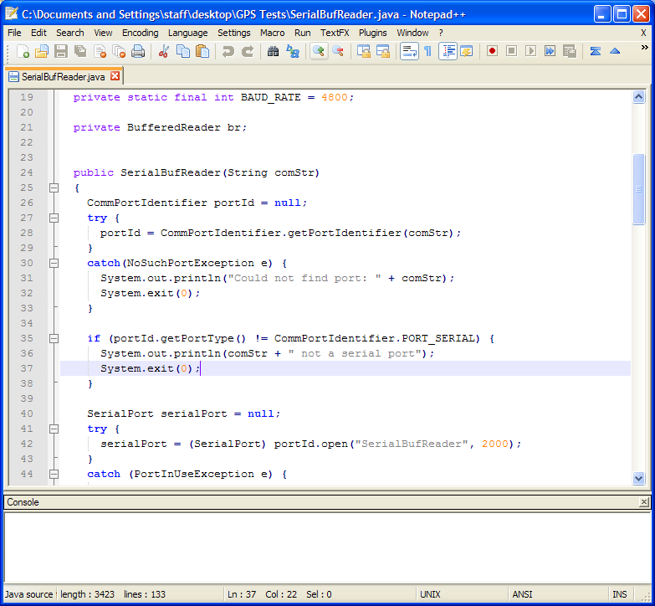
continued

Slide 44
Do not write on the print-out using a pen or pencil.
Do not put the print-out in a plastic envelope and/or binder.
Do staple the pages of the print-out together at the top-left hand corner.

Slide 45

5. More Information
A great book on coding style (for any language, not just Java):
  Code Complete
  Steve McConnell
  Microsoft Press, 2nd ed., 2004
  http://cc2e.com/

