Slide 1
DIN61-222 Adv. Prog. (Java)
Semester 1, 2019-2020
15. Exceptions
Objectives
examine Java's exception handling

Slide 2
1. Motivation
Lots of error checking in code makes the code harder to understand
more complex
more likely that the code will have errors!
e.g. Add error checking to the following C code:
int a[SIZE]; y = ... x = (1.0/a[y]) + (2.0/a[y+1]) + (3.0/a[y+2] );

Slide 3
Error Checking in C!
: if (y >= SIZE) printf("Array index %d too big\n", y); else if (a[y] == 0) printf("First denominator is 0\n"); if (y+1 >= SIZE) printf("Array index %d too big\n", y+1); else if (a[y+1] == 0) printf("Second denominator is 0\n"); if (y+2 >= SIZE) printf("Array index %d too big\n", y+2); else if (a[y+2] == 0) printf("Third denominator is 0\n"); :

Slide 4
A Modern Solution
Separate the error checking code from the main program code
the standard approach since the 1980’s
called exception handling

Slide 5
2. Exception Handling (in outline)
Format of code:
// statements;
try { // code...; } catch (Exception-type e) { // code for dealing with e exception }
// more-statements;
a try block
a catch block

Slide 6
Basic Approach
The programmer wraps the error-prone code inside a try block.
If an exception occurs anywhere in the try block, then the catch block is executed
the block can use information stored in the e object
continued

Slide 7
After the catch block has finished, execution continues in more-statements
execution does not return to the try block
If the try block finishes without an exception, then execution skips to more-statements after the catch block

Slide 8
Catching Math Errors
int x = 0; int y; : try { y = 1/x; : } catch (ArithmeticException e) { System.out.println(e); ...; y = 0; } System.out.println("y is " + y);
any Java code
is allowed here

Slide 9
3. Many Catch Blocks
There can be many catch blocks with a try block
the choice of which to use is based on matching the exception with the argument type of each catch block
after a catch block has finished, execution continues after all the catch blocks

Slide 10
Code Format
statements; try { code...; } catch (NullPointerException e) { code for dealing with a NULL pointer exception } catch (IOException e) { code for dealing with an IO exception } catch (MyOwnException e) { code for dealing with a user-defined exception } more-statements;
see section 7

Slide 11
Catching Many at Once
try {
// perform ops that can throw many exceptions
}
catch (NullPointerException | IOException e) {
// deal with two kinds of e
}
catch (MyOwnException e) {
// deal with it e
}

Slide 12
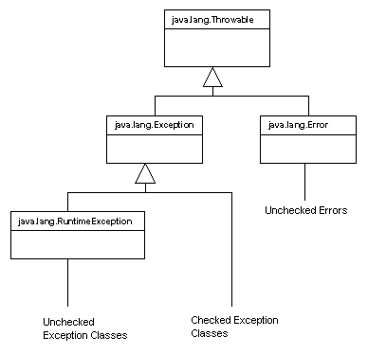
4. The Exception Class Hierarchy
for errors that
occur inside
the JVM, not
in your code

Slide 13
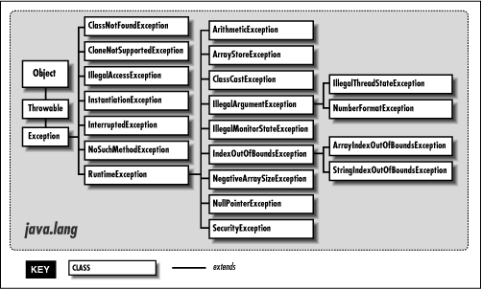
In More Detail (but not all!)

Slide 14
4.1. Two Exception Categories
1. Checked exceptions
subclasses of Exception
recovery should be possible for these types of errors
your code must include try-catch blocks for these or the compiler will reject your program
e.g. IOException
continued

Slide 15
2. Unchecked exceptions
subclasses of RuntimeException
exceptions of this type usually mean that your program should terminate
the compiler does not force you to include try-catch blocks for these kinds of exceptions
e.g. ArithmeticException

Slide 16
4.2. Text IO
Uses checked
exceptions
1
IO can generate lots of exceptions, but usually the program can recover
e.g. file not found, so look somewhere else
Most IO methods can produce java.io.IOException
a checked exception which your code must handle with try-catch blocks

Slide 17
Text Output to a File
Use the FileWriter class
open a file
write to the file
close the file
Failure at any point results in an IOException

Slide 18
Text Output to File
try {
FileWriter writer = new FileWriter("name of file");
while(there is more text to write) {
...
writer.write(next piece of text);
...
}
writer.close();
}
catch(IOException e) {
// something went wrong with accessing the file
}
the try-catch block
must be included

Slide 19
Text Input From File
Use the FileReader class.
Use BufferedReader for line-based input:
open a file
read from the file
close the file
Failure at any point results in an IOException.

Slide 20
Text Input From File
try {
BufferedReader reader = new BufferedReader(new FileReader("filename"));
String line = reader.readLine();
while(line != null) {
// do something with line
line = reader.readLine();
}
reader.close();
}
catch(FileNotFoundException e) {
// the specified file could not be found
}
catch(IOException e) {
// something went wrong with reading or closing
}
the try-catch block
must be included

Slide 21
4.3. Checking Maths
Uses an unchecked
exception
2
int x = 0; int y; : try { y = 1/x; : } catch (ArithmeticException e) { ...; y = 0; } System.out.println("y is " + y);

Slide 22
Or:
a try-catch block does
not need to be included
for an unchecked exception
int x = 0; int y; : y = 1/x; : System.out.println("y is " + y);

Slide 23
5. Throwing an Exception
Exceptions are caused (thrown or raised) by the JVM.
Also, your code can throw an exception by calling:
throw e

Slide 24
Example
private double safeSqrt(double x) { try { if (x < 0.0) throw new ArithmeticException(); . . .; } catch (ArithmeticException e) { x = 0.0; } return sqrt(x); }

Slide 25
5.1. Handling Exceptions
Exceptions thrown by a method can be either:
caught by the method’s catch block(s)
we’ve seen examples already
or be listed in the method's throws declaration
not the same as throw

Slide 26
Throws Declaration
Format:
int foo(int i) throws a, b, c { // if exceptions a, b, c occur in the
// body, then they are passed to the
// caller of foo }
continued

Slide 27
Example
double safeSqrt(double x) throws ArithmeticException { if (x < 0.0) throw new ArithmeticException(); . . .; return sqrt(x); }
no try-catch block
is needed since the
exception is passed
to the caller of
safeSqrt()

Slide 28
try-catch here to
deal with safeSqrt()
exception
foo(x)
void foo(double x) { double result;
try {
result = safeSqrt(x);
}
catch(ArithmeticException e)
{ System.out.println(e);
result = -1; } System.out.println("result: " + result); }
calls
throws exception
or returns a result
safeSqrt(x)

Slide 29
6. Not Handling an Exception
If a method raises an exception and it does not have a catch block or throws declaration then…
if the exception is a runtime exception (an unchecked exception), then the program will terminate at runtime
if the exception is a checked exception, then the compiler will reject your code at compile time

Slide 30
7. Defining New Exceptions
You can subclass RuntimeException to create new kinds of unchecked exceptions.
Or subclass Exception for new kinds of checked exceptions.

Slide 31
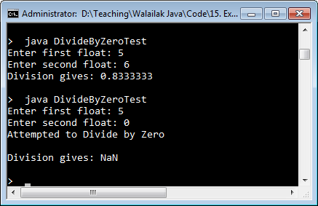
7.1 DivisionByZero Example
A new exception, DivideByZeroException, to handle division-by-zero
The example program reads in two floats and tries to divide them.

Slide 32
DivideByZeroException Class
public class DivideByZeroException extends ArithmeticException { public DivideByZeroException() {
super( "Attempted to divide by zero" );
} }

Slide 33
DivideByZeroTest.java
public class DivideByZeroTest
{
public static void main(String args[])
{
Scanner s = new Scanner( System.in );
System.out.print("Enter first float: ");
float x = s.nextFloat();
System.out.print("Enter second float: ");
float y = s.nextFloat();
s.close(); :

Slide 34
float result;
try {
result = quotient(x, y);
}
catch (DivideByZeroException e) {
System.out.println("Attempted to Divide by Zero\n");
result = Float.NaN; // "Not a Number" constant
}
System.out.println("Division gives: " + result);
} // end of main()

Slide 35
private static float quotient(float x, float y)
throws DivideByZeroException
{
if (y == 0)
throw new DivideByZeroException();
return x/y;
} // end of quotient()
} // end of DivideByZeroTest class

Slide 36
8. Stack Traces
If no handler is called, then the system prints a stack trace as the program terminates
it is a list of the called methods that are waiting to return when the exception occurred
very useful for debugging/testing
The stack trace can be printed by calling printStackTrace()

Slide 37
Using a Stack Trace
public class UsingStackTrace
{ public static void main( String args[] ) { try { method1(); } catch ( Exception e) { System.err.println(e.getMessage() + "\n");
e.printStackTrace(); } } // end of main()

Slide 38
private static void method1() throws Exception { method2(); } private static void method2() throws Exception { method3(); } private static void method3() throws Exception { throw new Exception( "Exception thrown in method3"); } } // end of UsingStackTrace class

Slide 39
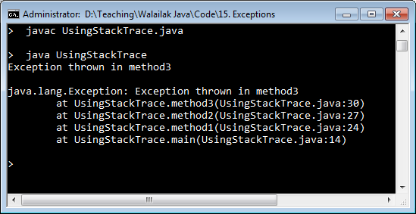
Usage
main()
method1()
method2()
method3()
e.getMessage() output
Exception!!
e.printStackTrace()
output

Slide 40
9. What if Several Handlers can Match?
If several handlers can match an exception, then the first one is used.
try {
result = quotient(x, y);
}
catch (DivideByZeroException e) {
System.out.println("Divide by Zero\n");
}
catch (ArithmeticException e) {
System.out.println("Math Problem\n");
}

Slide 41
What is a Match?
Matching is based on the Exception hierarchy (e.g. see slide 13).
If the class of the exception is the same as the argument type of the block, then there is a match.
A match is also possible if the block argument is a superclass for the exception type.
continued

Slide 42
The most general block argument:
catch (Exception e) { // code }
will catch every exception because Exception is the superclass of all exception types

Slide 43
10. The finally Clause
try {
// Protect one or more statements
}
catch(Exception e) {
// Report and recover from the exception
}
finally {
// Perform actions here whether // or not an exception is thrown
}
Typical usage is to free system resources before returning, even after throwing an exception.

Slide 44
10.1 Freeing Resources
public void storeInfo()
{ DataOutputStream dos;
try {
dos = new DataOutputStream( new FileOutputStream("movies.txt"));
dos.writeUTF("Java 7 Block Buster");
}
catch (IOException e)
{ e.printStackTrace(); }
finally {
try {
dos.close(); // always called
}
catch (IOException e)
{ System.out.println("Could not close stream"); }
}
}

Slide 45
Try-with-resources
public void storeInfo7()
{
try (DataOutputStream dos = new DataOutputStream( new FileOutputStream("movies.txt"));
{
dos.writeUTF("Added in Java 7");
}
catch (IOException e)
{ e.printStackTrace(); }
}
Java 7 added try-with-resources which
automatically calls close() at the
end of the try-catch block

Slide 46
11. The assert Statement
Used to check an object's state after it was changed
Use asserts during program development, and remove them from the finished version of the program.

Slide 47
Format
Two forms:
assert boolean-expression
assert boolean-expression : message
boolean-expression should be true at this point in the execution.
An AssertionError is thrown if the boolean-expression is false, and message is printed.

Slide 48
Assert Statement
public void removeDetails(String key)
{
if(keyInUse(key)) {
ContactDetails details = book.get(key);
book.remove(details.getName());
numberOfEntries--;
}
assert !keyInUse(key);
assert book.size() < 0 :
"Inconsistent book size in removeDetails()";
}

Slide 49
Guidelines for Using Assert
Only use them for checking code.
Remove them from your finished code.
Don’t change things in an assert: : assert book.remove(name); // BAD

Slide 50
12. Self-study from java9fp
Read Chapter 11 (Exception Handling, ...)
Download, compile, and run some of the examples from this section and from Chapter 11
my code is on the course website in <SITE>/Code/
the java9fp code is on the course website in <SITE>/Other Code/java9fp/java9fp_examples.zip

