Slide 1
DIN61-222 Adv. Prog. (Java)
Semester 1, 2019-2020
14. GUI Layout
Objectives
  describe the basic layout managers for GUIs

Slide 2
1. The 3-step GUI Again
A reminder of the three steps in writing GUIs:
  1. Declare the GUI components;
  2. Implement the event handlers for the components;
  3. Position the components on the screen by using layout managers and/or containers.

Slide 3
1.1. Emphasis of this Part
The examples in this part will concentrate on layout managers and the JPanel container
  step 3
Layout managers examined:
  FlowLayout, GridLayout, BorderLayout, BoxLayout, combining layouts

Slide 4
Basic Layouts as Pictures
grid
flow
N
W
C
E
S
box
border

Slide 5
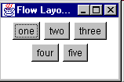
2. Flow Layout
Components are added left-to-right
  they are centered in the container (JFrame)
  a new line is started when necessary
Resizing the window may cause components to move to a new line.

Slide 6
FlowDemo.java
import java.awt.*;
import java.awt.event.*;
import javax.swing.*;
public class FlowDemo extends JFrame
{
public FlowDemo()
{
super("E-Commerce Application");
Container c = getContentPane();
c.setLayout( new FlowLayout() );
:

Slide 7
JCheckBox jck1 =
new JCheckBox("Downgrade dog to cat");
JCheckBox jck2 =
new JCheckBox("Upgrade bike to car");
JCheckBox jck3 =
new JCheckBox("Add speed package");
c.add( jck1 ); c.add( jck2 );
c.add( jck3 );
JButton jb1 = new JButton("place order");
c.add( jb1 );
JButton jb2 = new JButton("cancel");
c.add( jb2 );
JLabel jl = new JLabel(new ImageIcon("bmw.jpg"));
c.add(jl);
:

Slide 8
setDefaultCloseOperation(JFrame.EXIT_ON_CLOSE);
setSize(400,200);
setLocationRelativeTo(null); // center the window
setVisible(true);
} // end of FlowDemo()
public static void main(String[] args)
{ new FlowDemo(); }
} // end of FlowDemo class

Slide 9
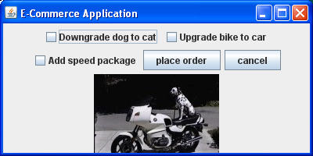
Initial Appearance

Slide 10
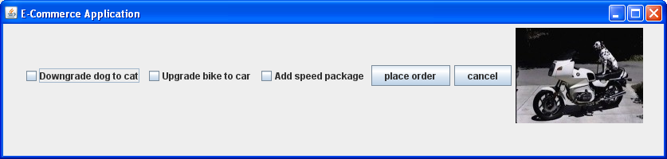
After Resizing
There is now space for everything on one line.

Slide 11
Notes
By default, all the components on a line are centered
  the alignment can be altered, e.g.
    c.setLayout( new FlowLayout(
    FlowLayout.RIGHT));
  there is also FlowLayout.LEFT
The component sizes are unchanged
  this is not true of some other layout managers

Slide 12
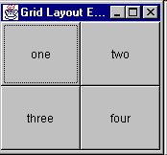
3. Grid Layout
2x2
GridLayout places components in a grid, specified in terms of the number of rows and columns
  the spacing between the grid cells can also be specified
Some of the components are resized to fit the grid cell they appear inside
  doesn't look nice
continued

Slide 13
GridDemo.java contains one major change from FlowDemo.java:
  c.setLayout( new GridLayout(3,2,10,7) );
  3 rows, 2 columns, 10 pixel horizontal spacing,
  7 pixel vertical spacing
The other change is to increase the vertical size of the frame:
  setSize(400,400);

Slide 14
GridDemo.java
import java.awt.*;
import java.awt.event.*;
import javax.swing.*;
public class GridDemo extends JFrame
{
public GridDemo()
{
super("E-Commerce Application");
Container c = getContentPane();
// use GridLayout: 3 rows, 2 columns
// 10 pixel horiz. gap, 7 pixel vert. gap
c.setLayout( new GridLayout(3, 2, 10, 7) );
:

Slide 15
JCheckBox jck1 =
new JCheckBox("Downgrade dog to cat");
JCheckBox jck2 =
new JCheckBox("Upgrade bike to car");
JCheckBox jck3 =
new JCheckBox("Add speed package");
c.add( jck1 ); c.add( jck2 ); c.add( jck3 );
JButton jb1 = new JButton("place order");
c.add( jb1 );
JButton jb2 = new JButton("cancel");
c.add( jb2 );
JLabel jl = new JLabel(new ImageIcon( bmw.jpg"));
c.add(jl);
:

Slide 16
setDefaultCloseOperation(JFrame.EXIT_ON_CLOSE);
setSize(400,400);
setLocationRelativeTo(null); // center the window
setVisible(true);
} // end of GridDemo()
public static void main(String[] args)
{ new GridDemo(); }
} // end of GridDemo class

Slide 17
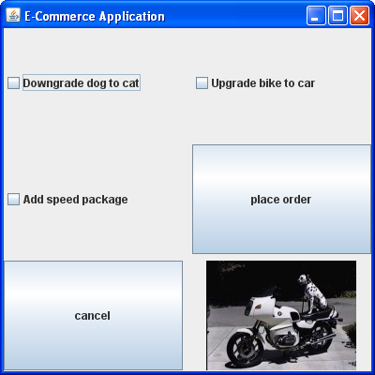
Appearance
check boxes
aren’t resized
Components
have been
resized to
equally fill
the 400x400
space.
Note the
horizontal
and vertical
spacing
between the
components.

Slide 18
GridDemoP.java
Components can be protected from resizing by being placed inside a JPanel
  the panel is resized instead
:
// use a panel to stop the cancel button growing
JPanel p = new JPanel();
JButton jb2 = new JButton("cancel");
p.add(jb2);
c.add( p );
:

Slide 19
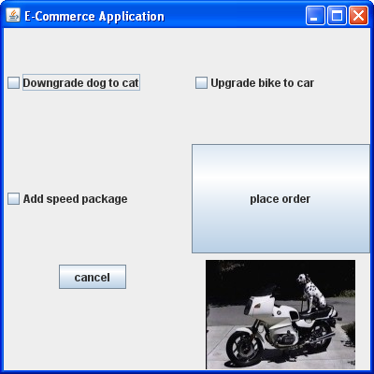
Appearance
the 'cancel'
button has
not been
resized

Slide 20
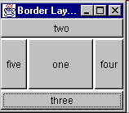
4. Border Layout
NORTH
WEST
CENTER
EAST
SOUTH
BorderLayout allows four components to be placed around the edges of a frame/applet, with a fifth component in the center
  the positions are NORTH, EAST,
  SOUTH, WEST, and CENTER
BorderLayout is the default layout for JFrame

Slide 21
BorderDemo.java
import java.awt.*;
import java.awt.event.*;
import javax.swing.*;
public class BorderDemo extends JFrame
{
public BorderDemo()
{
super("E-Commerce Application");
Container c = getContentPane();
// use BorderLayout:
// 10 pixel horiz. gap, 7 pixel vert. gap
c.setLayout( new BorderLayout(10,7) );
:

Slide 22
// JCheckBox jck1 = // not used here
// new JCheckBox("Downgrade dog to cat");
JCheckBox jck2 =
new JCheckBox("Upgrade bike to car");
JCheckBox jck3 =
new JCheckBox("Add speed package");
c.add( jck2, BorderLayout.EAST);
c.add( jck3, BorderLayout.SOUTH);
JButton jb1 = new JButton("place order");
c.add( jb1, BorderLayout.NORTH);
JButton jb2 = new JButton("cancel");
c.add( jb2, BorderLayout.WEST);
JLabel jl = new JLabel(new ImageIcon( "bmw.jpg"));
c.add(jl, BorderLayout.CENTER);
:

Slide 23
setDefaultCloseOperation(JFrame.EXIT_ON_CLOSE);
setSize(400,400);
// pack();
setLocationRelativeTo(null);
setVisible(true);
} // end of BorderDemo()
public static void main(String[] args)
{ new BorderDemo(); }
} // end of BorderDemo class

Slide 24
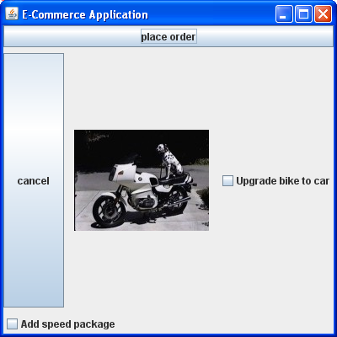
Appearance
Components
have been
resized to
fill the
400x400
space.
Note the vertical
and horizontal
spacing
between the
components.

Slide 25
Component Resizing
Components are resized:
  NORTH and SOUTH are stretched to be as wide as the window
  EAST and WEST are stretched to be tall enough to touch the NORTH and SOUTH components
  CENTER is enlarged to be as big as possible
Often the look of the GUI can be improved by calling pack().

Slide 26
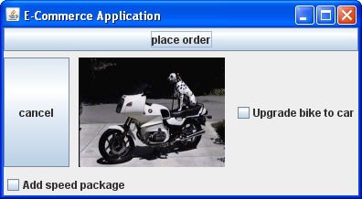
Appearance with pack()
The vertical
and horizontal
spacing
between the
components
is not affected.

Slide 27
More than Five?
It is possible to have more than five components in a GridLayout
  place them inside a JPanel (which can have its own layout)
  the JPanel container can become one of the components in the top-level frame/applet
This use of JPanel is shown later.

Slide 28
Less than Five?
If the grid does not have a component for a given position, then the other components are resized to fill the space.
  e.g. if NORTH or SOUTH are not used, then EAST, CENTER, and WEST will be made taller to fill the space
WEST
CENTER
EAST

Slide 29
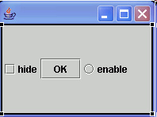
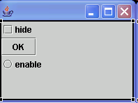
5. Box Layout
This places the components in a horizontal or vertical sequence
  components are not resized
BoxDemo.java places its components vertically
  aside from the layout manager, the code is very similar to FlowDemo.java
  pack() can be used to reduce the window size

Slide 30
BoxDemo.java
import java.awt.*;
import java.awt.event.*;
import javax.swing.*;
public class BoxDemo extends JFrame
{
public BoxDemo()
{
super("E-Commerce Application");
Container c = getContentPane();
// use BoxLayout: align components vertically
c.setLayout( new BoxLayout(c, BoxLayout.Y_AXIS) ); :

Slide 31
JCheckBox jck1 =
new JCheckBox("Downgrade dog to cat");
JCheckBox jck2 =
new JCheckBox("Upgrade bike to car");
JCheckBox jck3 =
new JCheckBox("Add speed package");
c.add( jck1 ); c.add( jck2 ); c.add( jck3 );
JButton jb1 = new JButton("place order");
c.add( jb1 );
JButton jb2 = new JButton("cancel");
c.add( jb2 );
JLabel jl = new JLabel(new ImageIcon("bmw.jpg"));
c.add(jl);
:

Slide 32
setDefaultCloseOperation(JFrame.EXIT_ON_CLOSE);
setSize(400,400);
// pack();
setLocationRelativeTo(null);
setVisible(true);
} // end of BoxDemo()
public static void main(String[] args)
{ new BoxDemo(); }
} // end of BoxDemo class

Slide 33
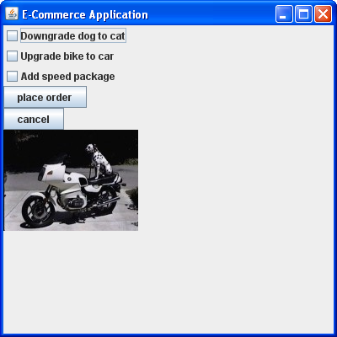
Appearance

Slide 34
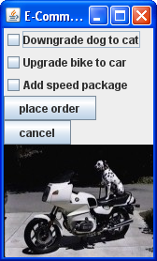
With pack()

Slide 35
6. Combining Layouts
Real GUIs usually require several layout managers for different parts of the display.
The basic technique is to create panels (with JPanel) to hold parts of the display
  each panel will have its own layout
  a panel may have subpanels

Slide 36
Layouts to Choose From...
grid
flow
N
W
C
E
S
box
border

Slide 37
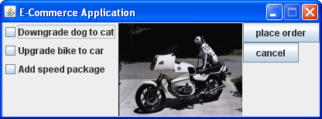
Example Appearance

Slide 38
Component Layout Hierarchy
frame
(border)
West
East
Center
panel p1
(vertical box)
panel p2
(vertical box)
image
check
box
check
box
check
box
button
button

Slide 39
West
Center
East
box
box
border

Slide 40
CombinedDemo.java
import java.awt.*;
import java.awt.event.*;
import javax.swing.*;
public class CombinedDemo extends JFrame
{
public CombinedDemo()
{
super("E-Commerce Application");
Container c = getContentPane();
// use default BorderLayout for frame
:

Slide 41
// panel 1: vertical box layout
JPanel p1 = new JPanel();
p1.setLayout(
new BoxLayout(p1, BoxLayout.Y_AXIS));
JCheckBox jck1 =
new JCheckBox("Downgrade dog to cat");
JCheckBox jck2 =
new JCheckBox("Upgrade bike to car");
JCheckBox jck3 =
new JCheckBox("Add speed package");
p1.add( jck1);
p1.add( jck2);
p1.add( jck3);
:

Slide 42
// panel 2: vertical box layout
JPanel p2 = new JPanel();
p2.setLayout(
new BoxLayout(p2, BoxLayout.Y_AXIS));
JButton jb1= new JButton("place order");
p2.add( jb1);
JButton jb2 = new JButton("cancel");
p2.add( jb2);
:

Slide 43
JLabel jl = new JLabel(
new ImageIcon("bmw.jpg"));
// add panels and image to frame
c.add(p1, BorderLayout.WEST);
c.add(jl, BorderLayout.CENTER);
c.add(p2, BorderLayout.EAST);
:

Slide 44
setDefaultCloseOperation(JFrame.EXIT_ON_CLOSE);
pack();
setResizable(false); // disable window resizing
setLocationRelativeTo(null);
setVisible(true);
} // end of CombinedDemo()
public static void main(String[] args)
{ new CombinedDemo(); }
} // end of CombinedDemo class

Slide 45
7. Improving the Appearance
There are many ways to improve on the basic appearance of the layouts:
  borders
  fixing the sizes of controls to be the same
    e.g. the size of buttons
  adding space between controls
CombinedDemo2.java uses these techniques.

Slide 46
CombinedDemo2.java
import java.awt.*;
import java.awt.event.*;
import javax.swing.*;
public class CombinedDemo2 extends JFrame
{
public CombinedDemo2()
{
super("E-Commerce Application");
Container c = getContentPane();
// use default GridLayout for frame
:

Slide 47
// panel 1: vertical box layout
JPanel p1 = new JPanel();
// 10 pixel invisible border all around
p1.setBorder(BorderFactory.createEmptyBorder(
10, 10, 10, 10) );
p1.setLayout(
new BoxLayout(p1, BoxLayout.Y_AXIS));
JCheckBox jck1 =
new JCheckBox("Downgrade dog to cat");
JCheckBox jck2 =
new JCheckBox("Upgrade bike to car");
JCheckBox jck3 =
new JCheckBox("Add speed package");
p1.add( jck1 );
p1.add( jck2 );
p1.add( jck3 );
:

Slide 48
// panel 2: vertical box layout
JPanel p2 = new JPanel();
// 14 pixel invisible border all around
p2.setBorder(BorderFactory.createEmptyBorder(
14, 14, 14, 14) );
p2.setLayout(new BoxLayout(p2,BoxLayout.Y_AXIS));
JButton jb1 = new JButton("place order");
p2.add( jb1);
// add 15 pixel vertical space between buttons
p2.add(Box.createRigidArea(
new Dimension(0, 15)));
JButton jb2 = new JButton("cancel");
// set the size of button jb2 to be same as jb1
jb2.setPreferredSize( jb1.getPreferredSize() );
p2.add( jb2 );
:

Slide 49
JLabel jl = new JLabel(new ImageIcon("bmw.jpg"));
// add panels and image to frame
c.add(p1, BorderLayout.WEST);
c.add(jl, BorderLayout.CENTER);
c.add(p2, BorderLayout.EAST);
:

Slide 50
setDefaultCloseOperation(JFrame.EXIT_ON_CLOSE);
pack();
setResizable(false);
setLocationRelativeTo(null);
setVisible(true);
} // end of CombinedDemo()
public static void main(String[] args)
{ new CombinedDemo2(); }
} // end of CombinedDemo2 class

Slide 51
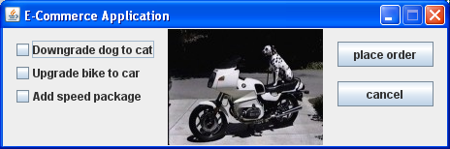
Appearance
buttons are
the same size
15 pixel
space
between
buttons
10 pixel
invisible
border
14 pixel
invisible
border

Slide 52
8. NestedSwinger Tool
My NestedSwinger tool translates a simple textual GUI notation into a Java application
  http://fivedots.coe.psu.ac.th/~ad/NestedSwinger/
Download the manual and the zipped application
  you need at least NestedSwinger.jar, TemplateForGUI.txt

Slide 53
ecommerce.txt
border {
west: vbox edged "Boxes" {
checkbox "Downgrade dog to cat"
checkbox "Upgrade bike to car"
checkbox "Add speed package"
}
center: label "bmw.jpg"
east:
vbox edged "Buttons" {
button "Place Order"
space 15
button "Cancel"
}
}

Slide 54
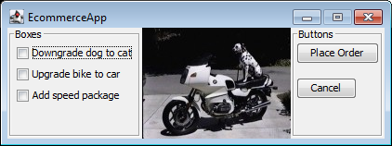
Translation
> java -jar NestedSwinger.jar ecommerce.txt
> javac EcommerceApp.java
> java EcommerceApp
Selected "Downgrade dog to cat"
Deselected "Downgrade dog to cat"
Selected "Upgrade bike to car"
Selected "Downgrade dog to cat"
Deselected "Upgrade bike to car"
Pressed "Place Order"
Pressed "Place Order"
Pressed "Cancel"
Pressed "Cancel"

