Slide 1
DIN61-222 Adv. Prog. (Java)
Semester 1, 2019-2020
13. GUI Examples II
Objectives
  describe some more GUI features: JPanel, and mouse listeners/adapters

Slide 2
1. Reminder of the 3-Step GUI
The three steps in writing GUIs:
  1. Declare the GUI components;
  2. Implement the event handlers for the components;
  3. Position the components on the screen by using layout managers and/or containers.

Slide 3
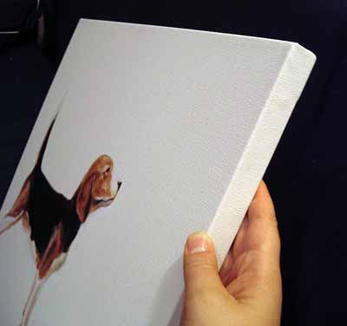
2. Painting with JPanel
One of the uses of JPanel is as a 'canvas' (painting surface).
Its paintComponent() method can be overridden, and then draw/paint operations can be added to it.

Slide 4
Whenever the JPanel is redrawn, paintComponent() is called to draw the panel.
The paintComponent() declaration is:
  public void paintComponent(Graphics g)
  g is the graphics context for the panel

Slide 5

The Graphics Context
g links to the panel's drawing area on screen.
void paintComponent(Graphics g)
{
JPanel
drawing
area
// drawing operations, e.g.
g.drawImage(...);
:
g
application
}

Slide 6
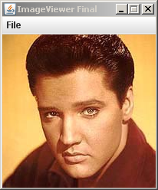
3. The Final ImageViewer
(ImageViewer)
a JFrame
The image is drawn onto
a JPanel, which is in the
content area of the JFrame.
(ImagePanel)
a JPanel

Slide 7
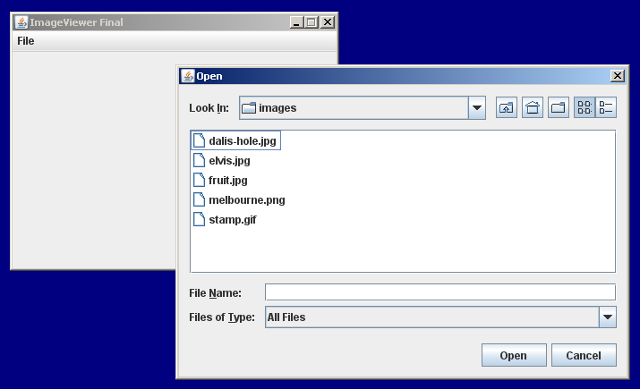
Other Features
The "open" menu item now calls JFileChooser to let the user choose an image file to load and display.
JFileChooser
continued

Slide 8
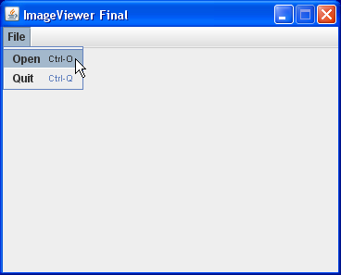
The menu items now have keyboard shortcuts:
  "open" ==> <ctrl>-o
  "quit" ==> <ctrl>-q

Slide 9
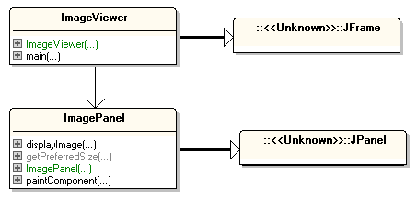
Class Diagrams
extends
uses
extends

Slide 10
The ImageViewer Class
public class ImageViewer extends JFrame
{
private JFileChooser fileChooser;
private ImagePanel imagePanel;
public ImageViewer()
{ super("ImageViewer Final");
fileChooser = new JFileChooser(
System.getProperty("user.dir") );
makeMenuBar();
Container c = getContentPane();
imagePanel = new ImagePanel();
c.add(imagePanel);
: // as before
} // end of ImageViewer()

Slide 11
private void makeMenuBar()
// Create menu bar; add shortcuts.
{
int shortcut_mask =
Toolkit.getDefaultToolkit().
getMenuShortcutKeyMask();
JMenuBar menubar = new JMenuBar();
setJMenuBar(menubar);
// create the File menu
JMenu fileMenu = new JMenu("File");
menubar.add(fileMenu);
:

Slide 12

choose, display image
JMenuItem openItem = new JMenuItem("Open");
openItem.setAccelerator(KeyStroke.getKeyStroke(
KeyEvent.VK_O, shortcut_mask)); // ctrl-o
openItem.addActionListener(new ActionListener() {
public void actionPerformed(ActionEvent e)
{ File f = chooseImage();
if (f != null)
imagePanel.displayImage(f);
pack(); // triggers resizing to fit image
}
});
fileMenu.add(openItem);
:

Slide 13
exit
JMenuItem quitItem = new JMenuItem("Quit");
quitItem.setAccelerator(
KeyStroke.getKeyStroke(KeyEvent.VK_Q,
shortcut_mask)); // ctrl-q
quitItem.addActionListener(new ActionListener() {
public void actionPerformed(ActionEvent e)
{ System.exit(0); }
});
fileMenu.add(quitItem);
} // end of makeMenuBar()

Slide 14
private File chooseImage()
// open file chooser and let the user select
// an image file
{
int returnVal =
fileChooser.showOpenDialog(null);
if (returnVal != JFileChooser.APPROVE_OPTION)
return null; // cancelled
return fileChooser.getSelectedFile();
} // end of chooseImage()

Slide 15
public static void main(String[] args)
{ new ImageViewer(); }
} // end of ImageViewer class

Slide 16
The ImagePanel Class
public class ImagePanel extends JPanel
{
private int width, height; // of this panel
private BufferedImage panelImage;
public ImagePanel()
{
width = 360; // size for empty panel
height = 240;
panelImage = null;
setBackground(Color.WHITE);
} // end of ImagePanel()

Slide 17
public void displayImage(File f)
// load and set the image for this panel
{
BufferedImage image = loadImage(f);
if (image != null) {
width = image.getWidth();
height = image.getHeight();
panelImage = image;
invalidate();
repaint(); // triggers a panel redrawing
// with the new image
}
} // end of displayImage()

Slide 18
private BufferedImage loadImage(File imageFile)
// load an image file and returns it as a
// BufferedImage.
{
try {
BufferedImage image = ImageIO.read(imageFile);
if (image == null ||(image.getWidth() < 0))
// probably bad file format
return null;
return image;
}
catch (IOException e)
{ return null; }
} // end of loadImage()

Slide 19
Redefined Methods from JPanel
public Dimension getPreferredSize()
/* Say how big we would like this panel to be.
This method gets called by the layout manager
when placing and sizing this panel in
the JFrame. */
{
return new Dimension(width, height);
}

Slide 20
public void paintComponent(Graphics g)
/* Draw the image onto the panel.
This method gets called by the JVM every
time it want to display (or redisplay)
this panel. */
{
super.paintComponent(g);
// repaint standard stuff first
Dimension size = getSize();
g.clearRect(0, 0, size.width, size.height);
if (panelImage != null)
g.drawImage(panelImage, 0, 0, null);
} // end of paintComponent()
} // end of ImagePanel class

Slide 21
4. Listener Interfaces
I'm looking at four listener interfaces that can handle events from different GUI components
  ActionListener
  ItemListener
  MouseListener
  MouseMotionListener
There are several other listener interfaces.
in the last part, part 12
this part

Slide 22
4.1. MouseListener
It deals with mouse clicks over GUI components.
Its interface has 5 methods:
  public void mouseClicked(MouseEvent e)
  public void mousePressed(MouseEvent e)
  public void mouseReleased(MouseEvent e)
  public void mouseEntered(MouseEvent e)
  public void mouseExited(MouseEvent e)

Slide 23
Using the Listener
The GUI control must be linked to code which implements the method in the listener.
public class Foo3 implements
MouseListener
{
public void mouseClicked(
MouseEvent e)
{ // do something with e
System.out.println("Bing");
}
: // all the other methods
}
the link
which
sends an
event e
GUI Window

Slide 24
4.2. MouseMotionListener
For efficiency reasons, mouse movement events are dealt with by a separate listener.
Its interface has 2 methods:
  public void mouseDragged(MouseEvent e)
  public void mouseMoved(MouseEvent e)

Slide 25
Using the Listener
The GUI control must be linked to code which implements the method in the listener.
public class Foo4 implements
MouseMotionListener
{
public void mouseDragged(
MouseEvent e)
{ // do something with e
System.out.println("Boo");
}
: // the other method
}
the link
which
sends an
event e
GUI Window

Slide 26
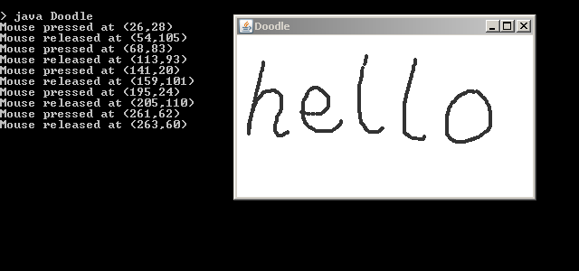
5. Mouse Example: Doodle
Doodle is a simple paint program for drawing onto a JPanel placed inside a JFrame.

Slide 27
Features
As the mouse is dragged, a series of black dots (circles) are drawn onto the JPanel.
  this requires a MouseMotionListener
When the mouse is pressed down, and released, the coordinates of the cursor are printed to stdout
  this requires a MouseListener

Slide 28
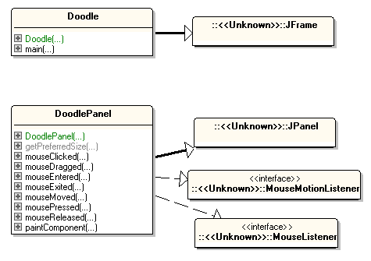
Class Diagrams
uses
multiple
inheritance:
1 class,
2 interfaces
lots of
methods

Slide 29
The Doodle Class
public class Doodle extends JFrame
{
public Doodle()
{ super("Doodle");
Container c = getContentPane();
c.add( new DoodlePanel() );
setDefaultCloseOperation(JFrame.EXIT_ON_CLOSE);
pack();
setLocationRelativeTo(null); // center the window
setVisible(true);
} // end of Doodle()
public static void main(String args[])
{ new Doodle(); }
} // end of Doodle

Slide 30
The DoodlePanel Class
Version 1
public class DoodlePanel extends JPanel
implements MouseMotionListener,
MouseListener
{
private static final int MAXPOINTS = 5000;
// for storing the paintable points
private Point[] points = new Point[MAXPOINTS];
private int nPoints = 0;
:
points[]
(x0,y0)
(x1,y1)
(x2,y2)
(x3,y3)
. . . .

Slide 31
public DoodlePanel()
{
setBackground(Color.white);
addMouseMotionListener(this);
addMouseListener(this);
} // end of DoodlePanel() constructor
public Dimension getPreferredSize()
// Say how big we would like this panel to be
{ return new Dimension(500, 300); }

Slide 32
public void paintComponent(Graphics g)
// repaint panel by redrawing stored points
{
super.paintComponent(g);
for (int i = 0; i < nPoints; i++)
g.fillOval( points[i].x, points[i].y, 4, 4);
// the pen is a 4x4 black circle
}

Slide 33
// methods for MouseMotionListener ----
public void mouseDragged( MouseEvent e)
// record cursor position, then request a repaint
{
if (nPoints < MAXPOINTS)
points[nPoints++] = new Point(e.getX(), e.getY());
repaint(); // the repaint will call paintComponent()
}
public void mouseMoved(MouseEvent e) {} // not needed

Slide 34
// methods for MouseListener -----------
public void mousePressed( MouseEvent e)
{ System.out.println( "Mouse pressed at (" + e.getX() +
"," + e.getY() + ")" );
}
public void mouseReleased( MouseEvent e)
{ System.out.println( "Mouse released at (" + e.getX() +
"," + e.getY() + ")" );
}
public void mouseClicked(MouseEvent e) {} // not needed
public void mouseEntered(MouseEvent e) {} // not needed
public void mouseExited(MouseEvent e) {} // not needed
} // end of DoodlePanel class

Slide 35
6. Adapter Classes
When we implement an interface (a listener class), we must implement all of the methods inside it.
Even if we only want to use one method, we still have to give empty implementations for all the other methods
  a lot of boring work for some listener classes
    e.g. MouseListener
continued

Slide 36
Java supplies predefined classes which implement the bigger listener classes
  called adapter classes
These adapter classes contain empty methods for all the event handlers
  the programmer can extend an adapter class, and only needs to override the methods needed.

Slide 37
Java's Adapter Classes
MouseAdapter and MouseMotionAdapter
WindowAdapter
FocusAdapter
ContainerAdapter
ComponentAdapter
KeyAdapter
Beginners often use
just the first three.

Slide 38
MouseAdapter.java
a user cannot create MouseAdapter objects
public abstract class MouseAdapter
implements MouseListener
{
public void mousePressed( MouseEvent e) {}
public void mouseReleased( MouseEvent e) {}
public void mouseClicked(MouseEvent e) {}
public void mouseEntered(MouseEvent e) {}
public void mouseExited(MouseEvent e) {}
}
empty
methods
This class is already present in
Java. You do not write this.

Slide 39
Extending MouseAdapter
You write this class.
class MouseHandler extends MouseAdapter
{
public void mousePressed( MouseEvent e)
{ System.out.println( "Mouse pressed at (" +
e.getX() + "," + e.getY() + ")" );
}
public void mouseReleased( MouseEvent e)
{ System.out.println( "Mouse released at (" +
e.getX() + "," + e.getY() + ")" );
}
} // end of MouseHandler class
only
override
the methods
needed;
the others
stay empty

Slide 40
MouseMotionAdapter.java
public abstract class MouseMotionAdapter
implements MouseMotionListener
{
public void mouseDragged( MouseEvent e) {}
public void mouseMoved( MouseEvent e) {}
}
empty
methods
This class is already present in
Java. You do not write this.

Slide 41
Extending MouseMotionAdapter
You write this class.
class MouseMotionHandler extends MouseMotionAdapter
{
public void mouseDragged( MouseEvent e)
{
if (nPoints < MAXPOINTS)
points[nPoints++] = new Point(e.getX(), e.getY());
repaint();
}
}
only override the method
needed; the other stays empty

Slide 42
Using the Handlers
My MouseHandler and MouseMotionHandler classes should be declared as inner classes of DoodlePanel so that they can access its points[] array.

Slide 43
DoodlePanel.java
Version 2
public class DoodlePanel extends JPanel
{
// fields (as before)
public DoodlePanel()
{
setBackground(Color.white);
addMouseMotionListener( new MouseMotionHandler() );
addMouseListener( new MouseHandler() );
} // end of DoodlePanel()
// getPreferredSize() and paintComponent() methods
// (as in first DoodlePanel class)
:

Slide 44
// -------- inner classes ------------
class MouseHandler extends MouseAdapter
{ // as in slide 39 ...
}
class MouseMotionHandler extends MouseMotionAdapter
{ // as in slide 41 ...
}
} // end of DoodlePanel

Slide 45
Using Anonymous Classes
The third way of implementing a listener is with anonymous (inner) classes.
  let's recode DoodlePanel to use them

Slide 46
The DoodlePanel Class
Version 3
public class DoodlePanel extends JPanel
{
// fields (as before)
public DoodlePanel()
{
setBackground(Color.white);
addMouseMotionListener( new MouseMotionAdapter() {
public void mouseDragged( MouseEvent e)
{ if (nPoints < MAXPOINTS)
points[nPoints++] = new Point(e.getX(),e.getY());
repaint();
}
});
:
uses the superclass
name

Slide 47
addMouseListener( new MouseAdapter() {
public void mousePressed( MouseEvent e)
{ System.out.println( "Mouse pressed at (" +
e.getX() + "," + e.getY() + ")" );
}
public void mouseReleased( MouseEvent e)
{ System.out.println( "Mouse released at (" +
e.getX() + "," + e.getY() + ")" );
}
});
} // end of DoodlePanel()

Slide 48
// getPreferredSize() and paintComponent() methods
// (as in first DoodlePanel class)
// no inner classes
} // end of DoodlePanel class

Slide 49
7. The SwingSet2 Examples
The Swing developers put together a "super" demo of all of Swing's features, stored in SwingSet2.jar.
  a copy is on the course website in OtherCode/
Download and execute:
  java -jar SwingSet2.jar
or double-click on the file
The source code is inside the JAR (open it using a zip tool, such as 7-Zip)

Slide 50
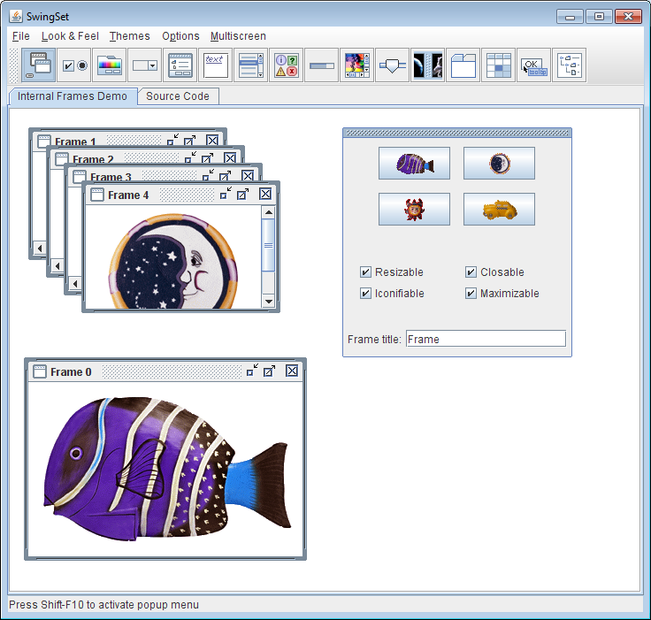

Slide 51
8. More Information
The Java tutorial "Creating a GUI with JFC/Swing".
  https://docs.oracle.com/javase/tutorial/uiswing/
Sub-topics include:
  Getting Started with Swing
  Swing Features and Concepts
  Using Swing Components
  Laying Out Components Within a Container
  Writing Event Listeners
I have books about Swing which I can lend to students.
Excellent

