Slide 1
DIN61-222 Adv. Prog. (Java)
Semester 1, 2019-2020
12. GUI Examples I
Objectives
describe some of the GUI controls and their listeners; more appear in part 13

Slide 2
Contents
1. Three Step GUI
2. Swing GUI Overview
3. Swing Hierarchy
4. Listener Interfaces
5. Button Example
6. TextField Example
7. Check Boxes Example
8. Radio Buttons Example
9. Combo Box Example

Slide 3
1. Three Step GUI
There are three main steps to creating a GUI for a Java application:
1. Declare the GUI components;
2. Implement the event handlers for the components;
3. Position the components on the screen by using layout managers and/or containers.
this part
and
part 13

Slide 4
2. Swing GUI Overview
The Swing GUI has six categories:
basic components
uneditable displays
interactive displays of highly formatted info
general-purpose containers
top-level containers
special-purpose containers
We will look at code
examples using the GUI
components listed in bold.

Slide 5
2.1. Basic Components
Component Swing Class Name
button JButton, JCheckBox, JRadioButton
combo box JComboBox
list JList
menu JMenu, JMenuBar, JMenuItem
slider JSlider
text field JTextField, JPasswordField

Slide 6
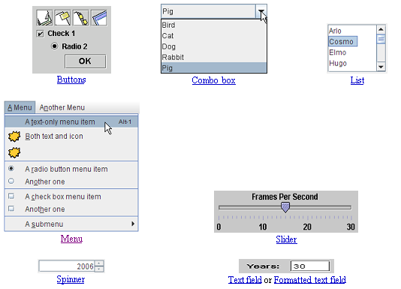
also known as
a pop-down list
These pictures are from the Java tutorial on Swing

Slide 7
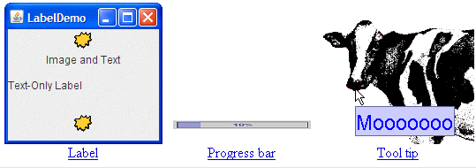
2.2. Uneditable Displays
Display Swing Class Name
label JLabel
Tooltip JToolTip
Progress bar JProgressBar

Slide 8
2.3. Interactive Displays
Display Swing Class Name
table JTable
text JTextPane, JTextArea, JEditorPane
tree JColorChooser
file chooser JFileChooser

Slide 9
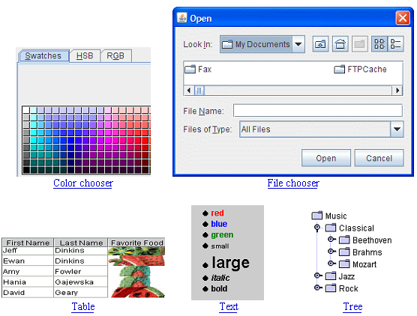

Slide 10
2.4. General Purpose Containers
Container Swing Class Name
panel JPanel
scroll pane JScrollPane, JScrollBar
split pane JSplitPane
tabbed pane JTabbedPane
toolbar JToolbar

Slide 11
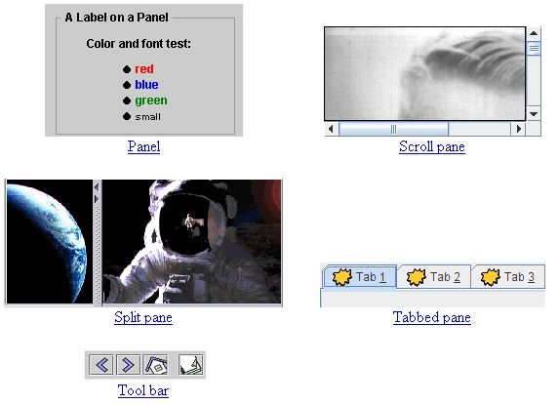

Slide 12
2.5. Top-level Containers
Container Swing Class Name
frame JFrame
applet JApplet
dialog JDialog, JOptionPane

Slide 13
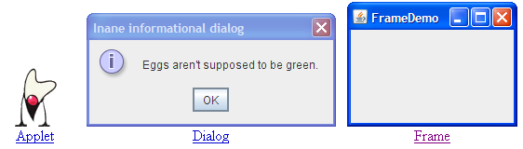

Slide 14
2.6. Special-Purpose Containers
Container Swing Class Name
internal frame JInternalFrame
layered pane JLayeredPane
root pane JRootPane

Slide 15
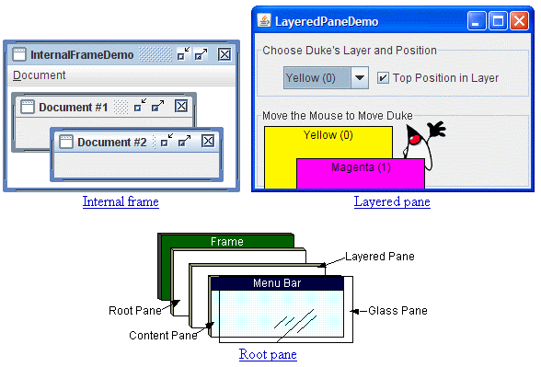

Slide 16
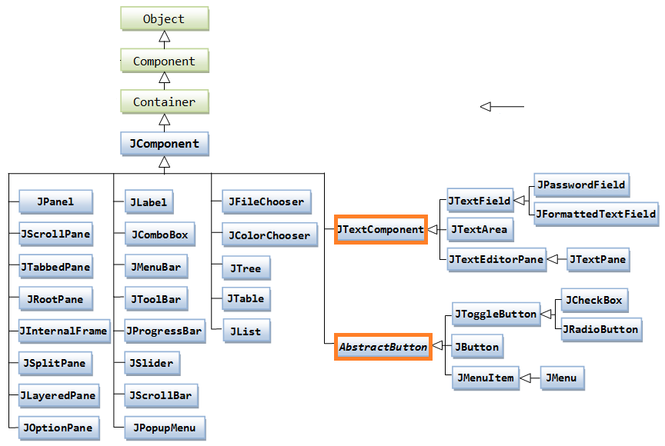
3. Swing Hierarchy (partial)
AWT
classes
extends
abstract
classes
most of the examples in
part 12 come from here

Slide 17
What is JComponent?
JComponent is the Swing ancestor of most things that appear in a GUI.
It holds common information such as:
size (preferred, minimum, maximum)
accessibility, internationalization
keyboard control support
thickness of lines around controls
debugging features

Slide 18
4. Listener Interfaces
I'll look at 4 listener interfaces that can handle events from different GUI components
ActionListener
ItemListener
MouseListener
MouseMotionListener
There are several other listener interfaces.
I'll use these two
in this part
in part 13

Slide 19
4.1. ActionListener
ActionListener can deal with events from:
JButton (most common)
JMenu, JMenuItem, JRadioButton, JCheckBox
when pressed
JTextField
when <enter> is typed
The interface has one method:
public void actionPerformed(ActionEvent e)

Slide 20
Using the Listener
The GUI component must be linked to code which implements the method in the listener.
public class Foo implements ActionListener { public void actionPerformed(
ActionEvent e) { // do something with e System.out.println("Ouch"); } }
button
the link
which
sends an
event e
GUI Window

Slide 21
4.2. ItemListener
ItemListener can deal with events from:
JMenu, JMenuItem, JRadioButton, JCheckBox (most common)
JButton
when an item is selected/pressed
The interface has one method:
public void itemStateChanged(ItemEvent e)

Slide 22
Using the Listener
The GUI component must be linked to code which implements the method in the listener.
public class Foo2 implements ItemListener { public void itemStateChanged(
ItemEvent e) { // do something with e System.out.println("EEEk"); } }
menu
the link
which
sends an
event e
GUI Window

Slide 23

5. Button Example
Output after three presses:
Pressed 1 Pressed 2 Pressed 3

Slide 24
Event Model
GUI
Press me
int pressCount = 1;
methods
press
event
actionPerfomed()
anon class

Slide 25
Steps in GUI Creation
The GUI is initialised in the class' constructor method.
Initialisation steps:
1. get the container for the frame
2. set the layout manager (FlowLayout)
3. declare the GUI components
4. add them to the container
5. register the components with event handlers
6. set window properties

Slide 26
ButtonTest.java
import javax.swing.*; import java.awt.*; import java.awt.event.*; public class ButtonTest extends JFrame { private int pressCount = 1; public ButtonTest() { super( "Testing JButton" ); Container c = getContentPane(); c.setLayout( new FlowLayout() ); :
step 1
step 2

Slide 27
// JButton with a string argument JButton jb = new JButton( "Press me" ); c.add( jb ); // Handle events from pressing the button jb.addActionListener( new ActionListener() { public void actionPerformed(ActionEvent e) { System.out.println("Pressed " + pressCount++ ); } } );
setDefaultCloseOperation(JFrame.EXIT_ON_CLOSE);
pack();;
setVisible( true ); } // end of LabelTest()
step 3
step 4
step 5
step 6

Slide 28
public static void main( String args[] ) { new ButtonTest(); }
} // end of ButtonTest class

Slide 29
Notes
The global variable pressCount remembers the number of presses between calls to actionPerformed().
The only information passed as an argument to actionPerformed() is the event object e
other information must be stored globally

Slide 30
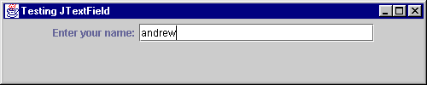
6. TextField Example
After typing enter, the text disappears from the field, and "You entered andrew" is printed.

Slide 31
Event Model
GUI
Enter...:
jtf
methods
type
enter
event
actionPerfomed()
anon class

Slide 32
TextFieldTest.java
// The JTextField GUI in a Java app import javax.swing.*; import java.awt.*; import java.awt.event.*; public class TextFieldTest extends JFrame { private JTextField jtf; // global since used in actionPerformed() public TextFieldTest() { super( "Testing JTextField" ); Container c = getContentPane(); c.setLayout( new FlowLayout() ); :

Slide 33
// label and text entry field JLabel jl = new JLabel("Enter your name:"); jtf = new JTextField(25); // 25 chars wide c.add( jl ); c.add( jtf ); // Handle events from pressing return jtf.addActionListener( new ActionListener() { public void actionPerformed(ActionEvent e) { System.out.println("You entered " + e.getActionCommand() ); jtf.setText(""); // clear text field }
} ); setDefaultCloseOperation(JFrame.EXIT_ON_CLOSE);
setSize(500,100); setVisible(true); } // end of TextFieldTest()

Slide 34
public static void main( String args[] ) { new TextFieldTest(); }
} // end of TextFieldTest class

Slide 35
Notes
The JTextField object, jtf, is global
this means that actionPerformed() can affect it
it sets the text to empty ("") after printing a message to stdout
The text inside the text field is accessed through the event object:
e.getActionCommand()

Slide 36
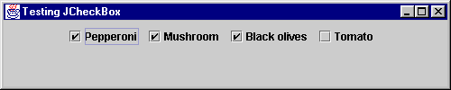
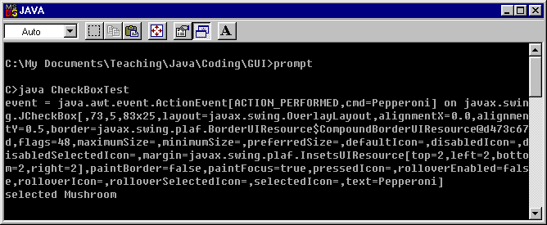
7. Check Boxes Example
Output to
window
when first two
boxes are
checked/
unchecked

Slide 37
Event Model
GUI
methods
press
event
actionPerfomed()
itemStateChanged()
select/
deselect
event
I could use
itemStateChanged()
to process all the events
anon classes

Slide 38
Features
creates 4 JCheckBox objects in an application
an anonymous class implements actionListener
actionPerformed() is called when the user presses the "Pepperoni" check box
an anonymous class implements itemListener
itemStateChanged() is called when the "Mushroom" box is 'ticked' or 'unticked'

Slide 39
CheckBoxTest.java
import javax.swing.*; import java.awt.*; import java.awt.event.*; public class CheckBoxTest extends JFrame { public CheckBoxTest() { super( "Testing JCheckBox" ); Container c = getContentPane(); c.setLayout( new FlowLayout() ); :

Slide 40
// 4 checkboxes JCheckBox jck1 = new JCheckBox("Pepperoni"); JCheckBox jck2 = new JCheckBox("Mushroom"); JCheckBox jck3 = new JCheckBox("Black olives"); JCheckBox jck4 = new JCheckBox("Tomato"); c.add( jck1 ); c.add( jck2 ); c.add( jck3 ); c.add( jck4 ); // actionListener for pepperoni box jck1.addActionListener( new ActionListener() { public void actionPerformed(ActionEvent e) { System.out.println("event = " + e); } }); :

Slide 41
// itemListener for mushroom box jck2.addItemListener( new ItemListener() { public void itemStateChanged(ItemEvent e) { if (e.getStateChange() == e.SELECTED) System.out.print("selected "); else System.out.print("de-selected "); System.out.print("Mushroom\n"); } }); setDefaultCloseOperation( JFrame.EXIT_ON_CLOSE); setSize(500,100); setVisible(true); } // end of CheckBoxTest()

Slide 42
public static void main( String args[] ) { new CheckBoxTest(); } } // end of CheckBoxTest class

Slide 43
Notes
addItemListener() is used to register an ItemListener with a control.
The anonymous class must implement ItemListener's itemStateChanged() method.
itemStateChanged() uses e.getStateChanged() to see if the box was ticked or unticked.
continued

Slide 44
actionPerformed() shows that an event object can be printed
sometimes useful for debugging

Slide 45
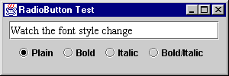
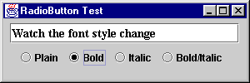
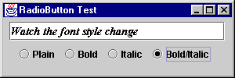
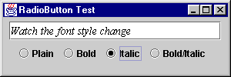
8. Radio Buttons Example
click on
radio buttons

Slide 46
Event Model
Watch the font...
methods
RadioButtonHandler
inner class
itemStateChanged(...) { // alter t }

Slide 47
Features
creates four JRadioButton objects in the application
a RadioButtonHandler inner class implements ItemListener
itemStateChanged() is called when the user selects/deselects any of the radio buttons
a ButtonGroup object which forces only one radio button to be 'on' at a time

Slide 48
RadioButtonTest.java
import java.awt.*; import java.awt.event.*; import javax.swing.*; public class RadioButtonTest extends JFrame { private JTextField t; private Font plainFont, boldFont, italicFont, boldItalicFont; private JRadioButton plain, bold, italic, boldItalic; :

Slide 49
public RadioButtonTest() { super( "RadioButton Test" ); Container c = getContentPane(); c.setLayout( new FlowLayout() ); t = new JTextField( "Watch the font style change", 25 ); c.add( t ); // Create radio buttons plain = new JRadioButton( "Plain", true ); c.add( plain ); bold = new JRadioButton( "Bold", false); c.add( bold ); italic = new JRadioButton( "Italic", false ); c.add( italic ); boldItalic = new JRadioButton( "Bold/Italic", false ); c.add( boldItalic ); :

Slide 50
// register all controls with 1 handler RadioButtonHandler handler = new RadioButtonHandler(); plain.addItemListener( handler ); bold.addItemListener( handler ); italic.addItemListener( handler ); boldItalic.addItemListener( handler ); // create link between JRadioButtons ButtonGroup radioGroup = new ButtonGroup(); radioGroup.add( plain ); radioGroup.add( bold ); radioGroup.add( italic ); radioGroup.add( boldItalic ); :

Slide 51
plainFont = new Font( "TimesRoman", Font.PLAIN, 14 ); boldFont = new Font( "TimesRoman", Font.BOLD, 14 ); italicFont = new Font( "TimesRoman", Font.ITALIC, 14 ); boldItalicFont = new Font( "TimesRoman", Font.BOLD + Font.ITALIC, 14 ); t.setFont( plainFont ); :

Slide 52
setDefaultCloseOperation( JFrame.EXIT_ON_CLOSE); setSize(300,100); setVisible(true); } // end of RadioButtonTest() public static void main( String args[] ) { new RadioButtonTest() }

Slide 53
Still inside
RadioButtonTest
class RadioButtonHandler implements ItemListener { public void itemStateChanged( ItemEvent e ) {
if (e.getStateChange() == ItemEvent.SELECTED) { if ( e.getSource() == plain ) t.setFont( plainFont ); else if ( e.getSource() == bold ) t.setFont( boldFont ); else if ( e.getSource() == italic ) t.setFont( italicFont ); else if ( e.getSource() == boldItalic ) t.setFont( boldItalicFont ); t.repaint();
} } } // end of RadioButtonHandler class
} // end of RadioButtonTest class

Slide 54
Notes
This example shows the use of an inner class to implement event handling:
RadioButtonHandler implements ItemListener
The other two approaches:
anonymous classes
have the program implement the event listener itself
continued

Slide 55
This example shows that several controls can have the same event handler
all 4 buttons use a single RadioButtonHandler object
The ButtonGroup object is not visible on the screen.

Slide 56
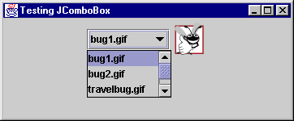
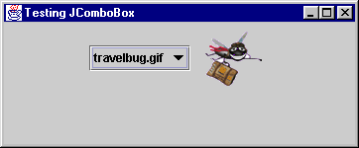
9. Combo Box Example
select
travelbug.gif

Slide 57

Event Model
methods
itemStateChanged()
select
item
event
anon class

Slide 58
Features
creates a JComboBox object in an application (a combo box is a drop-down list)
the selection updates an image inside a label
an anonymous class implements itemListener
itemStateChanged() is called when the user clicks on one of the items on the list

Slide 59
ComboBoxTest.java
import java.awt.*; import java.awt.event.*; import javax.swing.*; public class ComboBoxTest extends JFrame { private JComboBox<String> imNmsList; private JLabel label; private String names[] = { "bug1.gif", "bug2.gif", "travelbug.gif", "buganim.gif" }; private ImageIcon icons[]; :

Slide 60
public ComboBoxTest()
{
super("Testing JComboBox");
icons = new Icon[names.length];
for(int i=0; i < names.length; i++)
icons[i] = new ImageIcon(names[i]);
Container c = getContentPane();
c.setLayout(new FlowLayout());
label = new JLabel(icons[0]);
c.add(label); :

Slide 61
imNmsList = new JComboBox<String>(names);
imNmsList.setMaximumRowCount(3);
c.add(imNmsList);
imNmsList.addItemListener( new ItemListener() {
public void itemStateChanged(ItemEvent e)
{ label.setIcon(icons[ imNmsList.getSelectedIndex() ]); }
});
setDefaultCloseOperation(JFrame.EXIT_ON_CLOSE);
setSize(350, 100);
setVisible(true);
} // end of ComboBoxTest()
public static void main(String args[])
{ new ComboBoxTest(); }
} // end of ComboBoxTest class

Slide 62
Notes
itemStateChanged() does not use the e event object; it checks the imNmsList combo box
imNmsList.getSelectedIndex()
returns the index of the item selected
The image filenames are stored in an icon[]array, and used to update the label:
label.setIcon( icon[...])

