Slide 1
DIN61-222 Adv. Prog. (Java)
Semester 1, 2019-2020
11. Introducing
Java's GUI Features
Objectives
use an image viewer application to introduce Java's GUI features

Slide 2
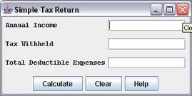
1. GUI Principles
events
(info. objects)
components
listeners (waiting code)
layout manager

Slide 3
1. GUI Principles
GUIs are built from components
buttons, menus, sliders, etc.
The positioning of GUI components in a window is done with layout managers
User actions are converted into events
button presses, menu selections, etc.
Events are processed by listeners.

Slide 4
2. Background
Simple GUI interfaces are written with Swing GUI components
Swing includes buttons, text fields, scrolling windows, editor windows, tree displays, etc
I'll describe some of them

Slide 5
2.1. JFC
Swing is part of the Java Foundation Classes (JFC)
there are over 300 classes in JFC!!
JFC also includes:
pluggable "look and feel", an accessibility API, Java 2D, drag-and-drop, multiple undo's

Slide 6
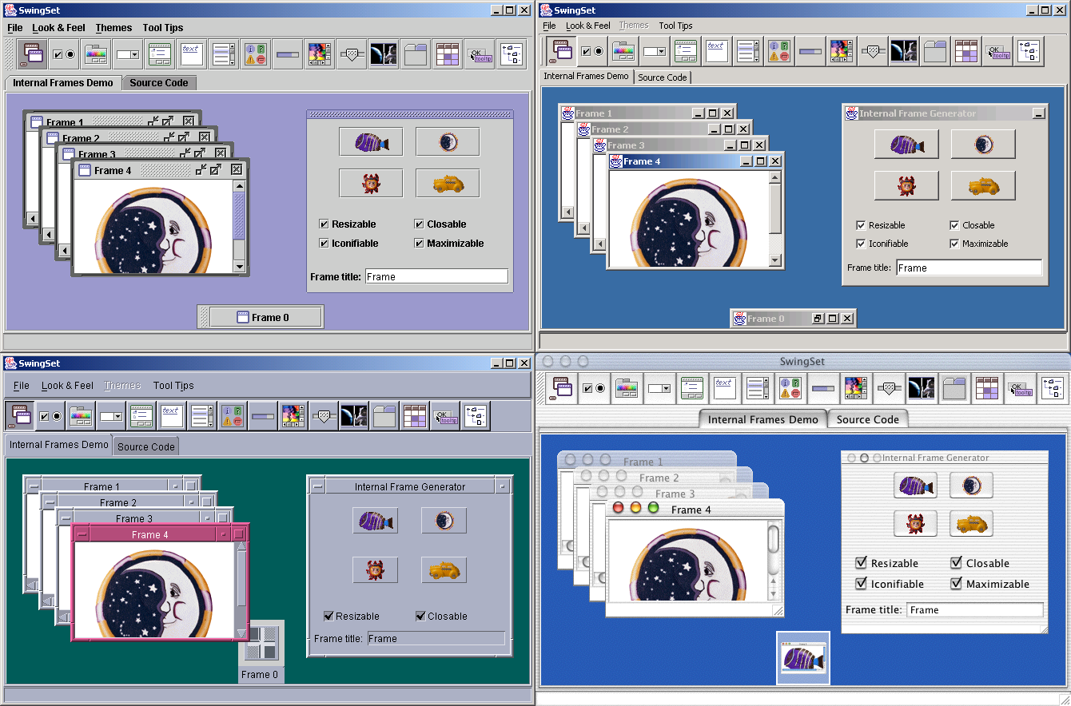
Some Java"Look and Feel"s

Slide 7
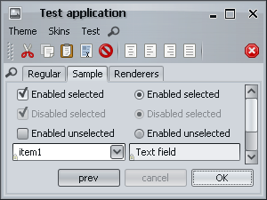
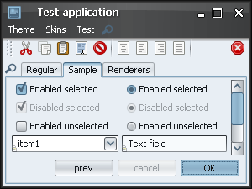
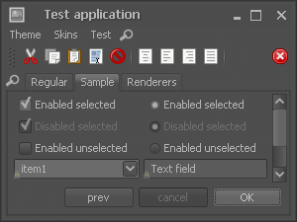
Using the Substance
L&F add-on library
(https://substance.dev.java.net/)

Slide 8
2.2. JavaFX
JavaFX is the newest GUI library for Java
it supports multimedia (animation, audio, and video) which is not part of Swing
look-and-feel is coded using CSS
JavaFX includes the Scene Builder tool for GUI visual layout – it generates XML not Java
This course will use Swing not JavaFX

Slide 9
3. Three Steps to GUIs
There are three main steps to creating a GUI for a Java program:
1. Declare the GUI components;
2. Implement the listeners for the components;
3. Position the controls on the screen by using layout managers (and containers).

Slide 10
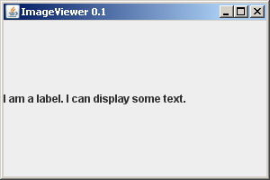
4. An Application Window
title
window controls
content pane
Implemented by subclassing JFrame

Slide 11
Coding an Application
Version 0.1
public class ImageViewer extends JFrame
{
public ImageViewer()
{
super("ImageViewer 0.1");
// create the GUI
Container c = getContentPane();
JLabel label = new JLabel("I am a label. I can display some text.");
c.add(label); :
JLabel is a GUI
component

Slide 12
// set close behaviour for JFrame as exit
setDefaultCloseOperation(JFrame.EXIT_ON_CLOSE);
setSize(300, 200);
// pack(); // reduce size to fit GUI components
setVisible(true);
} // end of ImageViewer()
// ----------------------------------------------
public static void main(String[] args)
{ new ImageViewer(); }
} // end of ImageViewer class
A GUI object is not
deleted at the end of main().
We must call exit.

Slide 13

Sizing the Application
Replace setSize() by pack():

Slide 14
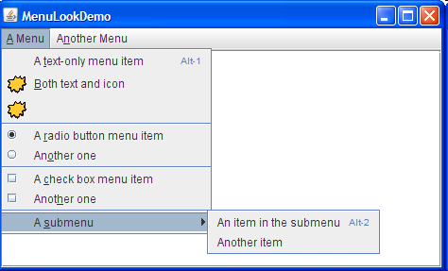
5. Adding Menus
JMenuBar
contains the menus
JMenu
contains the menu items
JMenuItem
individual items in a menu

Slide 15
Add Component to JFrame
Version 0.2
public ImageViewer()
{
super("ImageViewer 0.2");
// create the GUI
makeMenuBar();
Container c = getContentPane();
JLabel label = new JLabel("I am a label. I can display some text.");
c.add(label);
: // the same as before
} // end of ImageViewer()

Slide 16
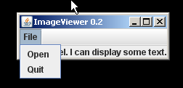
private void makeMenuBar()
// Create the main frame's menu bar.
{
JMenuBar menubar = new JMenuBar();
setJMenuBar(menubar); // add to 'menu area' of JFrame
// create the File menu
JMenu fileMenu = new JMenu("File");
menubar.add(fileMenu);
JMenuItem openItem = new JMenuItem("Open");
fileMenu.add(openItem);
JMenuItem quitItem = new JMenuItem("Quit");
fileMenu.add(quitItem);
} // end of makeMenuBar()

Slide 17
6. Event Handlers
An event handler is a method that is called automatically when an event occurs in a GUI component.
Examples of events include:
typing return in a text field
pressing a button
selecting a menu item
continued

Slide 18
Event handlers (methods) for different events are predefined by Java inside listeners.
A listener is an interface
it defines the interfaces of its event handler methods (i.e. the names, types of arguments)
the programmer must implement each method to respond to the event that triggers it
continued

Slide 19
6.1. Event Handler as a Diagram
class that implements
the listener interface
Program on-screen GUI
event
event handler method
data
methods
A typical action is for the
event handler method to
update the data in the
program.
Program Code

Slide 20
6.2. Using Event Handlers
The programmer must:
1. Implement the listener, by coding its event handler methods
2. 'Link' the GUI components in their program with the implemented listener
The Java runtime system will automatically pass events to the handlers for processing.

Slide 21
6.3. Components and Events
There are manyListener interfaces that can handle events from different GUI components. I'll look at:
ActionListener
ItemListener
MouseListener
MouseMotionListener

Slide 22
ActionListener
It deals with events from:
JButton,JMenu, JMenuItem, JRadioButton, JCheckBox
when a component is pressed/selected
JTextField
when enter is typed
The interface has one method:
public void actionPerformed(ActionEvent e)

Slide 23
Using the Listener
The GUI component must be 'linked' to code which implements the method in the listener.
public class Foo implements ActionListener { public void actionPerformed(
ActionEvent e) { // do something with e System.out.println("Ouch"); } }
item
the 'link'
which
sends an
event e
GUI Window

Slide 24
Centralized Event Processing
We write a single listener to handle all the events triggered in the program
implements the ActionListener interface
defines an actionPerformed() method
We must register the listener with each component
component.addActionListener(listener)

Slide 25
7. ImageViewer as a Listener
Version 0.3
public class ImageViewer extends JFrame implements ActionListener
{
private JMenuItem openItem, quitItem; // GUI components which use listeners
public ImageViewer()
{ // just as before }
:
public void actionPerformed(ActionEvent event)
{ // the event handler code }
} // end of ImageViewer class

Slide 26
Registering the Listener
private void makeMenuBar()
{ JMenuBar menubar = new JMenuBar();
setJMenuBar(menubar);
JMenu fileMenu = new JMenu("File");
menubar.add(fileMenu);
openItem = new JMenuItem("Open"); // global var
openItem.addActionListener(this);
fileMenu.add(openItem);
quitItem = new JMenuItem("Quit"); // global var
quitItem.addActionListener(this);
fileMenu.add(quitItem);
} // end of makeMenuBar()

Slide 27
Implementing the Listener
public void actionPerformed(ActionEvent event)
// Receive event, and do something
{
Object src = event.getSource();
if (src == openItem)
openFile();
else if (src == quitItem)
System.exit(0);
else
System.out.println("Cannot process action event for " + event.getActionCommand());
} // end of actionPerformed()

Slide 28
private void openFile()
// open a Swing file chooser to select a // new image file
{
// test output, until we do this properly
System.out.println("open file");
} // end of openFile()

Slide 29
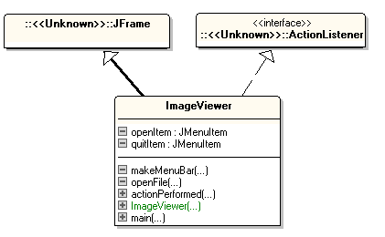
Class Diagram
multiple inheritance, using an interface

Slide 30
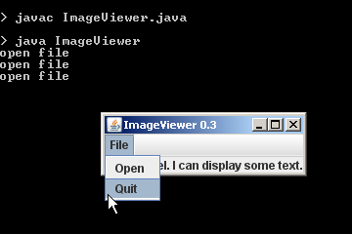
Execution

Slide 31
ImageViewer as a Diagram
GUI
Open
Quit
the 'link'
which
sends an
event e
data
methods
actionPerformed(...) {. . .}

Slide 32
Other Ways of Implementing Listeners
There are two other ways of implementing a listener
as an inner class, inside the GUI class
as a series of anonymous inner classes, one for each component

Slide 33
8. An Inner Class
An inner class is defined inside another class:
public class Enclosing { // fields, methods class Inner { // fields, methods } } // end of Enclosing class

Slide 34
Inner Class Objects
Objects created from an inner class only exist within the enclosing class.
Inner class objects can use the global fields of the enclosing class
useful for implementing listeners

Slide 35
9. ImageViewer with an Inner Listener
Version 0.4
public class ImageViewer extends JFrame
{ // no implements
private JMenuItem openItem, quitItem; // GUI components with actions
public ImageViewer()
{ // just as before }
// no actionPerformed() method
:

Slide 36
private void makeMenuBar()
{ JMenuBar menubar = new JMenuBar();
setJMenuBar(menubar);
JMenu fileMenu = new JMenu("File");
menubar.add(fileMenu);
MenuHandler mh = new MenuHandler(); openItem = new JMenuItem("Open"); // global var
openItem.addActionListener( mh );
fileMenu.add(openItem);
quitItem = new JMenuItem("Quit"); // global var
quitItem.addActionListener( mh );
fileMenu.add(quitItem);
} // end of makeMenuBar()
use same
inner class
object

Slide 37
still inside ImageViewer class
class MenuHandler implements ActionListener
{
public void actionPerformed(ActionEvent event)
// Receive notification of an action
{
Object src = event.getSource();
if (src == openItem)
openFile();
else if (src == quitItem)
System.exit(0);
else
System.out.println("Cannot process action event for " +
event.getActionCommand());
} // end of actionPerformed()
:
globals in ImageViewer

Slide 38
private void openFile()
// open a Swing file chooser to select file
{
// test output, until we do this properly
System.out.println("open file");
} // end of openFile()
} // end of MenuHandler inner class
// ----------------------------------------
public static void main(String[] args)
{ new ImageViewer(); }
} // end of ImageViewer class

Slide 39
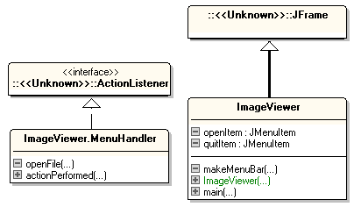
Class Diagrams

Slide 40
Execution (same as before)

Slide 41
Inner Classes Features
Inner classes allow code to be better structured
all the event handling is moved to a separate class from the GUI code
But, the event handler method can still get very large if there are many components, and the components must be declared as globals.

Slide 42
10. An Anonymous (Inner) Class
“Anonymous” means “no name”
an inner class with no name
An object created from an anonymous (inner) class is always referenced via its superclass name, as it has no class name
rather confusing at first
continued

Slide 43
The usual way of using anonymous classes is to use them to implement a separate event handler for each component
lots of anonymous classes, but small
This coding approach means that the GUI components do not need to be declared globally.

Slide 44
An Anonymous Action Listener
// in makeMenuBar() : JMenuItem openItem = new JMenuItem("Open");
openItem.addActionListener( new ActionListener() {
public void actionPerformed(ActionEvent e) {
openFile();
}
}); :

Slide 45
Anonymous Class Elements
Anonymous
object creation
openItem.addActionListener( new ActionListener() {
public void actionPerformed(ActionEvent e) {
openFile();
}
});
Anonymous class definition:
fields, methods (in this case just 1 method)

Slide 46
11. ImageViewer with Anon. Listeners
Version 0.5
public class ImageViewer extends JFrame
{ // no implements
// no globals required
public ImageViewer()
{ // just as before }
// no actionPerformed() method
:

Slide 47
private void makeMenuBar()
{ JMenuBar menubar = new JMenuBar();
setJMenuBar(menubar);
JMenu fileMenu = new JMenu("File");
menubar.add(fileMenu);
JMenuItem openItem = new JMenuItem("Open");
openItem.addActionListener( new ActionListener() {
public void actionPerformed(ActionEvent e)
{ openFile(); }
});
fileMenu.add(openItem);
JMenuItem quitItem = new JMenuItem("Quit");
quitItem.addActionListener( new ActionListener() {
public void actionPerformed(ActionEvent e)
{ System.exit(0); }
});
fileMenu.add(quitItem);
} // end of makeMenuBar()
use two
anon. class
objects

Slide 48
private void openFile()
// open a Swing file chooser to select a file
{
// test output, until we do this properly
System.out.println("open file");
} // end of openFile()
// no inner class
// -----------------------------------------
public static void main(String[] args)
{ new ImageViewer(); }
} // end of ImageViewer class

Slide 49
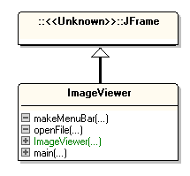
Class Diagram
unfortunately my UML
tool, essModel, does not
show anonymous classes

Slide 50
Execution (same as before)

Slide 51
Anon. Classes Features
Anonymous classes allow event handler code to be placed with the GUI component code
everything is in one place
the GUI components do not need to be globals
less coding required
But, anon. classes can be hard to find and read – keep them small (1-5 lines each)

Slide 52
11.1 Lambda Listener
The ActionListener interface only defines one method -- actionPerformed().
This means the code can be replaced by a Lambda expression:
openItem.addActionListener( e -> openFile() );
Lambda expressions first appeared
in Java 8.

Slide 53
If the actionPerformed() body has more than 1 line of code, then use e -> { ... }
button.addActionListener(e -> {
System.out.println("Handled Action listener");
openFile();
} );

Slide 54
makeMenuBar() uses Lambdas
private void makeMenuBar()
{ JMenuBar menubar = new JMenuBar();
setJMenuBar(menubar);
JMenu fileMenu = new JMenu("File");
menubar.add(fileMenu);
JMenuItem openItem = new JMenuItem("Open");
openItem.addActionListener( e -> openFile() );
fileMenu.add(openItem);
JMenuItem quitItem = new JMenuItem("Quit");
quitItem.addActionListener( e -> System.exit(0) );
fileMenu.add(quitItem);
} // end of makeMenuBar()

Slide 55
12. Listener Implementation Summary
There are three ways to implement a listener:
have the GUI class implement the listener itself (e.g. ImageViewer 0.3)
implement the listener as an inner class (e.g. ImageViewer 0.4)
implement multiple listeners as anonymous (inner) classes (e.g. ImageViewer 0.5)

Slide 56
13. Self-study NOT from java9fp
java9fp does not explain Swing. Instead it looks at JavaFX in chapters 12, 13, and 20.
JavaFX is not examinable, but very interesting
The previous edition of the book contains a chapter on Swing (chapter 12), which I will let you borrow.

Slide 57
Download, compile, and run some of the examples from this section (and the next 3 sections), and from Chapter 12
my code is on the course website in <SITE>/Code/
the chapter 12 code is on the course website in <SITE>/Other Code/ch12.zip

