Slide 1
DIN61-222 Adv. Prog. (Java)
Semester 1, 2019-2020
10. More Abstraction Techniques
Objectives
use a foxes-and-rabbits simulation to introduce abstract classes, interfaces, and multiple inheritance

Slide 2



1. Benefits of Simulation
Use to make predictions:
the weather, the stock market, traffic systems, nuclear processes
safer, cheaper, quicker
Example:
‘How will the wildlife be affected if we build a road through a park?’

Slide 3
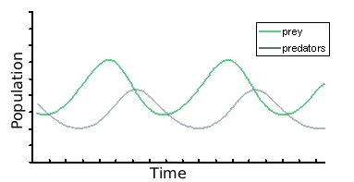

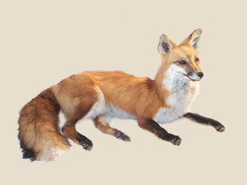
Predator-prey Simulations
There is often a natural balance between wild animals which varies over time.
e.g. rabbits
e.g. foxes

Slide 4
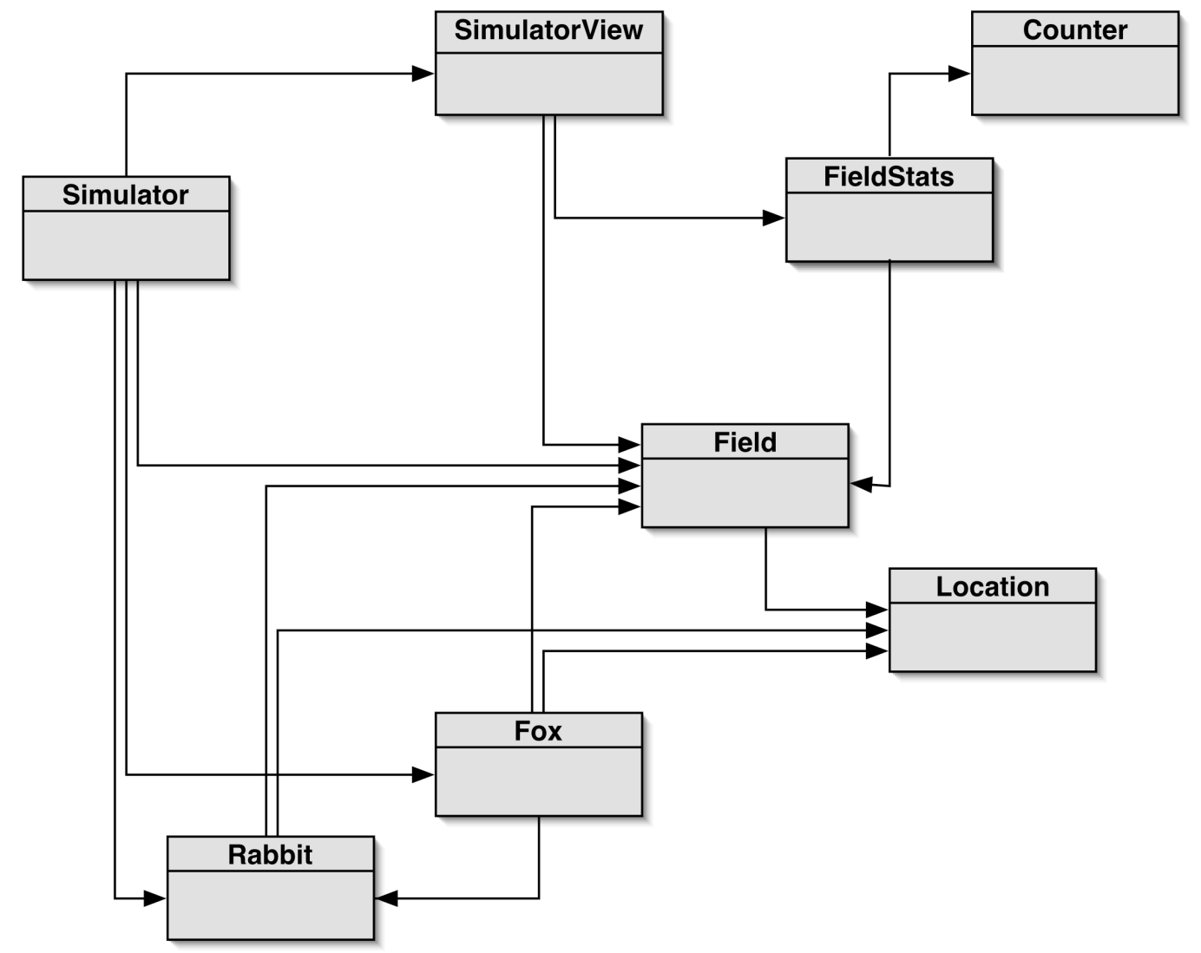
2. Foxes and Rabbits Simulation
application
details are not
important

Slide 5
The Important Classes
Fox
for simulating foxes (the predators)
Rabbit
for simulating rabbits (the prey)
Simulator
manages the overall simulation
holds collections of foxes and rabbits
Field
the field where the foxes and rabbits live
Location
a 2D position in the field

Slide 6
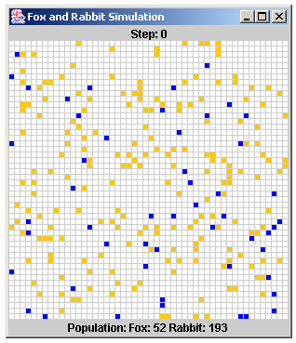
Simulator Running
Rabbits =
orange/yellow
Foxes = blue

Slide 7

Rabbit
public class Rabbit
{
// fields . . .
private int age;
private boolean alive; // alive or not?
private Location location; // position in field
// methods . . .
public void act(Field f, List<Rabbit> rs) { ... }
}

Slide 8

A Rabbit’s Behaviour
Implemented in Rabbit.act():
a rabbit gets older when act() is called
it may die of old age
a rabbit may create new rabbits
a rabbit tries to move to an empty adjacent square in the field
overcrowding will kill a rabbit

Slide 9
Rabbit.act()
The details are not
important.
public void act(Field f, List<Rabbit> rs)
/* A rabbit has babies, moves about, or dies of old age or overcrowding. */
{
incrementAge(); // may die
if (isAlive) {
// have rabbit make babies
for (int i = 0; i < numBabies(); i++) {
Rabbit r = new Rabbit();
Location loc = f.nextTo(location);
f.moveTo(r, loc); // add new rabbit to field
rs.add(r);
} :
continued

Slide 10
// try to move this rabbit
Location newLoc = f.nextTo(location);
if (newLoc != null) // if new location is free
f.moveTo(this, newLoc);
else // can't move - so die
isAlive = false;
}
} // end of act()

Slide 11

Fox
public class Fox
{
// fields. . .
private int age;
private boolean alive; // alive or not?
private Location location; // position in field
private int foodLevel; // increased by eating rabbits
// methods . . .
public void act(Field f, List<Fox> fxs) { ... }
}

Slide 12
A Fox’s Behavior
Implemented in Fox.act():
a fox gets older and hungrier when act() is called
it may die of old age or hunger
a fox may create new foxes
a fox tries to move to a food (rabbit) location or an empty adjacent square in the field
overcrowding will kill a fox

Slide 13
Fox.act()
The details are not
important.
public void act(Field f, List<Fox> fxs)
/* A fox makes babies, moves about looking for food,
or dies of old age, hunger, or overcrowding. */
{
incrementAge(); // may die
incrementHunger(); // may die
if (isAlive) {
// have fox make babies
for (int i = 0; i < numBabies(); i++) {
Fox fx = new Fox();
Location loc = f.nextTo(location);
f.moveTo(fx, loc); // place new fox in field
fxs.add(fx);
} :
continued

Slide 14
// try to move this fox
Location newLoc = findFood(f, location);
if (newLoc == null) // if no food then move randomly
newLoc = f.nextTo(location);
if (newLoc != null) // if new location is free
f.moveTo(this, newLoc);
else // can't move - so die
isAlive = false;
}
} // end of act()

Slide 15
Simplified Simulator Code
ArrayList<Fox> fxs = new ArrayList<Fox>();
ArrayList<Rabbit> rs = new ArrayList<Rabbit>();
Field f = new Field();
populate(f, fxs, rs);
// fill the field with foxes and rabbits at random locs
while (true) {
// update the simulation by one time unit
for(Rabbit r : rs)
r.act(f, rs);
for(Fox fx : fxs)
fx.act(f, fxs);
: }

Slide 16
3. Improving the Code
Place common fields and methods of Rabbit and Fox in a superclass called Animal
Simulator can now be simplified by using a single list of animals

Slide 17
Simplified Simulator Code
ArrayList<Animal> animals = new ArrayList<Animal>();
Field f = new Field();
populate(f, animals);
// fill the field with foxes and rabbits at random locs
while (true) {
// update the simulation by one time unit
for(Animal a : animals)
a.act(f, animal);
: }

Slide 18
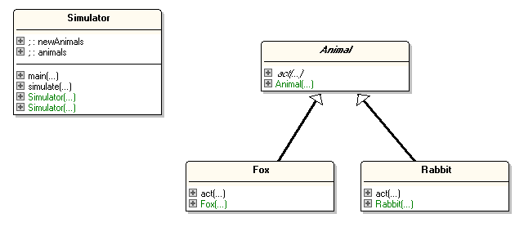
Class Diagrams
uses
is a

Slide 19
Animal.act()
There must be an act() method in Animal.
But it's not clear what code should go in act(), since the behaviours of Rabbit and Fox are different
continued

Slide 20
Instead of writing an Animal.act() method which does nothing useful, define it as abstract: abstract public void act(Field f, List<Animal> as); // no body code for act()
This makes the Animal class become abstract.

Slide 21
The Animal Abstract Class
public abstract class Animal
{
// fields . . .
abstract public void act(Field f, List<Animal> as); // no body code for act()
// other (ordinary) methods . . .
}

Slide 22
Abstract Classes and Methods
An abstract method has no body code
i.e. the method has no implementation
Abstract classes cannot be used to create objects
e.g. you cannot write: Animal a = new Animal();
continued

Slide 23
Subclasses of an abstract class should implement the abstract methods
e.g. Rabbit and Fox should implement act()
Rabbit and Fox are called concrete classes
If a subclass does not implement act() then it becomes abstract (just like Animal), and so cannot create objects.

Slide 24
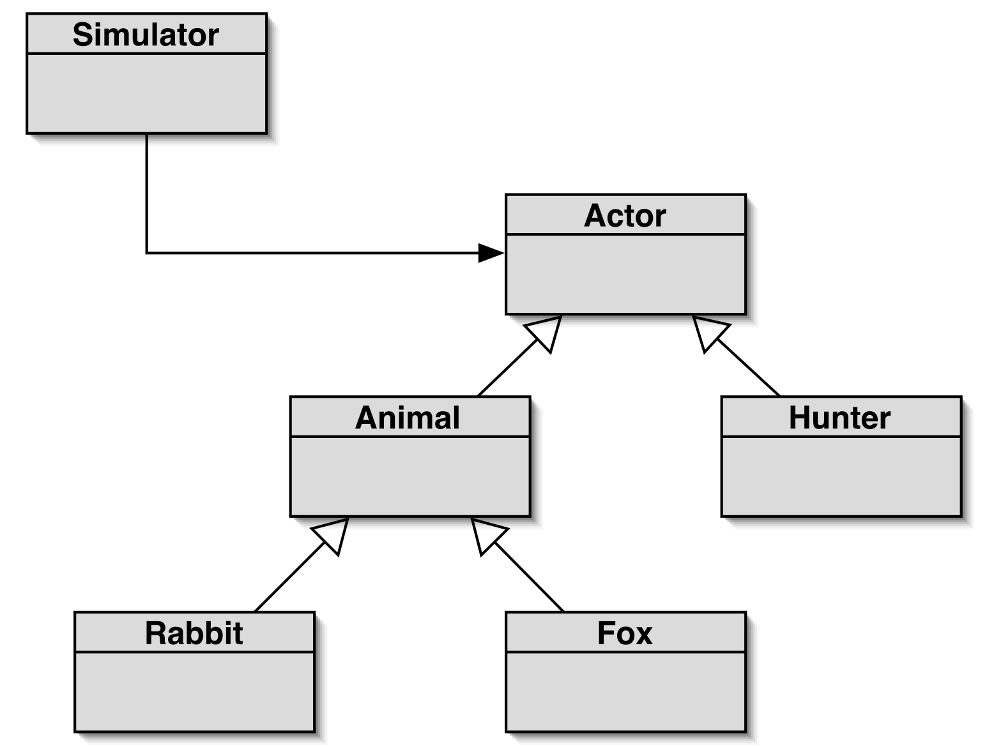

4. More Powerful Simulator
uses
is a
abstract
classes
concrete classes

Slide 25
The Actor Abstract Class
The Actor class contains the common parts of all actors, including an abstract act() method.
public abstract class Actor
{
// fields . . .
abstract public void act(Field f, List<Actor> as); // no body code for act()
// other (ordinary) methods . . .
}

Slide 26
Animal extends Actor, but is still abstract:
public abstract class Animal extends Actor
{
// fields . . .
abstract public void act(Field f, List<Actor> as); // no body code for act()
// other (ordinary) methods . . .
}

Slide 27

Hunter extends Actor, and supplies code for act():
public class Hunter extends Actor
{
// fields . . .
public void act(Field f, List<Actor> as); { // code for Hunter behaviour ... }
// other methods . . .
}

Slide 28
5. From Abstract to Interface
If an abstract class is so general that it has no data fields, and no ordinary methods, then it can be changed into an interface

Slide 29
An Actor Interface
public interface Actor
{
void act(Field f, List<Actor> as);
}
All the methods in an interface are public and abstract by default
so no need to include public and abstract keywords
There is no constructor.

Slide 30



Classes and Interface Summary
A (ordinary) Class.
All methods have
implementations. Can create objects.
An Abstract Class.
Some methods have
implementations; the methods with no implementations
are abstract.
An Interface
No methods have
implementations.
No data.
Cannot create
objects.

Slide 31
Using an Interface
An interface is inherited with the keyword implements (not extends).
The subclass must implement all of the methods in the interface.
continued

Slide 32
Hunter implements the Actor interface by supplying code for act():
public class Hunter implements Actor
{
// fields . . .
public void act(Field f, List<Actor> as); { code for Hunter behaviour ... }
// other methods . . .
}

Slide 33
6. Why have Interface Types?
There are three main reasons for using interfaces:
to support polymorphism
to implement multiple inheritance
to allow classes to offer different implementations for the same thing

Slide 34
6.1. Why have Interface Types? (1)
When a class implements an interface, it becomes the interface's subclass, and must implement all the interface methods and
this allows objects to be grouped together and manipulated more easily

Slide 35
Example
public interface Insurable
// methods required to make an class insurable
{
void setRisk(String risk);
String getRisk();
}

Slide 36
An Insurable Car
public class InsurableCar implements Insurable
{
private String type;
private int yearMade;
private Color colour;
// other fields related to cars...
private String riskKind;
public InsurableCar(String t, int y, Color c)
{ type = t;
yearMade = y;
colour = c;
riskKind = "Third Party, fire and theft";
} // end of InsurableCar()
public String toString()
{ return "CAR: " + colour + ", " + type + ", " + yearMade; }
// other methods related to cars...
continued

Slide 37
These methods MUST
be here since
InsurableCar
implements Insurable.
public void setRisk(String risk)
{ riskKind = risk; }
public String getRisk()
{ return riskKind; }
} // end of InsurableCar class

Slide 38
An Insurable House
public class InsurableHouse implements Insurable
{
private int yearBuilt;
private int numRooms;
// other fields related to houses...
private String riskKind;
public InsurableHouse(int y, int nr)
{ yearBuilt = y;
numRooms = nr;
riskKind = null;
} // end of InsurableHouse()
public String toString()
{ return "HOUSE: " + numRooms + ", " + yearBuilt; }
// other methods related to houses...
continued

Slide 39
public void setRisk(String risk)
{
if (riskKind == null)
riskKind = risk;
else
riskKind = riskKind + " / " + risk;
} // end of setRisk()
public String getRisk()
{ return riskKind; }
} // end of InsurableHouse class
These methods MUST
be here since
InsurableHouse
implements Insurable.

Slide 40
Using Insurables
Collect the insurable
objects together in a
polymorphic array.
public class UseInsurables
{
public static void main(String[] args)
{
Insurable[] ins = new Insurable[3];
ins[0] = new InsurableCar("toyota corolla", 1999, Color.WHITE);
ins[1] = new InsurableHouse(1995, 7);
ins[1].setRisk("Subsidence");
ins[1].setRisk("Flood");
ins[2] = new InsurableCar("porsche", 2007, Color.RED);
ins[2].setRisk("Comprehensive");
ins[2].setRisk("Any Named Driver");
for (Insurable in : ins)
System.out.println(in + " (" + in.getRisk() + ")");
} // end of main()
} // end of UseInsurables class
This method must be
available to every object.

Slide 41

6.2. Why have Interface Types? (2)
Interfaces allow Java to use multiple inheritance
e.g. an iPhone is a phone, and a camera, and a web browser
it is less powerful then multiple inheritance in C++, but simpler to understand, and much faster

Slide 42
Multiple inheritance allows a class to inherit functionality from multiple superclasses.
Java only allows multiple inheritance for interfaces and at most one ordinary (or abstract) class
interfaces have no implementations, so can be 'combined' easily

Slide 43
Example
In the Rabbits & Foxes simulation, have every class inherit Actor and Drawable
Actor is used to represent a thing in the simulation
Drawable is used to draw a thing in the GUI
The Drawable interface:
public interface Drawable
{
void draw(Field f, SimulatorView sv);
}
continued

Slide 44
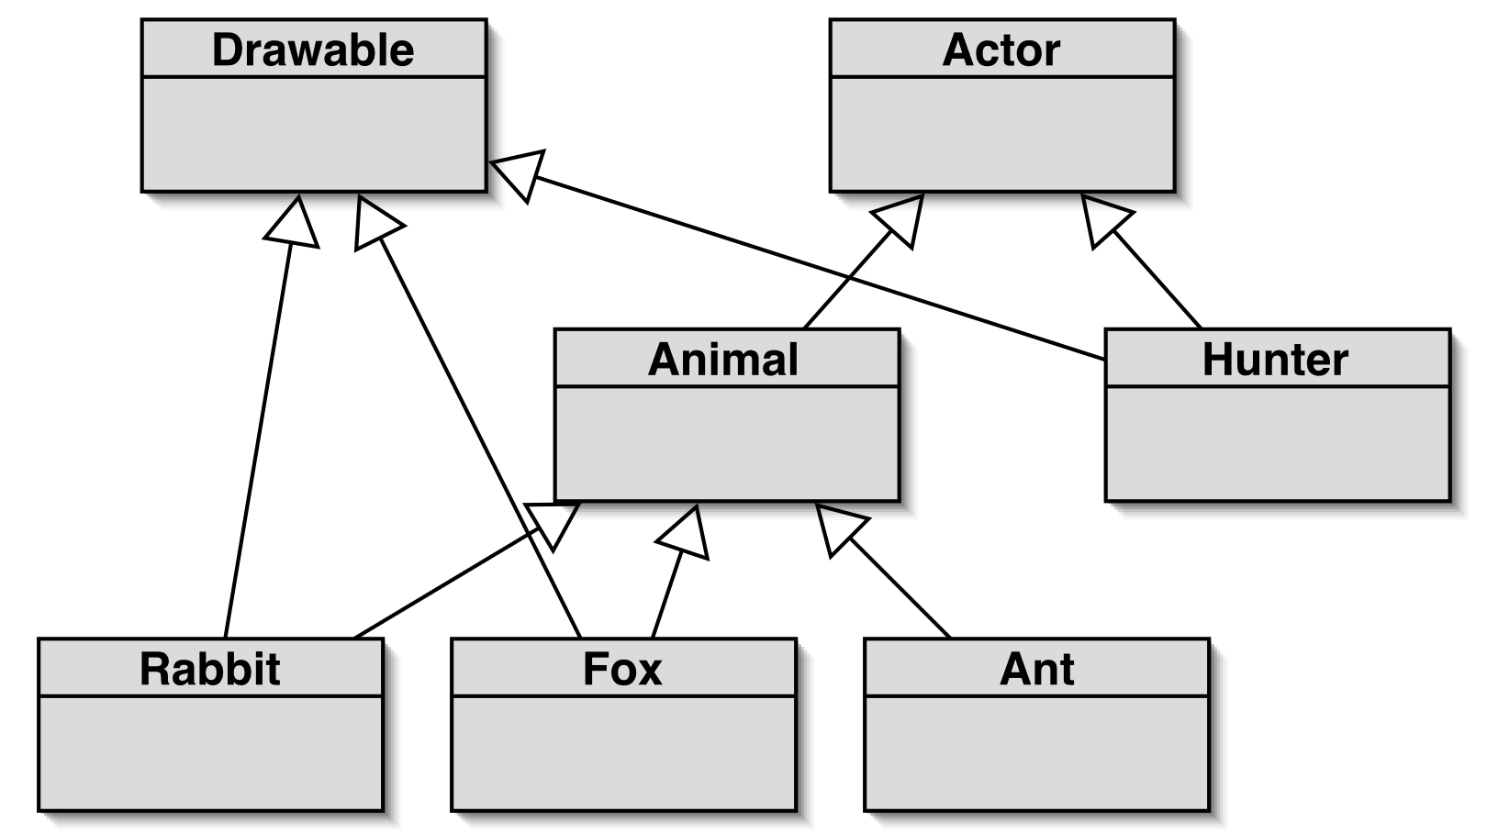
Class Diagram
<<interface>>
<<interface>>
implements
implements
implements
abstract
multiple
inheritance
concrete classes

Slide 45
Classes with Multiple Inheritance
public class Hunter implements Actor, Drawable
{ ...
public void act(Field f, List<Actor> as) // from Actor { ... }
public void draw(Field f, SimulatorView sv) // from Drawable
{ ... }
}
public class Fox extends Animal implements Drawable
{ ...
public void act(Field f, List<Actor> as) // from Animal { ... }
public void draw(Field f, SimulatorView sv) // from Drawable
{ ... }
}
okay, since only one
class

Slide 46
6.3. Why have Interfaces Types ? (3)
A class that implement an interface must implement all the methods
But the class can implement those methods in any way it wants.
This means that two classes that implement the same interface, will have the same methods, but can use different implementations

Slide 47
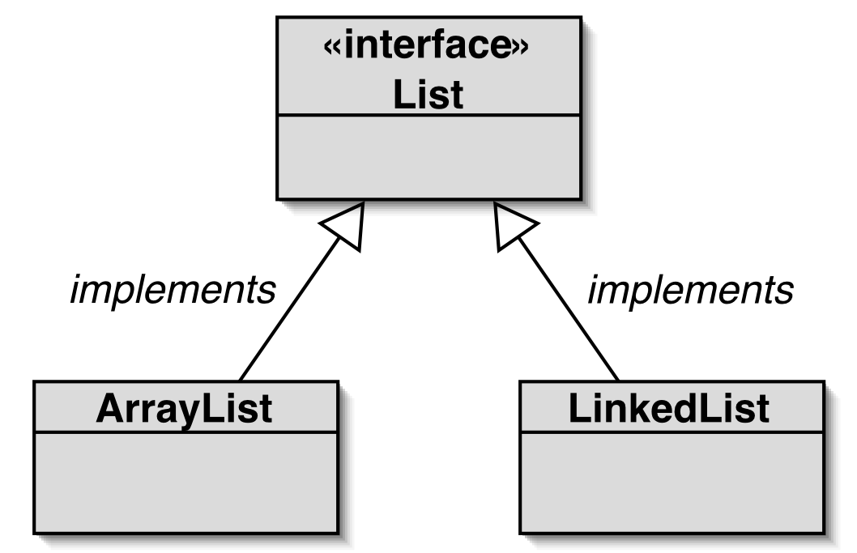
Example
Part of
Java's
collections
library.
both classes offer the same List methods (but implemented differently)
continued

Slide 48
ArrayList and LinkedList have the same methods but different implementations.
ArrayList uses arrays, so has fast search, slow insert/removal.
LinkedList uses "pointers" so has slow search, fast insert/removal.
A user can choose the class that has the best speed for their task. But either class will work since they both have the same interface.

Slide 49
Code Fragment
Using ArrayList:
ArrayList<String> notes = new ArrayList<String>(); notes.add("hello"); notes.add(0, "hi"); System.out.println( notes.get(1) );
To use a LinkedList instead, change only the first line to:
LinkedList<String> notes = new LinkedList<String>();

Slide 50
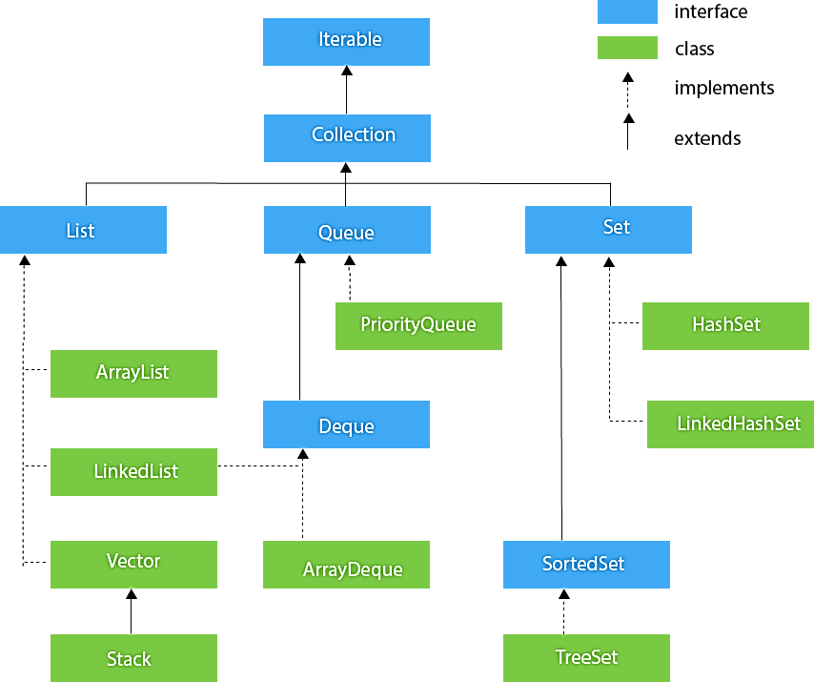
Collections in More Detail

Slide 51
7. Interfaces with default Methods
Since JDK 8, interfaces can now contain public default methods with implementations.
When a class implements the interface, it gets the interface’s default methods.

Slide 52
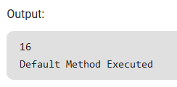
Example
public interface Foo
{
// abstract method
public void square(int a);
// public default method
default void show()
{ System.out.println( "Default Method Executed");
}
}
public class Test implements Foo
{
// impl of square abstract method
public void square(int a)
{ System.out.println(a*a); }
public static void main( String args[])
{
Test t = new Test();
t.square(4);
// default method executed
t.show();
}
}

Slide 53
8. Self-study from java9fp
Read Chapter 10 (Polymorphism & Interfaces)
Download, compile, and run some of the examples from this section and from Chapter 10
my code is on the course website in <SITE>/Code/
the java9fp code is on the course website in <SITE>/Other Code/java9fp/java9fp_examples.zip

