Slide 1
DIN61-222 Adv. Prog. (Java)
Semester 1, 2019-2020
7. Good Class Design
Objectives
introduce coupling, cohesion, responsibility-driven design (RDD), and refactoring

Slide 2
1. Why Class Design?
Getting code to work isn't enough.
The code must also be beautiful.
Benefits of good design:
simplifies debugging, modification, maintenance
makes the code easier to reuse in other projects

Slide 3
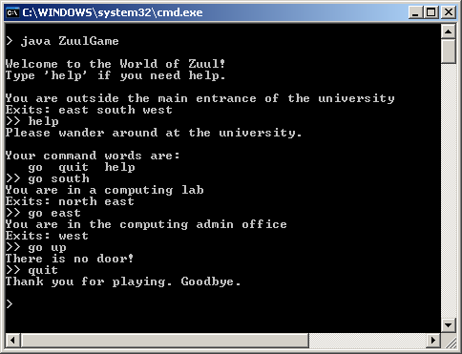
2. World of Zuul
My input follows the ">>" zuul prompts.

Slide 4
Zuul Features
The user can move between a series of rooms, get help, and quit
A real adventure game would allow multiple users, include hidden treasure, secret passwords, death traps, and more.

Slide 5
Zuul Map
rooms
pub
outside
theatre
exits/
doors
lab
office
The user starts in the
"outside" room.
The exits are to the
North, South, East, and West

Slide 6
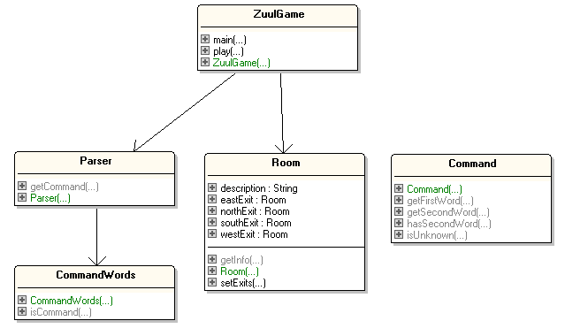
Zuul Class Diagrams
I can see some
problems
already!

Slide 7
Class Descriptions
ZuulGame
creates the rooms, the parser, and starts the game. It evaluates and executes the commands that the parser returns.
Parser
repeatedly reads a line from the terminal and interprets it as a two word command which it returns as a Command object
continued

Slide 8
CommandWords
holds an array of all the command words in the game, which is used to recognise commands
"go", "quit", "help"
Room
represents a room in the game, connected to other rooms via exits. The exits are labelled "north", "east", "south", and "west".
continued

Slide 9
Command
holds information about a user command, consisting of at most two strings
e.g. "go" and "south"

Slide 10
3. Code Design Concepts
Coupling
Cohesion
Responsibility-driven Design (RDD)
Refactoring
Code Size
Thinking Ahead

Slide 11
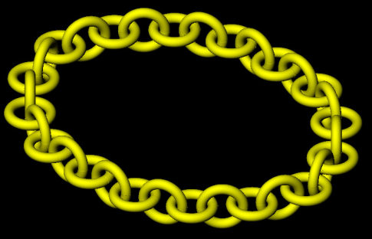


3.1. Coupling
Coupling are the links between classes in an application.
If two classes depend on many details of each other, they are tightly coupled. Usually bad.
Good design aims for loose coupling. Good.

Slide 12
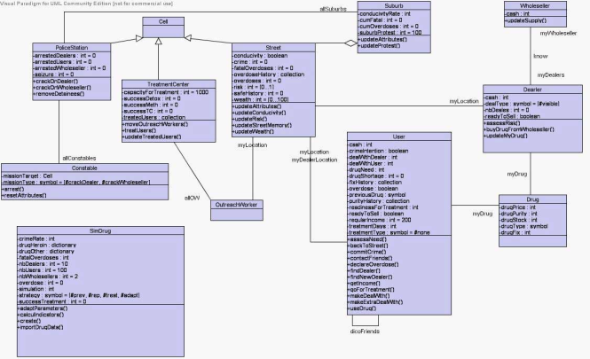
Loose Coupling
In class diagrams, loose coupling means less lines
Loose coupling makes it possible to:
understand one class without reading others
change one class without affecting others
Loose coupling make debugging, maintenance, and modification easier.

Slide 13
Implicit Coupling
Tight coupling based on public data fields is easy to find
look at the class diagram (see slide 6)
Implicit coupling are links that are hard to see.

Slide 14
3.2. Cohesion
Cohesion is the mapping of tasks to methods and classes.
High Cohesion is good. It means:
each class should represent one thing
each method should do one operation
Example:
the Plane class represent a plane
Plane.land() does one task
continued

Slide 15
High cohesion makes it easier to:
understand a class or method
give good names to the class or method
reuse classes or methods in other applications

Slide 16
3.3. Responsibility-driven Design (RDD)
Each class must protect its data
e.g. only use private fields
RDD usually means that code changes will be localized, which is good
i.e. a change only affects the class/method that is being modified
this makes the change easier to understand and implement corectly

Slide 17
3.4. Refactoring
Refactoring is a two-stage redesigning of classes/methods when an application needs modifying.
Usually this leads to existing classes/methods being split up, and new classes/methods are added.
continued

Slide 18
Two Steps
1. Restructure the existing code, keeping the same functionality, with very simple new classes/methods.
debug and test them
2. Add new functionality to the new classes/methods created in step 1.
debug and test again

Slide 19
3.5. Code Size
Common questions:
how big should a class be?
how big should a method be?
A method is probably too long if it does more then one task (e.g. Plane.land_and_take_off())
A class is probably too complex if it represents more than one thing (e.g. Luggage_and_Passenger class)

Slide 20
3.6. Thinking Ahead
When designing a class, think what changes are likely in the future
aim to make those changes easier
Example:
if the user interface is going to change (e.g. text-based → GUI) then make sure all the I/O is carried out in one class

Slide 21
4. Code Duplication in Zuul
Code duplication (BAD) means that a single design change requires code changes in many places
makes maintenance harder
this is a form of tight coupling
e.g. printWelcome() and goDirection() in Room
continued

Slide 22
private void printWelcome()
{
System.out.println();
System.out.println("Welcome to the World of Zuul!");
System.out.println("Type 'help' if you need help.");
System.out.println();
System.out.println("You are " + currRoom.description);
System.out.print("Exits: ");
if (currRoom.northExit != null)
System.out.print("north ");
if (currRoom.eastExit != null)
System.out.print("east ");
if (currRoom.southExit != null)
System.out.print("south ");
if (currRoom.westExit != null)
System.out.print("west ");
System.out.println();
} // end of printWelcome()
continued

Slide 23
private void goDirection(Command command)
{
:
System.out.println("You are " + currRoom.getInfo());
System.out.print("Exits: ");
if (currRoom.northExit != null)
System.out.print("north ");
if (currRoom.eastExit != null)
System.out.print("east ");
if (currRoom.southExit != null)
System.out.print("south ");
if (currRoom.westExit != null)
System.out.print("west ");
System.out.println();
}
} // end of goDirection()
looks
familiar

Slide 24
5. Poor RDD in Zuul
The Room class has poor RDD (BAD): it uses public fields
public String description; public Room northExit, southExit, eastExit, westExit;
The Room implementation is exposed.
Instead, use private fields and get methods
e.g. getExit()
continued

Slide 25
Only Room should manage the room desciption, but since it's a public field, ZuulGame can use it directly:
in ZuulGame.printWelcome():
System.out.println("You are " + currRoom.description);
Make the description field private, and add a get method (getInfo()).

Slide 26
6. Ease of Modification of Zuul?
If adding a new, simple task to the design means a lot of extra coding, then it's an indication that the original design is probably bad.
e.g. how easy is it to add "up" and "down" to the "go" command?
continued

Slide 27
This requires changes in:
Room setExits()
ZuulGame createRooms() printWelcome() goDirection()
room exits are manipulated in too many places: BAD

Slide 28
Why Limit the Exits?
The Room design limits the exits to be "north", "south", "east" and "west". Why? Probably BAD.
The Room class should allow any number of exits, in any direction:
use a HashMap to map a direction name (e.g. "up") to an adjacent Room object
continued

Slide 29
private HashMap<String, Room> adjRooms;
// maps directions to adjacent rooms
// in the Room constructor
adjRooms = new HashMap<String, Room>(); // no adjacent rooms initially
public void setAdjacentRoom(String dir, Room neighbour)
{ adjRooms.put(dir, neighbour); }
continued

Slide 30
The limit of four directions in Room is visible outside the class because of Room.setExits() used by ZuulGame:
Room outside = new Room("outside the main entrance");
Room theatre = new Room("in a lecture theatre");
Room pub = new Room("in the campus pub");
Room lab = new Room("in a computing lab");
Room office = new Room("in the admin office");
// link the room exits
outside.setExits(null, theatre, lab, pub);
theatre.setExits(null, null, null, outside);
pub.setExits(null, outside, null, null);
lab.setExits(outside, office, null, null);
office.setExits(null, null, null, lab);
4 arguments means 4 exits
continued

Slide 31
Recode the interface
change setExits() to setAdjacentRoom(), which sets one exit, and then call it as many times as needed
Room outside = new Room("outside the main entrance");
Room theatre = new Room("in a lecture theatre");
Room pub = new Room("in the campus pub");
Room lab = new Room("in a computing lab");
Room office = new Room("in the admin office");
// link adjacent rooms
outside.setAdjacentRoom("east", theatre);
outside.setAdjacentRoom("south", lab);
outside.setAdjacentRoom("west", pub);
theatre.setAdjacentRoom("west", outside);
pub.setAdjacentRoom("east", outside);
lab.setAdjacentRoom("north", outside); :
multiple
calls means
multiple
exits

Slide 32
7. Implicit Coupling in Zuul
The current commands:
go, help, quit
Add "look" to examine a room without going into it.
Requires changes to:
CommandWords
ZuulGame: modify processCommand() and add a look() method
continued

Slide 33
in processCommand():
String cmdWord = cmd.getFirstWord();
if (cmdWord.equals("help"))
printHelp();
else if (cmdWord.equals("go"))
goDirection(cmd);
else if (cmdWord.equals("quit"))
isFinished = tryQuit(cmd);
else if (cmdWord.equals("look")) look();
// else ignore any other words
continued

Slide 34
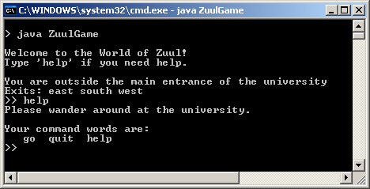
What about the output of "help":
The "help" command is implicitly coupled to CommandWords, which means that "help" should use it to list the commands.
continued

Slide 35
Current version of printHelp():
private void printHelp()
{
System.out.println("Please wander around at the university.");
System.out.println();
System.out.println("Your command words are:");
System.out.println(" go quit help");
}
implicit coupling to
CommandWords

Slide 36
8. Code Size in Zuul
How should items be added to the rooms?
an item has a description and weight
Bad approach:
add description and weight fields to Room
Good approach:
create an Item class, and add a "collection of Items" field to Room

Slide 37
9. Refactoring in Zuul
How can multiple players be added to the game?
currently there is one player represented by the current room he/she is occupying
private Room currRoom; // in ZuulGame
Based on RDD, players should be represented by objects of a new Player class.

Slide 38
Refactoring: Steps 1 and 2
1. Move currRoom to a new Player class. Test ZuulGame with one Player object.
2. Add the extra player fields to Player (e.g. items, strength). Test ZuulGame with one, two, several Player objects.

Slide 39
10. Self-study
Part 16 of these slides (16. Coding Style) gives some simple hints about good coding style, which you should use when coding the project.
I will not go through Part 16 in class; you should read it yourself.

