Slide 1
DIN61-222 Adv. Prog. (Java)
Semester 1, 2019-2020
6. Using Libraries
Objectives
  utilize some useful Java libraries (classes)
    e.g. String, Scanner, HashMap, and Random
Top Tip: google for
<class name> API Java 12

Slide 2
1. Creating a String Object
Four different ways
(there are more).
1
String color = "blue";
String s1 = new String("hello ");
char chs[] = {‘a’, ‘n’, ‘d’, ‘y’};
String s2 = new String(chs);
String s3 = s1 + s2 + " davison";
// + is string concatenation
s1
2
"hello "
3
4

Slide 3
Testing Strings for Equality
s1.equals(s2)
  lexicographical (dictionary) comparison
  returns true if s1 and s2 contain the same text
s1 == s2
  returns true if s1 and s2 reference the same object
Strings should always be compared with equals()
continued

Slide 4
t1
"foo"
t2
String t1 = "foo";
String t2 = "foo";
t1 == t2 returns false since t1 and t2 are different objects
t1.equals(t2) returns true since t1 and t2 contain the same text
"foo"

Slide 5
Comparing Strings
s1.compareTo(s2)
  returns 0 if s1 and s2 are equal
  returns < 0 if s1 < s2; > 0 if s1 > s2
s1.startsWith("text")
  returns true if s1 starts with “text”
s1.endsWith("text")
  returns true if s1 ends with “text”

Slide 6
Locating Things in Strings
for text analysis
s1.indexOf('c')
  returns index position of first ‘c’ in s1, otherwise -1
s1.lastIndexOf('c')
  returns index position of last ‘c’ in s1, otherwise -1
Both of these can also take string arguments:
  s1.indexOf("text")

Slide 7
Extracting Substrings
s1.substring(5)
  returns the substring starting at index position 5
s1.substring(1, 4)
  returns substring between positions 1 and 3
  note: second argument is end position + 1

Slide 8
Changing Strings
s1.replace('a', 'd')
  return new String object; replace every ‘a’ by ‘d’
s1.toLowerCase()
  return new String object where every char has been converted to lowercase
s1.trim()
  return new String object where any white space before or after the s1 text has been removed

Slide 9
Example
s
"HELLO"
String s = "HELLO";
s.toLowerCase();
System.out.println(s); // HELLO
String s1 = s.toLowerCase();
System.out.println(s1); // hello
s = s.toLowerCase();
System.out.println(s); // hello

Slide 10
Other String Methods
There are many more String methods!
  e.g. s.length()
Look at the Java documentation for the String class.
  Google for "String API Java 12"

Slide 11
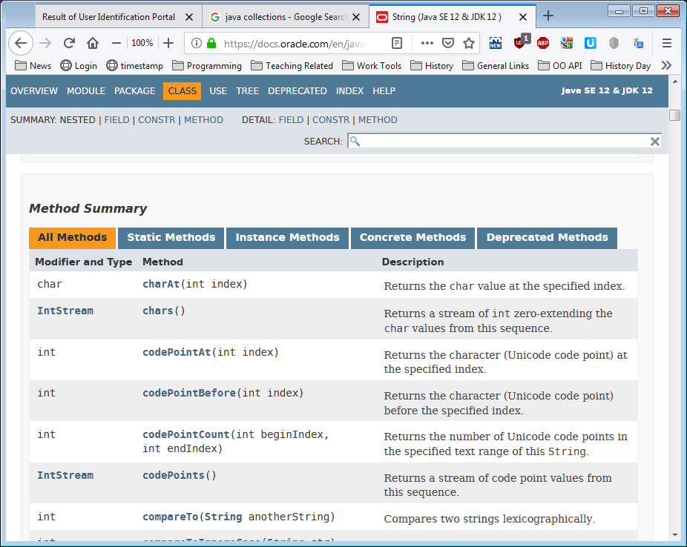

Slide 12
Strings and Arrays
String[] msgs = new String[4];
msgs[0] = "hello";
msgs[1] = new String("hi");
String t = msgs[1];
t.toLowerCase();
msgs[1].toLowerCase();
t = msgs[1].toLowerCase();
What is built?
What is changed?

Slide 13
Objects Diagram
Array Object
msgs
0
1
2
3
t
"hello"
String
objects
"hi"

Slide 14
2. Reading Input with Scanner
The Scanner class reads tokens (words) from an input stream.
The input is broken into tokens based on spaces
  the token separator can be changed
The tokens are usual read in as Strings or primitive types (e.g. int, float, char, double, boolean).

Slide 15
Read an Integer from the Keyboard
Scanner sc = new Scanner(System.in);
int i = sc.nextInt();
sc.close();
You specify the input token type by calling methods like nextInt(), nextDouble(), etc.
continued

Slide 16
2.1. ConsoleAdd.java
import java.util.Scanner;
public class ConsoleAdd
{
public static void main(String[] args)
{ Scanner s = new Scanner( System.in );
System.out.print("Enter first integer: ")
int x = s.nextInt();
System.out.print("Enter second integer: ")
int y = s.nextInt();
s.close();
System.out.println("Adding gives: " + (x+y) );
}
} // end of ConsoleAdd class

Slide 17
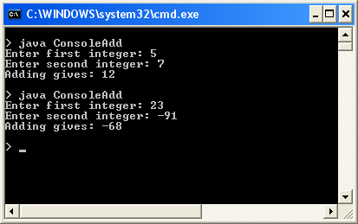
Usage

Slide 18
2.2. Read floats from a File
Scanner sc =
new Scanner(new File("floats.txt"));
while ( sc.hasNextFloat() )
float f = sc.nextFloat();
sc.close();
Scanner supports many nextXXX() and hasNextXXX() methods
  e.g. nextBoolean() and hasNextBoolean()
hasNextXXX() returns true if nextXXX() would succeed.

Slide 19
FloatsAdd.java
import java.io.*;
import java.util.Scanner;
public class FloatsAdd
{
public static void main(String[] args)
{
float num;
float total = 0.0f;
System.out.println("Openning " + args[0]);
:

Slide 20
try {
Scanner sc = new Scanner( new File(args[0]) );
while ( sc.hasNextFloat() ) {
num = sc.nextFloat();
System.out.println(num);
total += num;
}
sc.close();
}
catch(FileNotFoundException e)
{ System.out.println("Error: " + args[0] +
" not found"); }
System.out.println("Floats total = " + total );
}
} // end of FloatsAdd class

Slide 21

floats.txt Input File

Slide 22
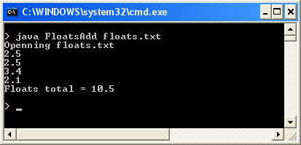
Usage

Slide 23
3. A Technical Support System
A technical support system
  users can describe their software problems and get advice instantly!
It read input from the user a line at a time, and generates 'suitable' responses.

Slide 24
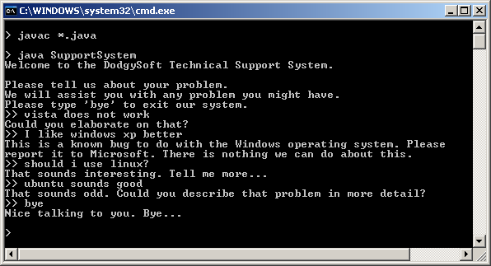
Execution
I type input
after the ">>" prompts.

Slide 25

What Classes and Methods?
Classes:
  a top-level class: SupportSystem
    it will execute a input-response loop
  a class for obtaining input: InputReader
  a class for generating responses: Responder
SupportSystem
Input
InputReader
Processing
Responder
Response

Slide 26
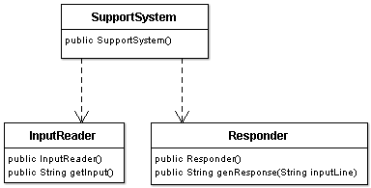
SupportSystem Class Diagrams

Slide 27
SupportSystem Processing Loop
Input
InputReader
printWelcome();
String line, response
boolean finished = false;
while (!finished) {
line = inputReader.getInput();
if (line.startsWith("bye")) // time to stop
finished = true;
else {
response = responder.genResponse(line)
System.out.println( response );
}
}
printGoodbye();
Processing
and Response
Responder

Slide 28
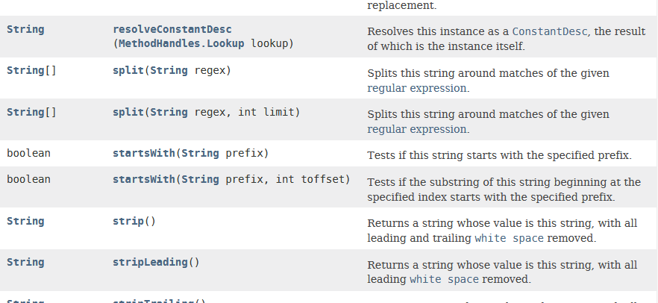
Part of the String API Doc

Slide 29
4. The InputReader Class
import java.util.*;
public class InputReader
{
private Scanner reader;
public InputReader()
{ reader = new Scanner( System.in ); }
Java's name for
stdin / cin
continued

Slide 30
public String getInput()
// Read a line of text from standard input
{
System.out.print(">> "); // print prompt
String inputLine = reader.nextLine();
return inputLine.trim().toLowerCase();
// trim spaces, and make lowercase
} // end of getInput()
} // end of InputReader class

Slide 31
Combining String Ops
String s1 = " ANDREW ";
s1 = s1.trim(); // "ANDREW"
s1 = s1.toLowerCase(); // "andrew"
or
String s1 = " ANDREW ";
s1 = s1.trim().toLowerCase(); // "andrew"

Slide 32
5. The Responder Class
An input line is passed to the responder and, based on the words in the line, the responder generates a String response.
If none of the words are recognized, then a default response is chosen at random.
continued

Slide 33
the input line
"I have a Windows problem"
split into words
"I"
"have"
"a"
"Windows""
"problem"
a map
data
structure
check each
word against
the keys in
a map
key
value
"crash"
"Please reboot...."
"slow"
"Get more memory..."
get a matching
value for the
response
"Windows"
"Switch to Linux"
:
:
:
:
continued

Slide 34
an ArrayList
else randomly
select a default
response from an
ArrayList
use a random
number between
0 and size-1
0
"Please tell me more."
1
"We don't support that OS."
2
"Upgrade your software."
:
:
:
:
size-1

Slide 35
6. Maps
Maps are collections that contain pairs of objects.
  a pair consists of a key and a value
A real-world Map example:
  a telephone book
The programmer passes a key to the Map.get() method, and it returns the matching value (or null).
name → phone no.

Slide 36
Using a Map
A HashMap with Strings as keys and values
HashMap
"Charles Nguyen"
"(531) 9392 4587"
"Lisa Jones"
"(402) 4536 4674"
"William H. Smith"
"(998) 5488 0123"
A telephone book

Slide 37
HashMap is called "Hash" "Map" because it is implemented using hash functions internally, but that is hidden from us.
  think of it as a map

Slide 38
Coding a Map
HashMap <String, String> phoneBook =
new HashMap<String, String>();
phoneBook.put("Charles Nguyen", "(531) 9392 4587");
phoneBook.put("Lisa Jones", "(402) 4536 4674");
phoneBook.put("William H. Smith", "(998) 5488 0123");
String phoneNumber = phoneBook.get("Lisa Jones");
System.out.println( phoneNumber );
prints: (402) 4536 4674

Slide 39
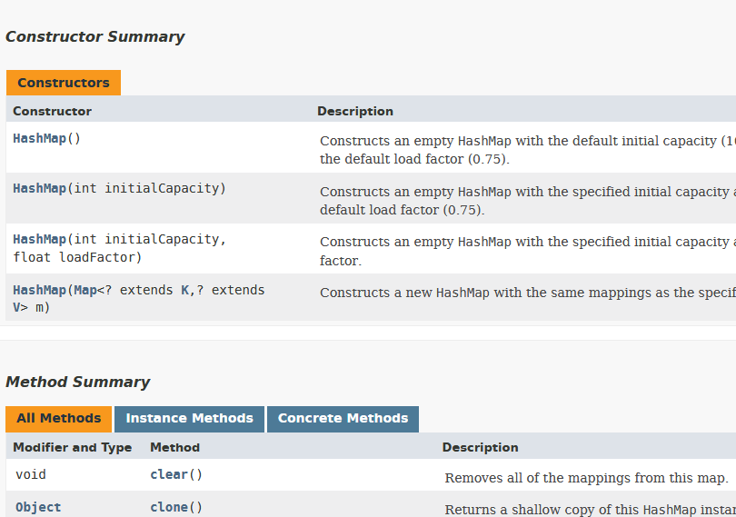
More on HashMap:
  google for "HashMap API Java 12"

Slide 40
7. Making Random Numbers
The library class Random can be used to generate random numbers
  floats, ints, booleans, etc
import java.util.Random;
Random randomGen = new Random();
int r1 = randomGen.nextInt();
// a random positive integer
int r2 = randomGen.nextInt(100);
// an integer between 0 and 99

Slide 41
A Random Example
import java.util.Random;
public class ShowRandom
{
public static void main(String[] args)
{
Random randGen = new Random();
System.out.println("10 random ints between 0 and 100");
for (int i = 0; i < 10; i++)
System.out.print( randGen.nextInt(100) + " ");
System.out.println();
System.out.println("\n5 floats between 0.0f and 1.0f");
for (int i = 0; i < 5; i++)
System.out.print( randGen.nextFloat() + " ");
System.out.println();
}
} // end of ShowRandom class

Slide 42
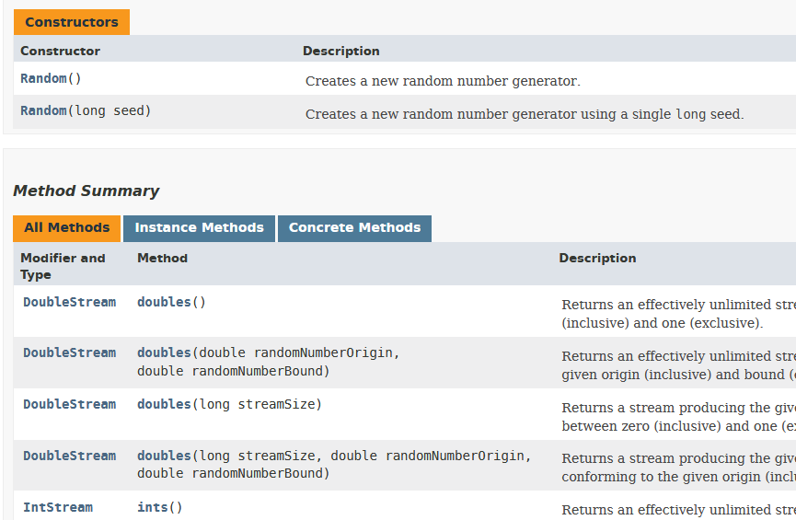
More on Random:
  google for "Random API Java 12"

Slide 43
8. Implementing Responder
public class Responder
{
private HashMap<String, String> respMap;
// map keywords strings to responses strings
private ArrayList<String> defaultResps;
private Random ranGen;
public Responder()
{
initResponses();
initDefaultResponses();
ranGen = new Random();
} // end of Responder()

Slide 44
private void initResponses()
/* Build keywords and their associated responses
into a map. */
{
respMap = new HashMap<String, String>();
respMap.put("crash",
"Well, it never crashes on our system");
respMap.put("configuration",
"Tell me more about your configuration.");
:
} // end of initResponses()

Slide 45
private void initDefaultResponses()
// Build a list of default responses
{
defaultResps = new ArrayList<String>();
defaultResps.add("That sounds odd.");
defaultResps.add("Please tell me more...");
:
:
} // end of initDefaultResponses()

Slide 46
public String genResponse(String inputLine)
// Generate a response from a given input line
{
String[] words = inputLine.split(" ");
// split line into words at spaces
String response = null;
for(int i=0; i < words.length; i++) {
response = respMap.get( words[i] );
if (response != null)
return response;
}
:
Another
String
method

Slide 47
/* None of the words from the input line
were recognized, so randomly select
a default responses to return. */
int i = ranGen.nextInt( defaultResps.size());
// 0 to size-1
return defaultResps.get(i);
} // end of genResponse()
} // end of Responder class

Slide 48
9. Self-study from java9fp
Read Chapter 14 (Strings, ...)
Download, compile, and run some of the examples from this section and from Chapter 14
  my code is on the course website in
  <SITE>/Code/
  the java9fp code is on the course website in
  <SITE>/Other Code/java9fp/java9fp_examples.zip

