Slide 1
DIN61-222 Adv. Prog. (Java)
Semester 1, 2019-2020
5. Methods and Grouping Objects
Objectives
discuss call-by-value and call-by-reference
discuss arrays, ArrayList

Slide 2
1. Parameter Passing
Java use two ways to pass parameters (data) into methods:
call-by-value
call-by-reference

Slide 3
What is Call-by-value?
I can use an example in C, which uses call-by-value.
void foo() { int x = 2; bar(x); printf("x is %d\n", x); }
void bar(int w) { w = 5; }
x
2
w
"x is 2" is printed

Slide 4
To get the new value back to foo(), the w must be returned (copied back):
void foo() { int x = 2; x = bar(x); printf("x is %d\n", x); }
int bar(int w) { w = 5;
return w; }
x
2
w
"x is 5" is printed

Slide 5
What is Call-by-reference?
An example for an imaginary language:
function foo() { integer x := 2; bar(x); print("x is %d \n", x); }
function bar(ref integer w) { w := 5; }
x
2
w
“x is 5” is printed

Slide 6
Call-by-reference creates a reference (or pointer) from w in bar() to x in foo()
when w changes, x is also changed
function foo() { integer x := 2; bar(x); print("x is %d \n", x); }
function bar(ref integer w) { w := 5; }
x
2
w

Slide 7
2. Java’s Parameter Passing
Variables of primitive types (e.g. int, double, char) are passed call-by-value
Object-type variables are passed call-by-reference

Slide 8
Java Call-by-Value Example
public class SimpleCalls
{
public static void main(String[] args)
{
int x = 3;
System.out.println("1. x = " + x);
squareBad(x);
// x = squareGood(x);
System.out.println("2. x = " + x);
} // end of main()
continued

Slide 9
static is used so that main() can call
these methods without creating an object first;
it has nothing to do with parameter passing
private static void squareBad(int x)
{
System.out.println("sqBad 1. x = " + x);
x = x*x;
System.out.println("sqBad 2. x = " + x);
}
private static int squareGood(int x)
{
System.out.println("sqGood 1. x = " + x);
x = x*x;
System.out.println("sqGood 2. x = " + x);
return x;
}
} // end of SimpleCalls class

Slide 10
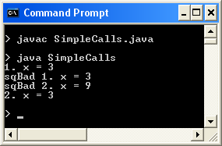

Execution
When calling squareBad()
→ no change to x in main()
When calling squareGood()
→ x is changed in main()

Slide 11
3. A Counter Class
public class Counter {
private int val;
public Counter(int x) { val = x; }
public void incr()
{ val++; }
public int getVal()
{ return val; }
}

Slide 12
Making Objects
Counter c = new Counter(5);
Counter d = new Counter(2);
c
a reference (pointer)
d
variable
val
5
val
2
Counter
object

Slide 13
4. Passing an Object to a Method
public static void main(String[] args) {
Counter c = new Counter(5);
foo(c);
System.out.println( c.getVal() );
}
private static void foo(Counter w)
{ w.incr(); }
What is printed? 6

Slide 14
Call-by-Reference Diagram
main()
foo(Counter w)
c
reference
back to
object
val
w
5
: w.incr();
:
:
foo(c); sop( c.getVal() );

Slide 15
5. The Meaning of x = y
Java has primitive types (e.g. int, char, boolean, etc) and classes (String, Integer, Counter, etc).
Assignment for primitive types copies the data value
a form of call-by-value
Assignment for objects copies the reference
a form of call-by-reference

Slide 16
5.1. Primitive Type Assignment
int c = 5;
int d;
d = c; // COPY DATA VALUE
d++;
System.out.println( c );
What is printed? 5
d
c
5

Slide 17
5.2. Object Assignment
Counter c = new Counter(5);
Counter d;
d = c; // COPY REFERENCE
d.incr();
System.out.println( c.getVal() );
What is printed? 6
c
val
5
Counter
object
d

Slide 18
6. Arrays
Java arrays look like C arrays, but...
Arrays are objects, and so are passed to methods using call-by-reference.

Slide 19
Create an Array in 2 steps
declare a variable
create array object with new
int c[] = new int[12]; // creates a 12 element int array c[0] = 2; // OK
or
int c[]; // declares a var; no object yet c[0] = 2; // ERROR! c = new int[12]; // allocates array object c[0] = 2; // OK
continued

Slide 20
In diagrams
int c[]; // declares a variable
c = new int[12]; // create array object
c[0] = 2;
c
...
c
0
1
11
object

Slide 21
1
3
4
6
n
0
1
2
3
confusing, since no 'new' is required
object
or:
int n[] = {1, 3, 4, 6} // creates a 4 element integer array
A common error:
int foo[12]; // a syntax error in Java

Slide 22
More Ways to Create an Array
Instead of:
int c[] = new int[12]; // OK
Can write:
int[] c = new int[12]; // OK
...
c
0
1
11
object

Slide 23
UseArray.java
int n[] = new int[10];
import javax.swing.JOptionPane;
public class UseArray
{
public static void main(String[] args)
{
int n[]; // declare var
n = new int[10]; // create array object
// no values stored in n[], so will contain 0's
String output = "Cell Value\n";
for(int i = 0; i < n.length; i++)
output += "n[" + i + "] == " + n[i] + "\n";
JOptionPane.showMessageDialog( null, output,
"Using an Array", JOptionPane.INFORMATION_MESSAGE );
} // end of main()
} // end of UseArray class
or
I've used two lines, just
because I can

Slide 24
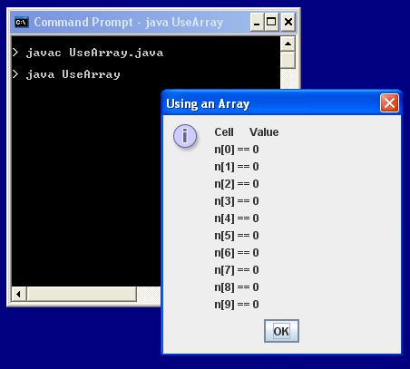
Execution

Slide 25
Notes
n variable; no object
int n[]
n is allocated array object with new
n = new int[10];
n.length
length always holds the length of the array object (i.e. 10 in this case)
n
...
n
0
1
9
object

Slide 26
Using an Array
Square brackets are used to access an array element:
n[i]
Array elements are used like ordinary variables
on the left of an assignment:
n[0] = 3;
in an expression:
x = n[1] – 3;
n[i]++;

Slide 27
7. Passing Arrays to Methods
Arrays are objects
they are passed to methods using call-by-reference
i.e. changes to an array inside a method affects the original

Slide 28
PassArray.java
public class PassArray
{
public static void main(String[] args)
{
int a[] = { 1, 2, 3, 4, 5 };
System.out.println("Values in the original array:");
for(int i = 0; i < a.length; i++)
System.out.print( a[i] + " ");
System.out.println(); :

Slide 29
modifyArray(a); // pass array call-by-reference
System.out.println("Values in the modified array:");
for(int i = 0; i < a.length; i++)
System.out.print( a[i] + " ");
System.out.println();
System.out.println("Before: a[3] = " + a[3]);
modifyElement(a[3]); // pass call-by-value
System.out.println("After: a[3] = " + a[3]);
} // end of main()
continued

Slide 30
b is an array
var, so passed
call-by-reference
private static void modifyArray(int b[])
// multiply each element by 2
{ for (int j = 0; j < b.length; j++)
b[j] *= 2;
}
private static void modifyElement(int elem)
// multiply elem by 2
{ elem *= 2; }
} // end of PassArray class
no return required
elem is a
primitive type,
so passed
call-by-value

Slide 31
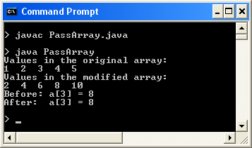
Execution
changed
unchanged

Slide 32
Notes
This application uses call-by-reference to change an entire array object, a
it changes back in main()
It also tries to changes an array element, a[3], by using call-by-value (copying)
it does not change back in main()

Slide 33
Call-by-Reference Diagram
main()
modifyArray(int b[])
1
2
3
4
5
object
reference
back to
object
b variable
a
: b[i] *= 2; :
:
modifyArray(a); :

Slide 34
Call-by-Value Diagram
main()
modifyElement(int elem)
2
4
6
8
10
8
elem
object
a
: elem *= 2; :
:
modifyElement( a[3]); :
value is
copied
over

Slide 35
8. Collections of Objects
Many applications involve collections of objects:
personal organizers
library catalogs
student-record system
The number of stored items varies over time as new items are added and old ones removed.
Arrays have a basic problem: their size is fixed
e.g. int[] c = new int[10];
what should the size be for a student-record array?

Slide 36
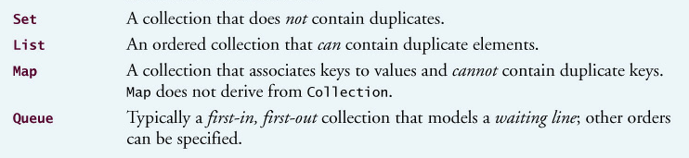
Collection Classes
Java supports four main kinds of collection classes, which are stored in the java.util package.

Slide 37
ArrayList
The ArrayList collection class is a list data structure with no fixed size
it grows and shrinks depending on how many objects are stored inside it
It's called an "Array" "List" because it is implemented using arrays internally, but that is hidden from us.
Think of it as a list.

Slide 38
ArrayList Example
ArrayList<String> msgs = new ArrayList<String>(); // no fixed size
msgs.add(“hello”);
msgs.add(“see you”);
String s1 = msgs.get(0);
System.out.println(“size: “ + msgs.size());
ArrayList Object
msgs
0
1
2
. . .
“hello”
“see you”
String
objects

Slide 39
remove() Complicates Things
msgs.remove(0);
System.out.println( msgs.size() ); // 1
String s2 = msgs.get(0); // "see you"
ArrayList Object
msgs
0
1
2
. . .
“see you”
String
object

Slide 40
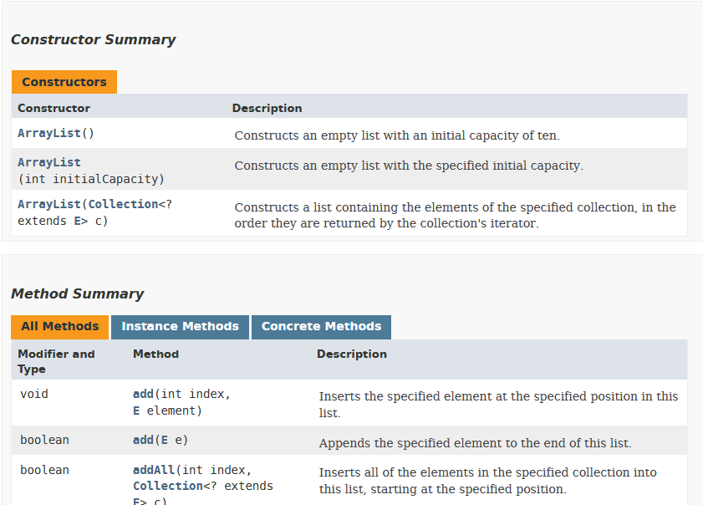
More on ArrayList:
Google for "ArrayList API Java 12"

Slide 41
10. A Counters Example
An ArrayList of Counter objects.
cnts
ArrayList object
0
1
2
. . . .
Counter
objects

Slide 42
CountersStore Class
public class CountersStore { private ArrayList<Counter> cnts; public CountersStore() { cnts = new ArrayList<Counter>(); } public void add(Counter c) { cnts.add(c); } public Counter get(int idx) { if ((idx < 0) || (idx >= cnts.size()) { System.out.println("Index out of range"); return null; } return cnts.get(idx); } } // end of CountersStore class

Slide 43
Using CountersStore
public class CountersStoreDemo
{
public static void main(String[] args)
{ CountersStore cs = new CountersStore(); Counter c1 = new Counter(5); cs.add(c1); cs.add ( new Counters(7) ); // second object added Counter c = cs.get(1); // get reference to second object c.incr(); // 7 --> 8 System.out.println( c.getVal() ); // prints 8 Counter foo = cs.get(1); // get reference to second object System.out.println( c.getVal() ); // prints 8! }
)

Slide 44
The References
cs
CountersStore object
cnts
ArrayList object
0
1
2
c1
. . . .
c
5
Counter
objects
foo
7

Slide 45
11. Generic Classes
Collections are known as parameterized or generic classes.
The type parameter says what we want in the list:
ArrayList<Counter>
ArrayList<String>
etc.

Slide 46
12. Self-study from java9fp
Read Chapter 7 (Arrays and ArrayLists)
Download, compile, and run some of the examples from this section and from Chapter 7
my code is on the course website in <SITE>/Code/
the java9fp code is on the course website in <SITE>/Other Code/java9fp/java9fp_examples.zip

