Slide 1
DIN61-222 Adv. Prog. (Java)
Semester 1, 2019-2020
4. Object Interaction
Objectives
  introduce modularization and abstraction
  explain how an object uses other objects

Slide 2
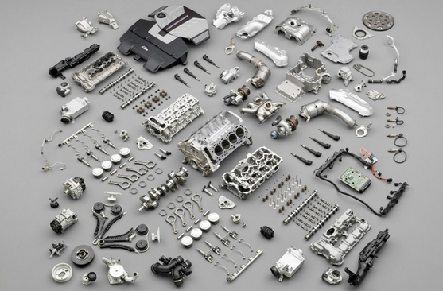
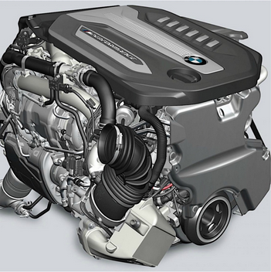
1. Modularization and Abstraction
Modularization divides a problem into
simpler sub-parts, which can be built separately, and which interact in simple ways.
move down
to a lower
level

Slide 3

Abstraction is the ability to combine low level details of a problem into higher levels.
move up
to a higher
level

Slide 4
Use in Programming
Use modularization to split a programming problem into sub-parts (modules).
  implement the modules
The implementation of the complete program will be easier, since abstraction can be used to write software in terms of the modules.

Slide 5

Example: Robot Software
modularization
?

Slide 6
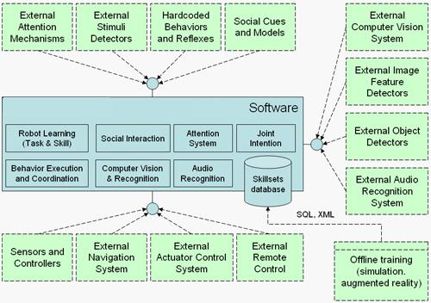
Code as Modules
Modules
("black
boxes")
Abstraction
"links" the
modules
together
using their
visible
interfaces.

Slide 7
Use in OOP
Use modularization to split the Robot programming problem into objects.
Implement the classes for the objects.
The implementation of the Robot class will be easier, since it will be coded using the smaller classes (e.g. Audio, Vision, Sensor).

Slide 8
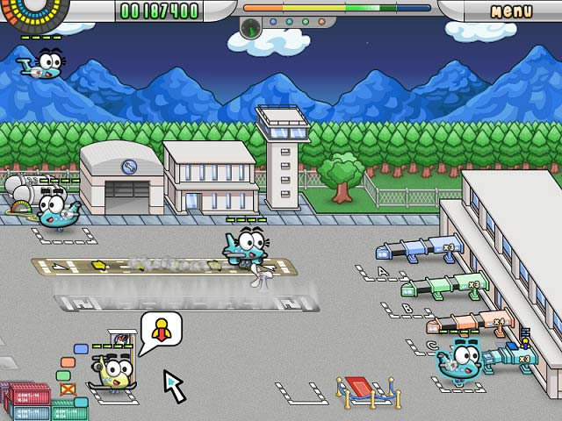
e.g. Airport Control System
modularize
into objects
(things)
Plane2
Passenger1
Plane1
Gate2
Luggage1
Gate1
Gate3
Passenger2
abstract into
classes
Plane
Gate
Airport
Luggage
Passenger
abstract (combine)
into class for problem

Slide 9
Objects to Classes
Consider what an object does (i.e. its interface)
  e.g what can a Plane object do?
  take-off, land, connect-to-gate, load-passengers, unload-passengers, load-luggage, unload-luggage
These become the public methods of the Plane class:
  void takeOff(); void land();
  void connect(Gate g);
  void load(Passenger p); void load(Luggage l);
  void unload(Passenger p); void unload(Luggage l);
The class will implement these methods.

Slide 10
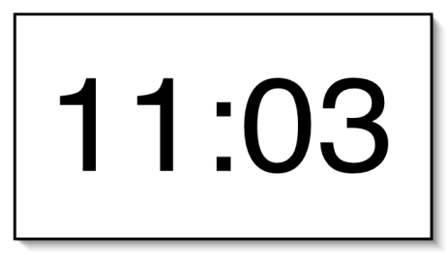
2. A Digital Clock
Implement a digital clock display, which shows the hours (0-23) and minutes (0-59).

Slide 11


Modularizing the Clock Display
Divide the clock display problem into two parts
  how to display the hours
  how to display the minutes
We need two number display objects
We need a NumberDisplay class
ClockDisplay object
two
NumberDisplay
objects

Slide 12
NumberDisplay Interface
What public methods are needed for a NumberDisplay class?
  get and set the number
  return the number as a string
    useful for printing
  increment the number
    the number will 'loop'
    e.g. 0, 1, 2, ..., 59, 0, 1, ... for the minutes display
    e.g. 0, 1, 2, ..., 22, 23, 0, 1, ... for the hours display

Slide 13
The NumberDisplay Class
public class NumberDisplay
{
private int currValue;
private int maxValue;
// number at which currValue goes back to 0
public NumberDisplay(int max)
{ maxValue = max;
currValue = 0;
}
continued

Slide 14
public void setValue(int newValue)
/* Set currValue to the new value.
If the new value is less than
zero or over maxValue, don't set it.
*/
{ if ((newValue >= 0) && (newValue < maxValue))
currValue = newValue;
}
public int getValue()
{ return currValue; }
continued

Slide 15
public String getDisplayValue()
// return currValue as a string
{
if (currValue < 10)
return "0" + currValue; //pad string with leading 0
else
return "" + currValue;
}
public void increment()
/* Increment currValue, rolling over to zero if the
maxValue is reached. */
{ currValue = (currValue + 1) % maxValue; }
} // end of NumberDisplay class

Slide 16
ClockDisplay Interface
What public methods are needed for a ClockDisplay class?
  initialize the clock and set the time
  return the current time as a string
    useful for printing
  increment the time by one minute
The time will be displayed using two NumberDisplay objects.

Slide 17
The ClockDisplay Class
two private
NumberDisplay
fields
public class ClockDisplay
{
private NumberDisplay hours;
private NumberDisplay minutes;
private String currTimeString;
// the current time as a string
public ClockDisplay()
// intialize the clock to 00:00
{
hours = new NumberDisplay(24);
minutes = new NumberDisplay(60);
setTimeString();
}
create two
NumberDisplay
objects
continued

Slide 18
a private method is
one that only other
methods in the class
can call
private void setTimeString()
/* store the current time as a string
of the form "hours:minutes" */
{
currTimeString = hours.getDisplayValue() +
":" +
minutes.getDisplayValue();
}
method calling
in NumberDisplay
objects
continued

Slide 19
public void setTime(int hour, int minute)
// set time to the specified hour and minute
{
hours.setValue(hour);
minutes.setValue(minute);
setTimeString();
} // end of setTime()
public String getTime()
// return the current time as a string
{ return currTimeString; }
method calling
in NumberDisplay
objects
continued

Slide 20
public void minIncrement()
// increment the clock by one minute;
// hour increments when minutes roll over to 0
{
minutes.increment();
if (minutes.getValue() == 0) // mins rolled
hours.increment();
setTimeString();
} // end of minIncrement()
} // end of ClockDisplay class

Slide 21
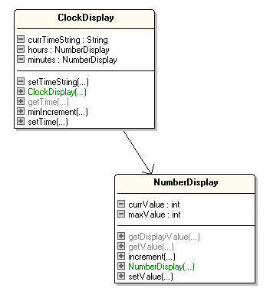
Classes Diagram
uses

Slide 22
3. Using ClockDisplay
public class ClockDemo
{
public static void main(String[] args)
{
ClockDisplay clock = new ClockDisplay();
clock.setTime(14, 10); // set time to 14:10
while(true) {
clock.minIncrement();
System.out.println(" tick...");
System.out.println("Current time: "+clock.getTime());
wait(100); // slow down the looping
}
} // end of main()

Slide 23
wait() is a static method
so it can be called by main()
without main() having to create
an object first.
private static void wait(int milliseconds)
/* stop execution for milliseconds
amount of time */
{
try {
Thread.sleep(milliseconds);
}
catch (Exception e) { }
} // end of wait()
} // end of ClockDemo class
sleep() is a method
in Java's Thread class

Slide 24
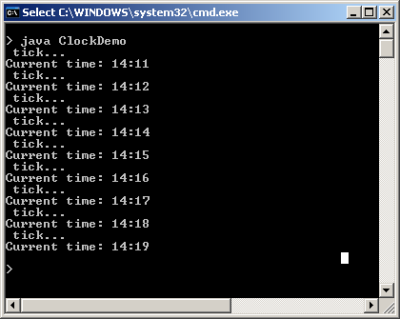
Compilation and Execution
Compile all java file
$ javac *.java
I typed ctrl-c to
stop the looping.

Slide 25
Objects Diagram for ClocksDemo
NumberDisplay object
ClockDisplay object
clock
currValue
hours
14
maxValue
24
minutes
currTimeString
NumberDisplay object
currValue
19
14:19
maxValue
60
String object

Slide 26
4. A More Graphical Clock
Michael Kölling and Bruce Quig write a Canvas class for displaying text and shapes in a window.
We can use their Canvas to display the changing clock display instead of using stdout.
Note: I do not care how Canvas is implemented; I only care about its interface (i.e. its public methods)

Slide 27
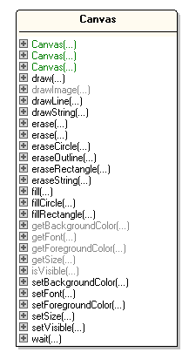
Canvas
Class
Diagram
Only showing the
public methods
(the interface).
To use Canvas, we only
need to understand its
interface.
I don't care how it is
implemented.

Slide 28
ClockCanvasDemo
Using Canvas
(compare to
slide 22)
public class ClockCanvasDemo
{
public static void main(String[] args)
{
Canvas canvas = new Canvas("Clock Demo",300,150, Color.white);
canvas.setVisible(true);
canvas.setFont( new Font("Dialog", Font.PLAIN, 96));
ClockDisplay clock = new ClockDisplay();
clock.setTime(14, 10); // set time to 14:10
while(true) {
clock.minIncrement();
canvas.erase(); // clear the canvas
canvas.drawString( clock.getTime(), 30, 100);
canvas.wait(100); // slow down the looping
}
} // end of main()
} // end of ClockCanvasDemo class

Slide 29
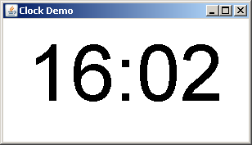
Compilation and Execution
Compilation now includes
ClockCanvasDemo.java and
Canvas.java
$ javac *.java
$ java ClockCanvasDemo

Slide 30
5. Drawing the Clock with StdLib
The "Programming in Java" website (https://introcs.cs.princeton.edu/java/home/) by Robert Sedgewick and Kevin Wayne includes a JAR file called stdlib.jar
  https://introcs.cs.princeton.edu/java/
  stdlib/stdlib.jar
The JAR file acts like a "package" containing multiple classes.

Slide 31
Stdlib.jar Classes
Docs at https://introcs.cs.princeton.edu/java/stdlib/
StdDraw.java draw geometric shapes in a window
StdIn.java read numbers and text from stdin
StdOut.java write numbers and text to stdout
StdAudio.java create, play, and manipulate sound
StdRandom.java generate random numbers
StdStats.java compute statistics
StdArrayIO.java read and write 1D and 2D arrays
In.java read numbers and text from files and URLs
Out.java write numbers and text to files
continued

Slide 32
Draw.java draw geometric shapes
DrawListener.java support keyboard and mouse events in Draw
Picture.java process color images
GrayscalePicture.java process grayscale images
Stopwatch.java measure running time
StopwatchCPU.java measure running time (CPU)
BinaryStdIn.java read bits from standard input
BinaryStdOut.java write bits to standard output
BinaryIn.java read bits from files and URLs
BinaryOut.java write bits to files

Slide 33
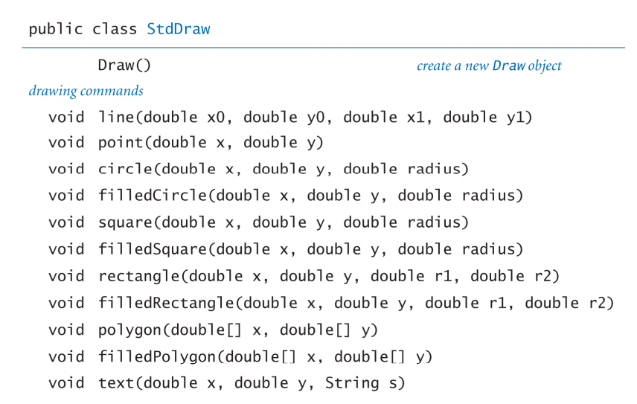
StdDraw Class
https://introcs.cs.princeton.edu/java/stdlib/StdDraw.java.html
continued

Slide 34
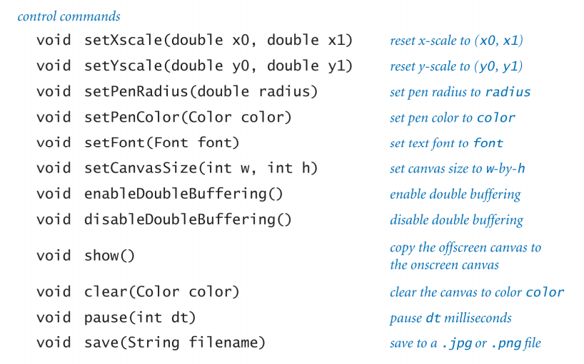

Slide 35
Implementation vs Interface
I do not care how the StdDraw class is implemented. I only need to know the interface (i.e. its public methods).

Slide 36
ClockDraw.java
public class ClockDraw
{
public static void main(String[] args)
{
StdDraw.setFont( new Font("Dialog", Font.PLAIN, 96));
ClockDisplay clock = new ClockDisplay();
clock.setTime(14, 10);
while (true) {
clock.minIncrement();
StdDraw.clear();
StdDraw.text(0.5, 0.5, clock.getTime()); // (x,y) is center
StdDraw.show();
StdDraw.pause(100);
}
} // end of main()
} // end of ClockDraw class

Slide 37
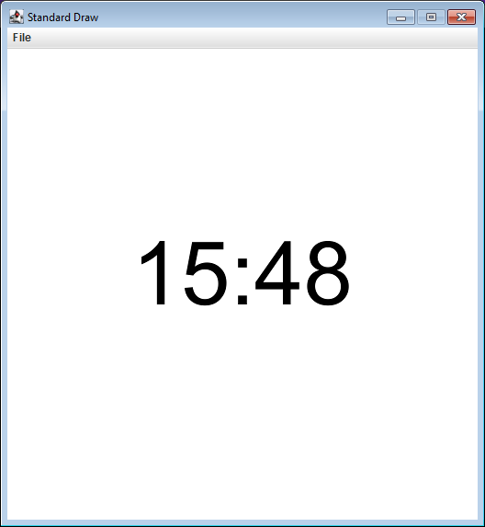
Compilation and Execution
$ javac -classpath .;stdlib.jar ClockDraw.java
$ java -classpath .;stdlib.jar ClockDraw
Tell Java to load the stdlib.jar JAR file

Slide 38
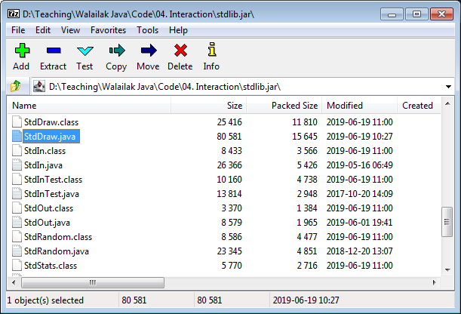
Looking Inside JAR Files
A JAR file is just a zipped directory of compiled Java classes, with optional source code.
Using 7-zip (or similar), you can look inside the JAR:

Slide 39
6. Self-study from java9fp
Read Chapters 4 and 5 (Control Statements)
  C-like: if, while, for, switch
Download, compile, and run some of the examples from the chapters.

