Slide 1
DIN61-222 Adv. Prog. (Java)
Semester 1, 2019-2020
2. Simple Java Programs
Objectives
give some simple examples of Java applications

Slide 2
1. Steps in Writing a Java Appl.
text file holding the application
Foo.java
javac Foo.java
call the Java compiler
Foo.class
class file holding Java bytecodes
java Foo
execute the class using the Java runtime system (the JVM)

Slide 3
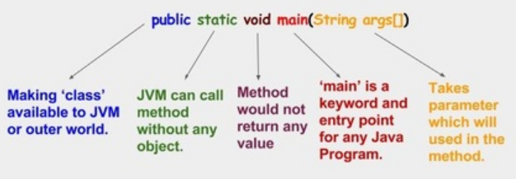
2. Hello.java
import java.io.*; public class Hello
{ public static void main(String args[]) { System.out.println(“Hello Andrew”); } } // end of class

Slide 4
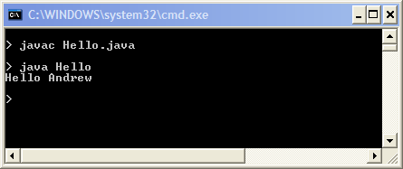
Compile & Run

Slide 5
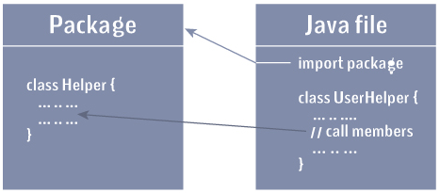
Notes
import imports pre-defined classes from the java.io package
* means “all classes”
The Java file (e.g. Hello.java) must contain a public class with the file’s name (e.g. Hello class).

Slide 6
System.out is the standard output stream
like cout (C++) or stdout (C)
System.out.println() is the main print function (method) in Java.
writes to screen
via output stream
Hello
main() calls
System.out.println(…)

Slide 7
3. A Better Programming Environment?
When first learning Java, it is best to use a simple programming environment
it forces you to understand how the language works
I write/compile/execute my programs using a simple configuable text editor called Notepad++
see http://notepad-plus-plus.org/
continued

Slide 8
Useful Notepad++ features
it will format Java code automatically
colour-coded display of code
it is possible to add calls to javac, java to the Notepad++ menu
no need to leave the editor to compile/run
there is an optional window that show the output from running Java code

Slide 9
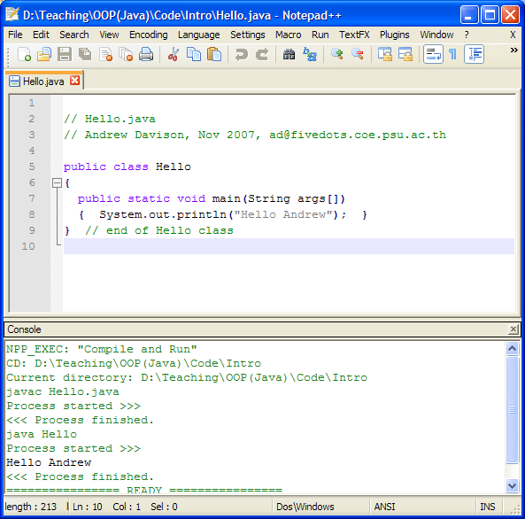

Slide 10
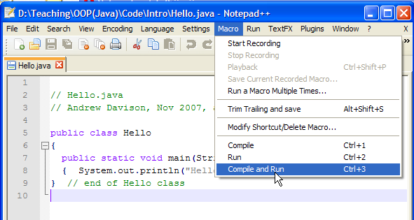
Notepad++ Macro Menu
Read the Notepad++Java.pdf document
at the course Website in /Assorted

Slide 11
4. Comparison.java
import javax.swing.JOptionPane; // GUI dialogs public class Comparison { public static void main( String args[] ) { String firstNumber,secondNumber,result; int number1,number2; // read user numbers firstNumber = JOptionPane.showInputDialog( "Enter first integer:"); secondNumber = JOptionPane.showInputDialog( "Enter second integer:" ); :

Slide 12
// convert numbers number1 = Integer.parseInt( firstNumber ); number2 = Integer.parseInt( secondNumber ); result = ""; if ( number1 == number2 ) result = number1 + " == " + number2; if ( number1 != number2 ) result = number1 + " != " + number2; if ( number1 < number2 ) result = result + "\n" + number1 + " < " + number2; if ( number1 > number2 ) result = result + "\n" + number1 + " > " + number2; if ( number1 <= number2 ) result = result + "\n" + number1 + " <= " + number2 :

Slide 13
if ( number1 >= number2 ) result = result + "\n" + number1 + " >= " + number2; // Display results JOptionPane.showMessageDialog( null, result, "Comparison Results", JOptionPane.INFORMATION_MESSAGE ); } // end of main() } // end of Comparison class

Slide 14
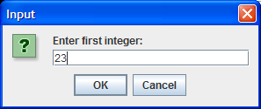
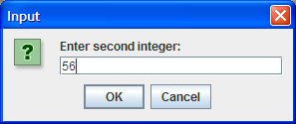
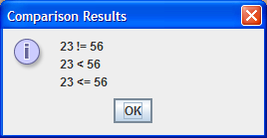
Compile & Run
$ javac Comparison.java $ java Comparison

Slide 15
Notes
The Comparison class is just a single main() function (method)
showInputDialog() and showMessageDialog() are simple (but quite flexible) methods for reading/writing input in dialog boxes
defined inside the JOptionPane class
continued

Slide 16
Notice the use of familiar C/C++ control structures (e.g. if, while) and data types (e.g. int, double)
"..."+"..." means concatenation (put strings together)
String is a pre-defined class for strings.
int is a built-in type (just like C’s int).

Slide 17
Calling Methods
Methods are defined in classes.
Syntax for calling a method: Class.method-name
or object.method-name
e.g. JOptionPane.showMessageDialog(...);
this calls the showMessageDialog() method in the class JOptionPane
Classes start
with an upper
case letter.

Slide 18
The Integer Class
int is a C-like built-in type
Integer is a Java class for integers
used when integer methods are required
Integer.parseInt() converts a string to int

Slide 19
Classes as Libraries
One way of using a class is as a library for useful methods.
the JOptionPane class has many methods for creating different kinds of dialog boxes;
the Integer class has many methods for manipulating integers

Slide 20
5. Classes, Packages, Modules
The Java "libraries" consist of 100's of classes, which are organized using packages and modules.
Related classes are stored in a package.
Related packages are stored in a module.
Example: there are many classes related to IO (Input/Output).
e.g. BufferedReader, Console, File, StringWriter, etc.
these are stored in the java.io package

Slide 21
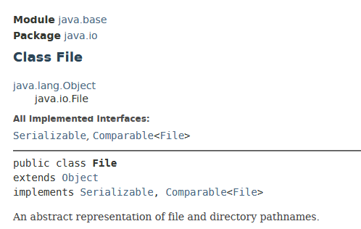
The Java IO package is one of many basic packages that are needed by almost all Java programs
commonly needed packages include: java.io, java.lang, java.math, java.net, etc.
these are stored in the java.base module
If you look at the documentation for the File class, it starts with its containing module and package:

Slide 22
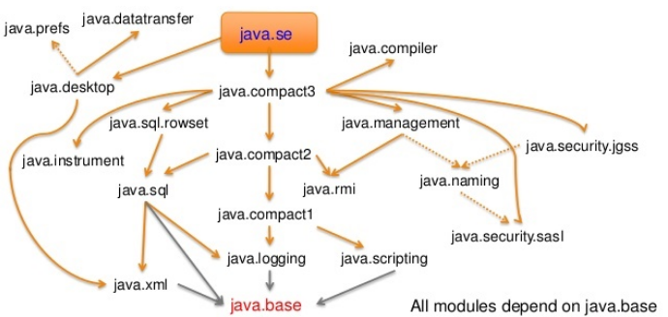
Modules "depend" on Each Other

Slide 23
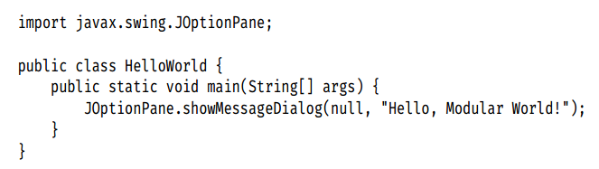
Our Programs
We will not be using modules in our Java programs.
We will be using packages. We list what we need in the import line of a program:
package
class
method

Slide 24
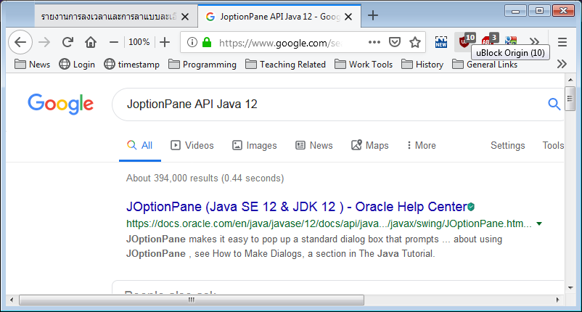
Finding Java Documentation
The easiest way to find information on a class in Java is to use the Google search query:
<class name> API Java 12
e.g.
click on the
"Oracle Help"
link

Slide 25
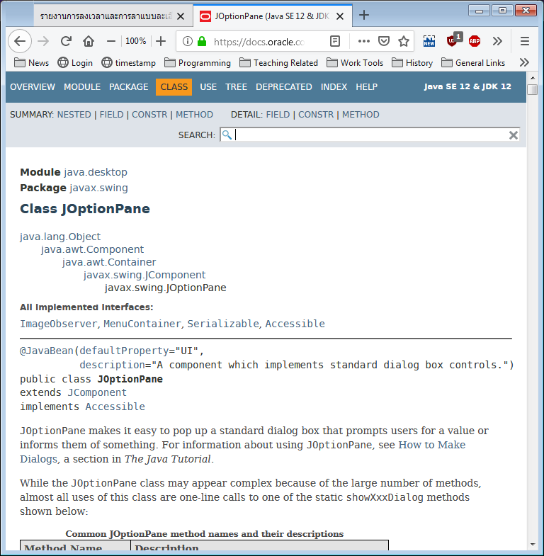

Slide 26
6. JShell
The JShell program provides a “read-evaluate-print loop”(REPL) where you type a Java expression.
JShell evaluates your input, prints the result, and waits for your next input.
The Windows 32-bit version of Liberica JDK 12.0.1 has an error in jdwp.dll in <JDK>/bin
Replace it with the jdwp.dll on the course website for JShell to work. Backup the old version as jdwp.dll.BAK

Slide 27
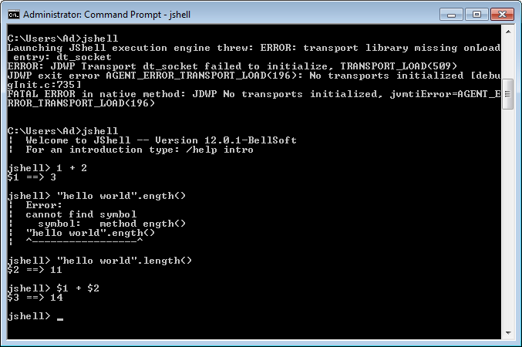
Problem
After replacing jdpw.dll

Slide 28
More Information on JShell
Oracle's Java Shell User’s Guide
https://docs.oracle.com/en/java/javase/12/ jshell/introduction-jshell.html
Chapter 23 of java9fp
reading this is optional

Slide 29
7. Self-study from java9fp
Read Chapter 2 (Intro to Java Apps, ...)
Download, compile, and run some of the examples from this section and from Chapter 2
my code is on the course website in <SITE>/Code/
the java9fp code is on the course website in <SITE>/Other Code/java9fp/java9fp_examples.zip

