Slide 1
DIN61-222 Adv. Prog. (Java)
Semester 1, 2019-2020
Please ask
questions
1. Preliminaries
Andrew Davison CoE, PSU ad@fivedots.coe.psu.ac.th
Objective
to give some background on the course

Slide 2
1. Outline of the Course
To develop skills in (introductory) object oriented programming (using Java) and object oriented modeling.
You must have passed DIN61-114 "Data structures and algorithms"
a good knowledge of C is assumed
We will use Liberica JDK 12 on Windows
https://bell-sw.com/pages/java-12.0.1/

Slide 3
Main Topics
More OOP; less Java
Java imperative features
Classes and Objects
Object Interaction; Grouping Objects
Using Libraries; Good Class Design
Inheritance, Abstraction
GUIs: the event model, layout
Exception (error) handling

Slide 4
2. Meeting Time / Location
Saturday | 2 hours; afternoon | ??
Saturday | 2 hours; evening | ??
Sunday | 1-2 hours; am | ??
Sunday (Lab) | pm | ??
I will be teaching here 6 times during the semester:
weeks 1, 4, 6 (before midterm)
weeks 10, 12 14 (after midterm)

Slide 5
3. Workload (% of total score)
Two Exercises
ex 1 ; weeks 5-7; worth 10%
ex 2; weeks 11-13; worth 10%
Java programming project
weeks 13-15; worth 20%
Mid-term Exam: 25% (2 hours)
Final Exam: 35% (3 hours)

Slide 6
Non-Attendence Penalty
I may take registration at the start of a class.
If someone is not there, they lose 1% (unless they have a good excuse).
A maximum of 10% can be lost
deducted from your final mark

Slide 7
4. Course Materials
All the handouts (and other materials, such as code examples) will be placed on-line at:
http://fivedots.coe.psu.ac.th/~ad/ teaching/AP222/
Print using 6 slides/page to save trees.

Slide 8
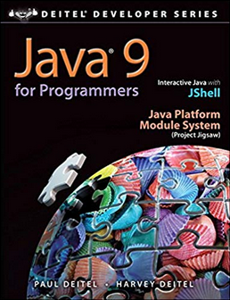
5. Reading Materials
"Java 9 for Programmers" (java9fp) Paul J. Deitel and Harvey Deitel, Prentice Hall, 4th edition, 2017
Code examples available at:
http://www.deitel.com/Books/Java/ Java9forProgrammers/tabid/3686/Default.aspx
I have a copy of this book, which I will make available to the students.

Slide 9
Self –study from java9fp
I will be assigning reading from java9fp, which will be tested on the exercises, project, and in the exams.

Slide 10
JDK 12 Documentation
https://docs.oracle.com/en/java/javase/12/
Java Tutorials:
https://docs.oracle.com/javase/tutorial/ tutorialLearningPaths.html
Java API documentation:
https://docs.oracle.com/en/java/javase/12/docs/ api/index.html

Slide 11
6. Java, JDK, etc.
Java is the name of the programming language.
JDK is the Java Development Kit
it consists of Java Runtime Environment (JRE) and tools to compile and debug Java
sometimes called Java SE (Standard Edition) and J2SE
JRE consists of the Java Virtual Machine (JVM) and programming libraries to run Java applications.

Slide 12
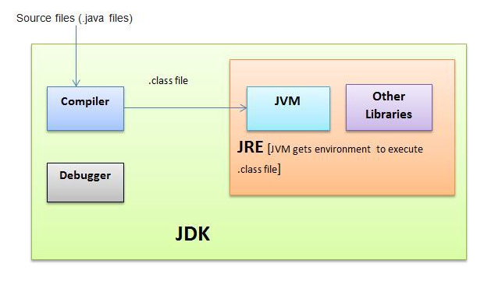

Slide 13
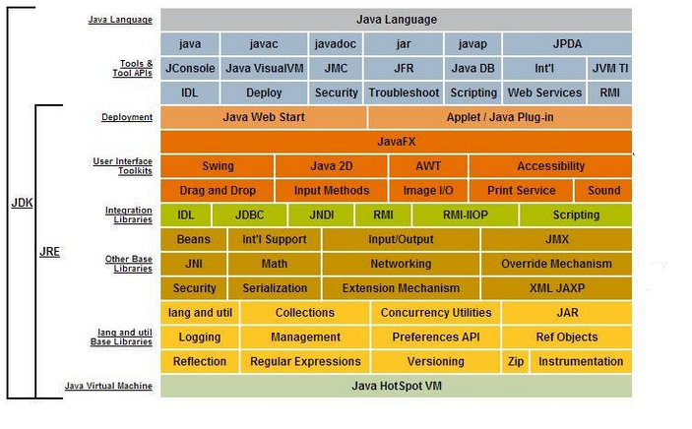
In More Detail (not examinable)

Slide 14
JDK Versions
Oracle JDK
the commercial implementation of the Java language
business users have to pay to use it!
OpenJDK
an open source implementation of Java with contribution from Oracle and others
Liberica JDK
a build of OpenJDK by BellSoft aimed at 32-bit machines

Slide 15
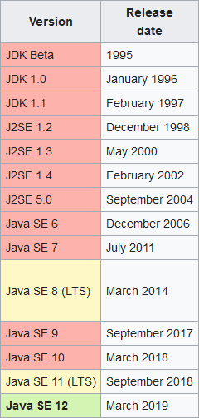
Java Versions
JDK 12

Slide 16
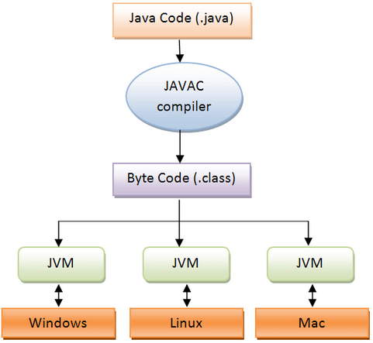
Java Runs Everywhere
But the "everywhere" must have a JVM installed on it.

Slide 17
7. Self-study from java9fp
Download and install Liberica JDK 12
https://bell-sw.com/pages/java-12.0.1/
Read Chapter 1
see me if you need the book

