Slide 1
Discrete Maths
Please ask
questions
240-213, Semester 2, 2022-2023
0. Preliminaries
Who we are: Aj. Taweesak rtaweesak@coe.psu.ac.th
Aj. Andrew ad@fivedots.coe.psu.ac.th
course leader;
teaching after midterm
teaching up
to midterm
Objective
to give some background on the course

Slide 2
Overview
What is Discrete Maths?
Meeting Times / Locations
Workload
Exercises
Course Materials
Books
Video
Math Web Sites

Slide 3
1. What is Discrete Maths?
Mathematical Reasoning
logic (propositional, predicate), proofs, induction
Combinatorics (counting)
requires search techniques in hard cases
Data Structures
e.g. sets, relations, graphs, trees
Algorithms (in 240-310)
functions, recursion, automata, grammars
analyze the memory used and running time
is an algorithm correct?
Number Theory
primes, encryption

Slide 4
Continuous Maths
Calculus
integration, differentiation
Infinite series, limits
Numerical analysis
approximate answers to complex problems

Slide 5
Discrete Mathematics as a Gateway
Importance in many computing courses:
Computer Architecture, Data Structures, Algorithms, Programming Languages, Compilers, Computer Security, Databases, Artificial Intelligence, Networking, Graphics, Game Design, Theory of Computation, ...
Uses beyond computing:
Concepts from discrete maths have been applied to many areas, such as chemistry, biology, linguistics, geography, business, etc.

Slide 6
Prerequisites
You must have passed 240-207 “Programming and Data Structures” (or similar)
knowledge of C is assumed

Slide 7
2. Meeting Times / Locations
Section 1: Friday, 14:30 – 16:30 (2 hours), R200
Section 2: Friday, 10:30 – 12:30 (2 hours), R200

Slide 8
3. Workload
Exercises 1: 10% (weeks 7 – 8)
Mid-term Exam: 35% (week 9)
two hours
Exercises 2: 10% (weeks 15-16)
Final Exam: 45% (weeks 17-18)
three hours
may
change

Slide 9
Non-Attendence Penalty
We may take registration at the start of a class.
If someone is not there, they lose 1% (unless they have a good excuse).
A maximum of 10% can be lost
deducted from your final mark

Slide 10
4. Exercises
They will be maths problems, perhaps with some simple algorithms to design/write.
There may be a small amount of coding, and you code in C, Java (or ask me)
Cheating will result in 0 marks.
YOU HAVE BEEN WARNED!!

Slide 11
5. Course Materials
No laptops, iPads, etc.
allowed in Aj. Andrew's
classes
All the handouts (and other materials) will be placed on-line at
http://fivedots.coe.psu.ac.th/ Software.coe/DiscreteMaths/
You should bring the printed slides and a pen/pencil to class so that you can write notes on them.
Print 6/8 slides per page, in grayscale

Slide 12
6. Books
Discrete Mathematics and its Applications Kenneth H. Rosen McGraw Hill, 2007, 7th edition
http://www.mhhe.com/math/advmath/ rosenindex.mhtml
Aj. Andrew has a copy that you can borrow.
There are many copies in the CoE library
main source;
very clear
continued

Slide 13
Schaum's Outlines: Discrete Mathematics Seymour Lipschutz and Marc Lipson McGraw Hill, 2007, 3rd ed.
less mathematical, more examples
Aj. Andrew has a copy that you can borrow.

Slide 14
7. Video
Discrete Mathematics (Arsdigita University) Instructor: Shai Simonson
http://www.youtube.com/ watch?v=Nt7JeGCZL5M&list=PL45589688F3702281
Based on the Rosen textbook
More information at:
http://archive.org/details/arsdigita_02_discrete_math
http://www.aduni.org/courses/discrete/

Slide 15
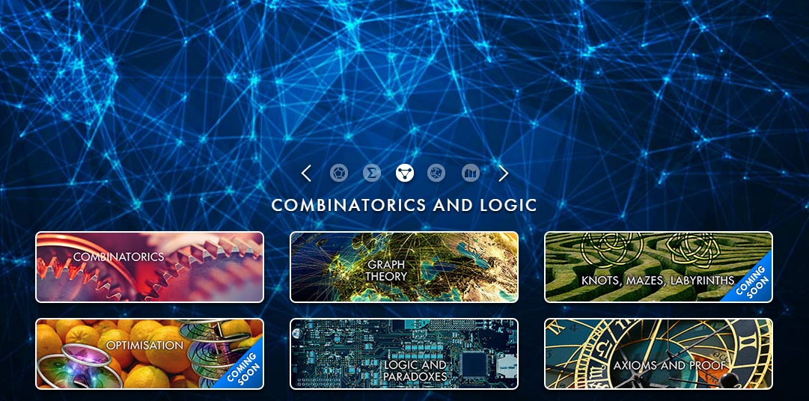
8. Math Web Sites
There are many – search for "Discrete Math"
One beautiful, fun site:
Mathigon: World of Mathematics
http://world.mathigon.org/

