Slide 1



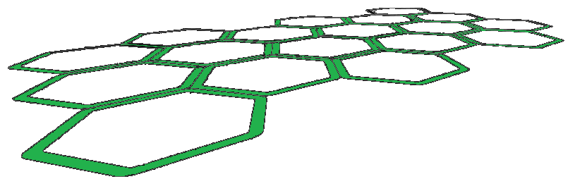

Kinect Open Source Programming Secrets
Hacking the Kinect with OpenNI, NITE, and Java
Andrew Davison
Prince of Songkla University
Thailand
ad@fivedots.coe.psu.ac.th

Slide 2
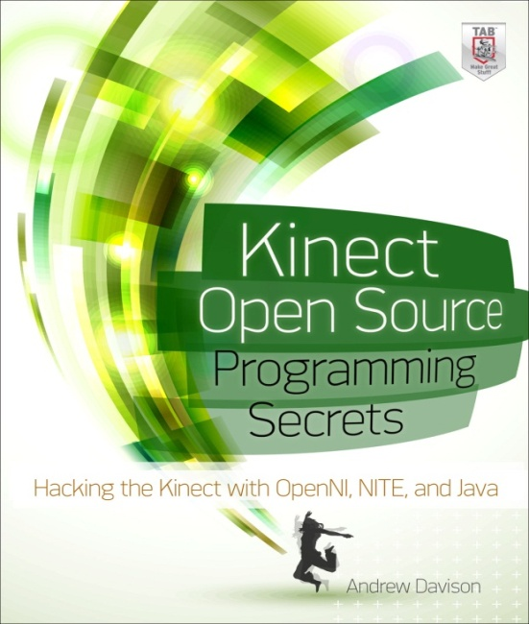
Overview
http://fivedots.coe.psu.ac.th/~ad/kinect
1. The Kinect Sensor
2. Maps
3. Skeletons
4. Hand Points
and Gestures
5. Computer Vision
6. Augmented Reality
7. Summary
using OpenNI
using NITE
as an input source
to other libraries
Eight examples
(if I have time)

Slide 3
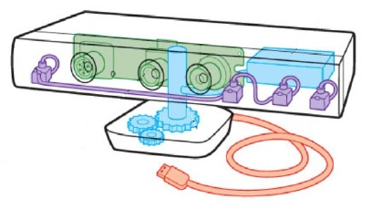
1. The Kinect Sensor
CMOS color sensor
(for RGB imaging)
one microphone
(downward facing)
status LED
three-axis
accelerometer
three microphones
(downward facing)
IR light
source
CMOS IR
sensor
motorized
tilting base
(up/down ~30°)
used for 3D
depth sensing

Slide 4
2. Depth, Image, IR Maps
The IR light emits a
fixed pattern of spots
(randomly distributed)

Slide 5
Map Generation
Depth Generator
Image
Generator
IR
Generator
initialize context
and generator(s)
OR
OR
Depth
Map
Image
Map
IR
Map
wait on context update
read map
camera
image
repaint

Slide 6
Initialization
Context context = new Context();
License license = new License("PrimeSense",
"0KOIk2JeIBYClPWVnMoRKn5cdY4=");
context.addLicense(license);
DepthGenerator depthGen = DepthGenerator.create(context);
MapOutputMode mapMode = new MapOutputMode(640, 480, 30);
// xRes, yRes, FPS
depthGen.setMapOutputMode(mapMode);
context.setGlobalMirror(true);
context.startGeneratingAll();

Slide 7
Wait, Read, Repaint Loop
while (isRunning) {
try {
context.waitAnyUpdateAll();
}
catch(StatusException e)
{ System.out.println(e);
System.exit(1);
}
updateDepthImage(); // my code
repaint();
}
try { // close down
context.stopGeneratingAll();
}
catch (StatusException e) {}
context.release();

Slide 8
OpenNI Generators
primarily used
by middleware
(e.g. NITE)

Slide 9
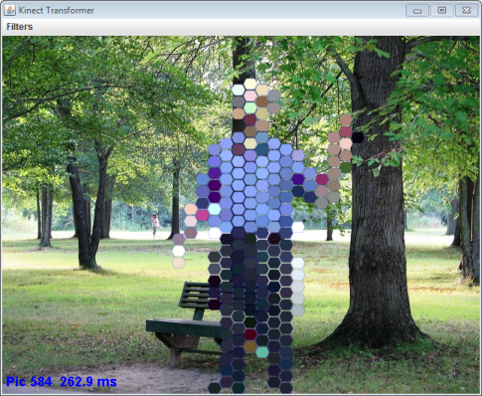
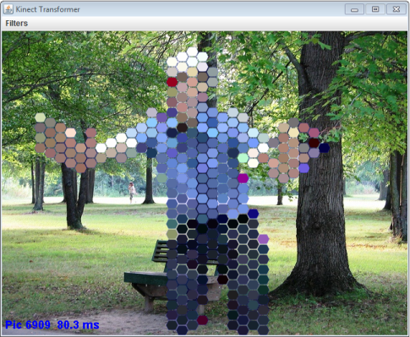
2.1. Transforming the User
later
The transformation is applied to all of the camera image,
but transparent parts of the changed image aren't visible.

Slide 10
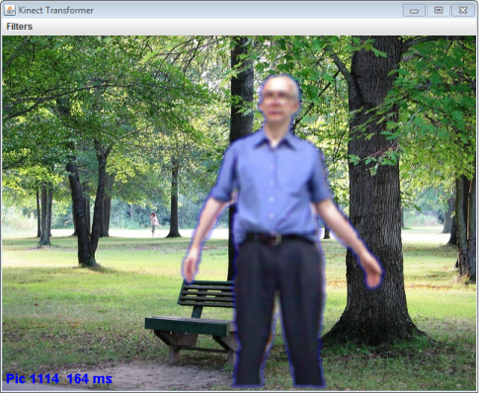
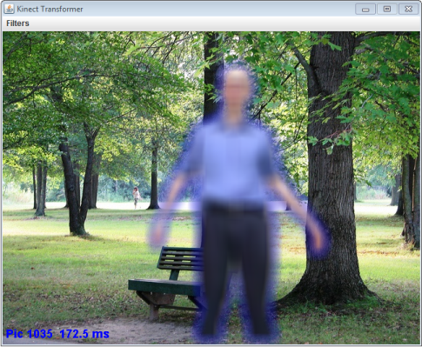
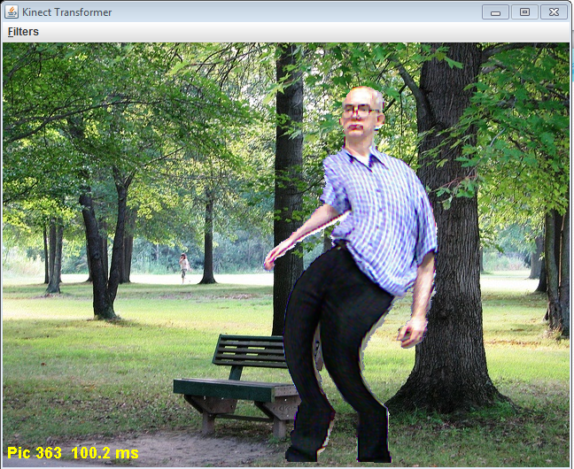
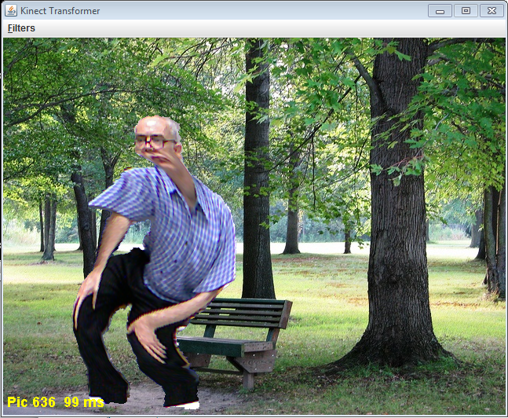
Time-based changes
cycle through blurring
Center-of-mass (CoM) based changes
change stays
centered on
user

Slide 11
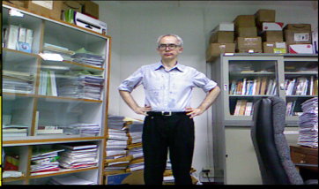
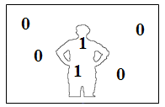
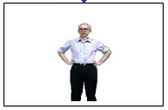

Building the Scene
set alternative
viewpoint
Depth Generator
Image
Generator
User
Generator
for real world
coordinates to 2D
(projective)
mapping
Scene
MetaData
camera
image
remove
background
scene map
(user ID map)
Java 2D filterOp
CoMs of
user IDs
(optional)
http://www.jhlabs.com/ip/filters/

Slide 12
Panel Execution
initialize context
and generator(s)
remove background
of camera image;
apply filterOp
(optionally based on
time and CoM of user)
wait on context update
update
repaint
draw background image
draw camera image;

Slide 13
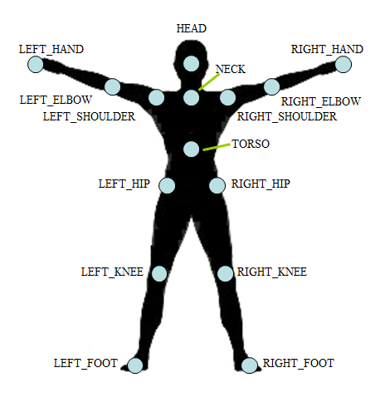
3. OpenNI Skeleton
There are 15 joints (and 9 more that are not currently initialized by the skeleton capability).
On-screen view,
with mirroring
enabled

Slide 14
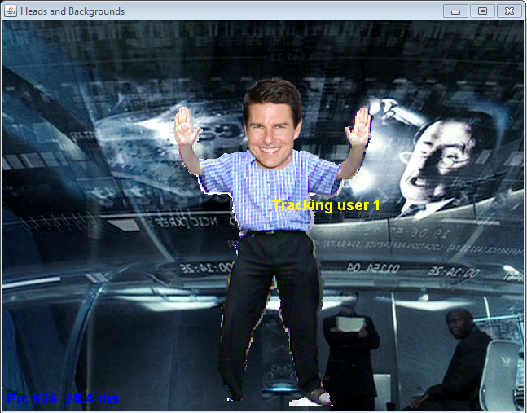
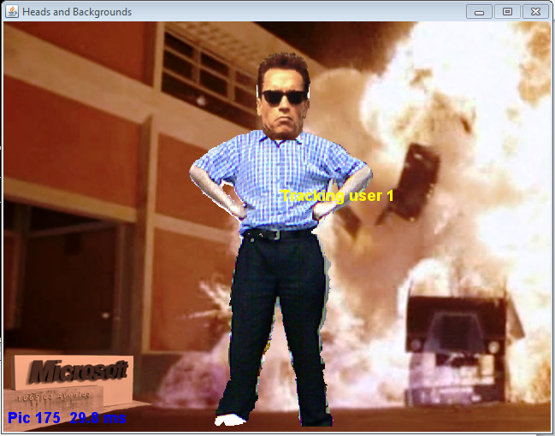
3.1. Heads and Backgrounds
switch heads and backgrounds
(via keyboard or dialog selection)

Slide 15
Generators (and Capabilities)
:
set alternative
viewpoint
Skeleton
Capability
Depth Generator
Image
Generator
User
Generator
Pose
Capability
for real world
coordinates to 2D
(projective)
mapping
:
Scene
MetaData
listeners
for various
user events
camera image
scene map
(user ID map)

Slide 16
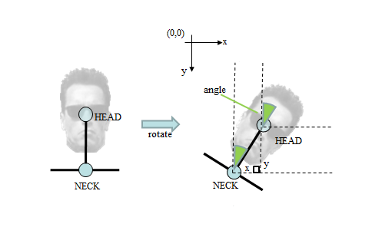
Rotating the Head Image
Calculated using
the head and neck
coordinates.

Slide 17
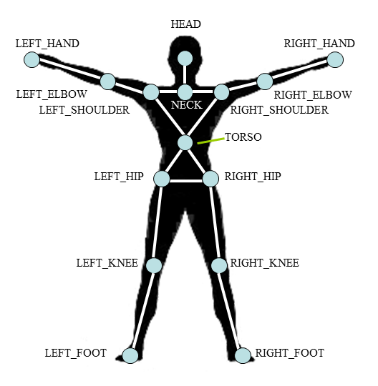
3.2. Viewing Users in 3D
rendered using Java 3D
for each
user
joints and limbs

Slide 18
Creating a Skeleton
calibration
completed
add a
Skeleton
object to
the 3D scene
user has
exited
user has
reentered
new user
lost user
Skeleton
Capability
calibration
starting
Depth Generator
User
Generator
Pose
Capability
for real world
coord to 2D
(projective)
mapping
psi pose
detected

Slide 19
Overview
1. The Kinect Sensor
2. Maps
3. Skeletons
4. Hand Points
and Gestures
5. Computer Vision
6. Augmented Reality
7. Summary
using OpenNI
using NITE
as an input source
to other libraries

Slide 20
4. NITE Hand Points and Gestures
NITE gestures are derived from a stream of hand points which record how a hand moves through space over time.
Gesture detectors are sometimes called point listeners (or point controls) since they analyze the hand points stream looking for gestures.

Slide 21
NITE Gesture Classes

Slide 22
4.1. Gesture GUIs (GGUIs)

Slide 23
Controlling the GGUIs
Depth Generator
Hands
Generator
Gesture
Generator
for coords mapping
Session
Manager
session ended (S)
Image
Generator
for camera image
Point
Control
new hand point (P1)
hand point moved (P2)
update GGUI
no active hand points (P3)
deactivate GGUI

Slide 24
Overview
1. The Kinect Sensor
2. Maps
3. Skeletons
4. Hand Points
and Gestures
5. Computer Vision
6. Augmented Reality
7. Summary
using OpenNI
using NITE
as an input source
to other libraries

Slide 25

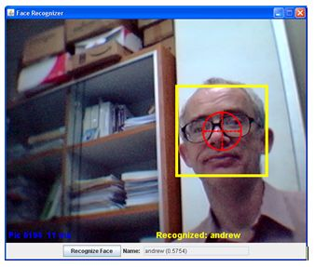
5. Computer Vision and the Kinect
http://opencv.willowgarage.com
Use the Kinect sensor as input to JavaCV
(a Java binding for OpenCV)
  input can be RGB and/or depth reading
Current and past (student) projects:
  motion detection
  face detection & recognition
  eye tracking

Slide 26
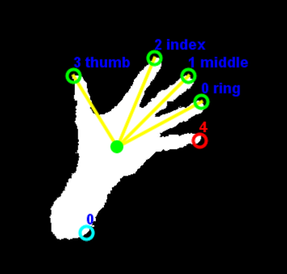
5.1. Hand Recognition

Slide 27




From OpenNI to OpenCV
Depth Generator
threshold
Depth
Map
smooth
largest
contour

Slide 28

largest contour
convex hull
convexity defects
end pt
depth
start pt
depth pt
each defect is a tuple:
(start pt, end pt, depth pt, depth)

Slide 29
simplified
convexity defects
end pt
depth
start pt
remove defects with:
shallow depths
small angles between
the start and end pts
depth pt

Slide 30
Finger Labeling
index
middle
ring
angle to
the horizontal
little
thumb
center of
gravity (cog)
rotate hand image to match
predefined hand 'parameters'
fragile, hacky

Slide 31
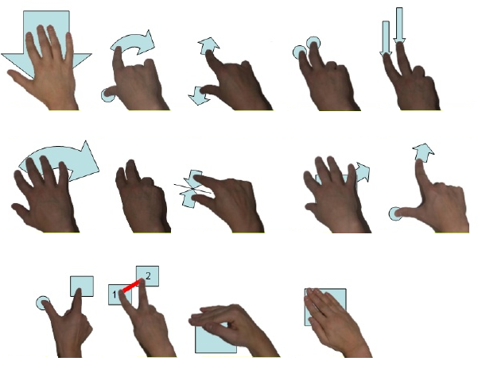
Uses?
move
finger rotate
zoom/pinch
double tap
multi slide
wave
hold
pick & drop
cluster & move
zoom spot
hold & tap
rotate two
cover
hide

Slide 32
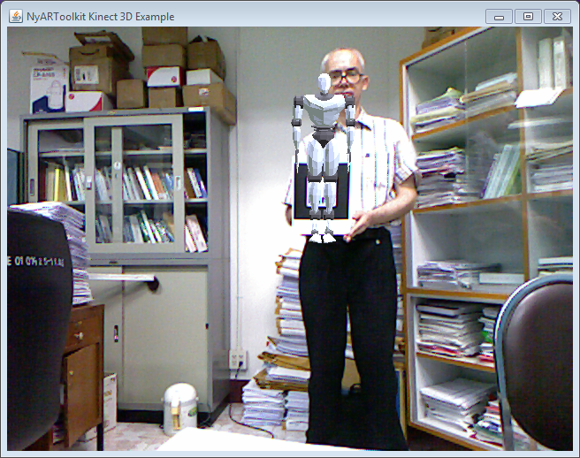
6. Augmented Reality (AR)
A combination of a real scene and virtual elements generated by the computer.
Uses the Kinect camera as input to NyARToolkit
http://nyatla.jp/nyartoolkit/wp/?page_id=198

Slide 33
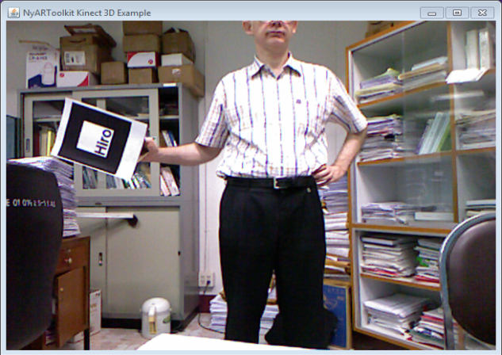
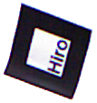

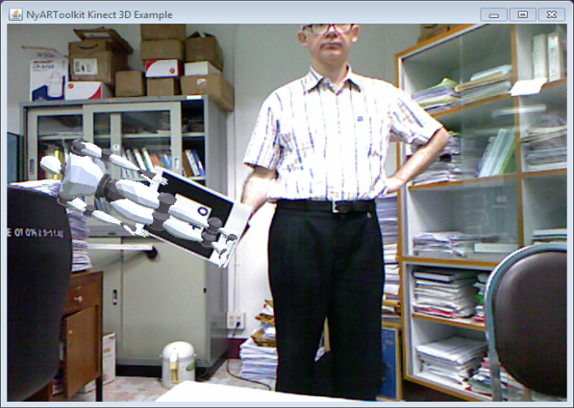

Using NyARToolkit and Java 3D
search for
Hiro marker
using NyARToolkit
Image
Generator
calculate
its position
and orientation
video stream
from the
Kinect
render model
in front of the
video frame
using Java 3D
apply position
and orientation
to marker model

Slide 34



The User's Viewpoint
+ Y
+ X
model
+ Z
background

Slide 35
7. Summary
OpenNI
  RGB, depth, IR maps
  skeletal tracking, scene/user IDs
NITE
  hand points, hand gestures
7 Examples
  aligned maps
  user transformation
  heads & backgrounds
  3D users
  gesture GUIs
  hand recognition
  augmented reality (AR)

Slide 36
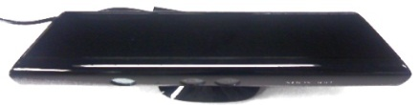

Topics not Discussed
left
right
θ
Tilt motor, LED, accelerometer
  easy to add using LibusbJava
Audio source input, speech recognition, beamforming
  using MS Kinect audio driver, JSAPI, TalkingJava,
Motion detection, face recognition, eye tracking
Multiple-marker AR
Games – Kinect breakout
positive
negative

Slide 37

More Information
All the code, draft chapters,
and extra examples,
are available at my website:
  http://fivedots.coe.psu.ac.th/
  ~ad/kinect/

Slide 38
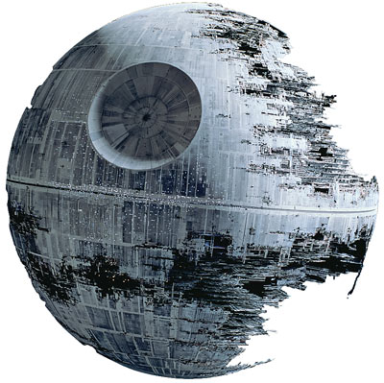
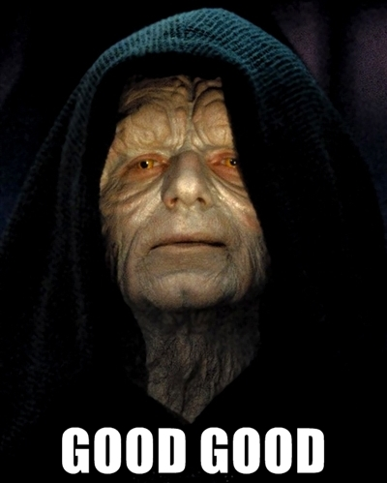
One last example...

Slide 39
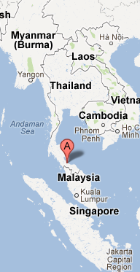
8. Where I work...
I'm an Ajarn (lecturer) in the Department of Computer Engineering (CoE),
Faculty of Engineering,
Prince of Songkla University (PSU)
I'm based at the Hat Yai campus, Songkhla province, in the south of Thailand.

Slide 40
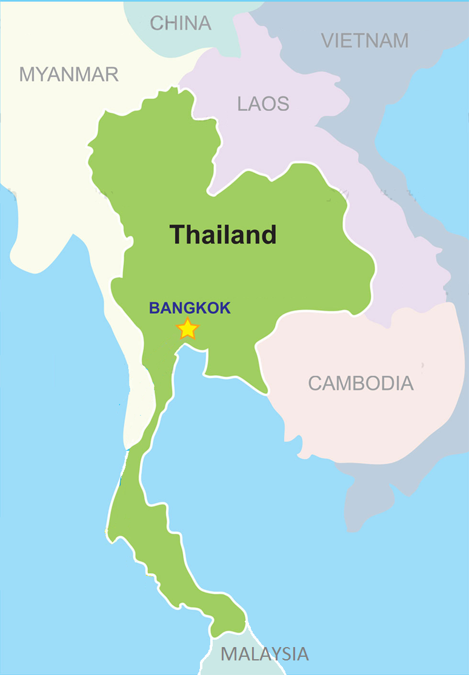
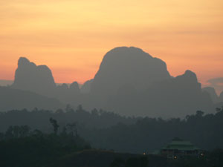
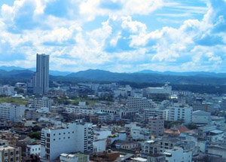

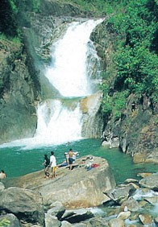
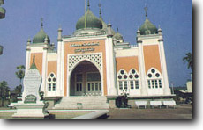
PSU at a Glance...
1st university in Southern Thailand, est. 1967
5 campuses
39,000 students (2012)
Surat Thani
Hat Yai
Phuket
Trang
Pattani

Slide 41
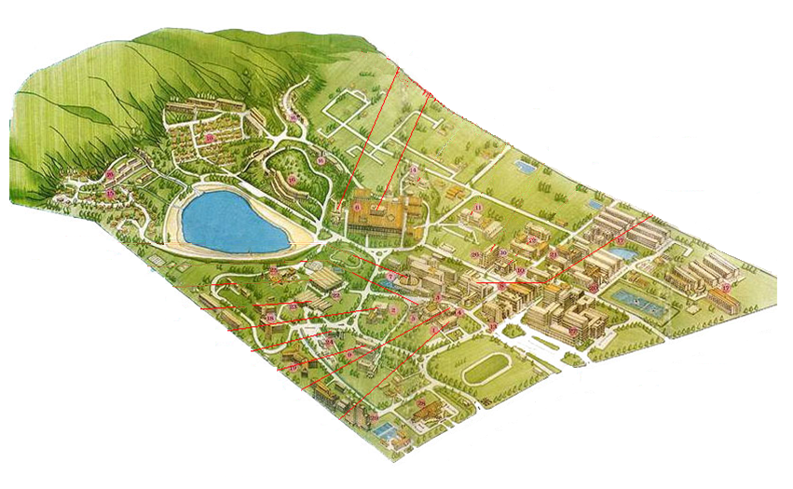
Prince of Songkla University
(PSU), Hat Yai campus
Department of
Computer Engineering (CoE)
Faculty of Engineering

Slide 42
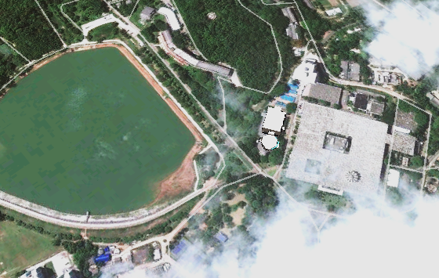
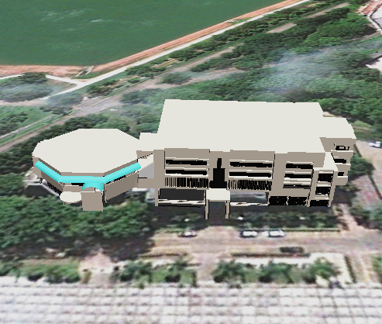

Slide 43

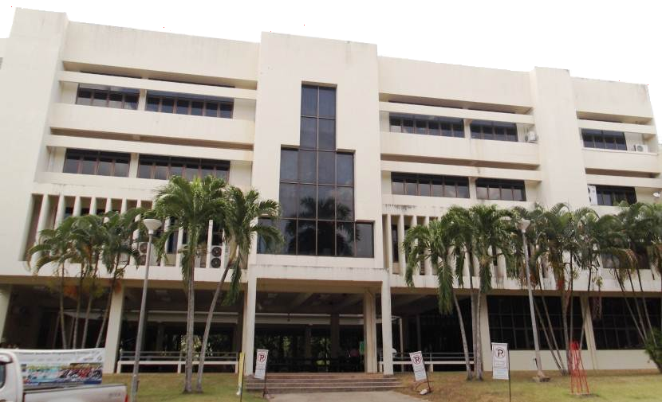
Department of Computer Engineering (CoE)

Slide 44
PSU Academically...
A National Research University (NRU)
Ranked 4th in the Nation in terms of publications
Research strong points include:
  Natural rubber
  Biodiesel and energy
  Sea food and Halal food
  Marine sciences
  Nanotechnology
  Peace studies

Slide 45


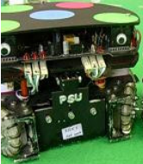
CoE Research Groups and Interests
Center for Network Research (CNR)
Wireless Sensor Network (WSN)
ANW Informatics Laboratory
Intelligent System (iSys) Research Team
  Computer Control and Robotics
  Computer System Design and VLSI Design

