Slide 1
Learning to Program with Games and Puzzles
ACTIS 2019. The 16th National Conference and International Conference on Applied Computer Technology and Information Systems.
Andrew Davison
Dept. of Computer Engineering
Prince of Songkla University
ad@fivedots.coe.psu.ac.th

Slide 2
Why Games and Puzzles?
Easy to explain, and remember. Helps motivate students.FUN
Introduces maths and algorithms, and more complex programming concepts.
Requires simple-to-use support libraries.

Slide 3
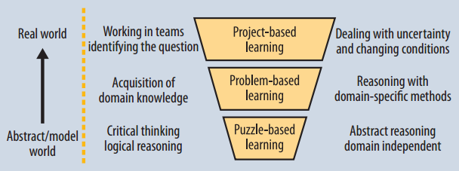
Learning Hierarchy

Slide 4
Programming Syllabus
1) Intro to Programming
Programming Tools
first year
2) Intermediate Programming
3) Maths for Programming
4) Intro to Algorithms
second year
5) Intermediate Algorithms

Slide 5
1. Intro. to Programming
Problem solving using imperative programming
mutable state, assignment
branching, loops
sequential data structures: arrays, lists
functions, parameter passing, recursion
or

Slide 6
Why Python?
It's easy to learn and use
the OOP part can be avoided until "Intermediate"
Lots of libraries
turtle graphics, StdDraw from S&W
Runs on everything
e.g. Raspberry Pi
Lots of help online

Slide 7
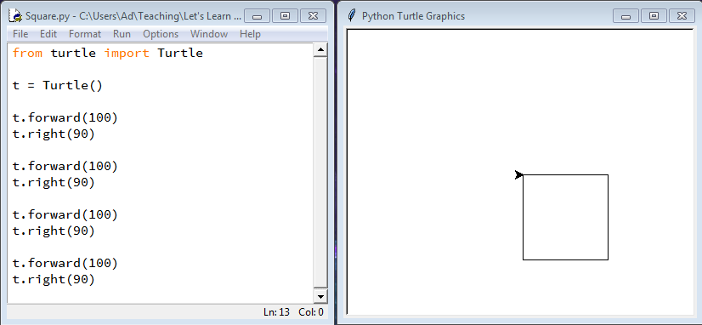
Turtle Graphics

Slide 8
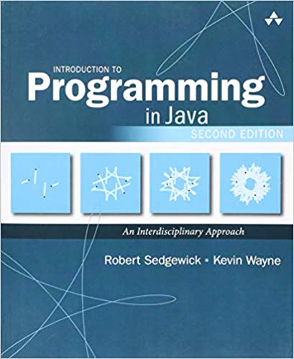
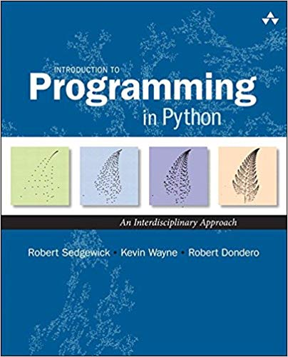
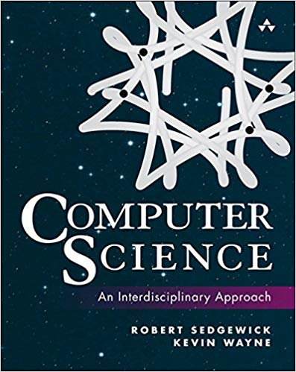
Books by S&W
https://introcs.cs.princeton.edu/ python/home/ (or java/home/ )
first 4 chapters

Slide 9
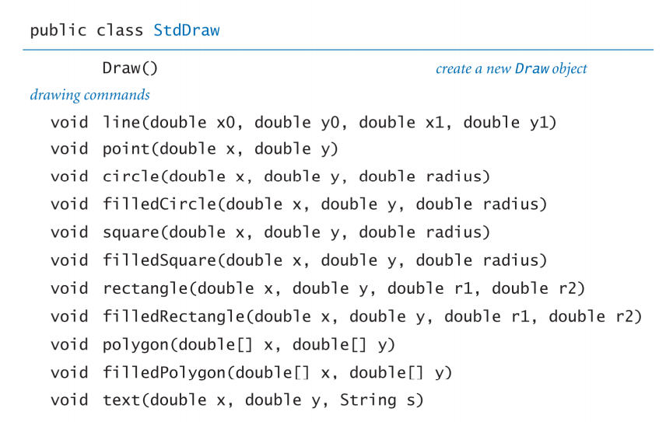
StdDraw Library

Slide 10
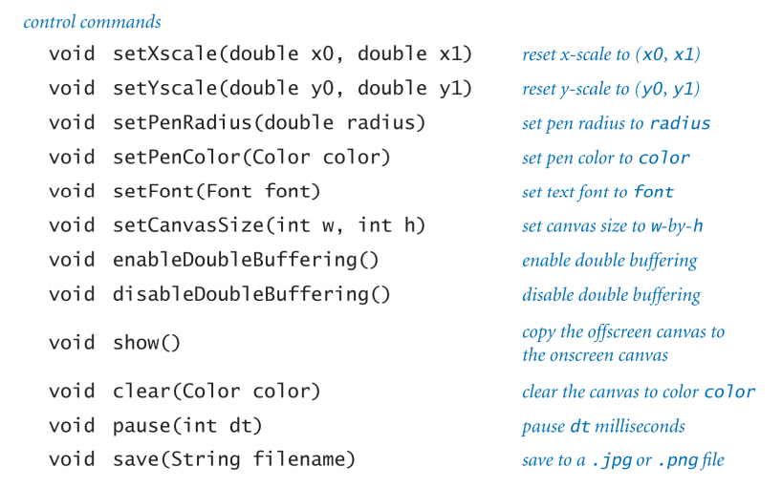

Slide 11
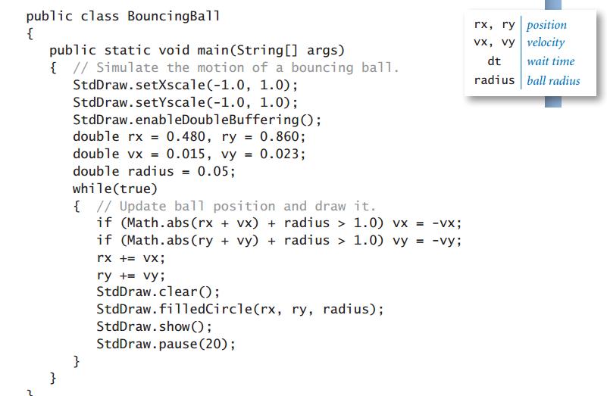
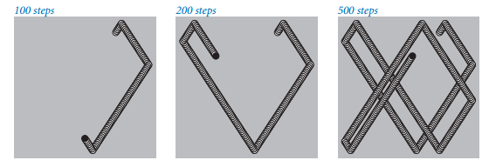
Bouncing Ball

Slide 12
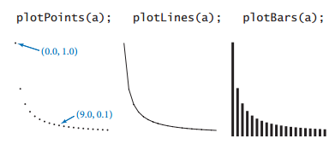
Other Libraries
Turtle.java built on top of StdDraw
StdAudio
StdRandom, StdStats
StdPlot

Slide 13
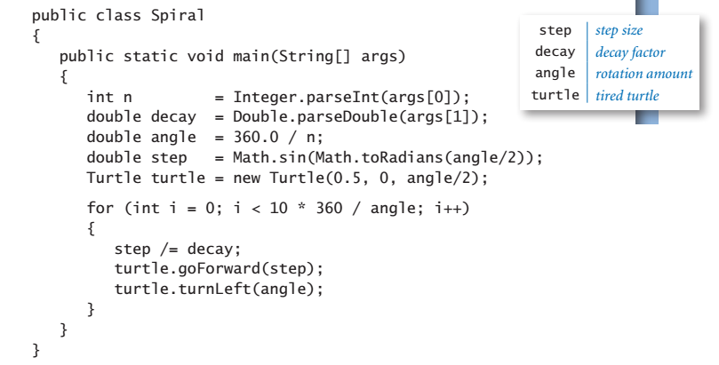
Turtles

Slide 14
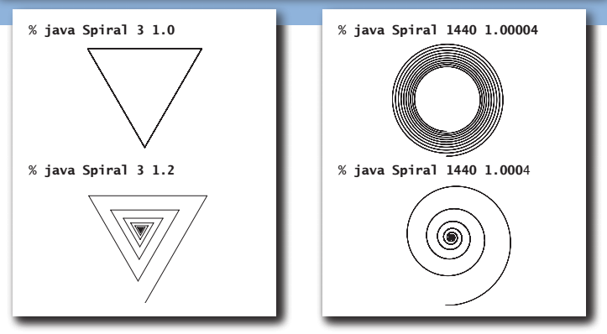

Slide 15
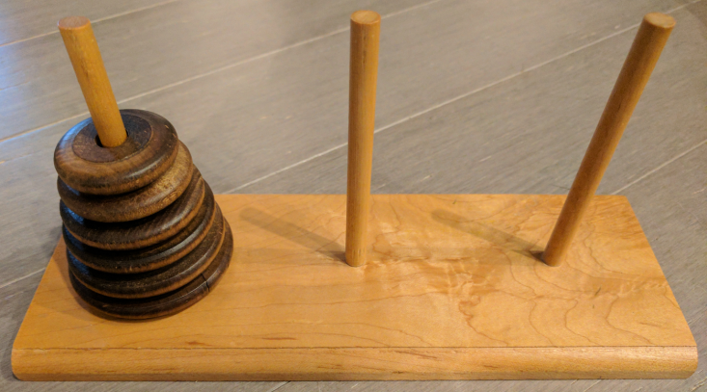
Recursion: Towers of Hanoi
We have three rods, and n disks on rod A. The disks are stacked in decreasing size order. The aim is to move the stack of disks to rod C, following these rules:
1) Only one disk can be moved at a time.
2) A move must take the top disk from one stack to the top of another stack.
3) No disk can be placed on top of a smaller disk.
A
B
C

Slide 16
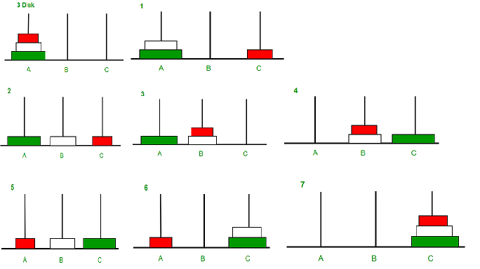
Three Disk Example

Slide 17
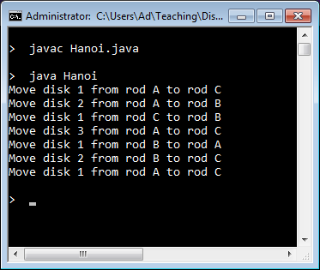
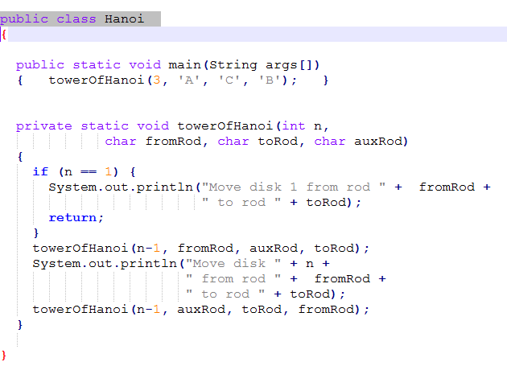
Code

Slide 18
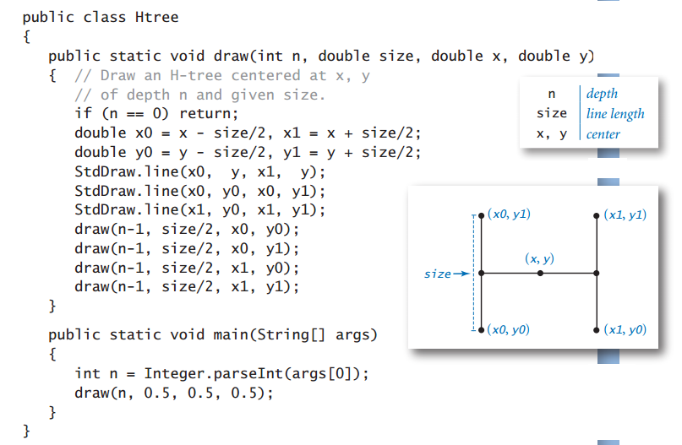
Recursive Graphics (fractals)

Slide 19
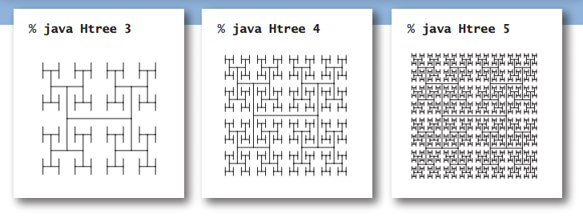

Slide 20
2. Intermediate Programming
Problem solving using object oriented programming
abstraction, info. hiding, prog. in large
classes, objects, inheritance, polymorphism
Focus on 2D game programming (pygame)
sprites, object interaction
event processing, game loop
http://www.pygame.org/

Slide 21
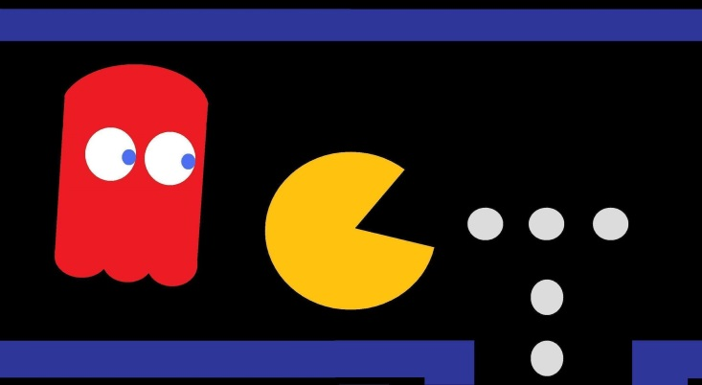
Game Things in Pygame
Sprites
moving game characters / objects
Collision detection
which sprites are touching?
Events
a user action (e.g. mouse or key press), or computer change (e.g. clock tick)
Game loop:
read new events
update sprites and game state
redraw game

Slide 22
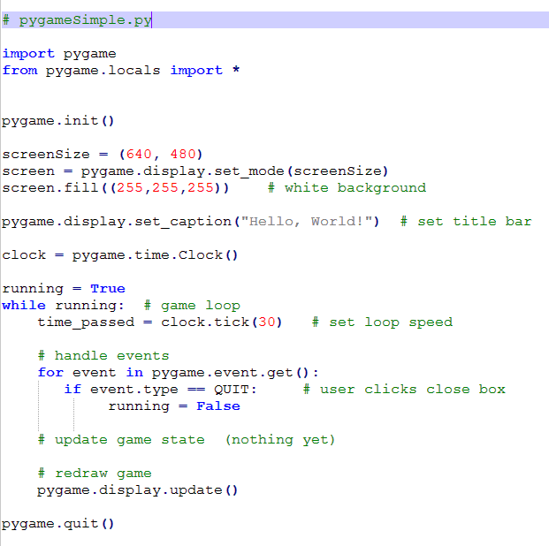

Slide 23
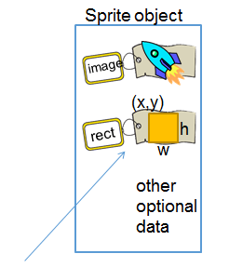
The Sprite Class
Every sprite object contains an image and a rectangle (which contains its (x,y) position, width and height).
Sprite includes many functions for adding the sprite to groups.
a sprite is moved
by changing the
(x,y) value in rect

Slide 24
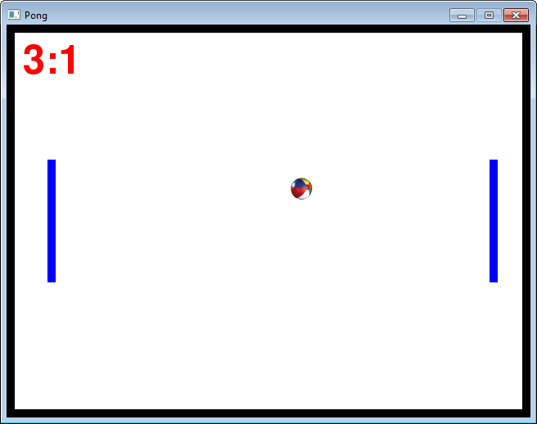
The Pong Game
each game 'thing' == a sprite object
4 BlockSprites
for the 4 walls
1 BallSprite
2 Paddle
sprites

Slide 25
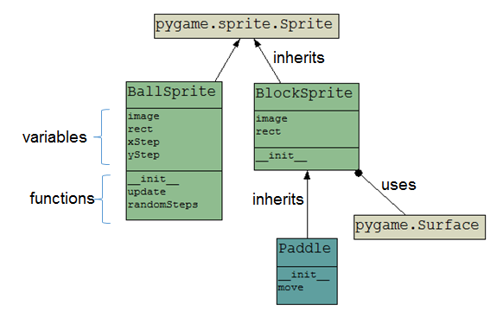
Class Hierarchy

Slide 26
More Games
Space Invaders
Whack-a-Mole
Snake
Fred's Bad Day
Breakout
Breakout with High Scores
Bomber Pilot
Tetrominoes
Tic-Tac-Toe
Card Game Basics
Tank
Platformer
15-Puzzle
15-Puzzle with Tweening
Cannon
Cannon with Physics

Slide 27
3. Maths for Programming
Discrete maths
induction, logic, set theory, combinatorics, graph theory, automata
Numerical maths
floating-point, solving linear equations, matricies, interpolation, approximation
sciPy

Slide 28
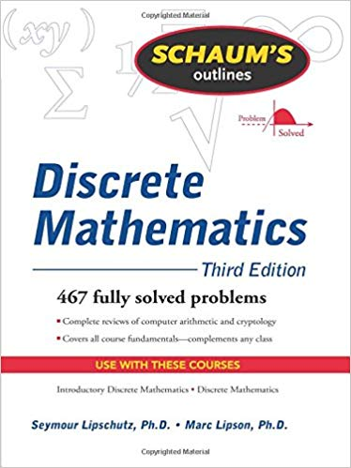
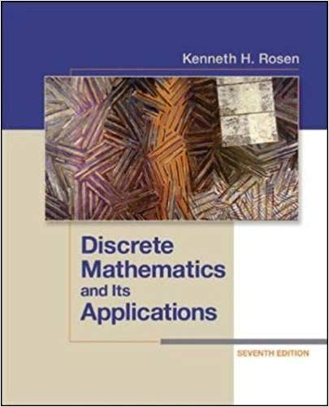
Discrete Maths

Slide 29
Induction: Tiling Problem
A right tromino is a “corner” shape:
Use induction to proof that right trominos can be used to tile (cover) any n*n size board, where n is a power of 2 and the board has 1 square missing.

Slide 30
For example, a 4*4 board (2²*2²), minus 1 square:

Slide 31
Logic: Knights and Knaves
On Logic Island, knights always tell the truth, and knaves always lie.
You meet two people, A and B.
A says “At least one of us is a knave" and B says nothing.
Can you work out which is a knight or knave?
Answer:
A is a knight. B is a knave.

Slide 32
Sets: Hilbert's Grand Hotel
The mathematician David Hilbert invented the Grand Hotel, which has a countably inﬁnite number of rooms, each occupied by a guest.
How can we accommodate a new guest arriving at the fully occupied Grand Hotel without removing any of the current guests?

Slide 33
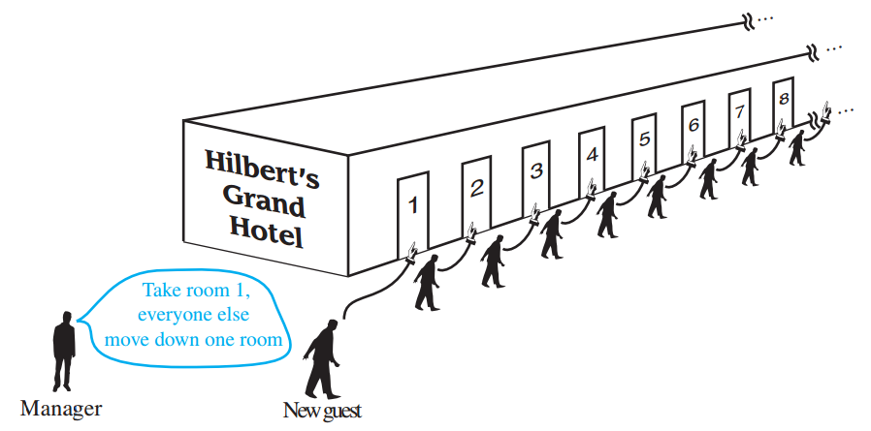

Slide 34
Combinatorics

Slide 35
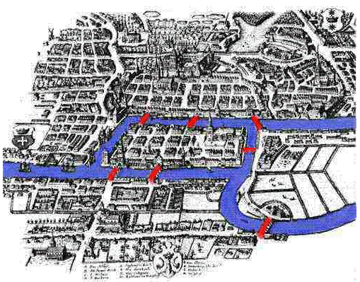
Graph Theory: Konigsberg Bridge Problem
Problem: Can you start in area "D", walk over each bridge (marked in red) exactly once, and end up back in area "D"?
A
B
C
D

Slide 36
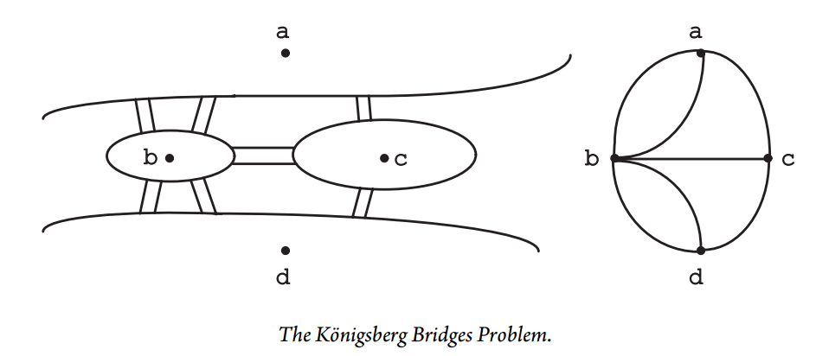
At least one node of odd degree (all of them in this case) means an Euler cycle is not possible.

Slide 37
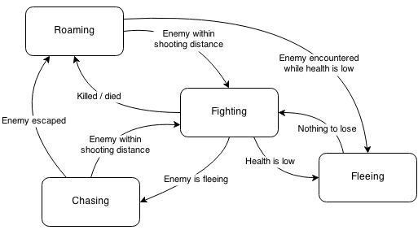
Game-playing Automata
start

Slide 38
4. Intro. to Algorithms
Sorting
Backtracking
Divide and conquer
Linear sorts
Hashing
Dynamic programming
Graphs
search
spanning trees
shortest path
Heaps

Slide 39
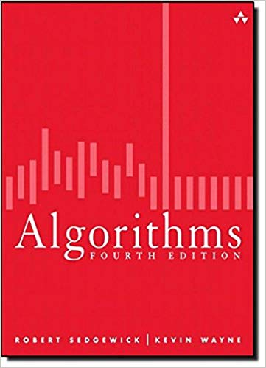
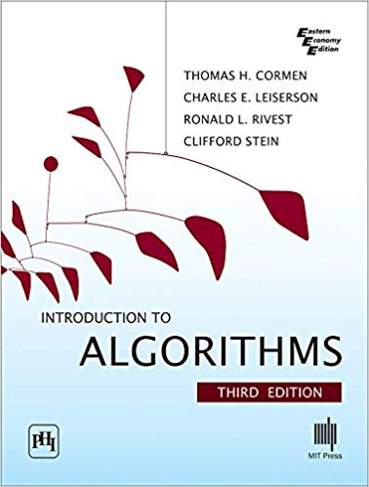
Books

Slide 40
Sorting: Dutch National Flag
Rearrange an array of characters R, W, and B (red, white, and blue) so that all the R’s come ﬁrst, the W’s come next, and the B’s come last.
Design a linear in-place algorithm for this problem.

Slide 41
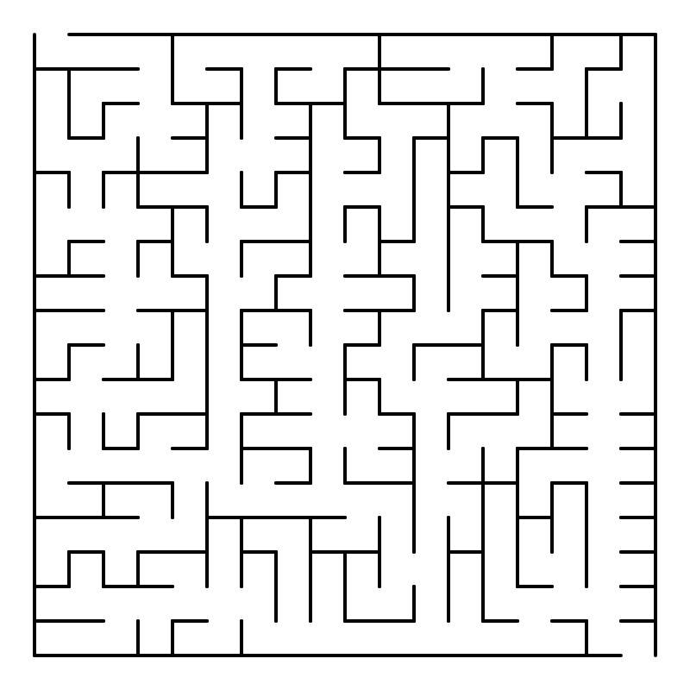
Backtracking: Mazes

Slide 42
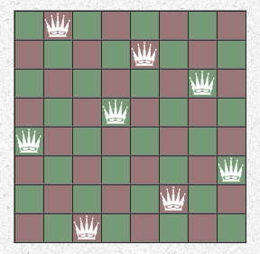
The Eight-Queens Problem
Put 8 queens on an 8×8 chessboard such that none of them is able to affect any of the others.
A solution requires that no two queens share the same row, column, or diagonal.
How many solutions? (92)

Slide 43
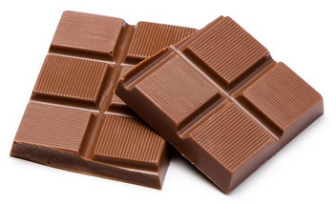
Divide and Conquer
A rectangular chocolate bar consists of m x n small rectangles, and you wish to break it into its parts.
At each step, you can only pick up one piece and break it along any of its vertical or horizontal lines.
How should you break the chocolate bar using the minimum number of steps?

Slide 44
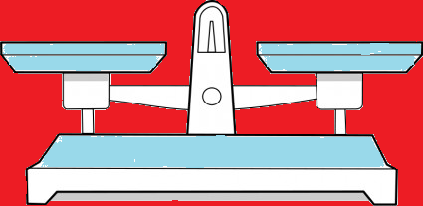
DP: The Knapsack Problem
1
6
18
22
28
use or not use
a weight
1
2
5
6
7
item 0
item 1
item 2
item 3
item 4
maximize cost, but
total weight ≤ 11
11
Crucial idea:
total weight
must be one of
12 values: 0=11

Slide 45
Spanning Trees: Rumors
There are n people, each with a different rumor. They want to share all the rumors by e-mail.
A person puts all the rumors he currently knows into an e-mail message. That message can only be sent to 1 person.
Design an algorithm that outputs the minimum number of messages that the n people need to send to make sure that everyone gets all the rumors.

Slide 46
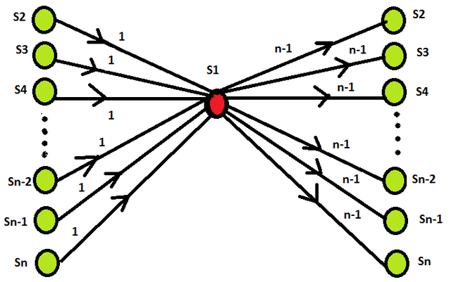
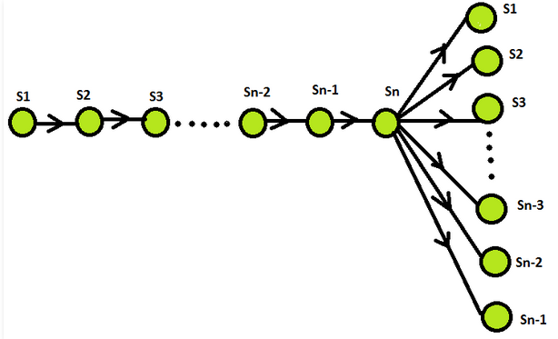
Some Possible Solutions
no. of rumors in 1 message
n-1
n-1
1
2
n-2
n-1
no. of rumors
in 1 message
n-1
2(n – 1) messages in both cases

Slide 47
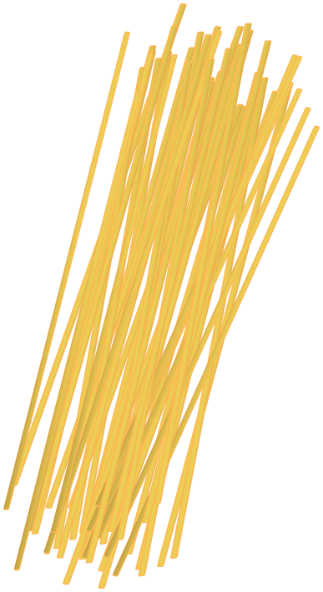
HeapSort: Spaghetti Sort
Imagine a handful of uncooked spaghetti, individual rods whose lengths represent numbers that need to be sorted.
Define a “spaghetti sort”—a sorting algorithm that takes advantage of this representation.

Slide 48
5. Intermediate Algorithms
Self-balancing trees
Red-Black trees, B-trees
Game trees
Max-flow
String Searching
Number Theory
Computational Geometry
Constraint Satisfaction
P and NP

Slide 49
Game Trees: Nim
In Nim there are two piles of stones.
Each player takes 1 or more stones from one pile.
The player who removes the last stone loses.
For example, the pile (3,2):

Slide 50
Part of Tree
no. of stones in each pile
(3,2)
(2,2)
(1,2)
(0,2)
(3,1)
(3,0)
. . . .
. . . .
(1,2)
(0,2)
(2,1)
(2,0)
(0,2)
(1,1)
(1,0)
. . . .
. . . .
. . . .
. . . .
. . . .
(2,0)
(1,0)
(0,0)
(1,1)
(0,1)
(2,0)
(0,1)
(1,0)
(1,0)
(0,0)
(0,0)
2nd loses
2nd loses
(stupidly)
2nd loses
2nd loses
2nd loses
(1,0)
(0,1)
(0,0)
(1,0)
(0,0)
(0,0)
(0,0)
(0,0)
1st loses
1st loses
1st loses
1st player's turn
2nd player's turn
(0,0)
(0,0)
(0,0)

Slide 51
Max-flow: Dining Problem
Four families go out to dinner together. They want to sit at four tables so that no two members of the same family are at the same table. Find a seating arrangement.
The sizes of the four families are (3,4,3,2)
12 people in total
The four tables have number of seats (5,2,3,2)
12 seats in total

Slide 52
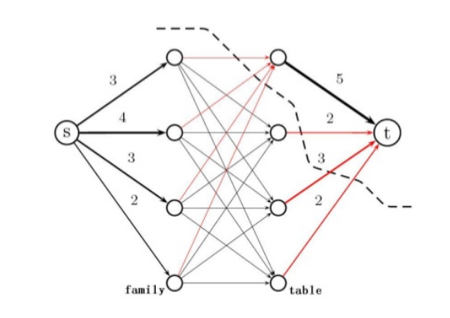
As a Max-Flow Graph
A flow is either 1 or 0
flow cut
The central edges are the table assignments (a capacity of 1). The cut shown has a capacity 11 which is the best. We can therefore not seat all 12 members of the four families.

Slide 53
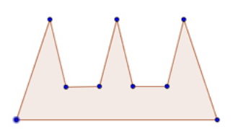
CG: The Art Gallery Problem
How many cameras are needed to guard
this gallery, and where should they be placed?
If there are n vertices in the polygon (e.g. n=9), then you never need n/3 cameras, rounded up (e.g. 9/3 = 3 cameras).
Floor plan of the art gallery.

Slide 54
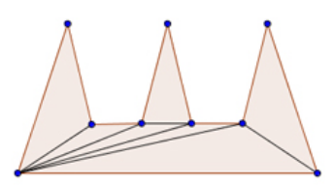
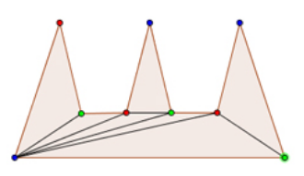
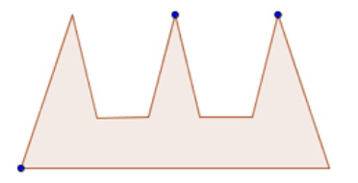
How?
Triangulation
3-Coloring
Select a color

Slide 55
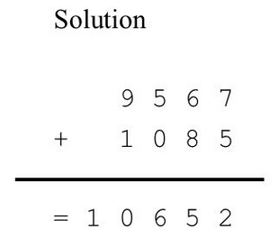
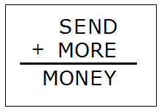
Constraints: Cryptoarithmetic
Find the digits corresponding to the letters:

Slide 56
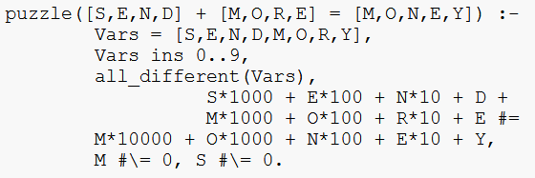
Using Constraint Logic Programming
Prolog with CLP packages clp(fd), clp(b)
A says: "At least one of us is a knave."

Slide 57
6. Conclusions
Puzzles/games help explain maths and algorithms.
Puzzles/games help explain OOP and introduce other useful techniques (e.g. event handling, constraints).
Most puzzles/games require a simple-to-use graphics library.

Slide 58
Thank You
Any Questions?

